Slide 1
The Future of Solar in the Sunshine State

Slide 2
Pompano Beach Green Station Demonstration Project
William L. Cross
South Florida Regional Transportation Authority

Slide 3
Tri-Rail’s “Green Station” Demonstration Project
Presented by: William L. Cross, P.E. South Florida Regional Transportation Authority

Slide 4
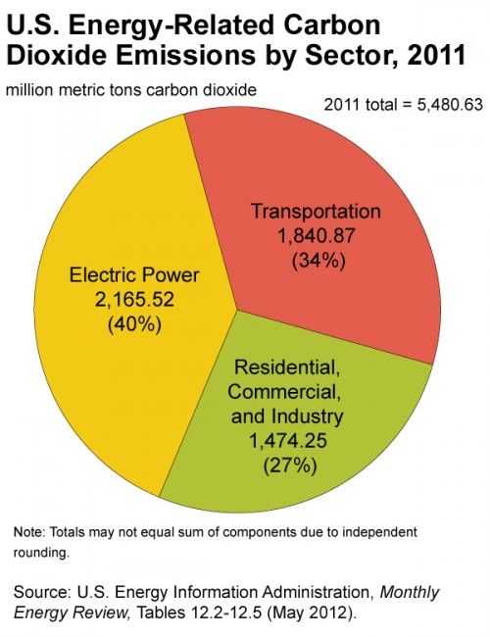
Transportation accounts for 1/3 of CO2 Emissions
Why?

Slide 5
SFRTA Board Supports “Green Initiatives”

Slide 6
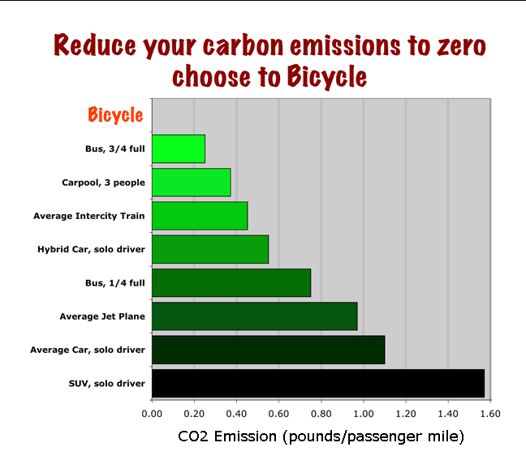

Slide 7
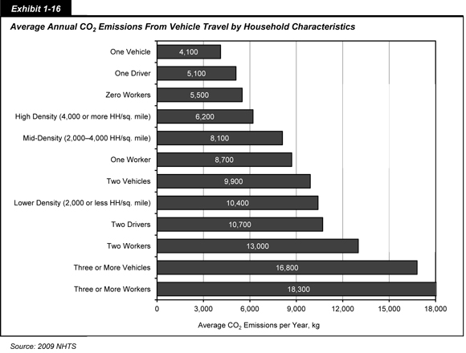
Transit Allows High Density Land Use, Which Cuts CO2
HIGH DENSITY
MID-DENSITY
LOWER-DENSITY

Slide 8
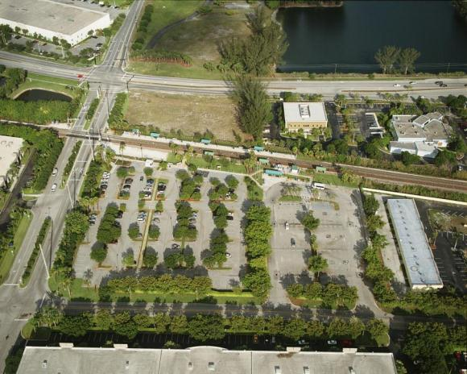
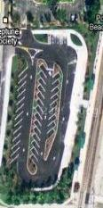
Pompano Beach Station Improvements
Goals of Project:
Upgrade to current design guidelines
Improve pedestrian access & circulation
Improve vehicular circulation and increase parking
Obtain “Silver” LEED Certification
First “Green” Station & prototype
West Lot
East Lot

Slide 9
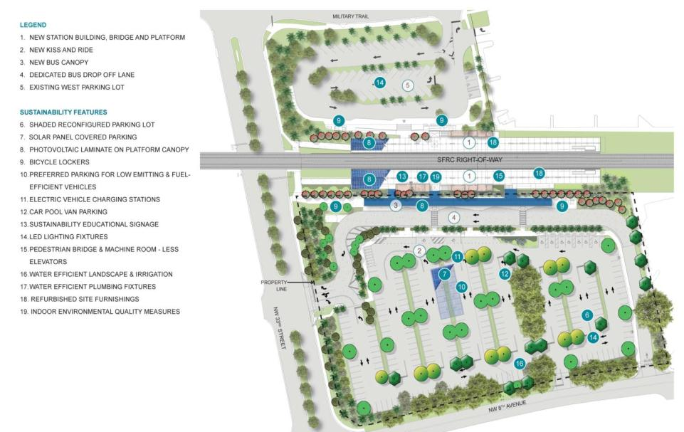
Tri-Rail Prototype “Green” Station

Slide 10
Federal Transit Administration TIGGER Grant
Transit Investments for Greenhouse Gas and Energy Reduction
SFRTA submitted grant application August 2011
Competitive Project Selection Process
FTA awarded $5.7 million on November 16, 2011
Grant allowed Design to include:
Increased solar energy to 100% plus
Electric vehicle charging stations
Parking canopy for additional solar panels and shaded parking

Slide 11
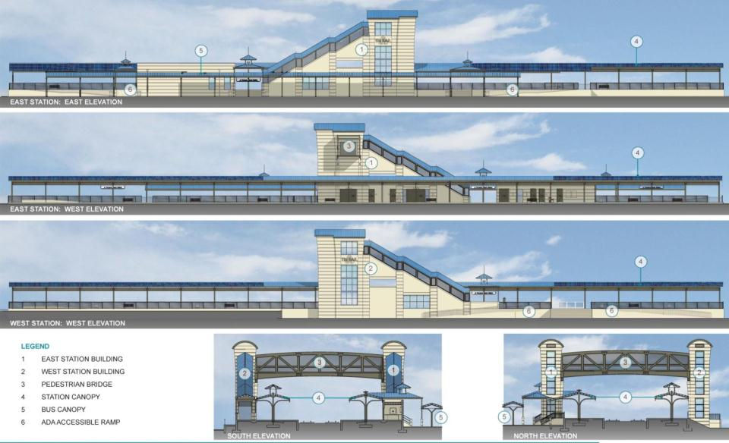

Slide 12
Existing and Typical Versus “Green” Tri-Rail Station
Solar Generation

Slide 13
Annual Station O&M Costs

Slide 14
Project Status
Fully Funded
Design Complete
Procurement Package Being Finalized
Anticipated Contract Procurement Mid-2013
Complete Late 2014

Slide 15
A Vision for Solar in the Sunshine State
Cory Ramsel
Manager of Development
Florida Power & Light

Slide 16
Unleashing Florida’s Solar Potential Creating jobs and building a lasting industry
Cory Ramsel
Sr. Manager of Development
Florida Power & Light Company
January 25, 2013

Slide 17
Cautionary statements and risk factors that may affect future results
Any statements made herein about future operating results or other future events are forward-looking statements under the Safe Harbor Provisions of the Private Securities Litigation Reform Act of 1995. These forward-looking statements may include, for example, statements regarding anticipated future financial and operating performance and results, including estimates for growth. Actual results may differ materially from such forward-looking statements. A discussion of factors that could cause actual results or events to vary is contained in the Appendix and in our Securities and Exchange Commission (SEC) filings.

Slide 18
NextEra Energy is comprised of two strong businesses supported by a common platform
$29.7 B market capitalization⁽¹⁾
41,493 MW in operation
$62.0 B in total assets
One of the largest U.S. electric utilities
Vertically integrated, retail rate-regulated
4.6 million customer accounts
24,594 MW in operation
U.S. leader in renewable generation
Assets in 23 states, Canada, and Spain
16,899 MW in operation
We have been in the solar business for 20 years!
1) Market Capitalization as of October 31, 2012, all other data September 30, 2012

Slide 19
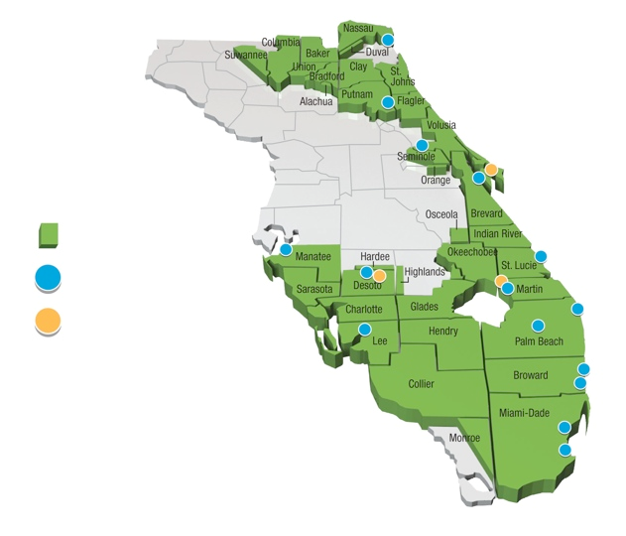
FPL provides customers with electricity that is low-cost, clean and reliable with a diverse fuel mix including natural gas, nuclear and solar
Service Area
Power Plant
Solar Facilities

Slide 20
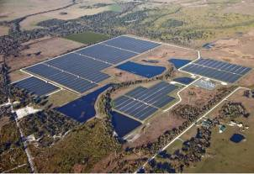
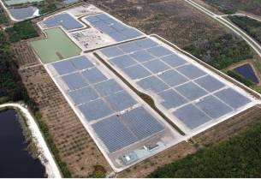
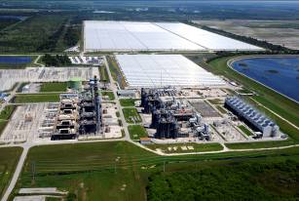
Solar Generation Development
Following the passage of legislation in 2008 allowing the PSC to approve renewable energy projects, FPL completed three solar facilities
DeSoto
Space Coast
Martin
Located on FPL property in DeSoto County in central FL
Photovoltaic technology
25 MW of capacity
Actual cost: $152 MM
Located at NASA’s Kennedy Space Center
Photovoltaic technology
10 MW of capacity
Actual cost: $71 MM
Located at FPL’s Martin Plant in Indiantown, FL
Solar hybrid technology
75 MW of capacity
Actual cost: $398 MM
Combined, all three projects came in more than $100 million under budget and created 5,000 direct and indirect jobs

Slide 21
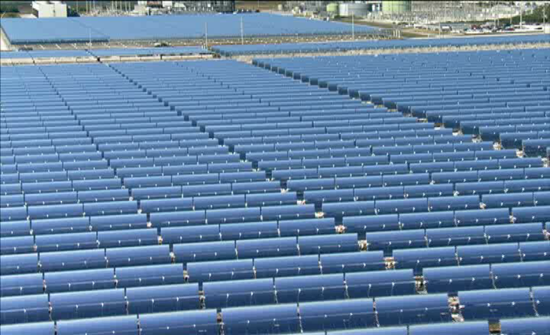
The solar projects have created thousands of jobs, pumped millions of dollars into the local economy and are providing long term benefits to the state and region
Martin Hybrid Solar Thermal Plant

Slide 22
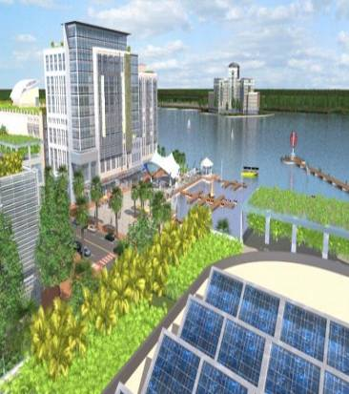
Recent economic studies have confirmed the expected net results of these potential investments
Example Solar Plant Impacts
Proposed 75-MW Babcock Ranch solar plant could generate the following economic impacts :
A total of 1,375 direct, indirect and induced jobs
Over $90 million in potential labor income
Over $293 million in gross domestic product
A total economic impact of $401 million arising from the proposed solar project
Close to $70 million in state and local fiscal revenues
1
1) According to study conducted by The Washington Economics Group (WEG), April 2011.

Slide 23
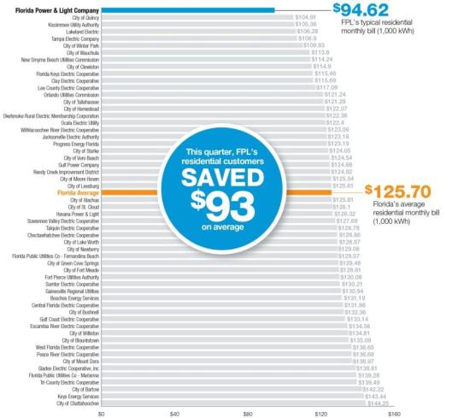
Florida Electric Utility Bill Comparison
Delivering Value to our Customers: Our typical residential customer bill continues to be the lowest of Florida’s 55 utilities
$94.62
FPL
Compared with
the state average,
FPL’s typical bill means
$373
in annual savings
based on rates for
Jan.-March 2012
$125.70
Florida Average
Sources: Average of January-March 2012 typical, 1,000-kWh monthly bill data compiled from the Florida Public Service Commission, Florida Municipal Electric Association, Reedy Creek Improvement District, Florida Electric Cooperatives Association and JEA. Notes: Figures include state gross receipts tax. “Florida Average” is the average of all bills depicted. Florida Public Utilities Co. operates as one utility but charges different rates in its two territories.

Slide 24
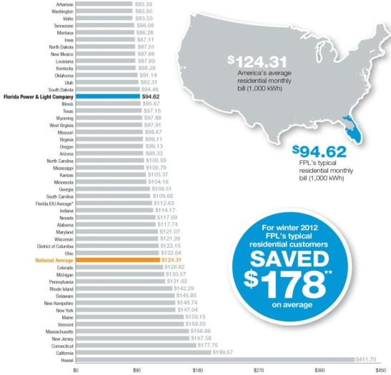
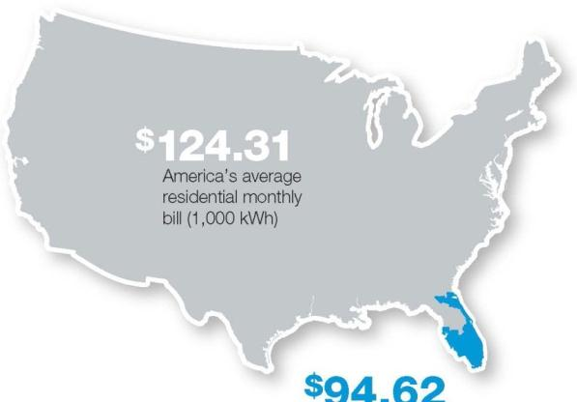
Keeping Florida Competitive
Our typical residential customer bill is also currently about 25 percent lower than the national average
$94.62
FPL
Compared with
the national average,
FPL’s typical bill is
25% lower
based on rates for
January 2012
$124.31
National Average
Source: Typical 1,000-kWh residential bills , Edison Electric Institute (EEI) Typical Bills and Average Rates Report for Winter 2012, published in May 2012, for rates effective Jan. 2012. Notes: Averages only include utilities that report their rates to EEI and may not be all-inclusive. “Florida IOU Average” is based on EEI data for the state’s investor-owned utilities: FPL, Gulf Power, Progress Energy Florida and Tampa Electric.

Slide 25
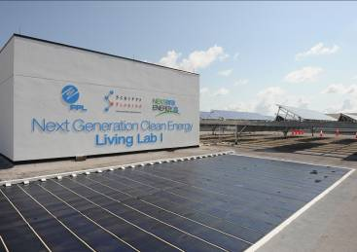
Florida can also become a magnet for renewable manufacturers and research dollars at public universities
The “living lab” at our corporate headquarters allows us to test a variety of solar technologies under real world conditions
Crystalline Silicon (mono, poly)
Thin Film (adhesive, glass panels, cylindrical)
Pole Mounted
With supportive policy, renewable energy industry companies will locate manufacturing and assembly facilities to Florida

Slide 26
A diversification of Florida’s energy landscape is better for the economy, environment, and all of us!
Together We Can Achieve
Energy security
Diversification of the state’s fuel sources and reduction of state’s dependence on fossil fuels
Economic development
Immediate creation of thousands of high‐paying direct and indirect jobs and industry‐driven revenue increase for local communities
Environmental benefits
Clean energy with no greenhouse gas emissions
Reduction of water consumed in conventional electric generation
Diversification of state economy
Leveraging state’s deep seaports, to become a primary exporter of renewable energy products
Attraction of renewable energy research and development
Administration and Policy support

Slide 27
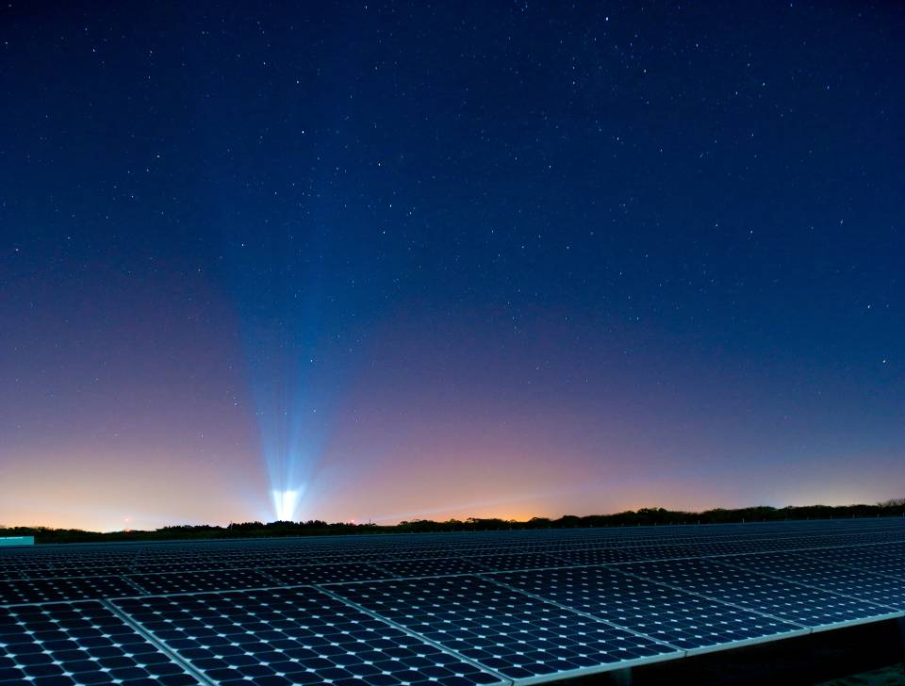
The only guarantee for failure is to stop trying
- John Maxwell

Slide 28
Enhancing Florida’s Economy and Environment Through Clean Energy Technologies
Stephen Barkaszi
Senior Research Engineer
Florida Solar Energy Center

Slide 29
The Future of Solar in Florida PV on your roof & pay $1.08 a gallon
January 25, 2012
Broward Go Solar Fest
Stephen Barkaszi

Slide 30
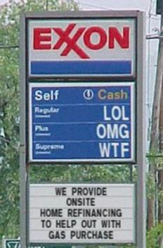
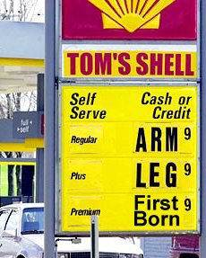
Where Do We Stand?
A little in the way of background . . .

Slide 31
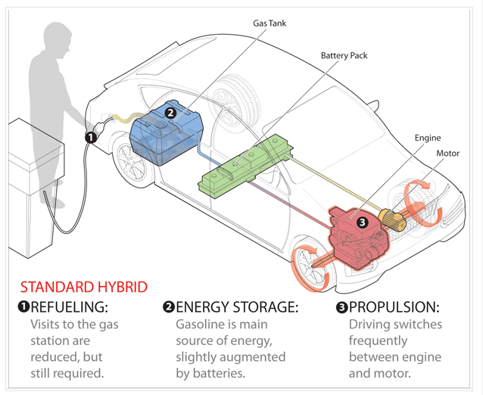
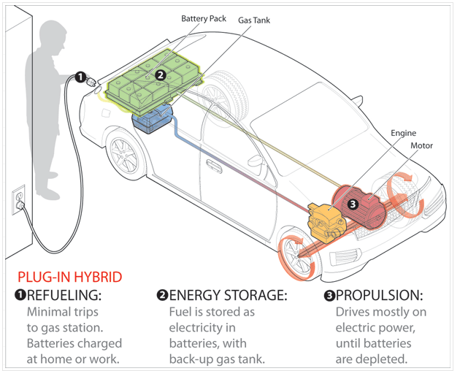
Toyota Prius
(50 MPG)
Chevy Volt
(<35 miles ∞ MPG, 60 miles 89 MPG)

Slide 32
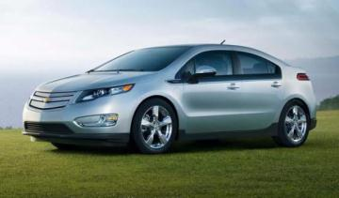
“Game Changers” The New Electric Cars
80% of VMT is less than 40 miles per day
26% of Florida vehicles are small cars
4,000 kWh/yr for 12,000 miles
If all small cars electric
1.4 billion gallons of gasoline saved per year
$2.6 billion net cost savings per year if PV electric
15 TWh (billion kWh) additional energy needs per year (4 MORE LARGE POWER PLANTS)!
Nissan Leaf (all electric)
Chevy Volt (plug-in hybrids)
Total Cost of Electric Car ~ Cost of Gasoline Car at the end of 5 years
Notes:
The new electric-drive cars, like the Nissan Leaf or plug-ins like the Chevy Volt, give us game changing options so that we may keep our capital in the state, increase economic activity produce high-wage jobs all at less cost than we pay today. Currently, 26% of all Florida vehicles are small cars primarily driven from home to work and back to home. If all small cars in Florida were electric or plug-in hybrid, we would save 1.4 billion gallons of gasoline. We will have to pay for the small car’s electricity, but this change will still save $2.6 billion in net fuel costs per year. This change to electric vehicles will require Florida to generate 15 billion more kWh (15 TWh) per year – the equivalent of more than four large electric power plants ( more than 4 500 MW coal plants in size) .
While the electric cars have a higher upfront cost the total cost of car ownership for the electric car is equal that of a similar gasoline car at the end of 5 years.

Slide 33
A Central Florida Example
Net Cost Savings
Notes:
So where does Florida get this 15 TWh of electricity?. The best place for a homeowner is out of your house. Using a 1600 square-foot prototypical existing central Florida home, the authors have performed a cost optimization analysis of retrofit energy and cost savings. This prototypical home uses $2,350 of electricity per year (Base case in the above figure). The figure shows a net savings of $446 per year if all of the energy savings options are implemented. It is important to point out that the cost savings are net of the costs of paying for the improvements through a 30 year mortgage at competitive market interest rates. These net savings represent actual cash that goes directly into the pocket of the homeowner. If after all the efficiency measures are used and the homeowner purchases 5 kW of PV the net savings is still more than $100 per year.
The analysis is conducted using a new in-house cost optimization module to the EnergyGauge USA software. The cost optimization module conducts the analysis over a specified life cycle analysis period (in this case 30 years) using standard mortgage terms (30 years at 6%) full replacement cost for items with lifetimes less than the analysis period, a general inflation rate of 2.6%, which is consistent with the average annual rate of change in the CPI during the past 10 years, a discount rate of 4.6% (2% greater than the general inflation rate) and a fuel inflation rate of 5.0%, which is again supported by the average annual change in fuel costs during the past 10 years. The maintenance costs for the improvements and their remaining salvage value at the end of the analysis period are also considered by the cost optimization analysis. The analysis is iterative in nature, whereby all of the candidate options for improvement (in this case about 45) are individually included in the original home (the “base” home) with the results ranked by their present value savings-to-investment ratio (SIR). The improvement with the largest SIR is then added to the base home to create a new base and the remaining improvement options are all reevaluated against this revised base home to find the next highest ranked SIR. This iterative process is repeated multiple times until all options with SIR greater than unity have been exhausted. In the above example, it required more than 250 individual annual home energy simulations to select the 13 improvements contained in the figure.

Slide 34
Notes:
Let us look at Florida Manufacturing Jobs as a Tale of Two Salad Bowls. The $10.00 bowl made in Florida using Florida materials keeps all the money and the jobs in Florida . The $9.50 bowl imported from China manufactured by Chinese using Chinese materials sends most of the money and the jobs to China. When Floridians purchase a salad bowl which purchase is best for Florida???

Slide 35
Notes:
Florida imports almost all of its energy resources. The citizens of Florida pay $27 billion for electricity and $30 billion for gasoline for a total of $57 billion per year. This compares to our state budget of $70 billion per year. But unlike our state budget where almost all of the funds are spent in Florida about half of the $57 billion spent on imported energy resources leaves the state. We are faced with two energy challenges – How can Florida reduce its imported energy costs and how can Florida’s electricity and transportation fuel be manufactured in Florida? In other words, can we design an energy future which allows Florida to keep our capital in the state, increasing economic activity and producing high-wage jobs. I believe we can and I would like to share such a vision.

Slide 36
Residential Photovoltaic Power is Equivalent to $1.08 Per Gallon Gasoline
 | Fuel Efficiency | Fuel Price | Cost per Mile | Cost per 12,000 Miles
Gasoline Car | 25 mpg | $3.25 per gal | 13¢ per mile | $1,560
Electric Car | 3 miles per kWh | 13 ¢/kWh ($1.08 per gal equiv.) | 4.3¢ per mile | $520
Notes:
The cost of residential photovoltaic electricity in Florida is equivalent to $1.08 per gallon gasoline! So you could own your own fueling station on your roof that allows you to drive your electric car at the equivalent gasoline price of $1.08 per gallon. About one-third the cost that you are paying today! It should be clear that renewable energy made in Florida is not too expensive! It is gasoline that is too expensive! So while we may never see $2 per gallon gasoline again, you can drive an electric car powered by PV manufactured in Florida at an equivalent cost of $1.08 per gallon while keeping all the money in Florida.
The efficiency of the average vehicle (cars and light trucks) on the road is 25 mpg and the efficiency of the electric car is 3 miles per kWh. At $3.25 per gallon and 13 cents per kWh for PV electricity from your roof, the gasoline car costs 13 cents per mile to drive while the electric car costs 4.3 cents per mile. Annual driving costs are reduced from $1,560 per year to $520 per year.

Slide 38
http://www1.eere.energy.gov/solar/pdfs/sssummit2012_plenary_swanson.pdf

Slide 39
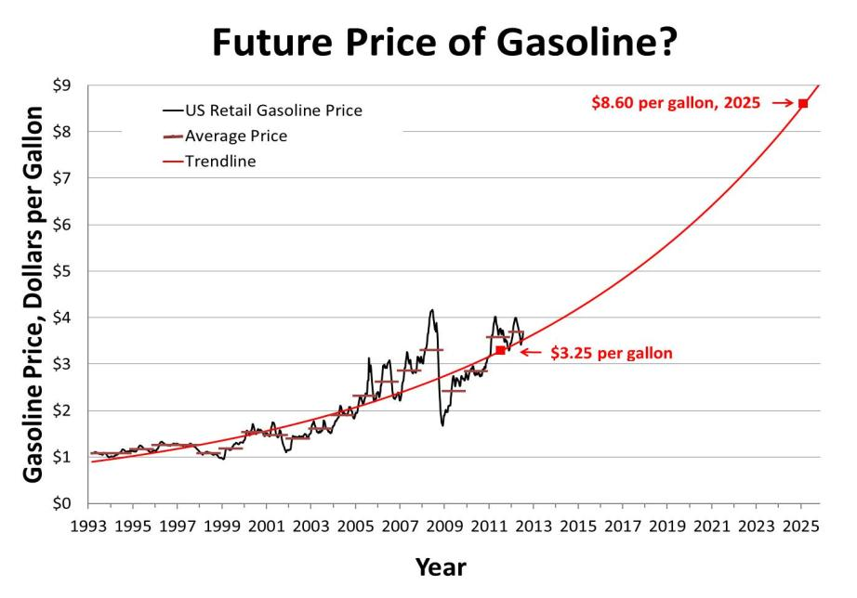

Slide 40
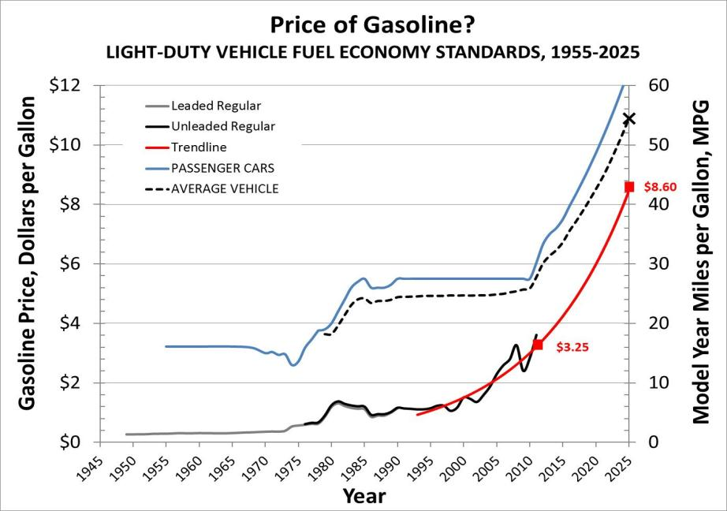

Slide 41
“Back of the Envelope” Numbers All Small Cars PV Electric by 2030
Annual Florida Gasoline use | 8.4 billion gal/y
Florida on-road vehicles | 14.3 million
Florida Small Cars (26.3%) | 3.76 million
Displaced Gasoline (16.7%) | 1.4 billion gal/y
Displaced Gasoline Cost ($3.25 /gal) | $4.6 billion/y
PV Electricity (4 Power Plants) | 15.0 TWh/y
PV Capital Cost ($2.9 Wp-dc installed) | $20.4 billion
PV Job-Years (manuf. & install.) | 238,000
PV Electricity Cost ($0.13 /kWh) | $1.96 billion/y
Cost Savings | $2.63 billion/y
Displaced OPEC oil imports | 67 %

Slide 42
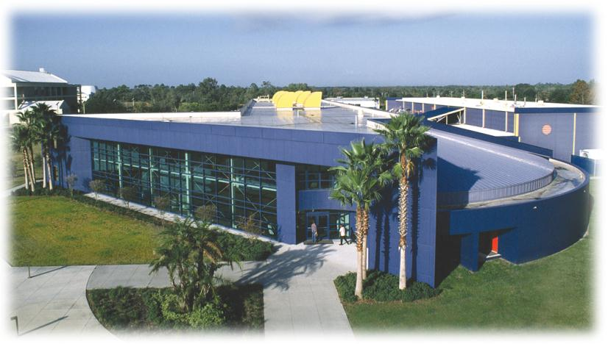
Stephen Barkaszi, PE
PV Systems Program Director
Notes:
Investing today in Renewable Energy and Green Jobs will cost us less than doing nothing!

Slide 43
Solar Powering Your Community
Casey Johnston
Director of Renewable Energy Programs
ICLEI – Local Governments for Sustainability

Slide 44
Solar Powering Your Community Through Employee Group Purchasing
Casey Johnston
Renewable Energy Program ICLEI USA
January 25th, 2013
Notes:
ICLEI is an international membership association of local government working on climate protection and sustainability. Globally, ICLEI has over 1200, 550+ of which are from the U.S. Our membership represents all types and all sizes of local governments, from tribes and cities, to counties, boroughs and villages. In the U.S. ICLEI USA’s membership represents over 1/3 of the total US population --- clearly demonstrating the massive opportunity that ICLEI member communities have to significantly impact climate protection and sustainability.
At ICLEI USA, our mission is to build, serve, and drive a movement of local governments to advance deep reductions in greenhouse gas emissions and achieve tangible improvements in local sustainability. The way we accomplish this is by providing tools, resources, networking opportunities, trainings, guidance, and peer-to-peer information exchange in four programmatic areas: climate mitigation; climate adaptation; renewable energy; and sustainability.

Slide 45
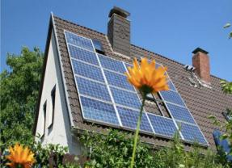
ICLEI’s Mission
Our mission is to build, serve, and drive a movement of local governments to advance deep reductions in greenhouse gas emissions and achieve tangible improvements in local sustainability.
Notes:
ICLEI is an international membership association of local government working on climate protection and sustainability. Globally, ICLEI has over 1200, 550+ of which are from the U.S. Our membership represents all types and all sizes of local governments, from tribes and cities, to counties, boroughs and villages. In the U.S. ICLEI USA’s membership represents over 1/3 of the total US population --- clearly demonstrating the massive opportunity that ICLEI member communities have to significantly impact climate protection and sustainability.
At ICLEI USA, our mission is to build, serve, and drive a movement of local governments to advance deep reductions in greenhouse gas emissions and achieve tangible improvements in local sustainability. The way we accomplish this is by providing tools, resources, networking opportunities, trainings, guidance, and peer-to-peer information exchange in four programmatic areas: climate mitigation; climate adaptation; renewable energy; and sustainability.

Slide 46
ICLEI USA Services
Basic Member Resources:
Tools and Programs
Ad hoc technical support
Communications/Media Support
Recognition
Training and Consulting Services
GHG Inventories
Climate Action Planning
Sustainability Planning
Training and TA for Solar

Slide 47
SunShot Solar Outreach Partnership
The SunShot Solar Outreach Partnership (SolarOPs) is a U.S. Department of Energy (DOE) program designed to increase the use and integration of solar energy in communities across the US.

Slide 48
Solar 3.0
Industry Partners
Solar30.org
Portal
States
PV Developers
PV Installers
Cities
Local/State Fire Marshals
Building Inspectors
Code Officials
Utilities
Notes:
*

Slide 49
Energy Benefits
Employee Group Purchase Program for ICLEI Members
Notes:
*

Slide 50
The US Solar Market
Germany
35.6%
USA 5.7%
http://www.map.ren21.net/GSR/GSR2012.pdf
Notes:
So lets start by taking a look at the state of the solar industry in the US and in the region. The US is currently 5th in the world in total installed capacity, behind Germany, Italy, Japan, and Spain.

Slide 51
The US Solar Market
Total installed solar capacity in the US
4 GW
Capacity installed in Germany in Dec 2011
4 GW
http://www.map.ren21.net/GSR/GSR2012.pdf
Notes:
Additionally, Germany’s market share is growing and a much more rapid pace than the US. While the US has a total installed solar capacity

Slide 52
The Cost of Solar in the US
Source: NREL (http://ases.conference-services.net/resources/252/2859/pdf/SOLAR2012_0599_full%20paper.pdf) (http://www.nrel.gov/docs/fy12osti/53347.pdf) (http://www.nrel.gov/docs/fy12osti/54689.pdf)

Slide 53
The Cost of Solar in the US
Source: NREL (http://ases.conference-services.net/resources/252/2859/pdf/SOLAR2012_0599_full%20paper.pdf) (http://www.nrel.gov/docs/fy12osti/53347.pdf) (http://www.nrel.gov/docs/fy12osti/54689.pdf)

Slide 54
The Cost of Solar in the US
Source: NREL (http://ases.conference-services.net/resources/252/2859/pdf/SOLAR2012_0599_full%20paper.pdf) (http://www.nrel.gov/docs/fy12osti/53347.pdf) (http://www.nrel.gov/docs/fy12osti/54689.pdf)

Slide 55
The Cost of Solar in the US
Profits, Taxes, & Overhead
Source: NREL (http://ases.conference-services.net/resources/252/2859/pdf/SOLAR2012_0599_full%20paper.pdf) (http://www.nrel.gov/docs/fy12osti/53347.pdf) (http://www.nrel.gov/docs/fy12osti/54689.pdf)

Slide 56
The Cost of Solar in the US
Solar Soft Costs
Source: NREL (http://ases.conference-services.net/resources/252/2859/pdf/SOLAR2012_0599_full%20paper.pdf) (http://www.nrel.gov/docs/fy12osti/53347.pdf) (http://www.nrel.gov/docs/fy12osti/54689.pdf)
Notes:
The remaining 50% of the costs are commonly grouped together as “soft costs”. These soft costs include the cost of handling processes such as permitting and interconnect, marketing costs including customer acquisition, and installation costs including design, financing, and labor costs.
In the US, we pay a significant premium on these solar soft costs.

Slide 57
Customer Acquisition
10x the cost for customer acquisition
Source: NREL, LBNL

Slide 58
Solution: Group Purchasing

Slide 59
Solution: Group Purchasing
Solarize Portland (2009-2011, 6 campaigns) - 560 contracts totaling 1.7 MW
Solarize Mass (12 months, 2011) - 162 contracts totaling 829kW

Slide 60
Solarize Model: Advantages
Barriers
High upfront cost
Complexity
Customer inertia
Solutions
Group purchase
Community outreach
Limited-time offer

Slide 61
Solarize: Advantages
Benefits to Local Government:
Low implementation cost: < $10,000 (+ labor)
Quick turn-around: 6-9 Months
Long-term impact: Builds a self-sustaining market, increases customer awareness

Slide 62
Energy Benefits: Employee Group Purchase Program
1083 participants / 118 Contracts Total Combined Capacity 652.3kW
850 participants / 90 Contracts Total Combined Capacity 620kW
Notes:
*

Slide 63
Energy Benefits
Benefits to Local Government:
No cost/Low cost
Fosters collaboration between LG and community members
Increases maturation of local market,
Achieves community emissions reductions
ICLEI Markets success
Notes:
How any large entity

Slide 64
Energy Benefits
Benefits to Program Participants:
Technical Education /Consumer education
Lower cost: 10% - 20%
Long-term impact: financial and environmental

Slide 65
Energy Benefits: Case Study
Solar Benefits Colorado
Customer Pool ~150,000
Source: Wikipedia

Slide 66
Solar Benefits Colorado: Timeline
Engage Leadership and Identify Employers
Marketing, Workshops, & Enrollment
Site Assessments and Contracting
Installation
Select Installer
Solar Benefits Colorado
Jan & Feb 2012
March & April 2012
April – Aug 2012
Aug - Sep 2012
Aug ‘12 – Apr ‘13
Jan 2012
April 2013

Slide 67
Solar Benefits Colorado: Timeline
Engage Leadership and Identify Employers
Marketing, Workshops, & Enrollment
Site Assessments and Contracting
Installation
Select Installer
REC Solar Offering 15-20% Below Avg Price
Solar Benefits Colorado
Jan & Feb 2012
March & April 2012
April – Aug 2012
Aug - Sep 2012
Aug ‘12 – Apr ‘13
Jan 2012
April 2013

Slide 68
Solar Benefits Colorado: Timeline
Engage Leadership and Identify Employers
Marketing, Workshops, & Enrollment
Site Assessments and Contracting
Installation
Select Installer
1083 households signed up
Solar Benefits Colorado
Jan & Feb 2012
March & April 2012
April – Aug 2012
Aug – Sep 2012
Aug ‘12 – Apr ‘13
Jan 2012
April 2013

Slide 69
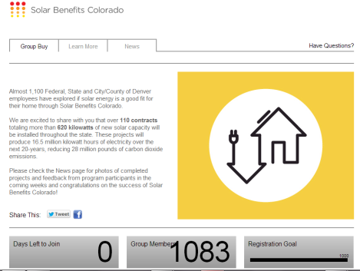
Solar Benefits Colorado: Marketing
Marketing Strategy:
In person workshops and lunch & learns
Program website
Email newsletters
Source: Vote Solar

Slide 70
Solar Benefits Colorado: Marketing
Frequently Asked Questions:
What happens if I move?
What happens when the power goes out?
Do I have to clean the panels?
Should I replace my roof first?

Slide 71
Solar Benefits Colorado: Timeline
451 households qualified of which 118 have moved forward. 26% Conversion Rate!
Engage Leadership and Identify Employers
Marketing, Workshops, & Enrollment
Site Assessments and Contracting
Installation
Select Installer
Solar Benefits Colorado
Jan & Feb 2012
March & April 2012
April – July 2012
Jun - Aug 2012
Aug ‘12 – Apr ‘13
Jan 2012
April 2013

Slide 72
Solar Benefits Colorado: Timeline
Engage Leadership and Identify Employers
Marketing, Workshops, & Enrollment
Site Assessments and Contracting
Installation
Select Installer
Solar Benefits Colorado
Jan & Feb 2012
March & April 2012
April – July 2012
Jun - Aug 2012
Aug ‘12 – Apr ‘13
Jan 2012
April 2013

Slide 73
Solar Benefits Colorado: Summary
Outreach and education to1083
118 new installations totaling 652 kW
<$4/W Pricing for Cash Purchases
24 Cash Purchases/94 SunRun Leases
$2.5 M in sales
15% – 20% discount in installation costs
System size range: 2.4kw-9.8kw
Average system size: 5.5 kW
Notes:
1100 participants / 113 Contracts Total Combined Capacity 629.58kW

Slide 74
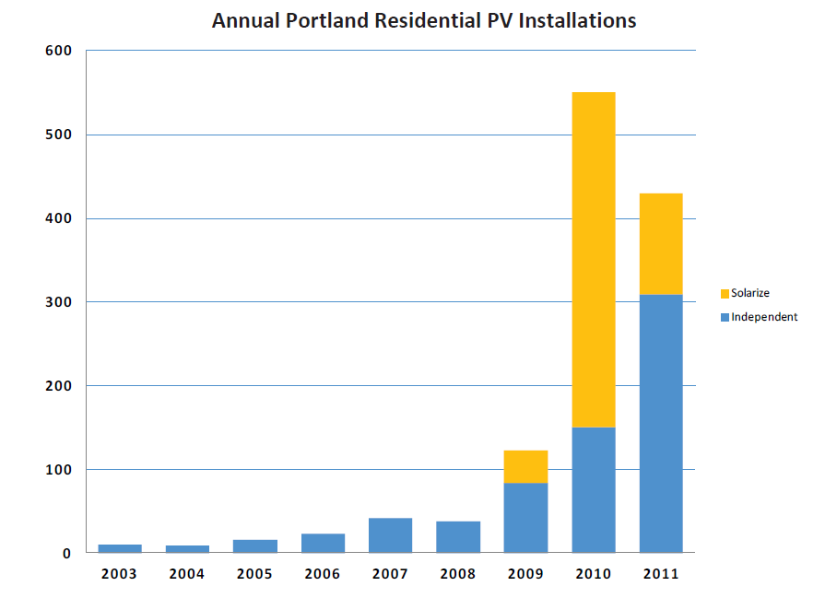
Group Purchase Programs: Impact
Lasting Impact
Source: NREL

Slide 75
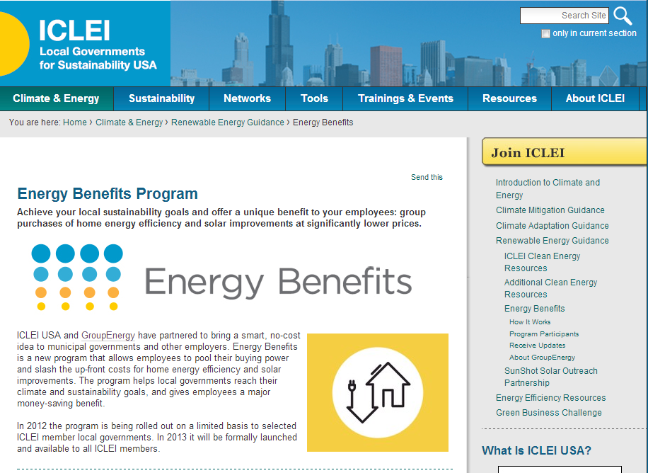
www.icleiusa.org
The Solarize Guidebook

Slide 76
Solarize: Resources
Resource
The Solarize Guidebook
A roadmap for project planners and solar advocates who want to create their own successful Solarize campaigns.
www.nrel.gov

Slide 77
Thank You
Casey Johnston
casey.johnston@iclei.org
706.206.7220

