Slide 1
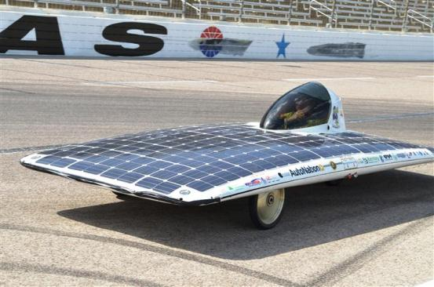
Closing Remarks
Broward County Commissioner Martin David Kiar
South Plantation High School Solar Knights

