Slide 1
Advancing Solar in the State
Buck Martinez, Sr. Director
Office of Clean Energy
Florida Power & Light Company
June 6, 2014

Slide 2
Advancing Solar Energy
Large-scale solar power plants
including world’s first solar-natural gas hybrid
first to bring commercial-scale solar power to Florida

Slide 3
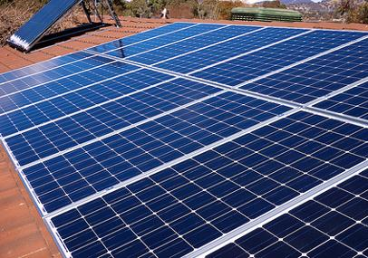
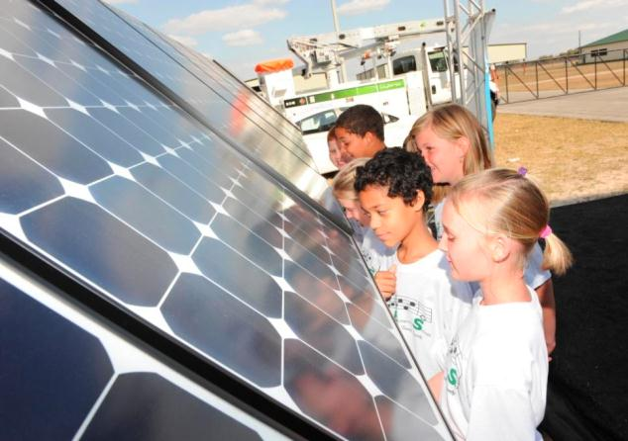
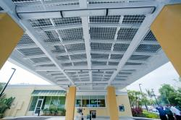
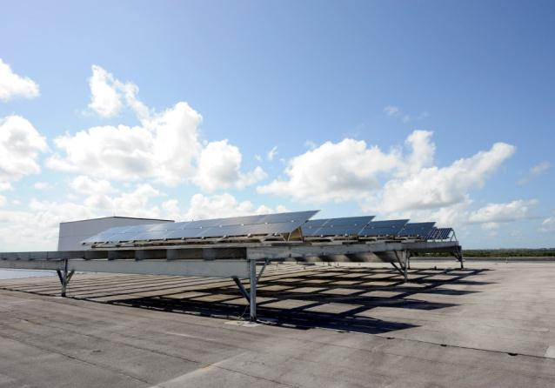
Advancing Solar Energy
Residential Water Heating
Residential Solar PV
Business Solar Water Heating
Business Solar PV
Solar for Schools
Low-Income Solar Water Heating
Research & Demonstrations

Slide 4
Advancing Solar Energy
Florida Solar Energy Center
Florida Energy Systems Consortium
Solar Electric Producers Association
Engaged on Department of Energy Sunshot Program

Slide 5
FPL Solar in Schools Program
On track with installations at 92 schools, one solar array in each of the 28 school districts within service territory
Schools receive teacher training, educational materials, real-time solar energy monitoring and technical assistance
Solar Demonstration Projects
Partnering with non-profit and governmental facilities to install solar energy systems as working demonstrations and hands-on exhibits.
In 2013, demonstrations at five locations, include:
Museum of Discovery and Science (Fort Lauderdale)
Imaginarium Science Center (Fort Myers)
Gulfcoast Wonder & Imagination Zone (Sarasota)
Brevard Zoo (Melbourne)
Kennedy Space Center Visitor Complex

Slide 6
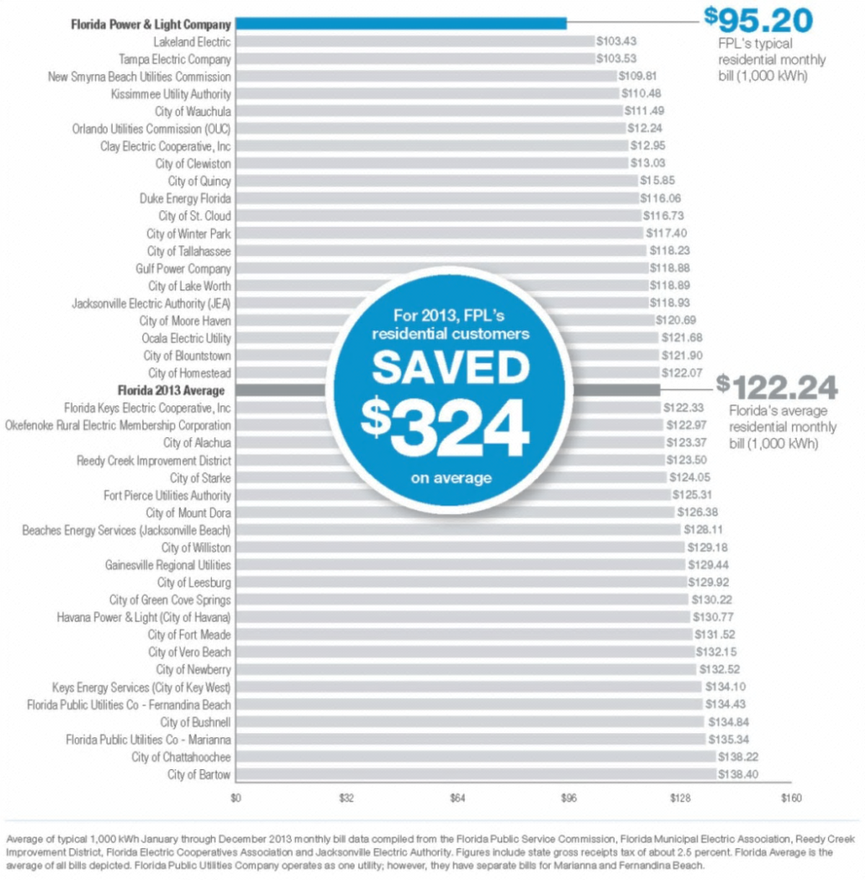
Low electric rates in Florida are a hurdle for rooftop solar in the Sunshine State
FPL’s typical 1,000-kWh residential customer bill continues to be lower than the U.S. average and the lowest in the state
(2013 data)

Slide 7
FPL Loves Solar Solar power should play increasing role in Florida’s cleaner energy mix
We support customers who want to install solar,
but subsidies don’t make economic sense
Customers shouldn’t pay for programs they can’t use
Customers should have a choice, you don’t
participate, you don’t pay
Voluntary pilot program gives more people a choice to support solar in Florida communities

Slide 8
FPL’s Voluntary Solar Petition Petition and tariff filed on April 2, projected approval June 2014
New three-year voluntary community-based solar partnership
pilot program
Pilot explores customer threshold for voluntary green pricing
Contribution fixed at $9 a month
Beginning Jan. 2015 first 300 kW to be built
Enrollment begins Jan. 2015, first billing occurs May 2015

Slide 9
FPL’s Voluntary Solar Petition
Voluntary contributions cover revenue requirements above fuel and emission
savings
FPL to build, own and operate the solar projects and the voluntary
contributions will cover the revenue requirements
-- Project investments managed to keep non-participants whole
Projects will be distributed throughout FPL service territory close to population centers
-- 100-300kW per installation depending on local demand
Open to every customer including those who can’t build their own
rooftop solar
By 2017, an estimated 2 MW of new, small distributed generation solar to be added

Slide 10
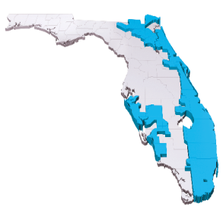
Existing PSC Solar Pilot Programs Not Cost-Effective
Cost more to fund than benefits provided
Drives up the cost of FPL customer bills
Program subsidized solar installations for a small segment of customers

Slide 11
From 2011-2013, Solar Pilot Cost FPL
Customers $30 million
$16.5 million for rebate subsidies for 900 customers
Least economical form of solar PV power
Individual, small-scale solar panel installations

Slide 12
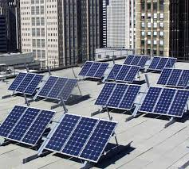
New Voluntary, Community-Based Solar
Partnership Pilot Program
Customers can contribute $9 a month
Option does not increase rates for non-participants
During the next three years, pilot program can support 25 commercial-scale, distributed solar arrays – 10 to 15 times larger than typical residential rooftop installation
Estimated total of 2.4 megawatts depending on customer participation

Slide 13
New Voluntary, Community-Based Solar
Partnership Pilot Program
To incentivate customer participation, NextEra Energy’s foundation to contribute $200,000 annually to the following non-profits:

Slide 14
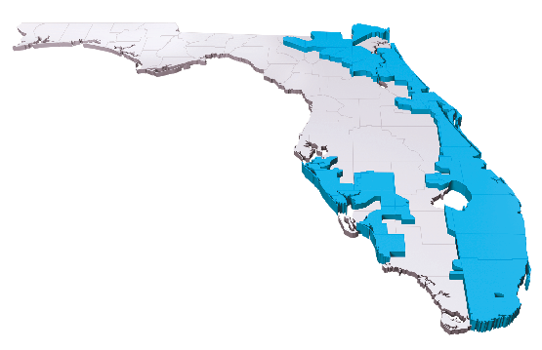
New Voluntary, Community-Based Solar
Partnership Pilot Program
Five pilot communities identified
-- Each provided letter of support with filing
Geographically diverse locations throughout FPL territory
City of Fort Lauderdale
City of Sarasota
City of Doral
City of West Palm Beach
City of Cutler Bay

Slide 15
New Voluntary, Community-Based Solar
Partnership Pilot Program
Key Program Highlights
-- Solar power creation without cost-shifting or subsidizing others
-- Program costs supported by 80 percent of voluntary contributions
-- Marketing and administrative costs capped at 20 percent
--Impacts to those who don’t participate are ZERO over the three-year pilot
Three-year pilot period determines customer interest
At minimum, 7,800 participants and 350 kW solar
built
At maximum, 13,500 participants and 2,400kW solar built
Foundation contributions based on maximum participation
Based on pilot success, FPL will recommend continuation or
termination

Slide 16
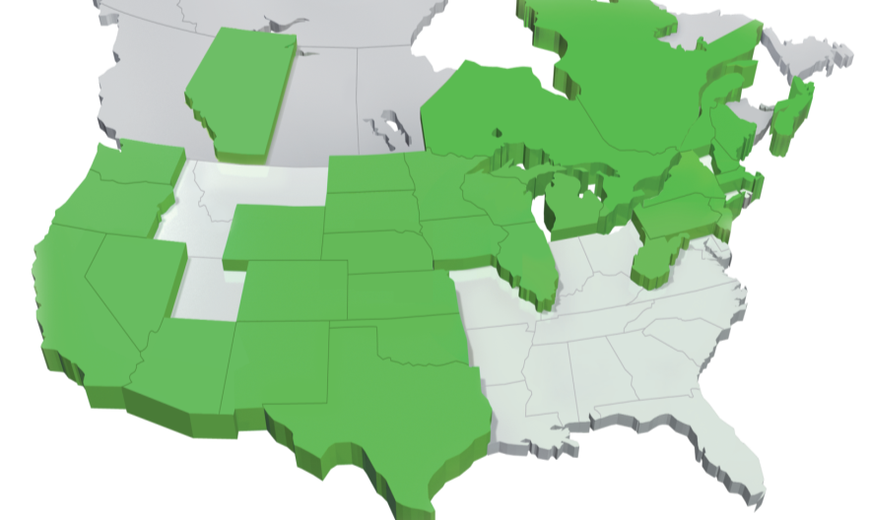
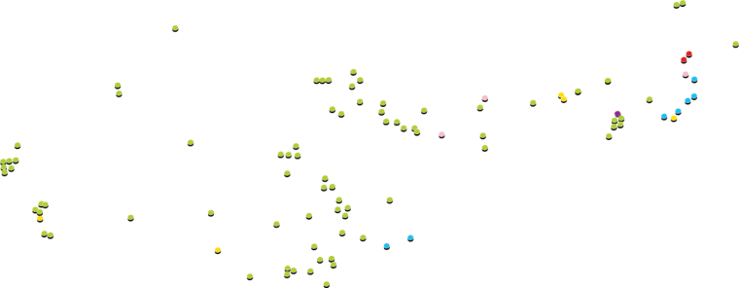
Fortune 200 & World’s Most Admired Companies seven years in a row
Headquartered in Florida
$31 billion invested in infrastructure improvements in past five years
#1 producer of renewable energy from the wind and sun in North America

Slide 17
35
counties
9,000
employees
74,000
miles of
power lines
4.7 million
customer
accounts
Serve over half of Florida

Slide 18
Keeping Customer Bills Low
▲ Price
2008 → 2013
FPL
Typical Customer Bill
10.2%
Medical Care
19.9%
Gasoline
14.8%
Food
12.5%
decrease
increase
increase
increase
Sources: Consumer Price Index data for Miami-Ft. Lauderdale and FPL’s 1,000-kWh residential bills, 2008 average and Dec. 2013

Slide 19
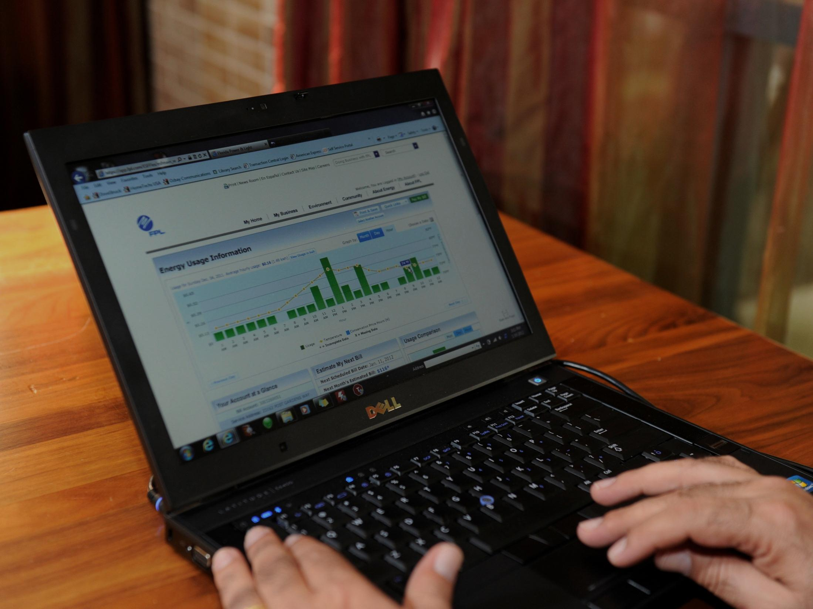
Helping our customers to be more energy-efficient
Conducted 3.4 million home/business energy surveys for customers
High-efficiency air-conditioning rebates for 1.5 million customers
810,000 customers participating in OnCall – largest load-management program in the nation

Slide 20
Questions??

