Slide 1
DESIGN DRIVEN DECISIONS the T’nT residence (Today and Tomorrow)
Go SOLAR Renewable Energy Fest Friday, June 6, 2014
Presented by Valerie J. Amor LEED AP BD&C, Assoc. AIA, Lic. RE Broker
valeriejamor@gmail.com
954.701.0698 Drawing Conclusions LLC
Founder/Action Oriented Visionary Eco Logical RE + Community Builder, LLC
Owner, Principal Broker
All ideas, images & presentations sole property of Drawing Conclusions LLC, no representation, copying or use of presentation without written permission; copyright 2014

Slide 2
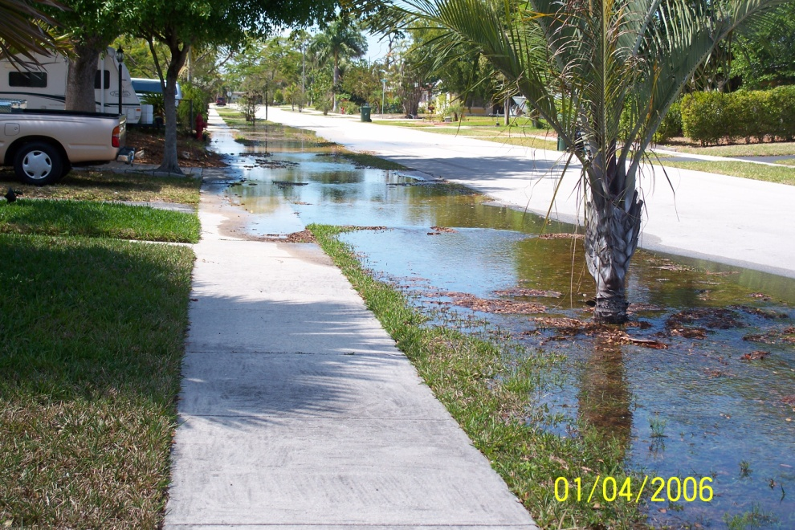
Issues:
Increasing Temperatures
Increasing temperatures and the associated increase in frequency, intensity, and duration of extreme heat events will affect public health, natural and built environments, energy, agriculture, and forestry.
Sea Level Rise Threats
Sea level rise poses widespread and continuing threats to both natural and built environments and to the regional economy.
Water Availability
Decreased water availability, exacerbated by population growth and land-use change, will continue to increase competition for water and affect the region’s economy and unique ecosystems.
global warming
climate change
Sources: Fifth IPCC Report 2014 - http://www.ipcc.ch/report/ar5/
Third National Climate Assessment Report 2014, Southeast Region - http://nca2014.globalchange.gov/highlights/regions/southeast

Slide 3
Issues:
Increasing Temperatures
Sea Level Rise
Water Availability
food
air
resources
shelter
transportation
community
infrastructure
energy
water

Slide 4
)
Residential rooftop PV
10%
Solar PV plants
47.9%
CSP plants
10%
Onshore wind
5%
Offshore wind
15%
Commercial/govt rooftop PV
10%
Wave devices
1%
Geothermal
0%
Hydroelectric
0.1%
Tidal turbines
1%
Transition to 100% wind, water, and solar (WWS) for all purposes
(electricity, transportation, heating/cooling, industry)
Total solar = 77.9%

Slide 5
Architectural Response:
systems - decentralization, centralization
shelter must become “alive”
planar architecture = helical 3D
DNA essence of life
Buildings no longer have the luxury to merely hold up other floors or the roof
no more lazy structures
X
Must produce clean air, potable water, food, energy, cultural marker, rebuild community , climate resilience

Slide 6
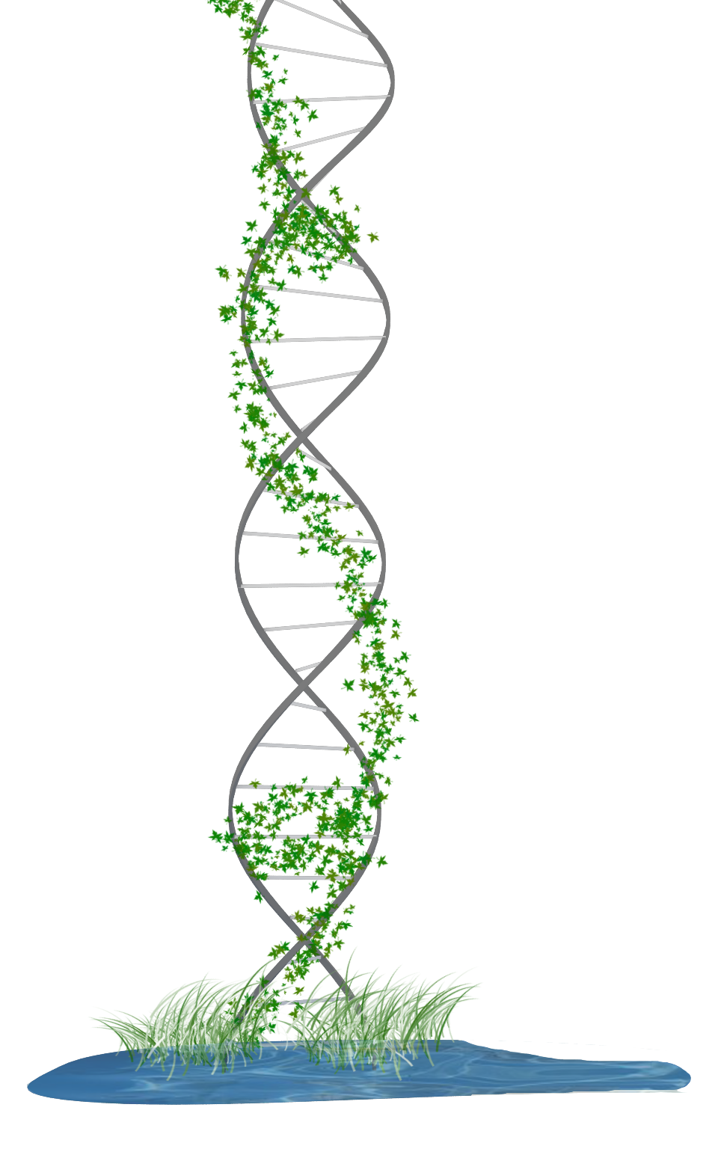
Architectural Response:
shelter - responsive to present and future climate impacts
water - capture, store, tertiary, reuse
energy - create, store, renewable, benign
air – purify, regulate temperature, humidity
food – local, organic
community – provide for multiple levels of
social connection

Slide 7
the T’nT residence (Today and Tomorrow)
Today
What the owner needs and can afford today
Tomorrow
What the owner will need and can afford tomorrow
Goal
Decrease energy use
Increase climate resilience

Slide 8
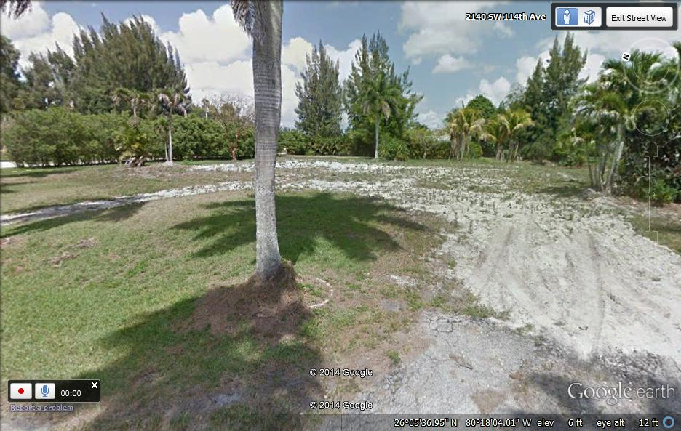
the T’nT residence (Today and Tomorrow)
2400 sq. ft. + two car garage
1+ acre previously developed
4 bedroom, 4 bathrooms
Kitchen, living area
covered exterior courtyard
, c
Looking east

Slide 9
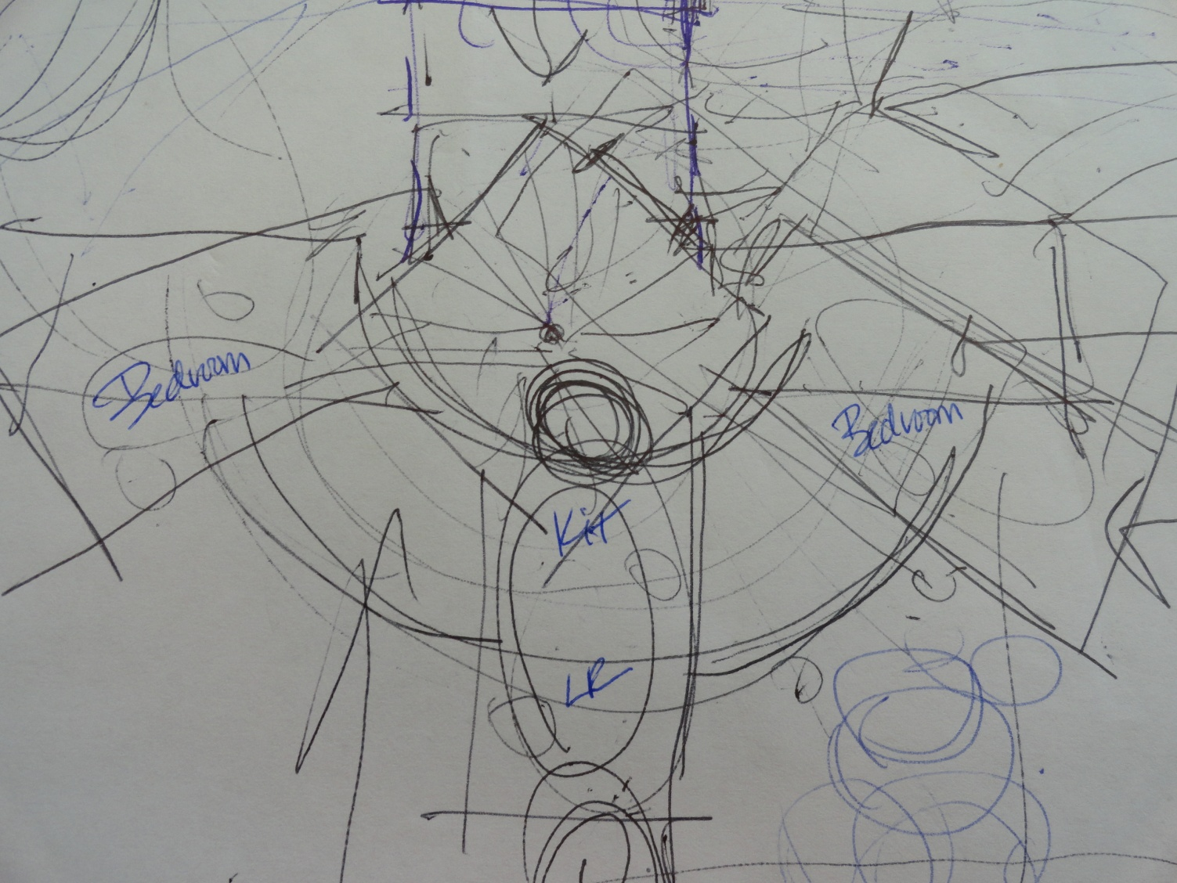
the T’nT residence (Today and Tomorrow)
three, rectangular 800 sq. ft. living spaces
unified around central outdoor courtyard
outdoor courtyard covered by rain gutter roof:
partially covers roof terraces
rain gutter system supplies:
roof , patio, ground rain barrels underground cisterns
flat roof: doubles as rain water capture,
social space, growing food, solar energy generation
pond
west
north

Slide 10
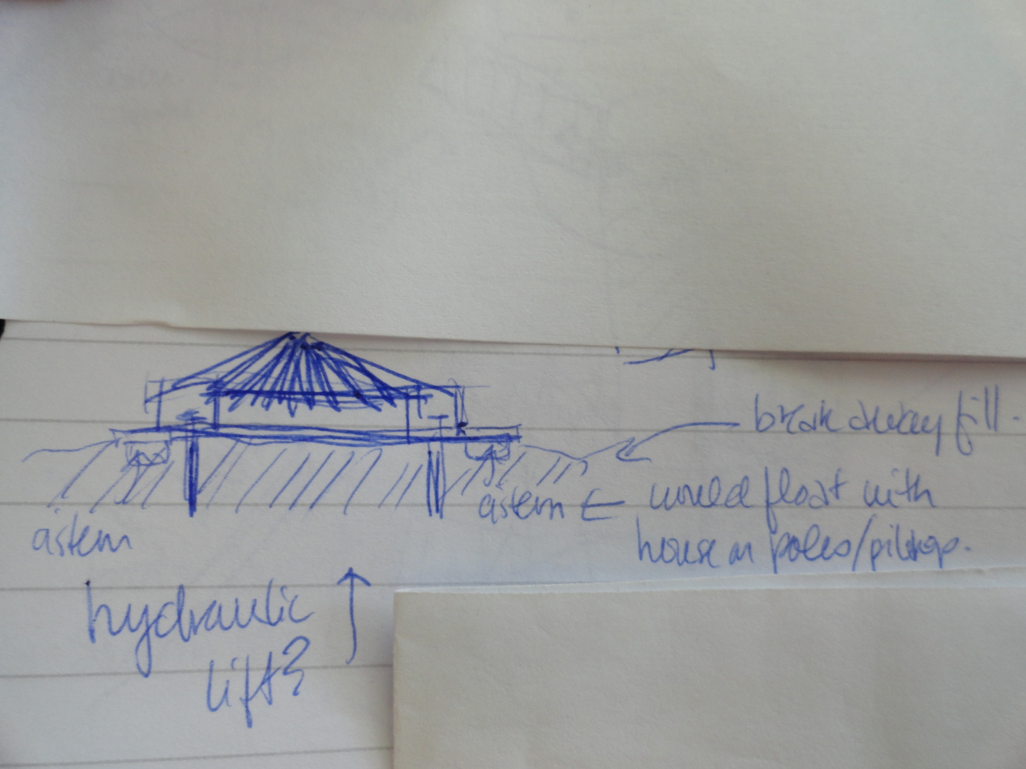
the T’nT residence (Today and Tomorrow)
two story – garage under house
no “important stuff” in garage - allows for abandonment of bottom level (SLR) house, flood insurance
all electrical on main floor of house
bermed around floating pad – cool garage (no a/c required)
berm can be re-constructed to become moot around house
Check Climate Central for address - SLR predictionhttp://sealevel.climatecentral.org

Slide 11
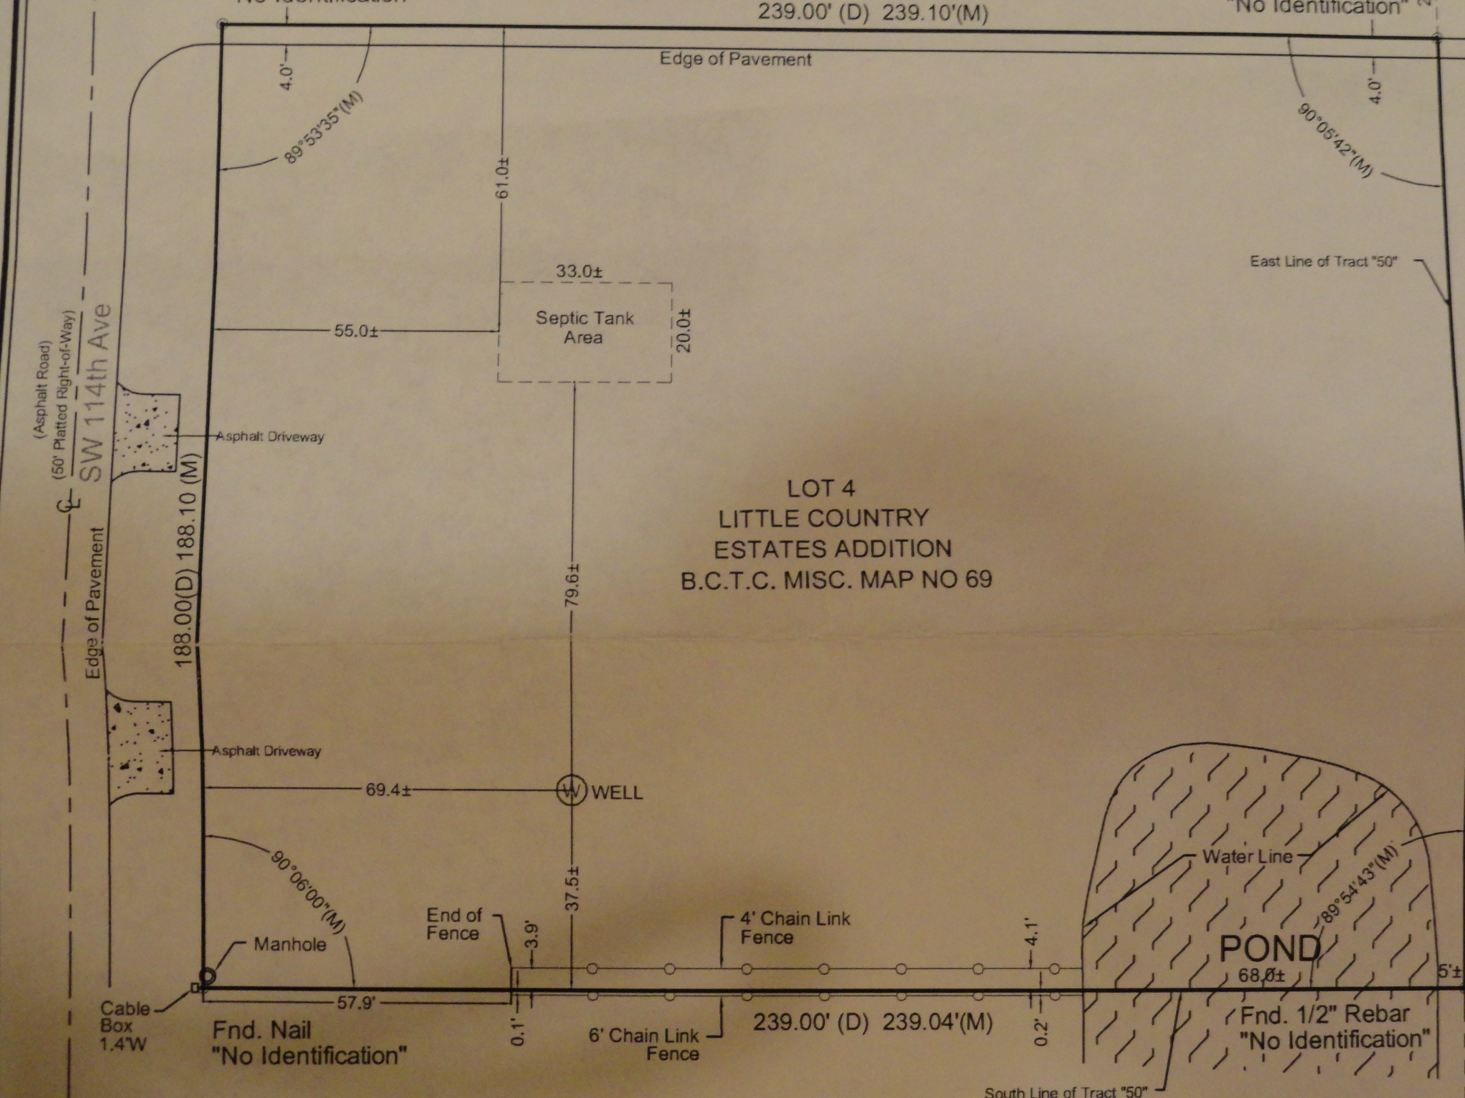
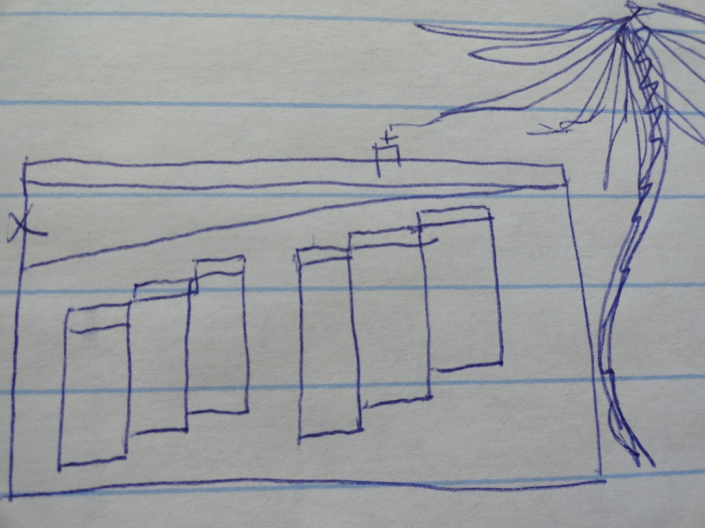
the T’nT residence (Today and Tomorrow)
pond
sited to maximize indirect light, daylighting, reduce heat gain
tilt-up concrete construction
modular sizes
R value: wall 15, roof 40 (energy modeling)
stained, embedded with stones, recycled glass – sealed
fenestrations – stepped with transom above
to facilitate natural ventilation
placement decided by sun study – operable
hurricane impact ( by code)
Benefits –
reduction of costs due to repetition
no future painting required
minimal upkeep
reduce energy requirements
north
facing west

Slide 12
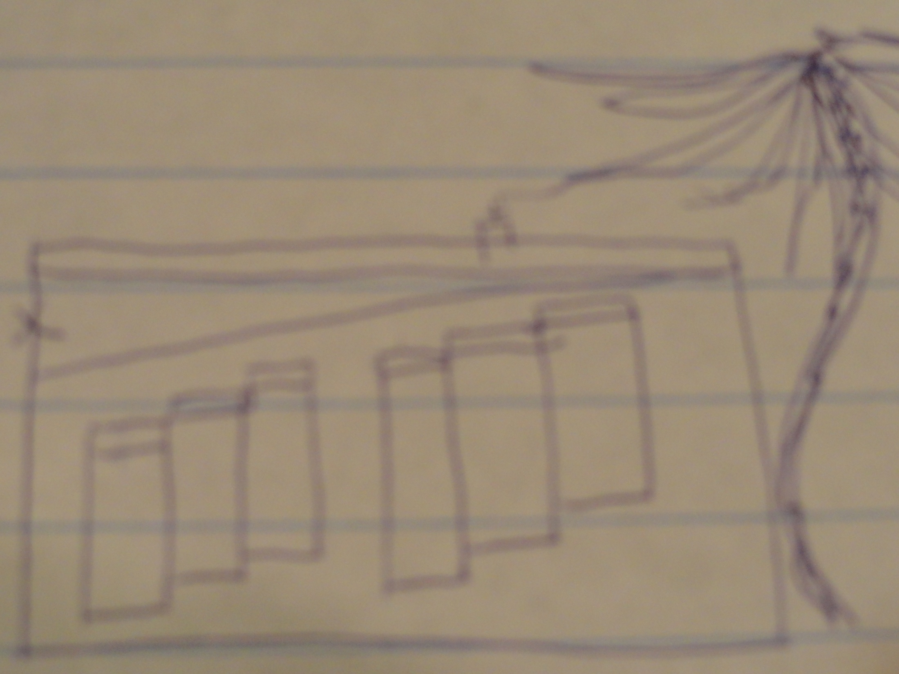
the T’nT residence (Today and Tomorrow)
energy - rain gutters, micro turbines
solar panels, window shades (storage)
mixed mode ventilation – emphasis on natural ventilation
ceilings angled inside to maximize air flow
(passive stack)
programmable thermostat
occupancy and light sensors
centralized controls, whole house automation
a/c - 20-24 seer (code 13) Ecotech
zones
net plus! – connect and sell back to grid (net metering)
ev connection - tomorrow
roof mounted helical wind turbine - tomorrow

Slide 13
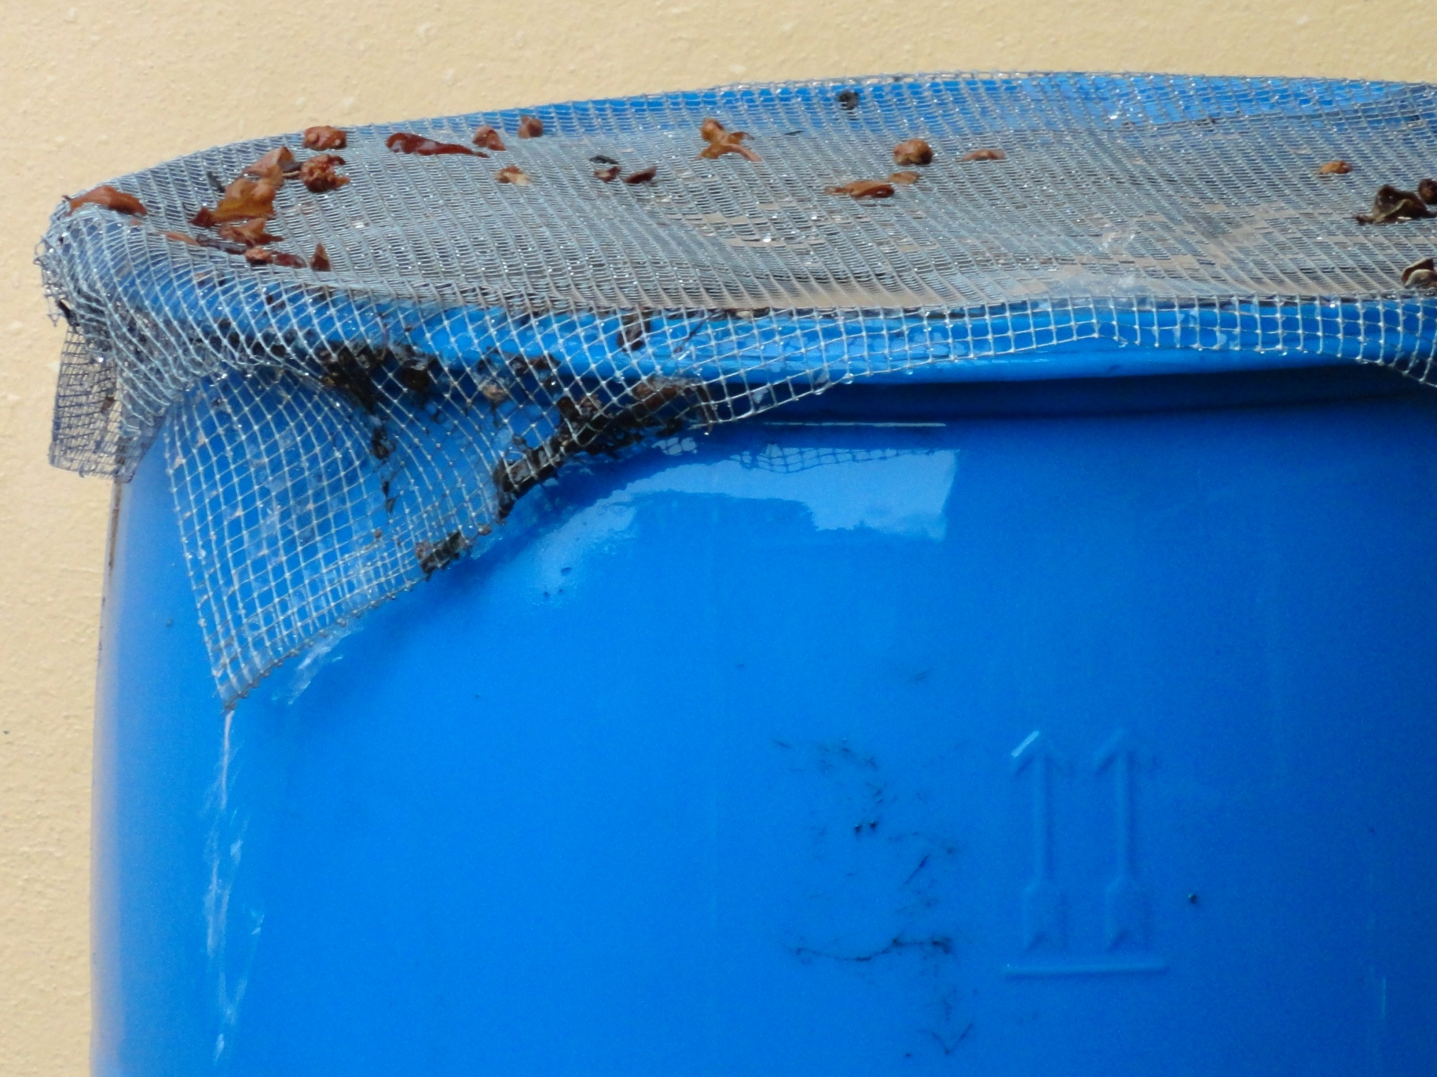
the T’nT residence (Today and Tomorrow)
rain water capture
storm water capture
cisterns
rain barrels
grey water reuse
black water reuse
tertiary water treatment (pond)
well (temporary) salt water intrusion
a/c condensate capture, reuse
humidity capture, reuse
Benefits – no water exits, all reused
black water to tertiary (code issues)

Slide 14
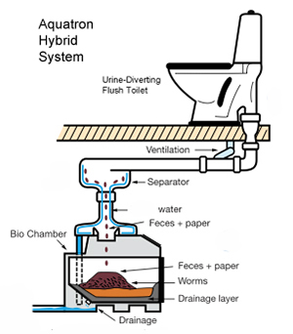
the T’nT residence (Today and Tomorrow)
solar water heater – no pool
tankless water heater, recirculating hot water
low flow fixtures, dual flush toilets
septic (temporary)
composting toilets –
today 1, tomorrow all
composting toilet, urine diverter (marine grade)
water, waste spaces clustered to minimize line runs, garage
facilitate future composting toilets
Benefits – composting material
Less materials

Slide 15
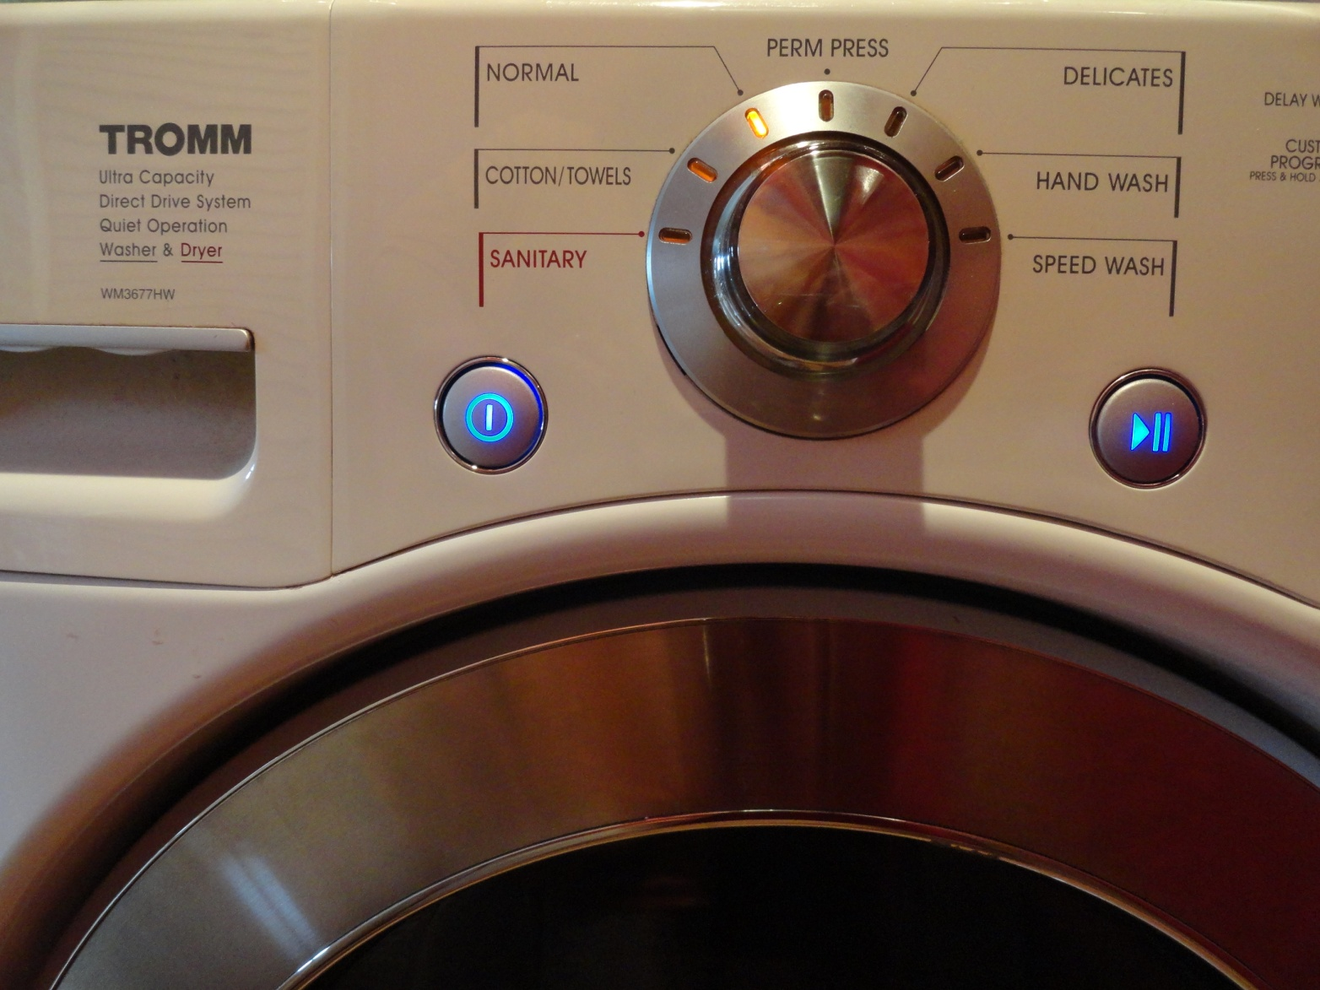
the T’nT residence (Today and Tomorrow)
Washer/dryer all-in-one, no dryer vent, 110V
interior finishes - floors: polished concrete
walls: tile, glass, concrete – no dry wall
no curtains – windows angled to maximize indirect light, no direct light
Energy Star appliances
energy tomorrow - power floors
furniture
kinetic, piezoelectric energy

Slide 16
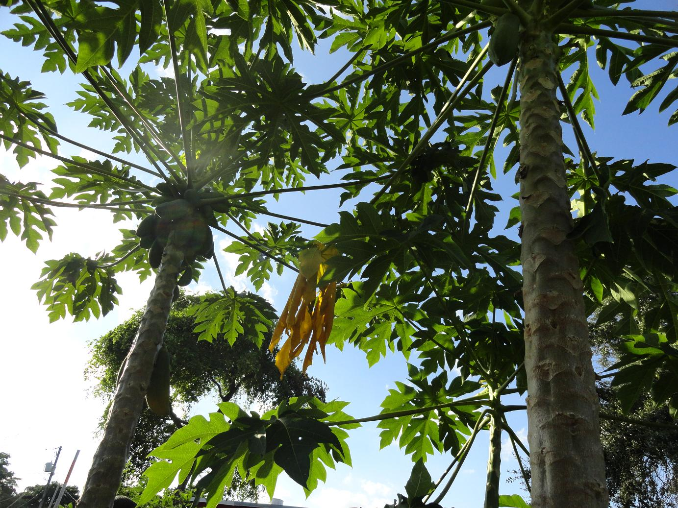
the T’nT residence (Today and Tomorrow)
Exterior, interior vegetation cleans, cools air
food forest – layered for year round growing
cooling, strategic shading (particularly west side)
bio diversity promotes natural system
food – local, organic, permaculture healthier, less refrigeration required
vertical growing, aquaponics – tomorrow
goats, sheep, chickens, cows
compost, recycle, biodigester - tomorrow

Slide 17
DESIGN DRIVEN DECISIONS the T’nT residence (Today and Tomorrow)
Presented by Valerie J. Amor LEED AP BD&C, Assoc. AIA, Lic. RE Broker Drawing Conclusions LLC
Founder/Action Oriented Visionary Eco Logical RE + Community Builder, LLC
Owner, Principal Broker
valeriejamor@gmail.com
954.701.0698

