Slide 1
Solar Energy in Florida for less than $1 a gallon
Second Annual Go SOLAR and Renewable Energy Fest
Fort Lauderdale, Florida
June 7, 2014
James Fenton
University of Central Florida, Florida Solar Energy Center
jfenton@fsec.ucf.edu www.fsec.ucf.edu

Slide 2
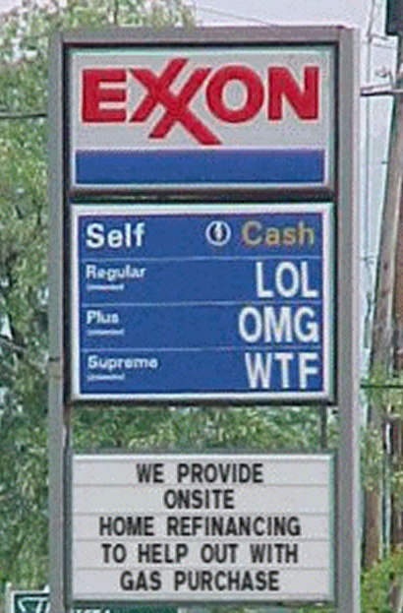
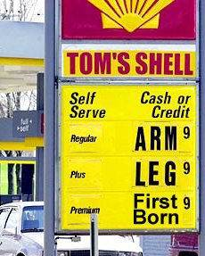
Where Do We Stand?
A little
in the way
of background . . .

Slide 3


Gasoline & Electricity Prices
 | 80s and 90s | 2010 | 2012 (April 9) | 2013 | 2025
 | $1/gal | $2.96/gal | $3.99/gal | $3.65/gal | ??
 | 8¢/kWh | 12¢/kWh | 11.7¢/kWh | 12¢/kWh | ??

Slide 4

“Thinking Outside The Box”
Instructions: Connect all nine dots with four straight lines without lifting your pencil
Watch out for the perceived boundaries of the problem!

Slide 5

A Florida Fable: The Foreign Fuel (1:38 minutes) http://vimeo.com/26289868

Slide 6
Energy is Fungible
Why can’t we drive our cars with locally made electricity, and if we do, how much oil can we displace?
Will Photovoltaic Electricity be Cheaper than Gasoline?

Slide 7
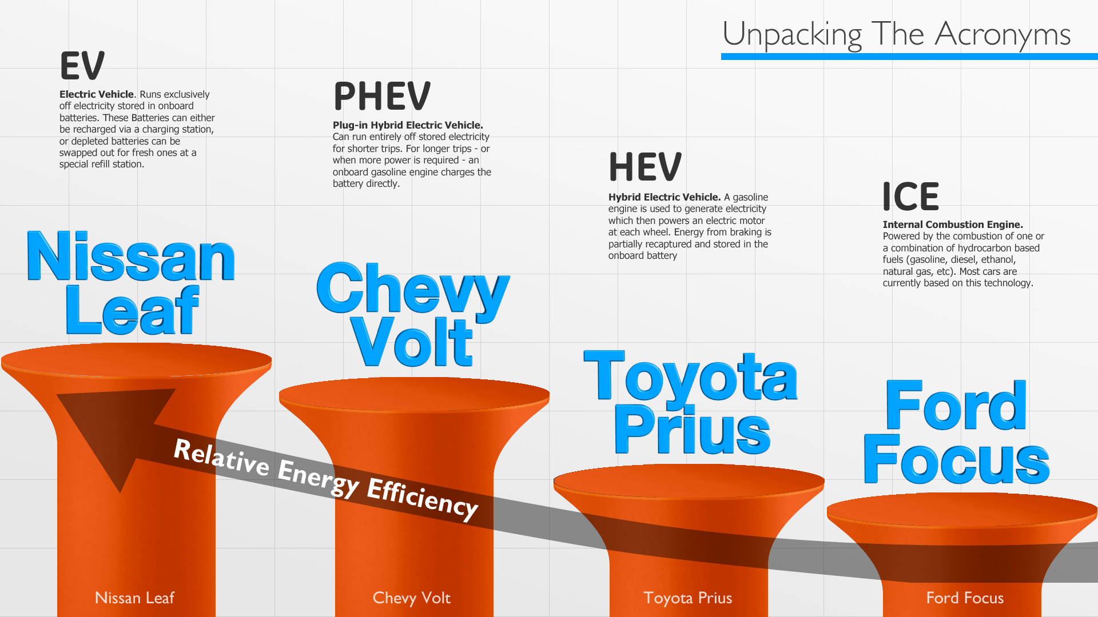
Image taken from http://visualization.geblogs.com/visualization/evs/
Notes:
Image taken from http://visualization.geblogs.com/visualization/evs/ on January 17 2014

Slide 8
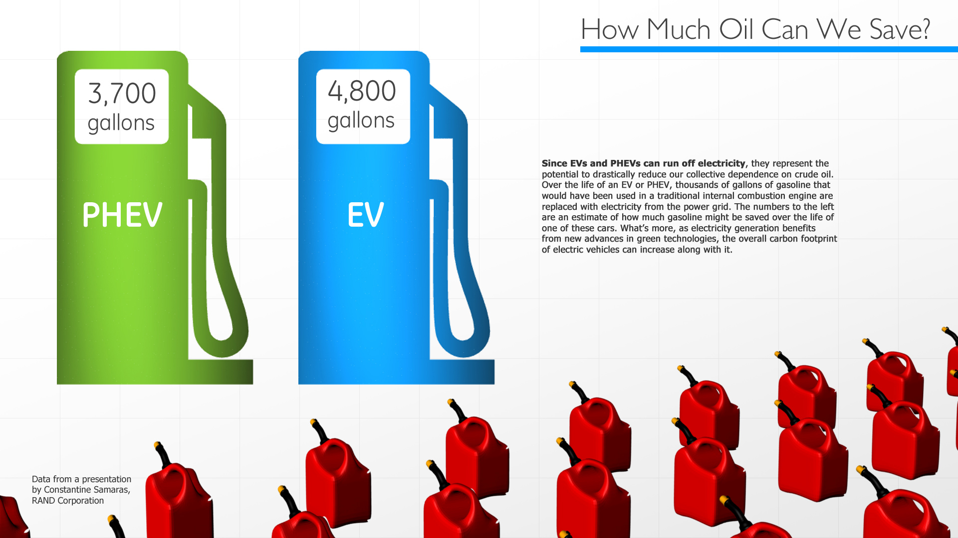
“Game Changers”
The New Electric Cars
Image taken from http://visualization.geblogs.com/visualization/evs/
Notes:
Image taken from http://visualization.geblogs.com/visualization/evs/ on January 17 2014

Slide 9
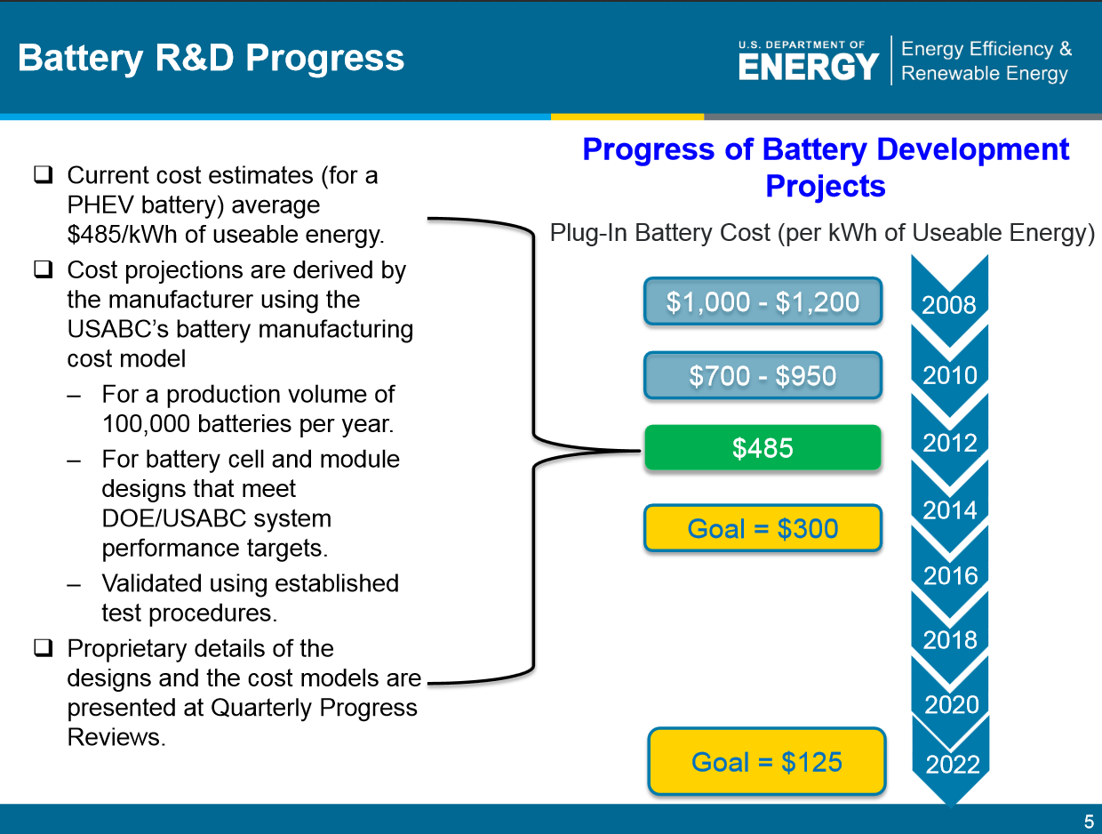

Slide 10
2013 HEV, PHEV, and EV Sales are Up
Total U.S. auto sales for 2013, 15.5 million
EV sales up 241%
  22,610 Nissan Leaf
  17,650 Tesla Model S
PHEV sales up 27%
  23,094 Chevrolet Volt
HEV sales up 14%
http://insideevs.com/monthly-plug-in-sales-scorecard/

Slide 11
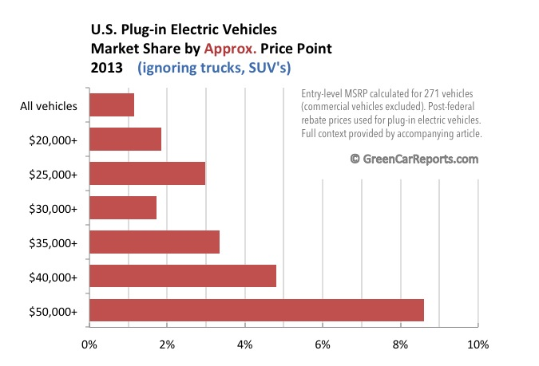
Electric-Car Market Share In 2013: Understanding The Numbers Better, Matthew Klippenstein Jan 11, 2014
http://www.greencarreports.com/news/1089555_electric-car-market-share-in-2013-understanding-the-numbers-better/
Notes:
Electric-Car Market Share In 2013: Understanding The Numbers Better
By Matthew Klippenstein Jan 11, 2014
http://www.greencarreports.com/news/1089555_electric-car-market-share-in-2013-understanding-the-numbers-better

Slide 12

Residential Electricity is Equivalent to
$0.98 Per Gallon Gasoline
 | Fuel Efficiency | Fuel Price | Cost per Mile | Cost per 12,000 Miles
Gasoline Car | 25 mpg | $3.25 per gal | 13¢ per mile | $1,560
Electric Car | 3 miles per kWh | 11.7 ¢/kWh ($0.98 per gal equiv.) | 4¢ per mile | $480
Notes:
The cost of residential electricity in Florida is equivalent to $0.99 per gallon gasoline! Sounds too good to be true! Let me explain. The efficiency of the average vehicle (cars and light trucks) on the road is 25 mpg and the efficiency of the electric car is 3 miles per kWh. At $3.25 per gallon and 12 cents per kWh for electricity, the gasoline car costs 13 cents per mile to drive while the electric car costs 4 cents per mile. Annual driving costs are reduced from $1,560 per year to $480 per year. If you retrofitted your house as I showed earlier you would save $446 per year almost enough to drive your electric car for free!

Slide 13
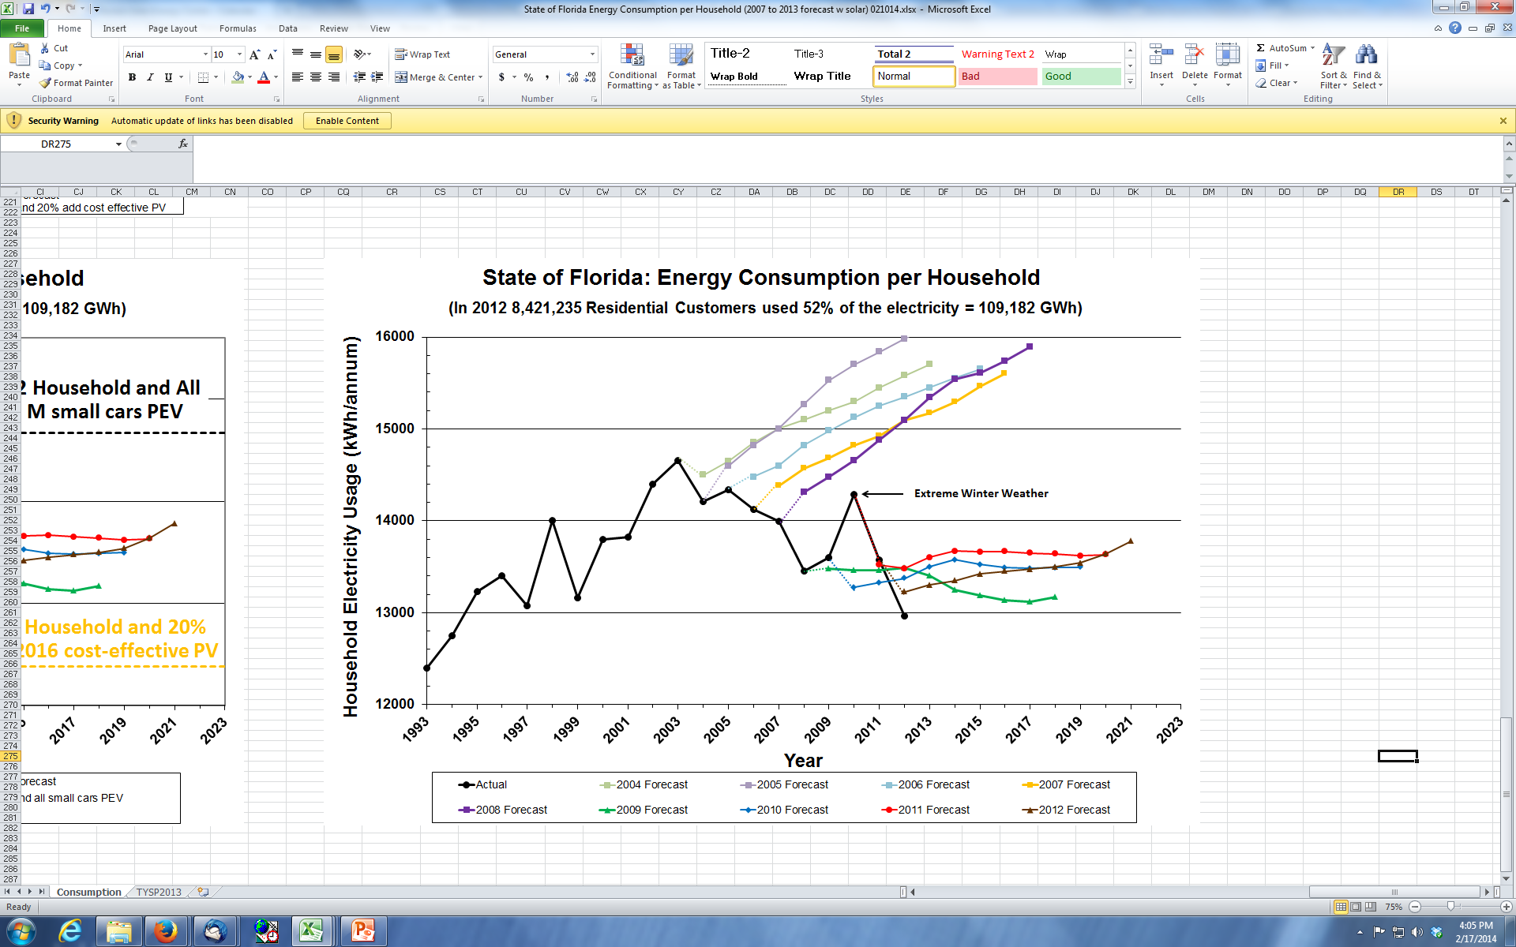

Slide 14

Switching FL’s Small Cars to PEVs
23%
of Florida’s vehicles (3.5M)
are small cars
  12,000 m/yr
  30 mpg
  $3.25/gal
  $4.65 B/yr
  12,000 m/yr
  3 m/kWh
  11.7¢/kWh
  $1.68 B/yr
Saves
18%
of Gasoline
Notes:
The new electric-drive cars, like the Nissan Leaf or plug-ins like the Chevy Volt, give us game changing options so that we may keep our capital in the state, increase economic activity produce high-wage jobs all at less cost than we pay today. Currently, 26% of all Florida vehicles are small cars primarily driven from home to work and back to home. If all small cars in Florida were electric or plug-in hybrid, we would save 1.4 billion gallons of gasoline. We will have to pay for the small car’s electricity, but this change will still save $2.6 billion in net fuel costs per year. This change to electric vehicles will require Florida to generate 15 billion more kWh (15 TWh) per year – the equivalent of more than four large electric power plants ( more than 4 500 MW coal plants in size) .

Slide 15
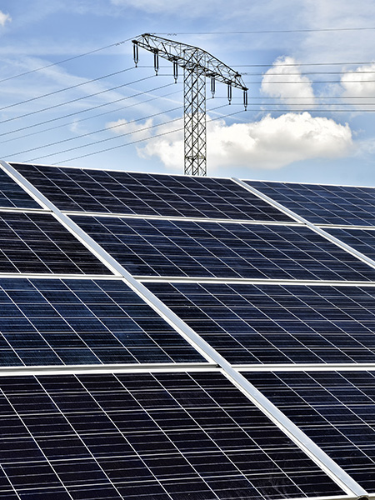
Switching All of FL’s Small Cars to PEVs
9.5 GW of PV Would Power ALL Small Cars
  Utility-Installed PV
  $2.10/W w/ ITC = $14B
  (3 yrs of Gasoline Savings)
  Utility-Produced PV
  7.2¢/kwh w/ITC =
  $0.60 gallon equivalent
  Utilities Should Be in the Solar
  Transportation Fuel Business!
Notes:
The new electric-drive cars, like the Nissan Leaf or plug-ins like the Chevy Volt, give us game changing options so that we may keep our capital in the state, increase economic activity produce high-wage jobs all at less cost than we pay today. Currently, 26% of all Florida vehicles are small cars primarily driven from home to work and back to home. If all small cars in Florida were electric or plug-in hybrid, we would save 1.4 billion gallons of gasoline. We will have to pay for the small car’s electricity, but this change will still save $2.6 billion in net fuel costs per year. This change to electric vehicles will require Florida to generate 15 billion more kWh (15 TWh) per year – the equivalent of more than four large electric power plants ( more than 4 500 MW coal plants in size) .

Slide 16
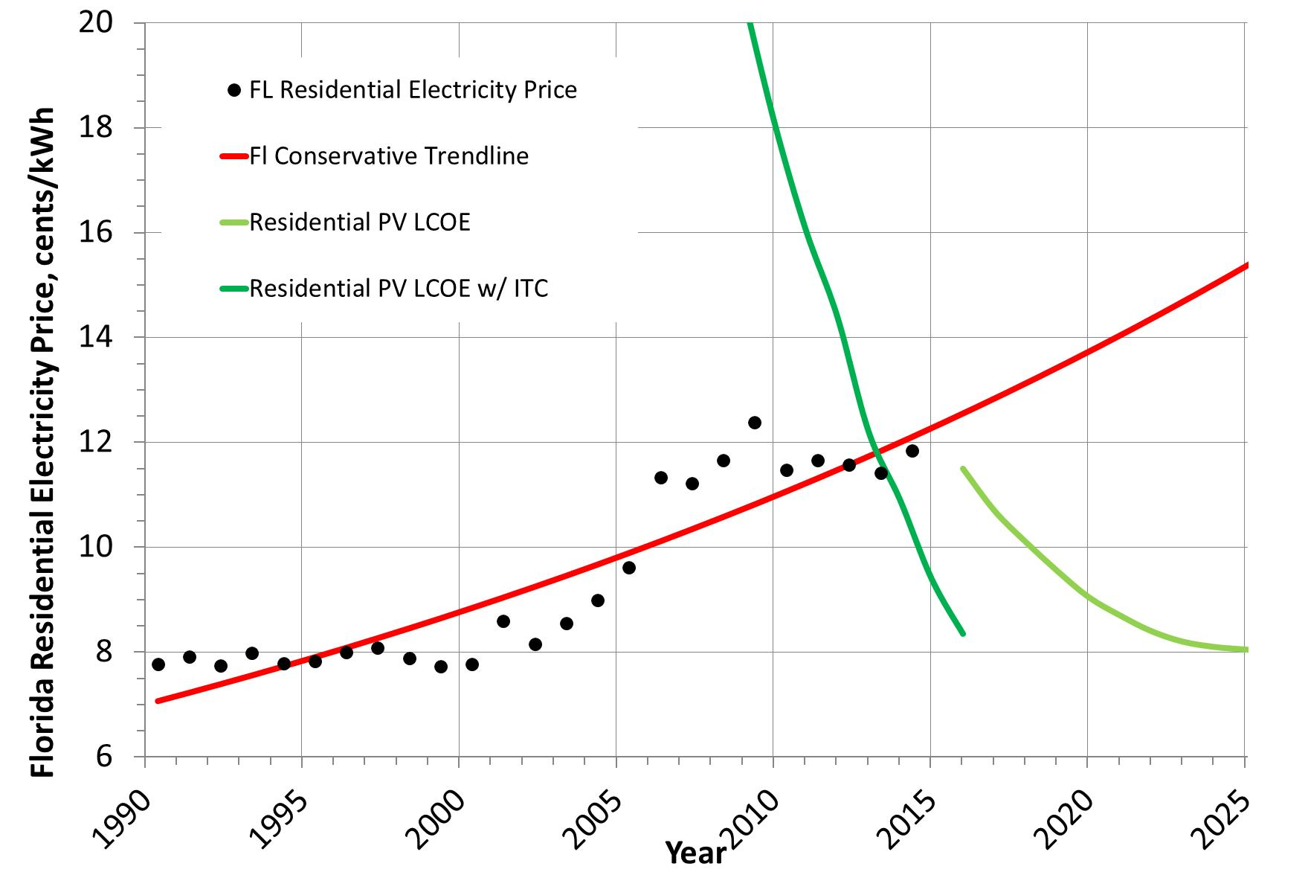
PV Grid Parity?
15.5 ¢/kWh
TODAY
2016 Residential rooftop PV at 9 ¢ kWh
8 ¢/kWh
Florida Least Cost Potential 16,350 MW residential PV in 2016
5 kW/resident leads to 3.3M residences, 1.5 voters/resident ~ 4.9 Million voters
http://www.ilsr.org/wp-content/uploads/2012/12/commercial-solar-grid-parity-report-ILSR-2012.pdf

Slide 17
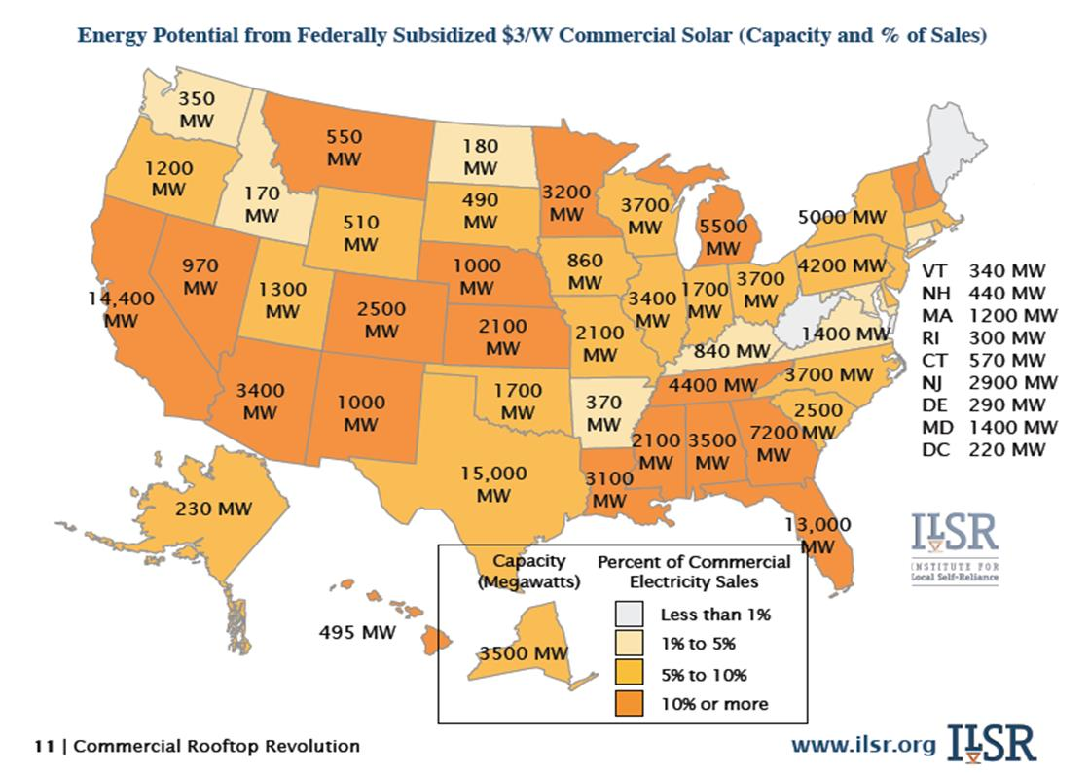
30% ITC + 10% Depreciation allowance ~ $2.40/W
2016
Commercial Rooftop Revolution
John Farrell Dec 2012
2016
Florida Least Cost Potential 16,350 MW residential & 13,430 MW commercial PV (14% FL’s electricity)
5 kW/resident leads to 3.3M residences, 1.5 voters/resident ~ 4.9 Million voters
http://www.ilsr.org/wp-content/uploads/2012/12/commercial-solar-grid-parity-report-ILSR-2012.pdf
http://www.ilsr.org/projects/solarparitymap/

Slide 18
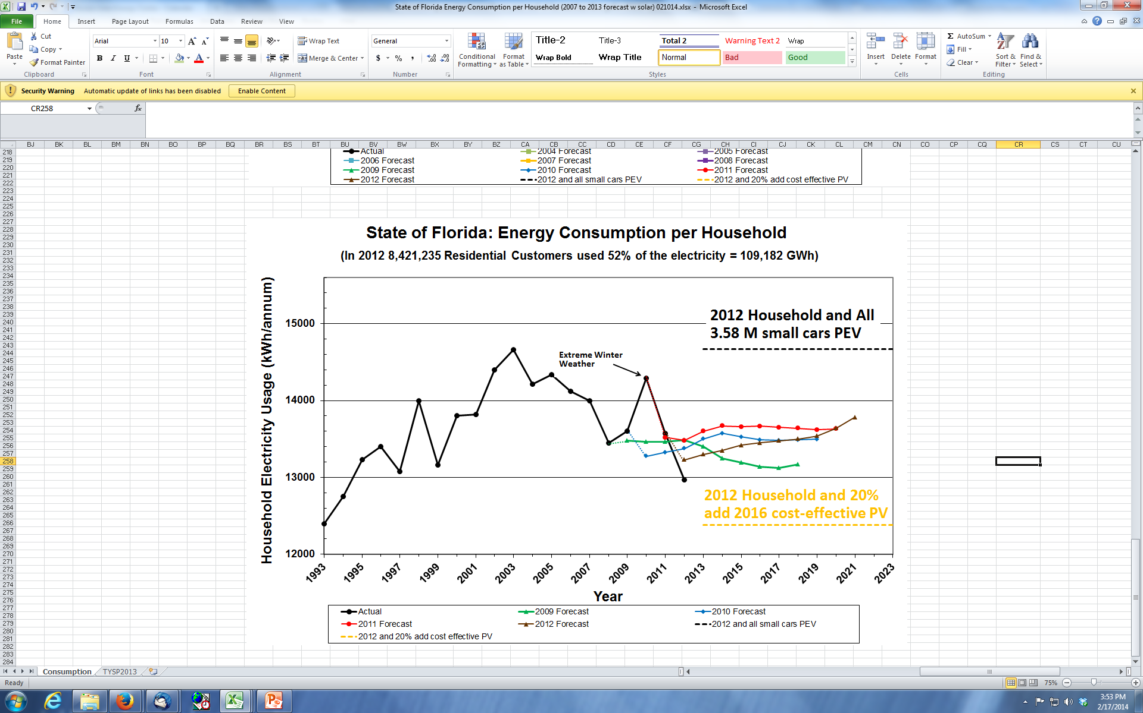

Slide 19
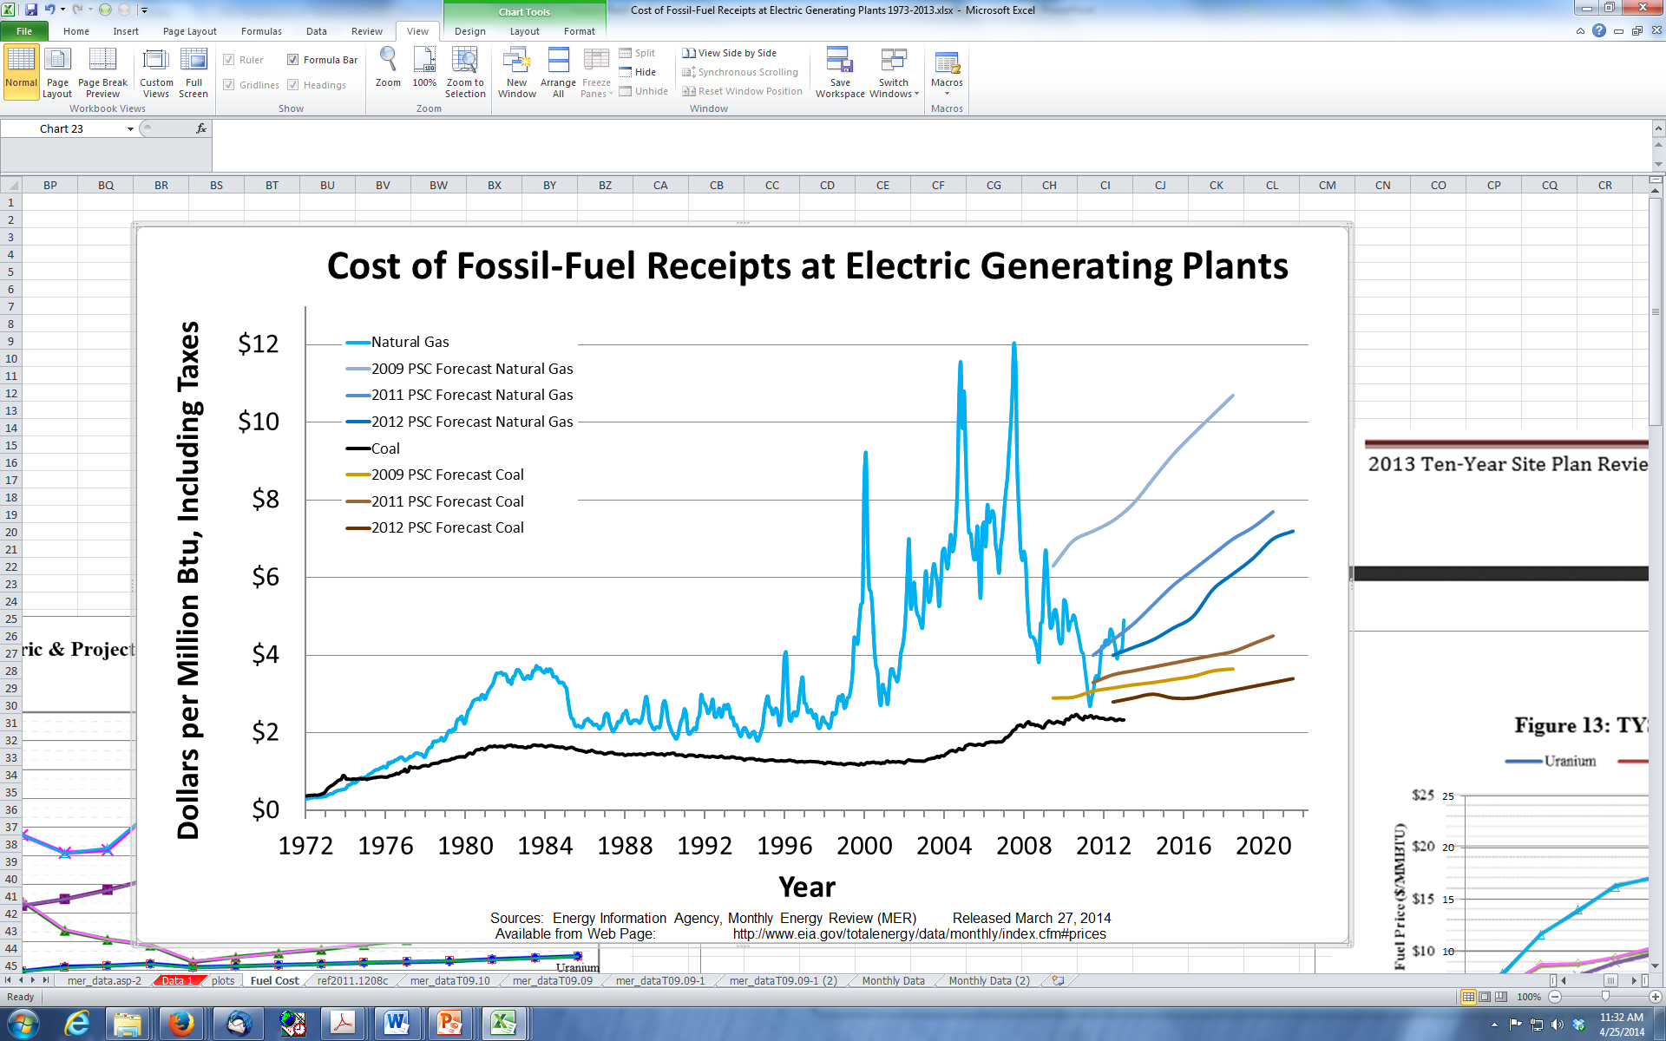
http://www.psc.state.fl.us/publications/pdf/electricgas/TYSP2013.pdf

Slide 20
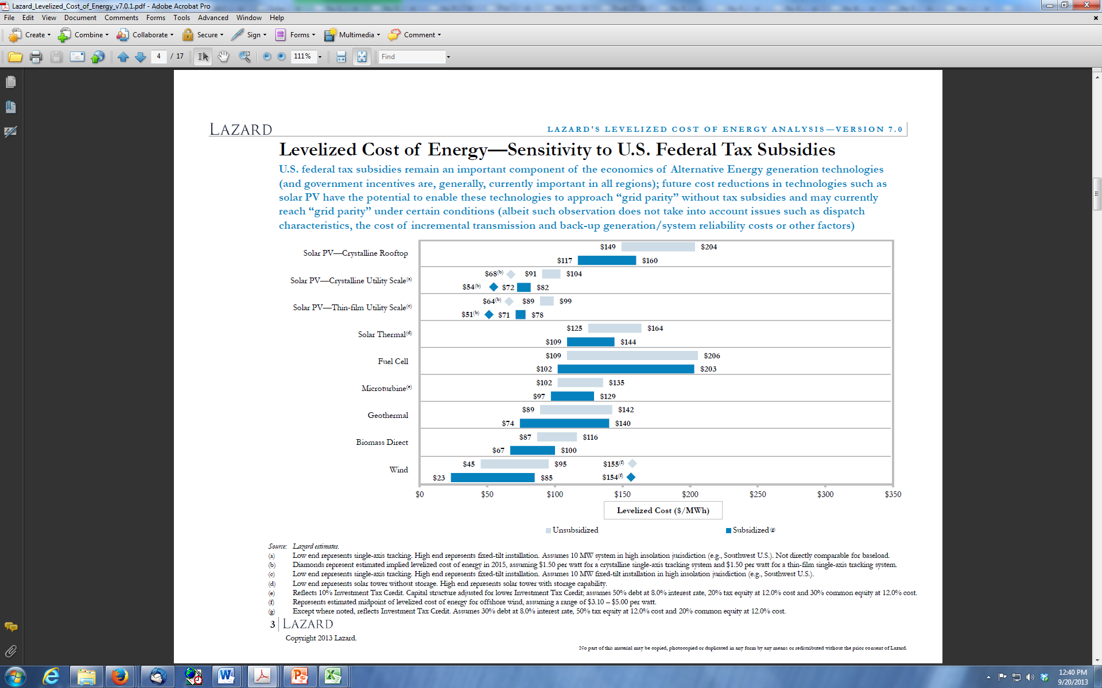
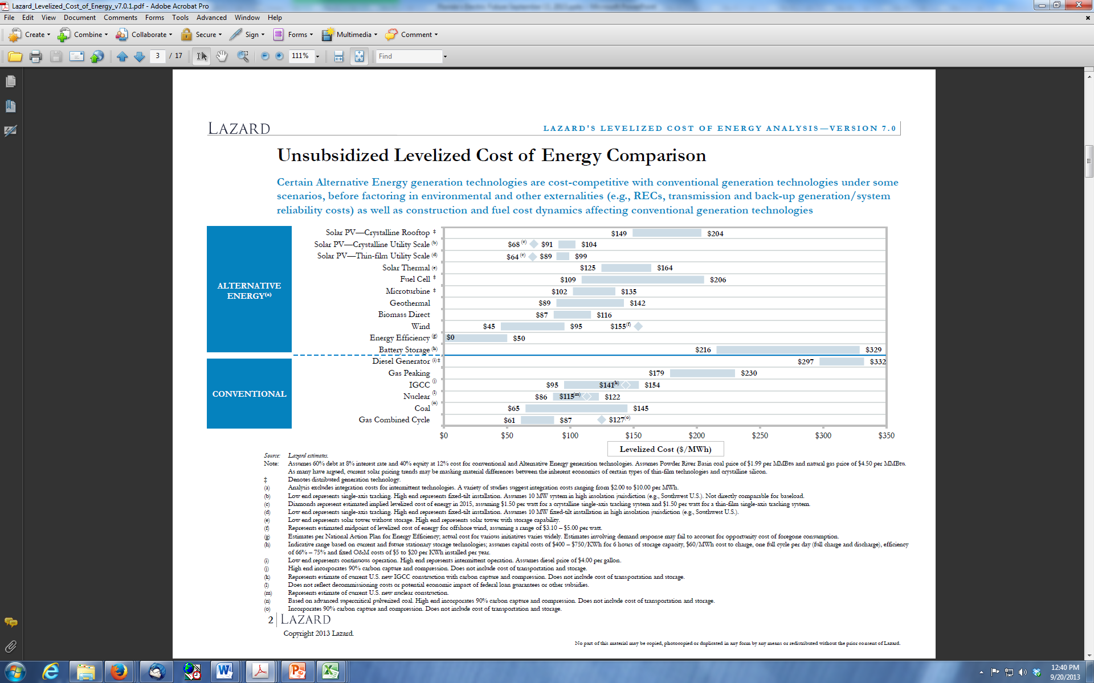
Gas Combined Cycle Today
Florida’s Average Residential Electricity Rate
Adapted from Lazard’s Levelized Cost of Energy Analysis Version 7.0 August 2013
20
Notes:
http://gallery.mailchimp.com/ce17780900c3d223633ecfa59/files/Lazard_Levelized_Cost_of_Energy_v7.0.1.pdf
L A Z A R D ' S L E V E L I Z E D C O S T O F E N E R G Y A N A L Y S I S
—
V E R S I O N 7 . 0
August 2013

Slide 21
Utility Solar Cheaper than GCC in 2015
Florida’s Average Residential Electricity Rate
By 2015
Utility Solar Cheaper
than Gas Combined Cycle
Adapted from Lazard’s Levelized Cost of Energy Analysis Version 7.0 August 2013
21
Notes:
http://gallery.mailchimp.com/ce17780900c3d223633ecfa59/files/Lazard_Levelized_Cost_of_Energy_v7.0.1.pdf
L A Z A R D ' S L E V E L I Z E D C O S T O F E N E R G Y A N A L Y S I S
—
V E R S I O N 7 . 0
August 2013

Slide 22
Solar Less Than 5¢/kWh in Austin, Texas!
(Cheaper Than Natural Gas, Coal, & Nuclear)
Austin Energy purchases 4.8¢/kWh
  25 year power purchase agreement from SunEdison (operational 2016)
150 MWs this is large, not small
  estimated cost @ $1.4/W w/ITC = $147M
Will lower electric rates for Austin Energy customers
DOE projected < 6¢/kWh by 2020
Austin Energy’s Conventional Options
  natural gas 7¢/kWh, coal 10¢/kWh, nuclear < 13¢/kWh
Austin Energy paid 16.5 ¢/kWh in 2009
New Mexico PPA 5.8 ¢/kWh, North Carolina PPA 7 ¢/kWh
  Smaller installations ~ 20 MWs
Texas is a Red State where Hydrocarbons dominate, yet it went Solar
Florida is a Red State with no Hydrocarbons, Solar should dominate!
Notes:
Utility-Installed PV
$1.4/W w/ ITC equivalent to 4.8 cents/kWh????
http://www.greentechmedia.com/articles/read/Cheapest-Solar-Ever-Austin-Energy-Buys-PV-From-SunEdison-at-5-Cents-Per-Ki
cleantechnica.com/2014/03/13/solar-sold-less-5¢kwh-austin-texas/
http://www.austinenergy.com/wps/portal/psp/about/press-releases/austin-energy-announces-150mw-utility-scale-solar/!ut/p/a1/rVNrb9owFP0t_UC-ubl5EMykaHIpbYII9LG2wJfKJCaEJU5qGyj99XPCNA1tqGVdpPh9j4_PPdecmRNzxukmS6nKSk7zej7znsHGdtADO8Skb0M4gr4z7N_COPT0genvB8bjmzaEnTt7eHvvWPjB-mD8kY_Ae_FP5sycxVxVamlOK1m1oGnovFwrPRZMSiRYzqhkUi-vpco4YpyJdIco5-Wax0wiqw3FFq1Vlmdqh2RMc4ZkmVNRo1c0ZQmTWcqbWZwl5tSlC4d6tItixwLkuosYdcHzkIvnHZx0kzmFxBwckv9TG_14W0S9KK0vUUuU8UVpTkjN3Zwccjcnp3NvtHknO_sDx-UffCCBhM8drN8g2IIJJs7XQhtnqVT1pQUt2G6352lZpjk7j8uiBXr3q6S-MkSs_JXx4htMitiXhizXImb-ls2NOPE7xoYlPvSuprdXK3Jt6DC_xmxZDmlZ9lX919B7WfaqNBfU65Wsu6oUiubNSHtCd42yzfzQF3rlZHXroLOfaA0A1C24z_erbu9m913KHbzeDCMevcEmIou_CbUspU70oUBHTPF5N2jcbPXyMiO6Xkqu2Gvtsf9fMFNd0J2jhiGWeX9iFe0BraDtWhdgDcYRwUDcMAh63W8QXnv_CPiLIbSxpxkOgTwGAwcu7M8CYhz0IXwMvEtnGFnX_dMZVsXDQ4FXi-Lp0rvDOyffDIN8UxTPoxGicwxbcnb2AwirxIk!/dl5/d5/L2dBISEvZ0FBIS9nQSEh/
Solar Less Than 5¢/kWh In Austin, Texas! (Cheaper Than Natural Gas, Coal, & Nuclear)
Here’s a milestone to mark. Solar power is apparently going to be sold to Austin Energy for a tiny bit less than 5¢/kWh under a new 25-year power purchase agreement (PPA) with SunEdison. Austin Energy says the deal will even lower electric rates a bit.
It’s from no small project either. It’s from two solar power plants totaling 150-megawatts of capacity — a 350,000-panel, 100-megawatt facility; and a 150,000-panel, 50-megawatt facility nearby.
Oh, by the way, this wasn’t the only proposal Austin Energy received. It beat out about 30 other solar power proposals. Needless to say, competition is a brewin’ in Texas!
“Austin Energy is poised to sign what could be the world’s cheapest solar-power deal,” Marty Toohey of statesman.com wrote.
“It’s the cheapest I’ve seen,” said Raj Prabhu, the CEO of Mercom Capital Group, an Austin-based energy consulting group that monitors the industry nationally. He said he isn’t familiar with the details but added, “This seems to be new territory.”
“It is certainly at the very low end of the prices I have seen,” said Jurgen Weiss, an energy economist with the Brattle Group, an international consulting firm that advises the Electric Reliability Council of Texas. “As many had predicted, we’re entering a time in which, with some caveats, solar presents quite an attractive alternative to conventional sources.”
Lowest price yet for solar?
I have a hard time believing that’s the lowest solar power has gone for anywhere in the world, but it may be the lowest in the US if you remove state subsidies from other projects.
We reported last February on a PPA in New Mexico in which First Solar was selling electricity for 5.8¢/kWh. That’s the lowest I think I have seen. However, GTM Solar Analyst Cory Honeyman says that ”new PPAs signed in North Carolina fetched prices for less than 7 cents per kilowatt-hour.” The notable difference in the New Mexico and North Carolina projects, as implied above — they took advantage of in-state subsidies for solar. That’s not the story with this Texas deal.
SunEdison project beat natural gas, coal, and nuclear on price
If you removed the ITC (a federal tax credit for solar), the cost would probably be about 8¢/kWh. Still, that’s not bad. Austin Energy’s 30-year LCOE estimate for natural gas was 7¢/kWh, while the estimate for coal clocked in at 10¢/kWh and the estimate for nuclear at 13¢/kWh.
Only wind — 2.8¢/kWh to 3.8¢/kWh — was lower.
Things change fast
I remember watching a utility company CEO roundtable a few years ago that featured solar leaders in the utility arena. Larry Weis, General Manager of Austin Energy, was on that panel. So, he was considered a good guy in the solar space. However, he was adamant a number of times that solar was expensive and the cost had to come down for solar to become competitive.
In 2009, Austin Energy actually agreed to contract for 16.5¢/kWh for power from a solar project in the Webberville, TX.
Clearly, things have changed fast. (Of course, anyone who reads CleanTechnica already knows that.) Still, I think it’s hard even for those in the industry to keep up with solar prices.
Here’s another big note regarding this new PPA: the original Request for Proposals for this Austin Energy contract was for 50 MW. Why would Austin Energy up that to 150 MW after getting the bids? I think you know why.
Don’t forget, this is peak power!
One final thing worth pointing out: solar power produces electricity at peak demand. That is very high-value electricity. The fact that bids are coming in below 5¢/kWh is huge.
“At this price, it’s a game changer, not just for Austin Energy but for the future of electric generation in Texas,” said Tom “Smitty” Smith, head of the Texas chapter of Public Citizen, an environmental watchdog group. “No state has more solar potential than Texas. Some states have places of more intense sunlight, but Texas has vast areas of dry, arid desert that are perfect for solar.”
Beating Targets — Big Time!
I lied. Here’s one more note: the US Department of Energy projected that the cost of solar would drop below 6¢/kWh before 2020.
Also, note that the deal is not final. It goes up for an Austin City Council vote on March 20. However, it looks like an obvious shoe-in.
Read more at http://cleantechnica.com/2014/03/13/solar-sold-less-5%c2%a2kwh-austin-texas/#XlpWYCx1Y57JMRWq.99

Slide 23
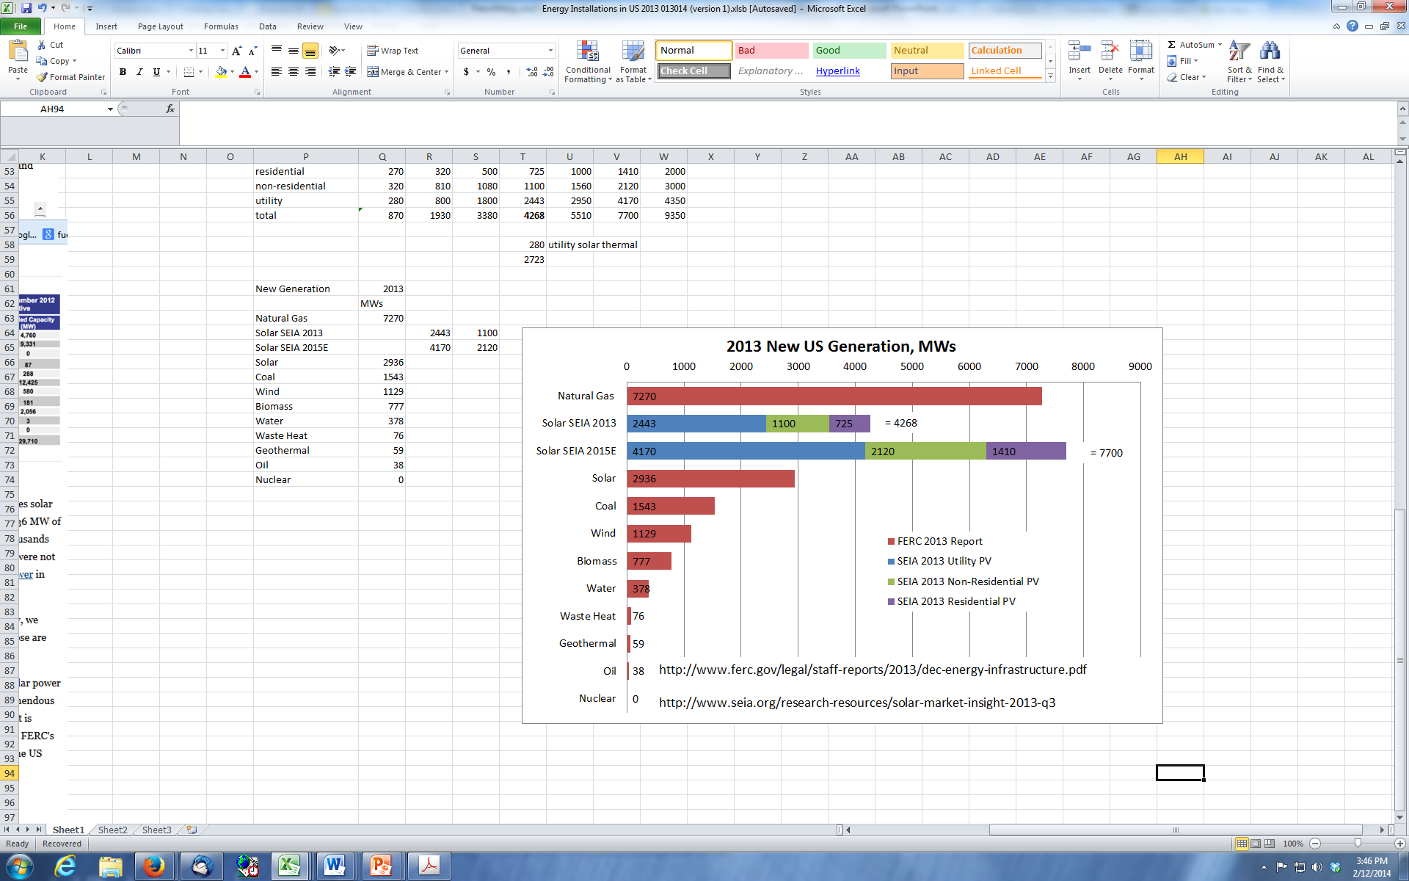
Notes:
A report from the Federal Energy Regulatory Commission (FERC) reveals that 2.9 GW of utility-scale solar capacity was added in the U.S. last year.
Large scale solar installations in the U.S. grew by 43% in 2013, with PV playing its part in the sector's rise.FRV U.S
Installed solar power capacity in the U.S. grew by 42.8% in 2013, with the country adding 2.9 GW of large-scale solar energy to the grid, according to the latest Energy Infrastructure Update report from FERC's Office of Energy Projects.
The report also found that combined renewable energy sources (solar, wind, geothermal, biomass and hydropower) accounted for 37% of all electrical generating capacity in 2013, outstripping coal (which provided just 10.8%), oil and nuclear. Natural gas – boosted by a series of successful fracking initiatives – led the way, however, fuelling 51.1% of new energy capacity (7.2 GW overall).
Despite the dominance of gas, the U.S. solar industry is sure to be encouraged by FERC's findings, which show that solar energy (from both PV and concentrated solar power installations) was the second-most popular source of power last year, and by far the fastest-growing renewable energy source, with 266 individual commercial-size installations added. It should also be noted that these figures do not include an estimated 1.6 GW of "behind the meter" sources of solar PV – such as rooftop residential installations and smaller commercial arrays.
Read more: http://www.pv-magazine.com/news/details/beitrag/utility-scale-us-solar-capacity-grew-43-in-2013_100014056/#ixzz2uHgQee1F

Slide 24
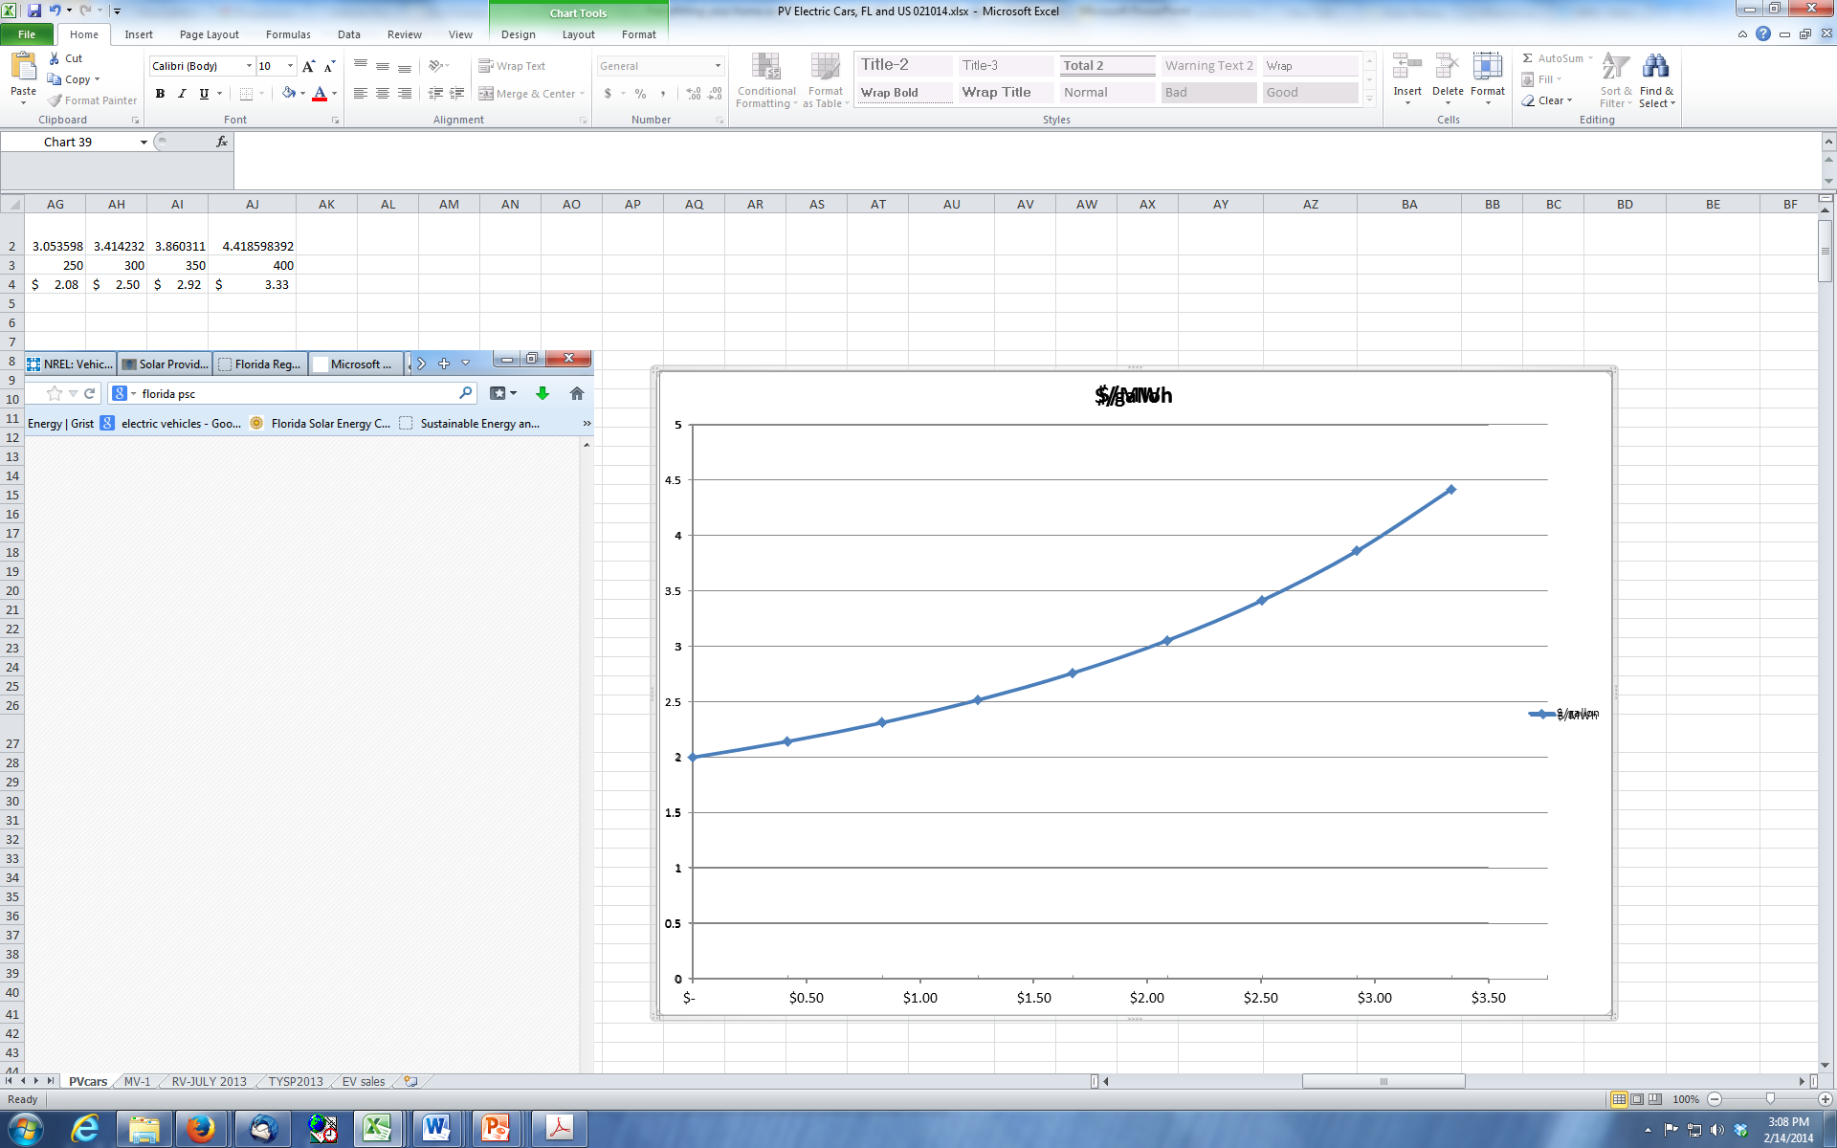
All Electricity Cheaper Than Gasoline
2013 Res Roof PV
$1.08 per gallon
By 2015 Utility Solar $0.45 gallon
$3.25 per gallon gasoline
2013 Utility Solar
$0.60 to $0.68
per gallon
Florida’s Average Residential Electricity Rate
$0.98 per gallon
Adapted from Lazard’s Levelized Cost of
Energy Analysis Version 7.0 August 2013
Equivalent cost of Gasoline, $ per gallon
24
Notes:
http://gallery.mailchimp.com/ce17780900c3d223633ecfa59/files/Lazard_Levelized_Cost_of_Energy_v7.0.1.pdf
L A Z A R D ' S L E V E L I Z E D C O S T O F E N E R G Y A N A L Y S I S
—
V E R S I O N 7 . 0
August 2013

Slide 25
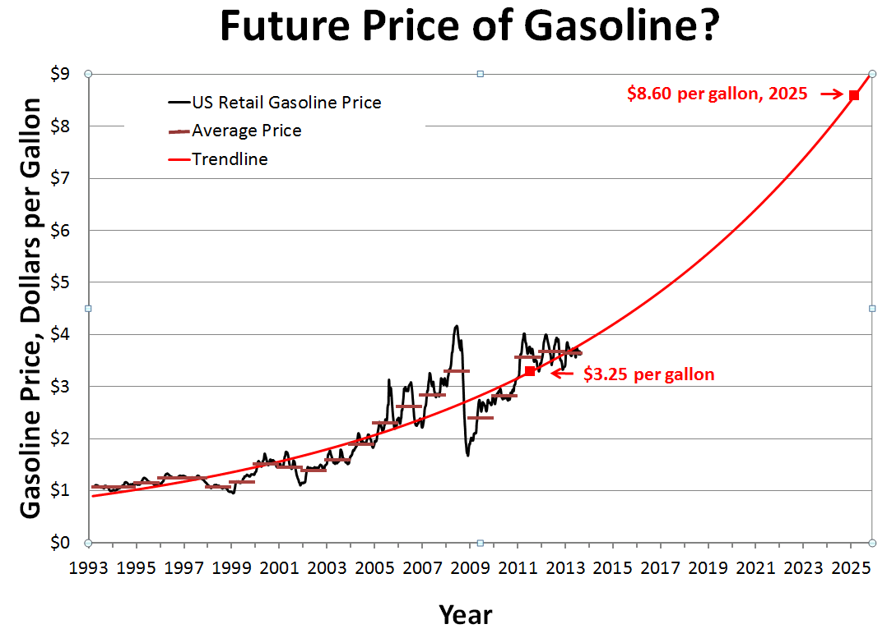
Notes:
Gasoline Cost 1996-2011.xls

Slide 26
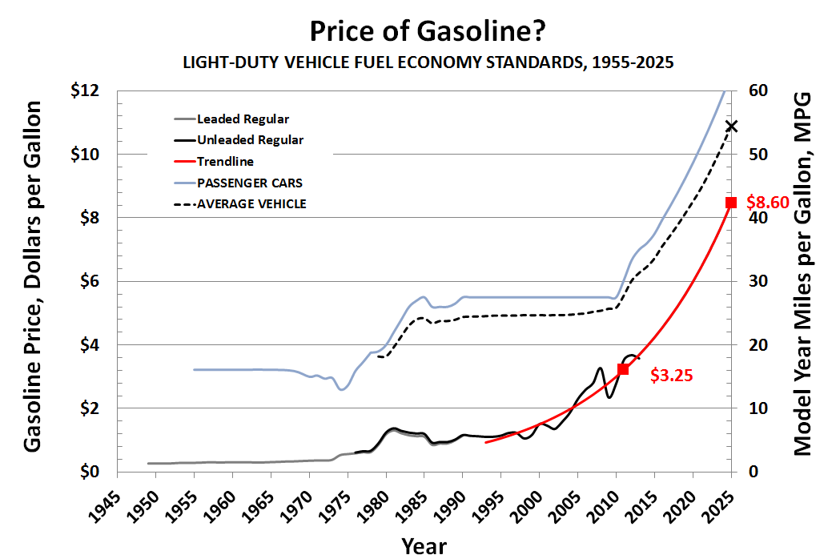

Slide 27
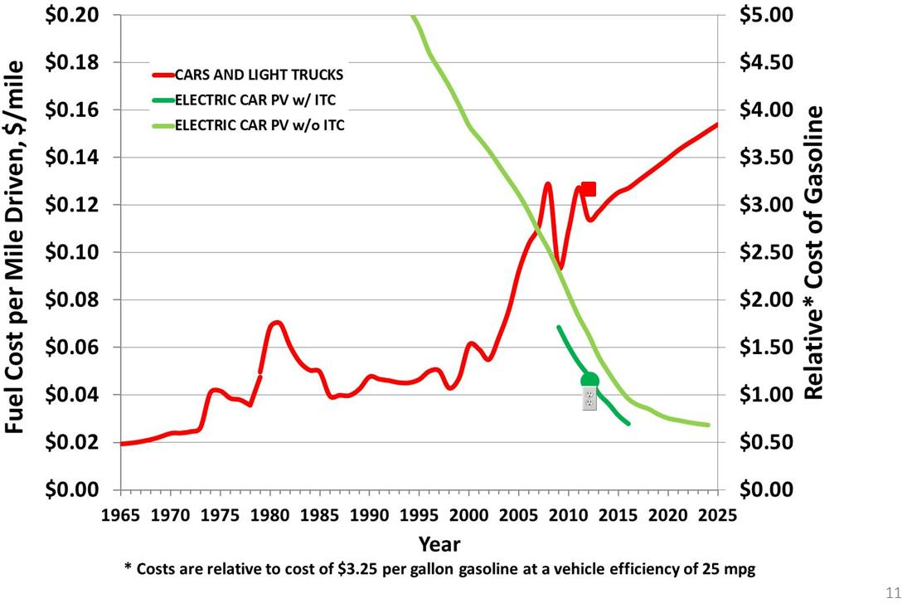
PV $1.08 a Gallon Today, Less than a $1 Tomorrow
Notes:
PV $1.08 a gallon today less than a $1 tomorrow!!! The red curve is a plot of the fuel cost per mile driven on the left side vertical axis in dollars per mile for the average miles per gallon model year car and light truck. You will recall that for gasoline cars we calculate the fuel cost per mile driven in dollars per mile by taking the cost of gasoline in that year divided by the average miles per gallon model year car and light truck of that year. The right side vertical axis shows the relative cost of gasoline, which is the cost relative to a cost of $3.25 per gallon gasoline at a vehicle efficiency of 25 mpg, for a given model year vehicle. The light green curve shows the fuel cost per mile driven for a residential PV system without the federal income tax credit installed at the same year as the purchase of a given model year electric car. The dark green curve is for a residential PV system with the federal income tax credit.
The red square shows todays 25 mpg car and $3.25 gasoline. The green circle shows todays electric car and your cost of the PV powerplant on your roof at a relative cost of gasoline of $1.08. The electric wall plate shows todays electric car and your purchase of electricity out of the wall in Florida.

Slide 28

We are like tenant farmers chopping down the fence around our house for fuel when we should be using Natures inexhaustible sources of energy......
...... I'd put my money on the sun and solar energy.
What a source of power! I hope we don't have to wait until oil and coal run out
before we tackle that. Thomas Edison (1931)
28
Notes:
28

Slide 29
