Slide 1
Training Opportunities for the Solar Workforce
Colleen McCann Kettles
Go SOLAR Fest
Fort Lauderdale, Florida
June 7, 2014

Slide 2
SunShot Soft Cost Reductions

Slide 3
US DOE Solar Instructor Training Network
Notes:
As part of a national effort, FSEC hosts the Southeast Provider of the US DOE Solar Instructor Training Network. SITN is a regionalized program of photovoltaic practitioner training. The Southeast Region uses a train the trainer approach.

Slide 4
Florida Solar Energy Training Providers
Notes:
In Florida alone, FSEC has prepared more than 25 state and community colleges, vocational-technical schools and high schools to provide instruction at the local level in solar energy technologies.

Slide 5
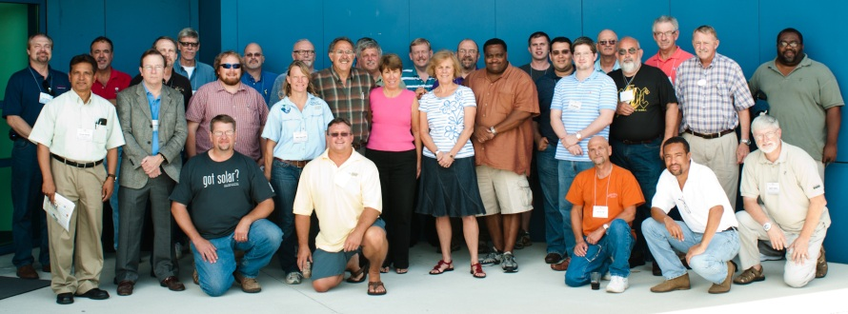
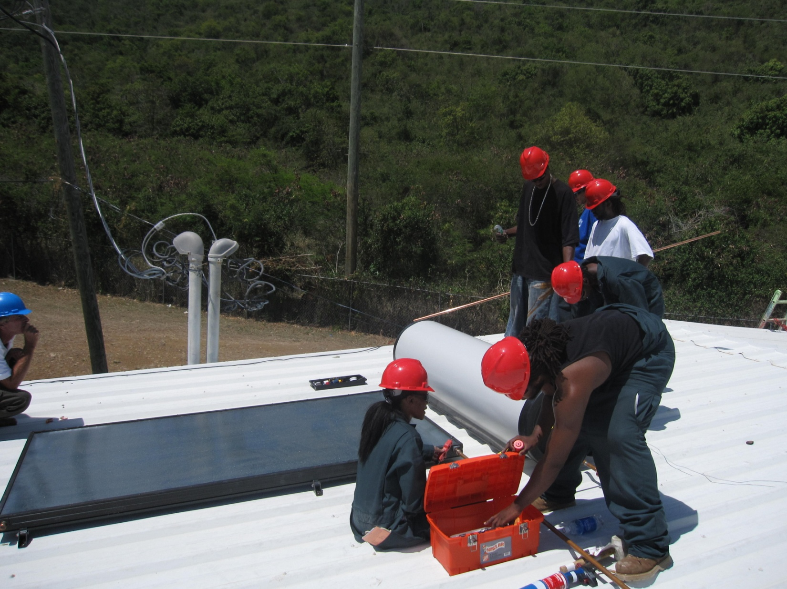
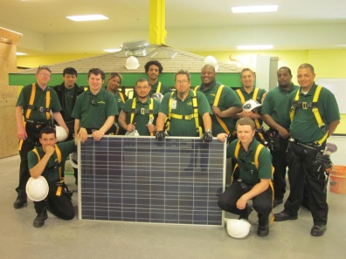
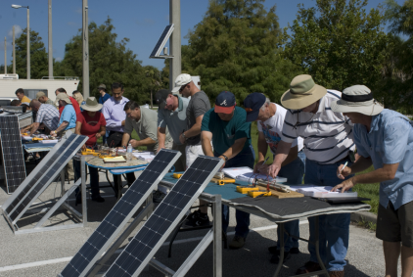
FSEC Solar Training Programs
Train-the-Trainer Workshops
Southeast Solar Training Program
5 year, $2 million DOE funded program
Trained 176 faculty from 67 SE institutions
Current emphasis is on quality control:
Training of building officials
NABCEP certification of instructors and providers
Efforts will integrate solar into other relevant curriculum
Training for faculty from Alabama, Arkansas, Florida, Georgia, Kentucky, Tennessee, Puerto Rico and the US Virgin Islands.

Slide 6
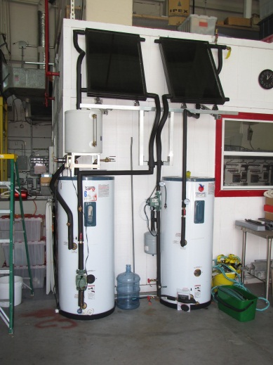
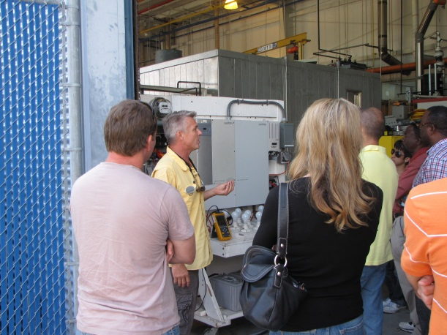
FSEC Solar Training Programs
FSEC Continuing Education Workshops
PV Systems (2,400 students since 2003)
Solar Water Heating Systems (400 students since 2008)
Workshop students engaged in hands-on laboratory experiences.

Slide 7
Let’s Get To Work!
Not so fast…
Notes:
Through the SITN, FSEC and its training partners have trained more than 500 students for entry into solar energy careers. But, the current job market will not support this influx.

Slide 8
Banner Center Internship Program
Partnership between the Banner Center for Clean Energy, Brevard Workforce, Florida solar industry
Identified highly skilled displaced aerospace workers who expressed an interest in pursuing energy careers or who had received training previously from the Banner Center or its partners
Notes:
So, here is our case study that has just been implemented. Banner Center Internship Program:
Piloted in Brevard County due to the retirement of the shuttle program and displacement of thousands of aerospace workers.
Transferability of space worker skills to energy career is very high (90+%).

Slide 9
Banner Center Internship Program
Applicants were screened and evaluated and put through a two day intensive PV workshop
Went to work with a local solar contractor using Adult Workforce Experience (AWE) program funds.
Installed 10 kW PV systems on schools throughout the East Coast and Central Florida
Provided an opportunity for employer and employees to gauge their skills and abilities and continued interest in this career path
Notes:
Hired by a local solar contractor who was involved in a large project that involved installing PV on 90 schools throughout the state. These are ground mounted systems so their training would prepare them for installation of small distributed systems as well as the larger scale solar farms that our utilities and others are deploying throughout the state. [Go Through Bullets]

Slide 10
Clean Energy Banner Center Internship Program
Notes:
Here they are going through their classroom training here at FSEC.

Slide 11
Clean Energy Banner Center Internship Program
Notes:
And here they are in the field getting their hands-on, on the job training. They are standing in front of their first completed installation.

Slide 12
Banner Center Internship Program
The goal was to secure permanent employment for those successfully completing the internships
The contractor hired two of the 18 workers to continue using OJT funds
Two additional workers were hired by another solar contractor
Five of the candidates found employment elsewhere, including one with a major IOU

Slide 13
Lessons Learned
Training programs should explore creative avenues for job placement
Partnerships with local workforce agencies are mutually beneficial
Program provided additional revenue to training provider
Training providers should confirm they are on the approved vendor list
Training will need to be for jobs that are on the Targeted Occupational List

Slide 14
Lessons Learned
OJT experience is mutually beneficial for the employer and employee
Serves as a proving ground and reality check
For the unemployed, even a brief opportunity to be back in the job market improves self esteem
Workers trained were equipped to pursue parallel career opportunities
Solar industry business models could benefit from a consolidated staffing approach

Slide 15
Florida’s Solar Energy Potential
Florida, “the sunshine state,” ranks third in the nation for solar potential
Florida’s solar policies lag behind many other states in the nation: it has no renewable portfolio standard and does not allow power purchase agreements, two policies that have driven investments in solar in other states.
Reference: www.seia.org

Slide 16
Facts on the Florida Solar Industry
There are currently more than 306 solar companies at work throughout the value chain in Florida, employing 4,000.
In 2013, Florida installed 26 MW of solar electric capacity, ranking it 18th nationally.
The 218 MW of solar energy currently installed in Florida ranks the state 12th in the country in installed solar capacity. There is enough solar energy installed in the state to power 25,100 homes.
In 2013, $81 million was invested in Florida to install solar for home, business and utility use.
Reference: www.seia.org

Slide 17
National Solar Jobs Census 2013
Prepared by The Solar Foundation
Available at: www.thesolarfoundation.org/research/national-solar-jobs-census-2013

Slide 18
National Solar Jobs Census 2013

Slide 19
State Solar Jobs 2013 Florida
4,000 Solar Jobs
Top 3 Solar Sectors By Employment
Installation
Manufacturing
Sales & Distribution
Solar Jobs Rank (Change Since 2012): 7 (+5)
Change In Solar Jobs Since 2012: +1500
Solar Jobs Per Capita Rank (Change Since 2012): 39 (-11)
Total Solar Companies: 309
Maximum Solar Resource Rank: 14 (5.49 Kwh/M²/Day)
Number Of Homes Powered By Solar Rank: 11 (~20299 Homes)
Electricity Price Rank (Most Expensive): 17
Legal Status Of Third-party Ownership: Not Allowed
Net Metering Policy Grade: B
Interconnection Policy Grade: D
Renewable Portfolio Standard (RPS) Target: N/A
RPS Solar Carve-out Target: N/A
http://thesolarfoundation.org/solarstates

Slide 20
Workforce Recommendations
Invest in solar workforce development
The majority of employers have some trouble finding qualified applicants to fill their positions. Most often to blame for these difficulties:
Lack of technical experience
Deficiencies in communication, problem solving and analytical skills, and education

Slide 21
Workforce Recommendations
While solar energy creates jobs across a wide variety of occupations and technologies, the majority of these jobs are for highly-skilled and highly trained workers.
50% of solar jobs require workers with previous experience
25% require at least a bachelor’s degree
13% require an associate’s degree or other certification from an accredited college.

Slide 22
Workforce Recommendations
Programs that stand to make the greatest impact on solar workforce development are:
Those that provide high-skilled workers with new or updated skills or experience, and;
Comprehensive entry-level programs (typically offered through technical high schools, community-based organizations, and community colleges) that prepare lower-skilled workers to move into more highly-skilled occupations.

Slide 23
Workforce Recommendations
Integrate solar curricula into more traditional or mainstream coursework
Cultivate a workforce with a set of solar skills that enhance a more broadly applicable set of core trade (e.g., roofing or electrical) or professional (e.g., legal or finance) skills
This will help ensure that program graduates are diverse enough to be successful, despite fluctuations in demand for some of their skills

Slide 24
Workforce Recommendations
Support high-quality training
There a direct connection between installed capacity and number of solar jobs, but there is also a direct connection between training and quality. Shoddy workmanship often results in high call-back frequency, which can narrow profit margins for companies.

Slide 25
Get On Board!

Slide 26
Contact Information
Colleen McCann Kettles, JD
Florida Solar Energy Center
1679 Clearlake Road
Cocoa, FL 32922
321-638-1004
ckettles@fsec.ucf.edu

