Slide 1
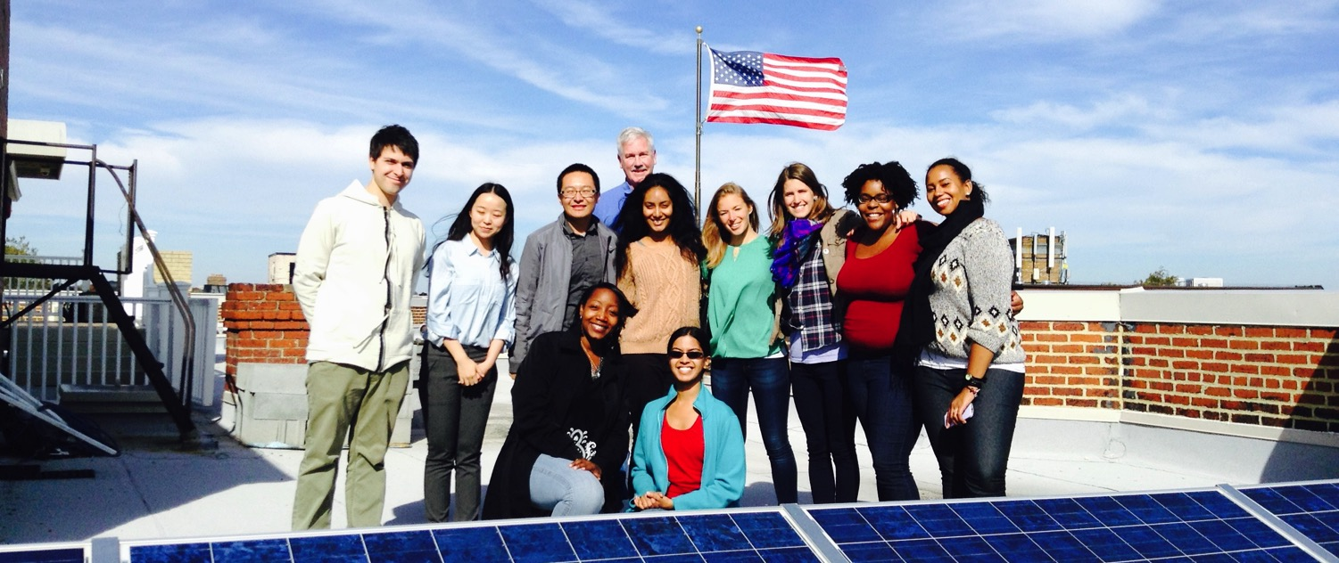
Go Solar Day

Slide 2
Overview
Who we are
How we got started
What we do
What are solar co-ops
FL Partners
Our end goals
www.flsun.org

Slide 3
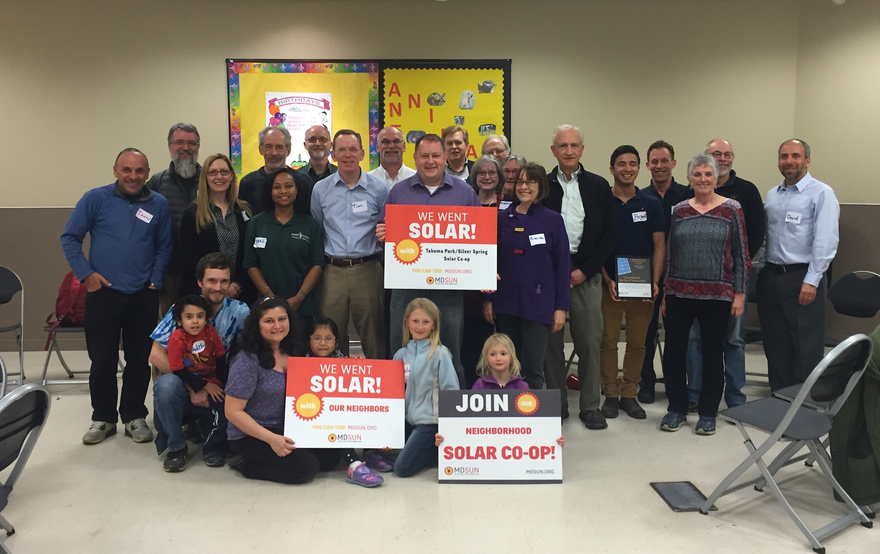
Who we are
We are a network of people taking control of our energy by installing solar and generating our own electricity.

Slide 4
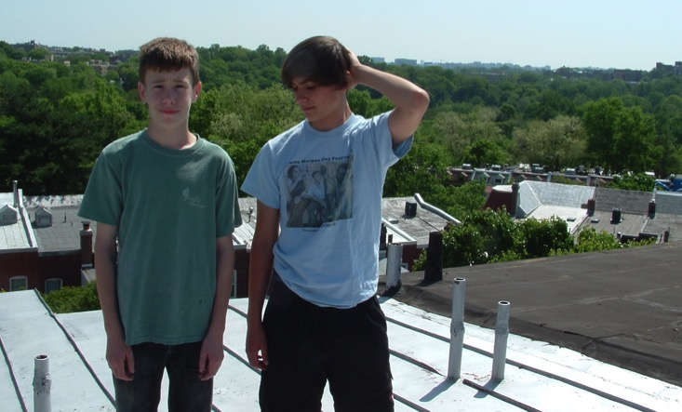
How we got started
Started in 2007
It wasn’t easy!

Slide 5
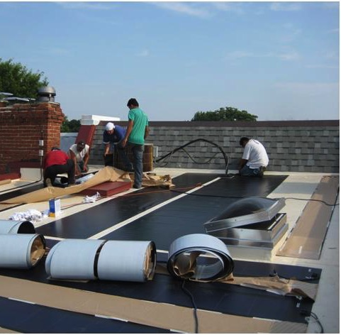
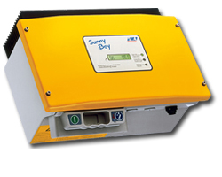
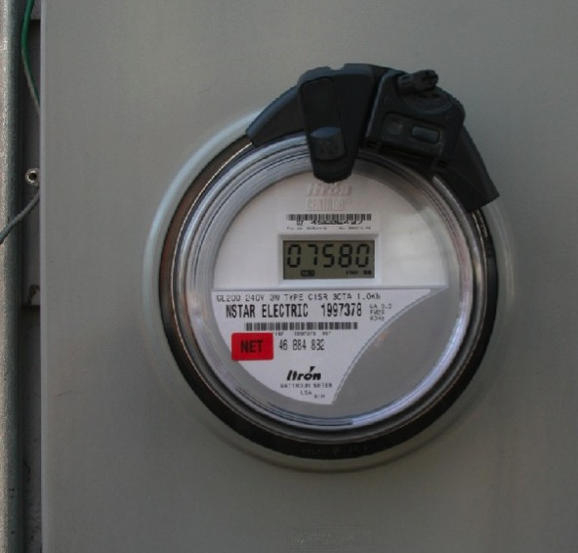
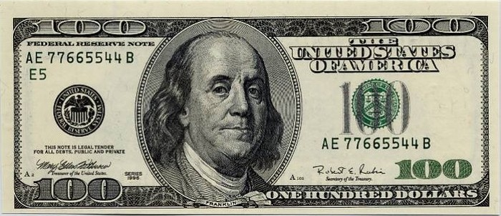
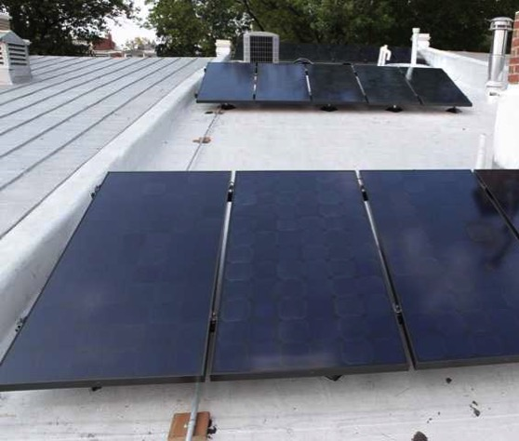
It was harder than we thought!
How we got started
Notes:
There were only two companies working in DC. They told us totally different things about how to install PV on our roof, and then there were the issues of Cost, equipment, taxes, regulations, rules, permits, meters, billing, historic association, SRECs, PSC

Slide 7
Helping communities go solar

Slide 8
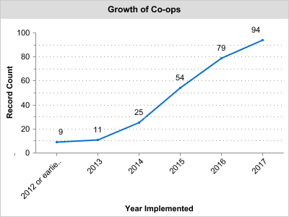
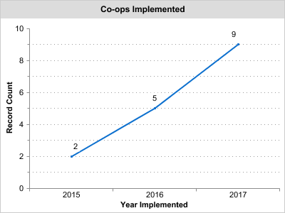
Co-op’s To Date
CPN and Florida

Slide 9
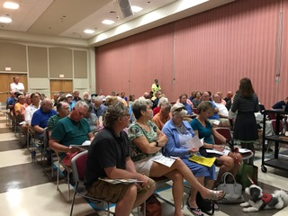
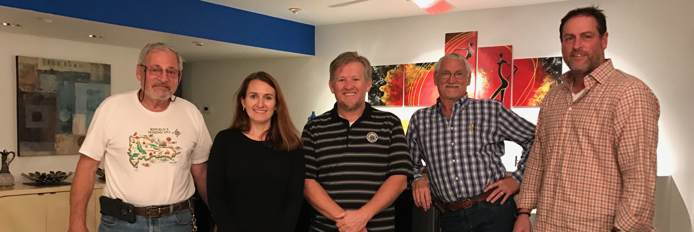
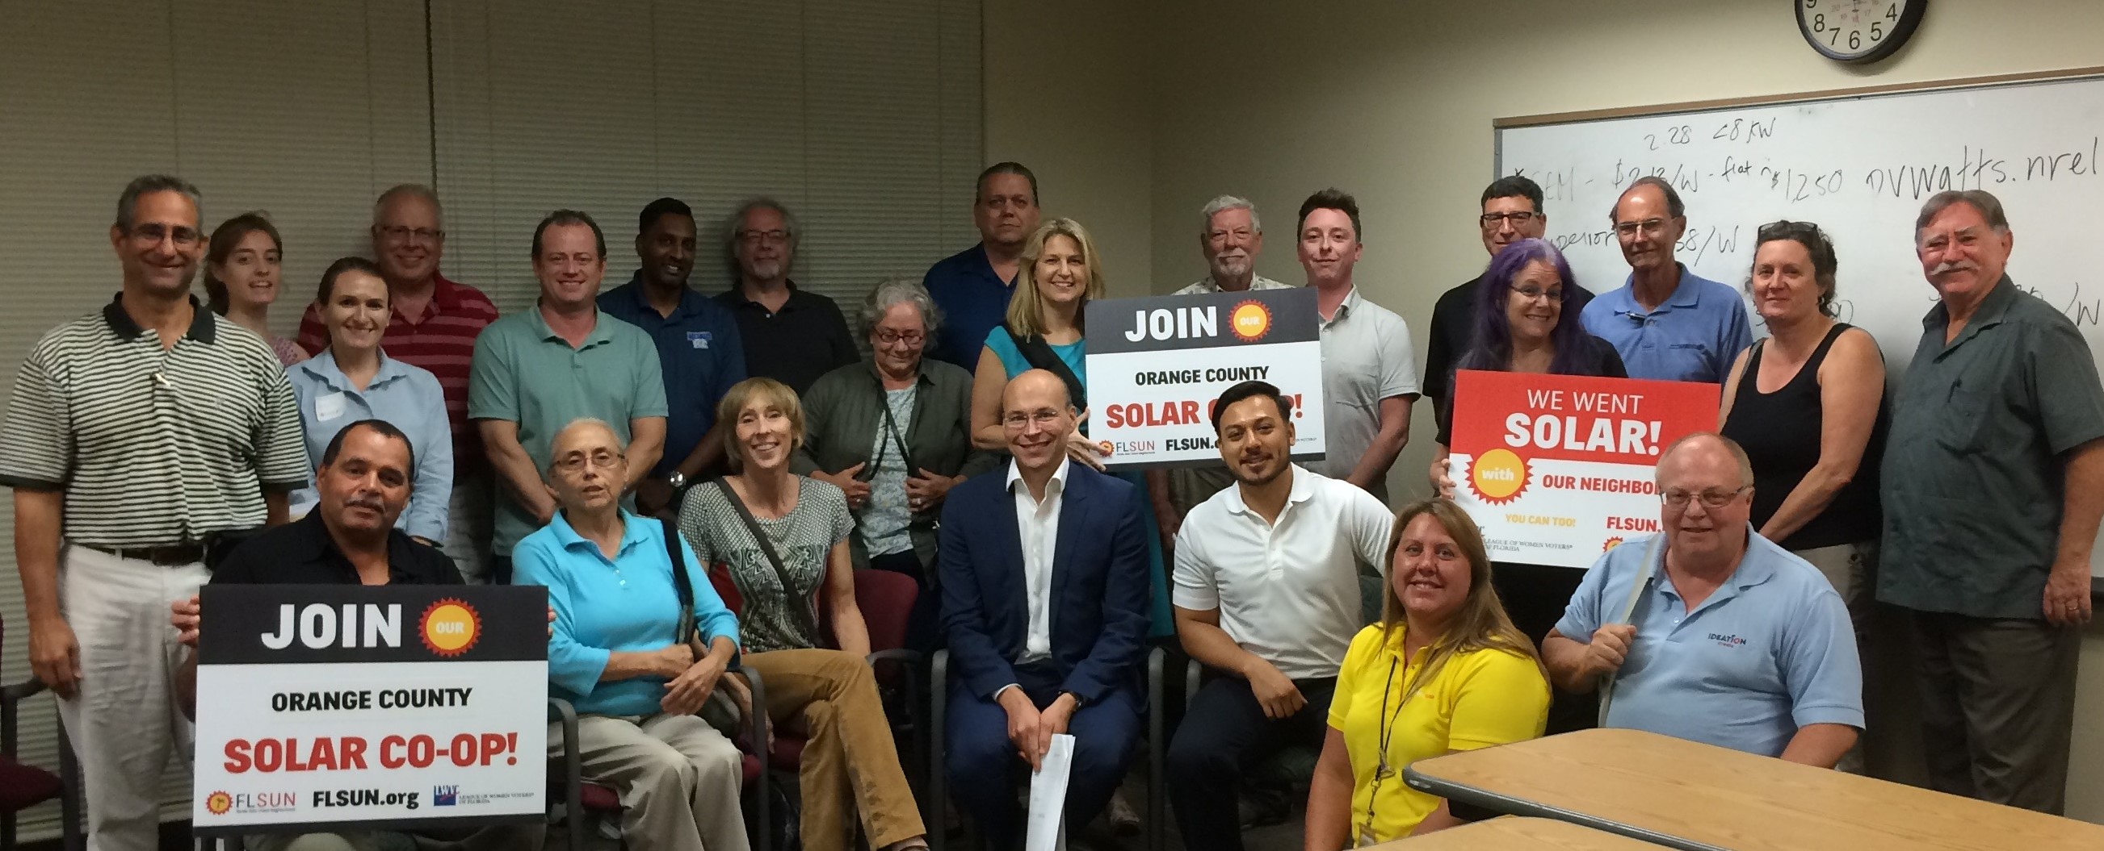
Number of Co-op Participants 11,656

Slide 10
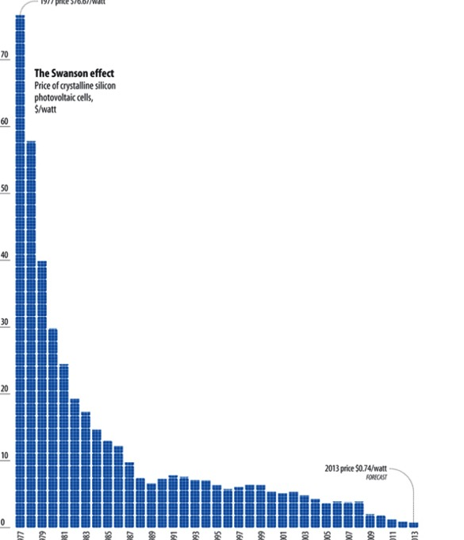
Solar economics
Solar in increasingly affordable
Costs have come down 90% since the 1970s
Solar is no longer a specialty, expensive or boutique project for a homeowner
But, can still be a daunting to tackle
1970’s 2013

Slide 11
How solar co-ops work

Slide 12
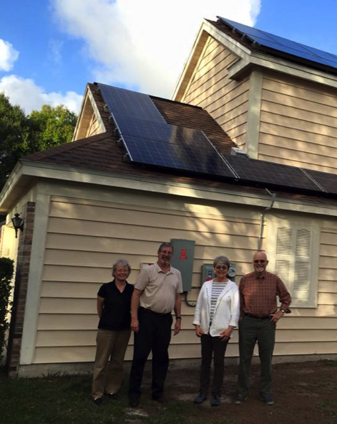
Co-op process
Benefits of co-ops
Save on cost of system (10-20%)
Get support of the group through the process
Connect with fellow solar enthusiasts
Become part of a growing solar movement

Slide 13
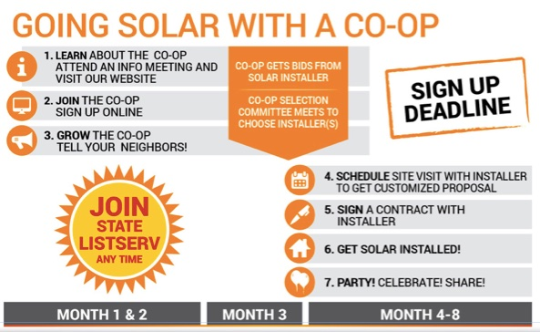
Solar Co-op Information Session
Co-op process
Notes:
Emphasize participants direct involvement & collaborative decision making/selection
Online sign-up process is non-binding but essential to build group size
Roof assessment process
to protect homeowners
avoid wasting people’s time
Yes / No / Maybe response
Satellite imagery sometimes out of date
20 to 30 signups w/ good roofs
Each RFP reflects interest of the group collectively
Selection process
Committee of volunteers
Group stays open after selection
Proposal & installation phase
Bi-lateral contracts between homeowner & installer
We’re an interested 3rd party that follows along to make sure things go smoothly
If you sign a contract we get $500 from installer
Contract sign to completed system time. Set expectations for your area and key milestones
Party! & connecting to larger network via listserv, newsletter, etc.

Slide 14
Co-op process
Who picks the installer? – Co-op members
When someone joins a co-op, they select specific installer criteria from some or all of the following:
Offer the best price
Use higher quality equipment
Have more experience
Offer stronger warranties
Are a local company
Other - Please describe

Slide 15
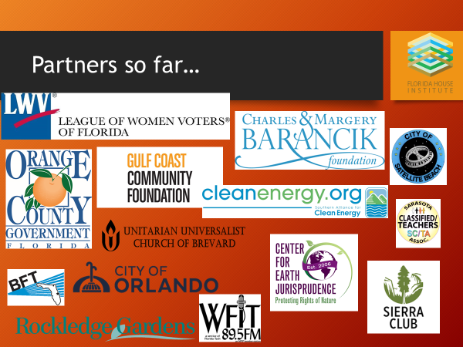

Slide 16
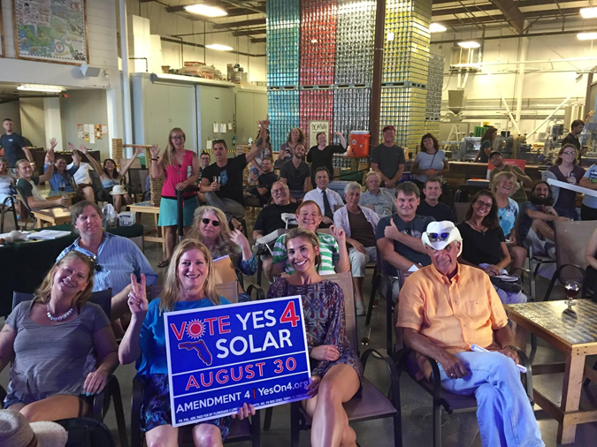
Our Goals
Expand solar in Florida
Grow a solar movement in Florida
Newsletter sign-up on FLSUN.org
Join the Listserv
Tell your friends and neighbors

Slide 17
Thank You!
Angela DeMonbreun
FL Sun Program Director

