Slide 1
Solar in Broward County, Florida

Slide 2
Broward’s Go SOLAR Program: Lessons Learned, Accomplishments and Future Direction
Bertha Henry, Broward County Administrator
Armando Linares
Deputy Director,
Environmental Protection & Growth
Management Department

Slide 3
U.S. Environmental Protection Agency and Renewable Energy
Bryan M. Myers
Region 4 Energy and Climate Change Coordinator
U.S. Environmental Protection Agency

Slide 4
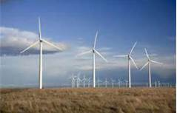
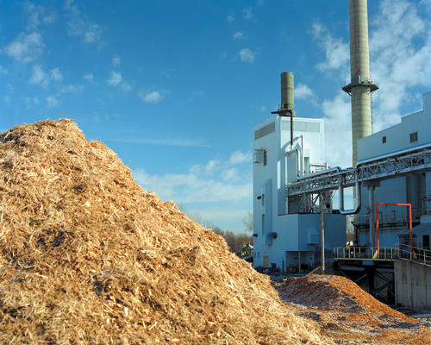
EPA and Renewable Energy
Presentation to the Go SOLAR Fest
January 25, 2013
Bryan Myers
U.S. Environmental Protection Agency
Atlanta, Georgia

Slide 5
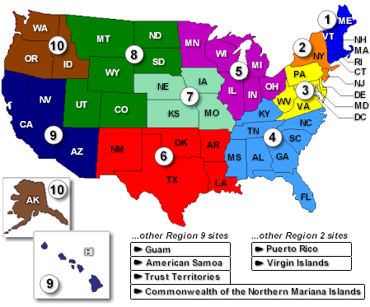
U.S. EPA and Clean Energy
EPA’s mission is to protect human health and the environment
All media (air, water, land)
Through standards, monitoring, mitigation, economics
Through regulatory and voluntary programs
EPA is working with U.S. Departments of State, Transportation, Energy, and Agriculture to mitigate GHG emissions
www.epa.gov/cleanenergy

Slide 6
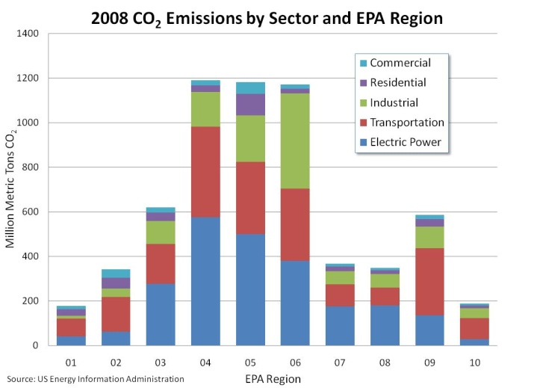
Home to 20% of the U.S. population
We generated about 24% of electricity in U.S. in 2009
Responsible for about 24% of U.S. power production CO₂ emissions in 2009
Region 4 industries emitted 34% of all U.S. air emissions reported to TRI (41% of those emissions are from EGUs)
Region 4 has 4,210 of the 20,904 U.S. facilities reporting to TRI (20%)
We use more fuel and drive more miles than any other Region
Energy Information Administration (2008 and 2009), Federal Highways Administration (2008), U.S. Census Bureau (2010), EPA Toxic Release Inventory Program (2010)

Slide 7
Importance of Clean Energy
Clean energy refers to lower emitting power technologies, including energy efficiency, renewable energy, natural gas, nuclear power, and coal with carbon capture and storage (CCS)
Beyond lower emissions, clean energy may offer co-benefits, including:
lower demand for cooling water and other finite resources
reduced exposure to fuel price volatility
enhanced national energy security
economic benefits such as job creation and technology development
Distributed clean energy also helps reduce peak electrical demand and grid congestion

Slide 8
US Ene

Slide 9
Renewable Fuels Standard (RFS2)
Lifecycle GHG Thresholds Specified in EISA
(percent reduction from 2005 baseline for gasoline and diesel)
Renewable fuel* | 20%
Advanced biofuel | 50%
Biomass-based diesel | 50%
Cellulosic biofuel | 60%
Revision to current RFS (RFS1) as required by the Energy Independence and Security Act (EISA)
Significant increase in renewable fuels to displace petroleum consumption (36 billion gallons by 2022)
Requires GHG lifecycle analysis
Original Rule published 3/26/10
On 1/9/12, EPA published the volume requirements and associated percentage standards that apply in calendar year 2012
On 11/16/12, EPA denied requests for the waiver of the renewable fuel standard
*The 20% criterion generally applies to renewable fuel from new facilities that commenced construction after December 19, 2007.
http://www.epa.gov/otaq/fuels/renewablefuels/index.htm

Slide 10
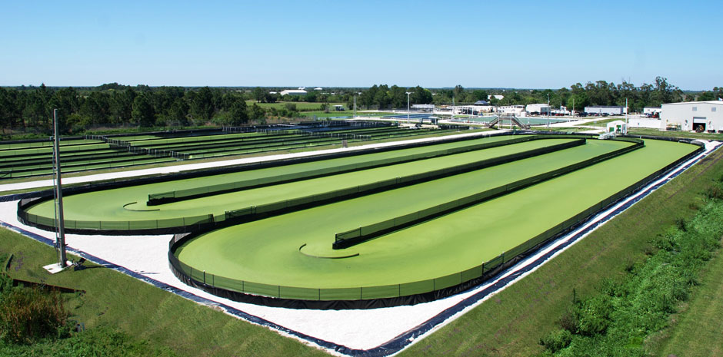
GHG Reporting for Biomass Facilities
Parabel micro-crop facility in Fellsmere, Florida
Green Circle BioEnergy Facility in Cottondale, Florida

Slide 11
State Implementation Plans
A State Implementation Plan (SIP) is a plan developed by a state air pollution agency showing how that state will comply with the requirements of the federal Clean Air Act. The SIP consists of narrative, rules, technical documentation, and agreements that an individual state will use to meet National Ambient Air Quality Standards.
On July 3, 2012, the U.S. Environmental Protection Agency (EPA) released the first version of the “Roadmap for Incorporating Energy Efficiency and Renewable Energy (EE/RE) Policies and Programs in State Implementation Plans (SIPs) and Tribal Implementation Plans (TIPs).”
The Roadmap will help air agencies estimate and account for emission reductions from EE and RE policies and programs in their Clean Air Act plans to improve air quality (SIPs and TIPs). EE/RE policies and programs offer the potential to achieve emission reductions at a cost that can be lower than traditional control measures.

Slide 12
State and Local Climate and Energy Program
EPA's State and Local Climate and Energy Program provides technical assistance,
analytical tools, and outreach support to state, local and tribal governments.
Examples of Tools & Resources @ www.epa.gov/statelocalclimate/
● Local Government Climate and Energy Strategy Series
Overview of greenhouse gas (GHG) emissions reduction strategies that local governments can use to achieve economic, environmental, social, and human health benefits. The series covers energy efficiency, transportation, community planning and design, solid waste and materials management, and renewable energy.
● Clean Energy Financing Programs/Financing Program Decision Tool
This EPA tool helps state and local government staff identify clean energy financing programs suited to their target market and available resources. It is an ideal place to start designing or revising a clean energy financing program.
● EPA’s Climate Showcase Communities Program
Program helps local governments and tribal nations pilot innovative, cost-effective and replicable community-based greenhouse gas reduction projects. Fifty Climate Showcase Communities across the United States are leading projects in energy production, residential and commercial energy efficiency, waste management, transportation and land use that reduce energy use and save money.

Slide 13
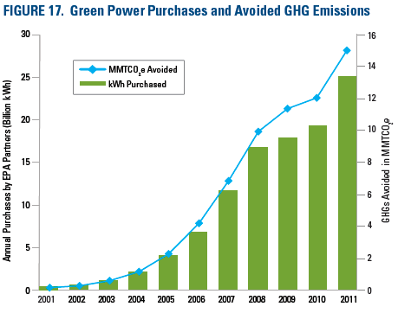
Green Power Partnership (GPP)
www.epa.gov/greenpower
EPA’s Green Power Partnership is a voluntary program that encourages organizations to buy green power to reduce the environmental
impacts associated with purchased electricity use, while demonstrating environmental leadership.
As of 2011, nearly 1300 organizations committed to buying about 25 billion kWh of green power annually—enough electricity to run more than two million average American homes for one year
Webinar - "Market Outlook and Innovations in Wind and Solar Power" Tuesday, February 12, 2013 1:00-2:00 pm (EST)

Slide 14
RE–Powering America's Lands

Slide 15
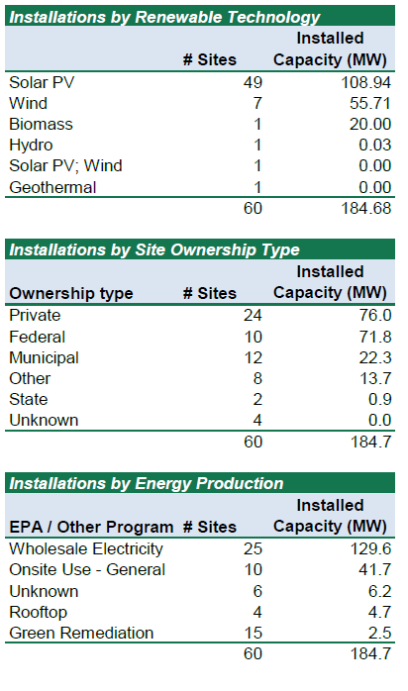
RE–Powering America's Lands
“In 2010, SunPower completed construction of the
10 MW Exelon City Solar project in Chicago, a project that
transformed a 41-acre former industrial property that had been
vacant for more than 30 years into a source of reliable, emission
free energy and pride for the community. As well as adding
renewable energy to the grid at peak demand hours, the project
enhanced the neighboring community by creating more than 200
construction jobs, using locally sourced steel tubing and other
construction materials, beautifying a brownfield sites, and improving
safety for local residents.”
Tom Werner, CEO
SunPower Corporation
www.epa.gov/renewableenergyland/

Slide 16
Landfill Methane Outreach Program (LMOP)
LMOP is a voluntary assistance and partnership program that promotes the use of landfill gas as a renewable, green energy source. By preventing emissions of methane through the development of landfill gas energy projects, LMOP helps businesses, states, energy providers, and communities protect the environment and build a sustainable future.
The more than 500 currently operational LFG energy projects provide greenhouse gas reduction benefits that are equivalent to the Carbon sequestered annually by nearly 20 million acres of pine or fir forests.
These projects also provide enough energy to power more than 940,000 homes and heat more than 722,000 homes annually.
.
www.epa.gov/lmop/

Slide 17
AgStar
● Through the AgSTAR Program, EPA partners with the U.S. Department of Agriculture (USDA) to
collaborate with the nation’s agriculture industry to reduce methane emissions by promoting the
use of biogas recovery systems to manage animal waste.
● EPA offers an array of tools and information designed to assist livestock producers in evaluating
and implementing methane recovery systems.
● Currently, there are more than 200 manure digester systems operating or under construction in
the U.S.
● Biogas recovery systems help reduce GHG emissions reduce local water and air pollution, act as
a source of renewable energy, provide rural economic development, better manage nutrients,
and generate other value-added products (e.g.,manure fibers) that improve farm revenues.
www.epa.gov/agstar

Slide 18
Examples of State Policies to Support Renewable Energy
Renewable Portfolio Standards (RPS)
Public Benefits Funds for Renewable Energy
Output-Based Environmental Regulations
Interconnection Standards
Net Metering
Feed-In Tariffs
Property Assessed Clean Energy (PACE)
Financial Incentives – www.dsireusa.org

Slide 19
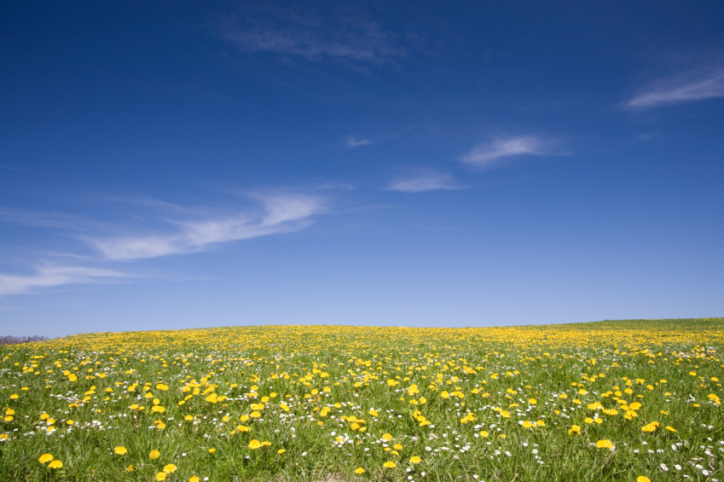
Questions?
Bryan Myers
Myers.Bryan@epa.gov
404-562-9603

Slide 20
Local Banks are Investing in Solar Energy
Bob Powell
Regional Vice President of TD Bank

Slide 21
TD Bank – Becoming as “Green” as our Logo
Bob Powell
Regional Vice President – Broward County
January 25, 2013

Slide 22
Net Zero Store – Cypress Creek & Andrews Ave
Front View of the Store

Slide 23
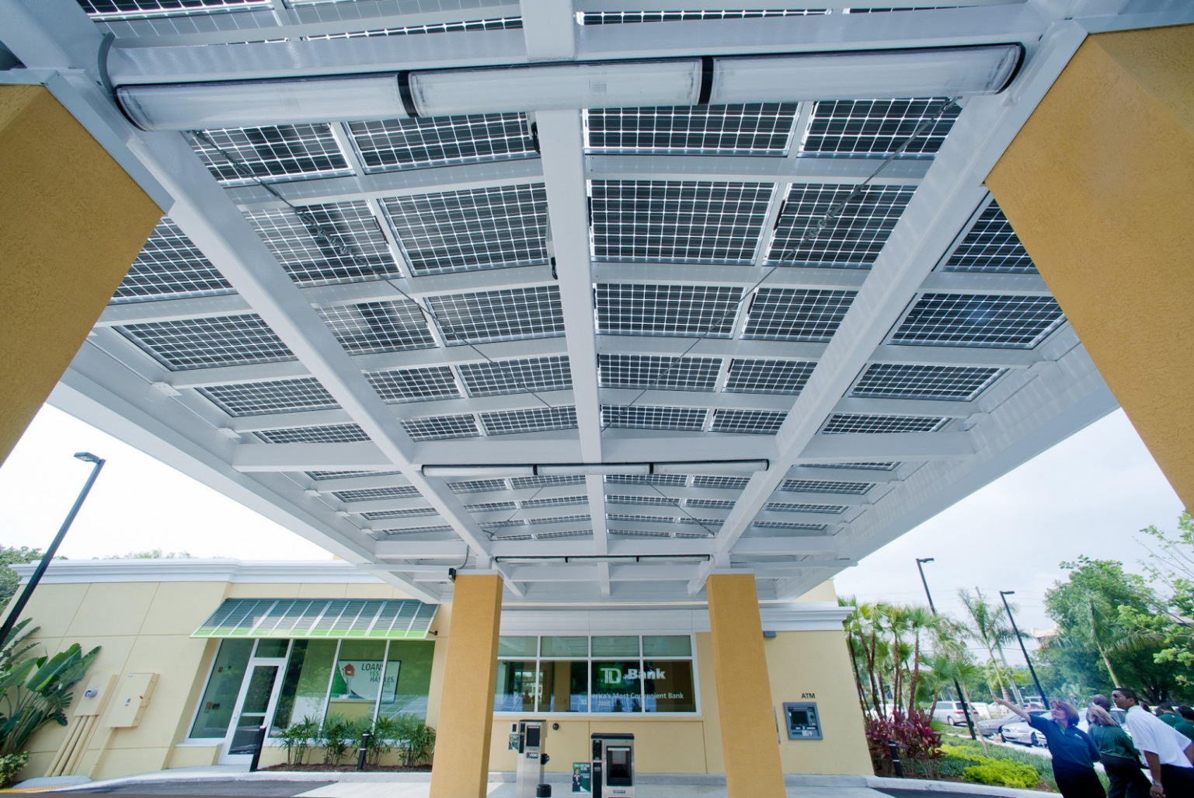
Net Zero Store – Cypress Creek & Andrews Ave
Underneath View of the Drive-Thru

Slide 24
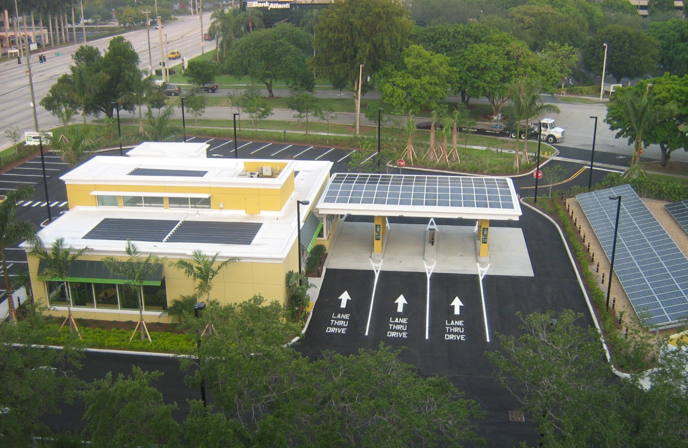
Net Zero Store – Cypress Creek & Andrews Ave
Aerial View of the Store

Slide 25
Local Banks are Investing in Solar Energy
Allysa Wetcher
PNC Bank Manager of New
Net-Zero Branch in Broward County

Slide 26
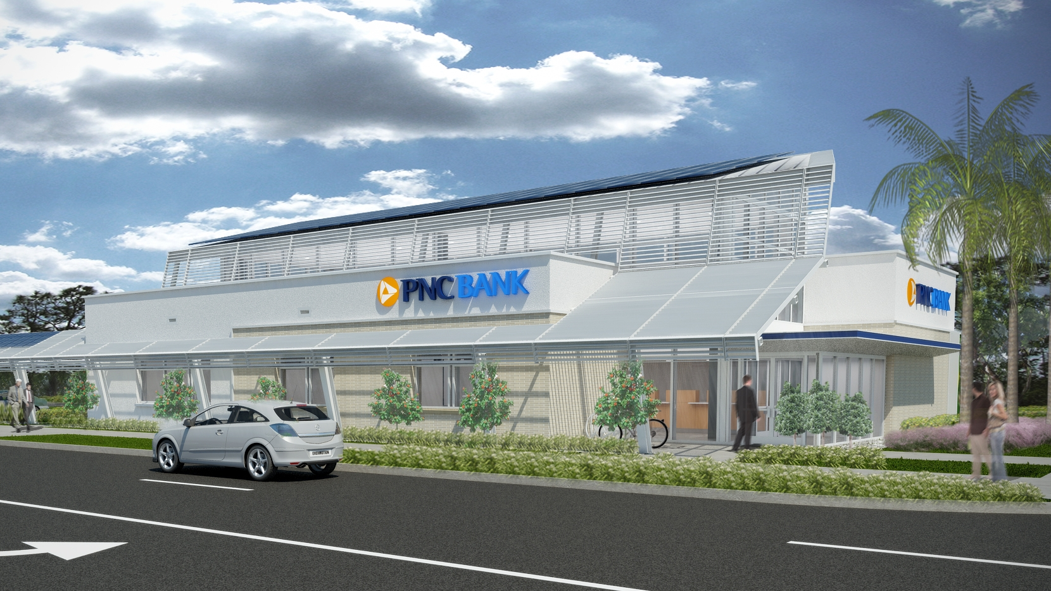
PNC Bank Net Positive Branch on Davie Blvd & Andrews Ave, Ft Lauderdale
Allysa Wetcher, VP Branch Manager

Slide 27
Achieving Net Positive
PNC expects its new net-zero energy bank branch to exceed LEED® Platinum certification and to produce more energy than it consumes. PNC collaborated with Gensler and the Department of Energy as part of the DOE’s Net-Zero Energy Commercial Building Initiative to create a branch that is 50 percent more efficient than the typical bank branch. Upon completion, the branch will feature 211 solar panels, a riverfront walking path for the public, paving designed to reduce rainwater runoff, high-efficiency LED lights and Energy Star® appliances.
Some net-zero elements are being incorporated in the next generation of PNC’s green buildings, including 12 branches that are currently in the design phase.

Slide 28
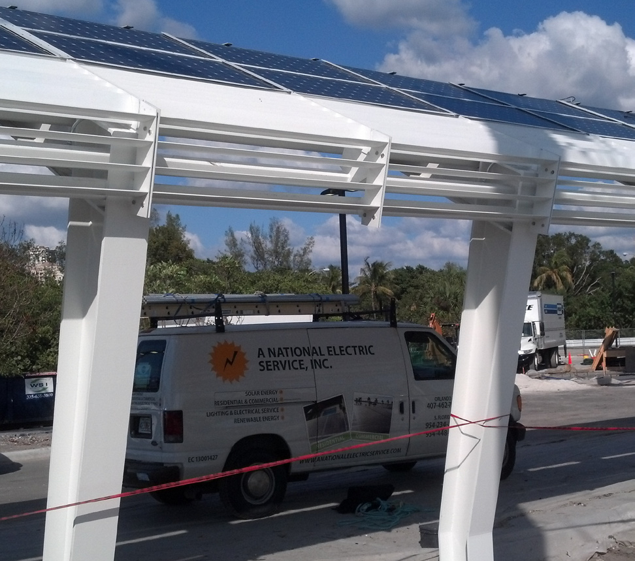
A NATIONAL SOLAR, LLC
“We’re the team that will save you green”

Slide 29
Green Technology
ENERGY SAVINGS: PNC expects to produce an estimated 84,000 kWh/yr while only consuming 78,000 kWh/yr.
DAYLIGHT HARVESTING: The branch will be powered by the sun using the most efficient photovoltaic (solar) panels on the commercial market. Daylight harvesting will be achieved through the use of sensors that control dimmable light fixtures as natural sunlight increases.
DIRECT CURRENT (DC) POWER: Solar panels will send energy from the sun to a direct current (DC) ceiling grid system that powers high-efficient, LED interior lighting. This direct transfer of energy prevents the energy loss that accompanies the power-consuming conversion to alternating current (AC).
OCCUPANCY SENSORS: Occupancy sensors will prompt lights and computer monitors to shut off automatically in unoccupied spaces.
ENERGY RECOVERY VENTILATION: This system captures and transfers energy from conditioned air as it exits the building to fresh air as it enters the building and results in reduced cooling costs.
LOW-VOC CARPET AND PAINT: PNC will use flooring, walls, paint and adhesives made with materials that contribute to healthy indoor air quality.
RECYCLED MATERIALS: PNC is using local and recycled building resources for structural and shell materials, as well as finishes. 98 percent of deconstructed building materials will be diverted from landfills.
Landscaping & Environment
NATIVE PLANTS & BIOSWALE: The landscape design is composed of native Florida species, minimizing irrigation needs. Natural drainage channels lined with plants will filter out pollutants and permit ground absorption, thus diverting 90 percent of site stormwater from municipal sewer systems.
RIVERFRONT PATH: A riverfront walking path with indigenous plants surrounds the site and is available to the local community.
GREEN SCREEN: This 216 square foot vertical garden will feature various plant species that adorn the building’s façade.

Slide 30
Green Milestones
PNC was the first major U.S. bank to apply green building standards to all new projects and has more newly constructed LEED-certified buildings (119) than any company on Earth. PNC opened its first green building in 2000, at which time the 650,000 square foot PNC Firstside Center on Pittsburgh’s First Avenue was the largest LEED-certified building in the world. In 2009, PNC opened Pittsburgh’s Three PNC Plaza, one of the largest LEED-certified, mixed-use buildings in the United States. PNC’s most recently constructed green office building is LEED-certified PNC Place, which sits just blocks from the White House and serves as PNC’s regional headquarters in the capital. The Tower at PNC Plaza, which is scheduled to open in 2015, will serve as PNC’s Pittsburgh headquarters and is expected to be the greenest skyscraper in the world.

Slide 31
Q&A
Allysa Wetcher, VP Branch Manager
1153 S Andrews Ave, Ft Lauderdale, Fl 33316
954-523-1530

