Slide 1

Financing, Net Metering, Solar Rights and Insurance Session

Slide 2
Net Metering, Interconnection and
Solar Rebates
John McComb
Customer Technology Support
Florida Power & Light

Slide 3
GO SOLAR Fest
FPL Customer Service
Customer Technology Support
John McComb, P.E., E.C.
Jan. 25, 2013

Slide 4
Agenda
The FPSC Net Metering rule
Net Metering Example
Net Metering Interconnection Requirements
Net Metering Customers
FPL Contact Information

Slide 5
FPSC Rule 25-6.065: Interconnection and Net Metering of Customer-Owned Renewable Generation
The Public Service Commission of Florida sets forth the requirements for interconnecting a renewable energy source
The rule:
  Sets forth the conditions required for a renewable energy source to be interconnected with the local utility safely through the customer’s internal wiring
  Requires an interconnection agreement between the customer and the utility
  Defines Net Metering as a metering and billing methodology whereby customer-owned renewable generation is allowed to offset the customer’s electricity on-site
All retail rate customers are eligible it interconnect once they satisfy the program requirements found at www.FPL.com/netmetering

Slide 6
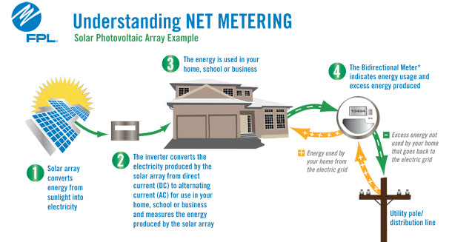
Net metering measures both energy used from the grid and excess energy produced that is sent to the grid
FPL’s meter only measures the “excess energy” sent to the grid, not the total energy produced by the PV system

Slide 7
Net Metering Interconnection Agreement
All renewable energy systems connected to the grid require an interconnection agreement
An agreement between FPL and a customer, allowing the customer to safely interconnect a renewable energy system to the grid through internal wiring
The Interconnection Agreement has different requirements dependent upon the system (tier) size
  Tier 1 – 0 kW to 10 kW AC
  Tier 2 – Larger than 10 kW to 100 kW AC
  Tier 3 – Larger than 100 kW to 2,000 kW AC
All retail rate customers are eligible it interconnect once they satisfy the program requirements found at www.FPL.com/netmetering

Slide 8
Interconnection Agreement – Tier 1 Requirements
The majority of renewable energy systems meet the Tier 1 requirements
To approve the system to be energized, FPL must have copies of:
  Application
    This document includes customer and system information necessary to approve the interconnection agreement
  Completed Interconnection Agreement
    An agreement between FPL and a customer, allowing the customer to safely interconnect a renewable energy source to the grid through internal wiring
  Building Permit approving the installation of the renewable energy system. This permit must be signed by the local Authority Having Jurisdiction (AHJ)
Tier 2 and Tier 3 have additional requirements for insurance and a safety disconnect switch

Slide 9
FPL has renewable energy customers throughout its service area
Interconnected Customers as of Jan. 15, 2013
Broward FPL
  Residential
  Customers 146 1,710
    kW 870 9,666
  Commercial
  Customers 65 456
    kW 1,555 9,795

Slide 10
You can contact FPL by email, phone or fax if you have questions on net metering or solar rebates
Contact Information
www.FPL.com/netmetering
  Agreements, application and instructions
www.FPL.com/solarrebates
  Solar rebate reservation information
E-mail: netmetering@fpl.com
SolarPVSupport@fpl.com
Phone: (305) 387-6614 - Net Metering
      (800) Dial FPL - Solar Rebates
(305) 552-2275 - Net Metering FAX

Slide 11
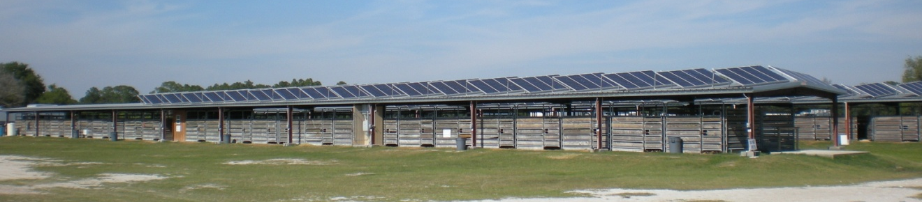
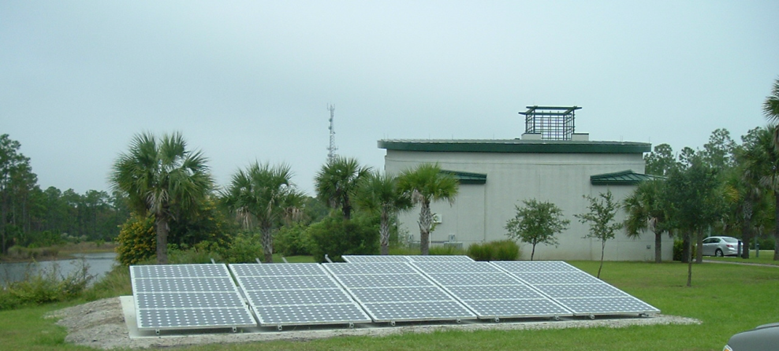
Thank you

Slide 12
Florida Power & Light’s Financial
Incentives and Rebates
Joe Acquaviva
Supervisor, Build Smart & Solar Programs
Florida Power & Light

Slide 13

FPL’s Solar Rebate Program

Slide 14
FPL offers solar rebate programs for customers who install solar photovoltaic (PV) and solar water heating systems in their homes and businesses
FPL’s Solar Rebate Programs
FPL’s solar rebates are part of a five-year pilot program authorized by the Florida Public Service Commission to promote clean solar power and reduce energy consumption
Rebates are limited and will be available on a first-come-first-served basis
Any system components installed prior to FPL’s issuance of a rebate reservation will not qualify for the rebate
Notes:
Welcome and short description of each topic
14

Slide 15
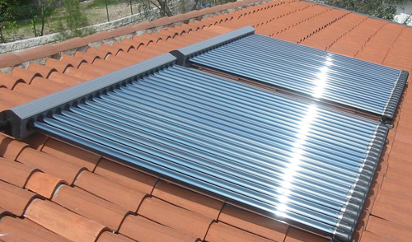

There are four rebate programs that are available to customers
Solar Pilot Portfolio Overview
Solar Water Heating
RESIDENTIAL REBATES | BUSINESS REBATES
Solar Photovoltaics
RESIDENTIAL REBATES | BUSINESS REBATES
Notes:
Portfolio has 7 programs,
6 resulting in customer owned installations of solar water heating and PV
1 that allows FPL to demonstrate, educate and evaluate emerging renewable technologies
The incentive programs are focused on the 2 technologies identified by the FPSC : Solar Water Heating and Solar PV
The Renewable Research and Demonstration project
Allows FPL educate and create awareness around the applicability of these technologies.
Makes sure that FPL is ahead of technology curve and has reliable performance data on new technologies.
Total budget cap of approximately $2.5 MM over 5 years
FPL led a collaboration with TECO, Gulf and Progress that led to consistency across the solar portfolios
Most incentive programs offered are the same, the only exception is that FPL is only utility with business solar water heating
Florida rebate information showed FPL business customers installing SWH
Incentive structures are similar
Differences in budget allocations stem primarily from differences in the limitations on overall pilot funds. Gulf and Teco very small budgets.
FPSC staff trying to investigate and achieve more consistency of allocations across utilities without a formal workshop.
15

Slide 16
FPL is offering new rebate programs for customers who install solar photovoltaic and solar water heating systems in their homes and businesses
Residential Solar Water Heating $1000 per installed solar water heater. One rebate per premise* for the life of the program | Business Solar Water Heating $30 per 1,000 BTUh/day of the maximum rated output of the installed system; $50,000 maximum rebate amount per premise* for the life of the program (Customers with multiple premises* can receive a maximum combined rebate for their premises* of up to $150,000 per funding year)
Residential PV $2 per watt of the direct current (DC) rating of the solar panels of a PV system , with maximum rebate of $20,000 per premise.* One rebate per premise* for the life of the program | Business PV Variable rebate depending on the direct current (DC) rating of the solar panels: $2 per watt for the first 10 kilowatts, $1.50 per DC watt 10 kW up to 25 kW, and $1 per DC watt greater than 25 kW. Up to $50,000 per premise* for the life of the program (Customers with multiple premises* can receive a maximum combined rebate for their premises* of up to $150,000 per funding year)
*A premise is defined as a dwelling or business under the control of a single customer where electric utility service terminates. Separate buildings and adjoining buildings in a group of buildings, which have separate FPL electric service, and contain separate dwellings or businesses, are separate premises.

Slide 17
Get ready
You will need to log-in to your account on www.FPL.com in order to apply for this program,
If you are not registered with FPL you will need to register for online access
Mark your calendar to go to www.FPL.com/solarrebates
    You will be prompted to log-in using the username and password that you created for online access to your account
2014 funds will be available in October, 2013, date and time is TBD

Slide 18
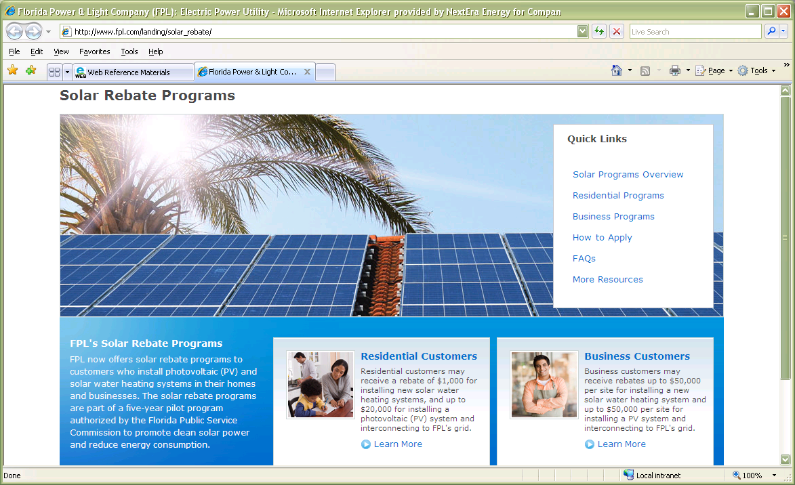
Get set and go
Go to www.FPL.com/solarrebates
Select the program you’ll be applying for

Slide 19
PV Checklist
The FPL Rebate Certificate with the FPL customer’s signature.(can be downloaded at www.FPL.com/solarrebates )
A signed purchase agreement contract for the purpose of the photovoltaic system
A document showing the anticipated annual electric production of the proposed system using the PVWatts-1 calculation
Digital photos of the installation
Digital photos panel nameplate(s) (sticker located behind the panel that specifies the wattage of the panel)
A copy of the contractor’s invoice
Net-metering application
A signed Net Metering Interconnection agreement
A copy of the final passed permit, indicating the date the permit was applied for and the date it passed inspection. Permit issued date must be after reservation approval date
If your PV system is Tier 2 or 3, proof of insurance

Slide 20
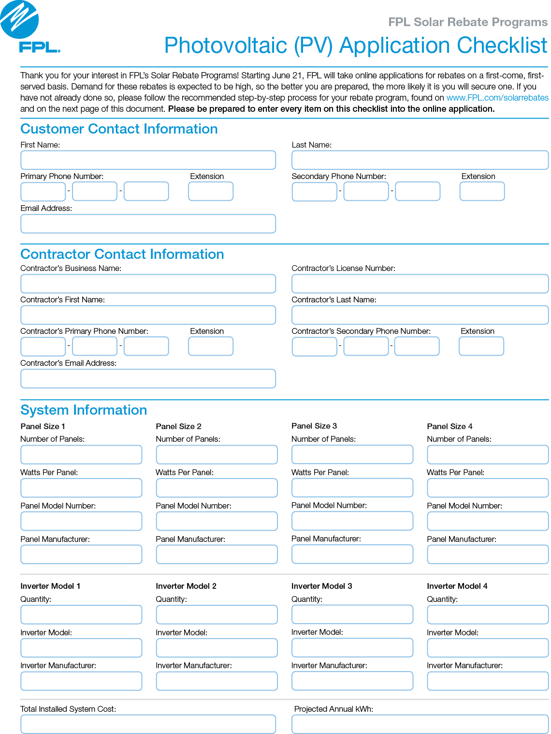
PV Checklist

Slide 21
Solar Water Heating Checklist
The FPL Rebate Certificate with the customer’s signature;
A signed purchase agreement contract for the purchase of the solar water heating system;
Digital photos of the installation
Digital photos of the solar collector nameplate(s);
A copy of the contractor’s invoice; and
A copy of the final passed permit, indicating the date the permit was applied for and the date it passed inspection. Permit issued & passed date must be after reservation approval date

Slide 22
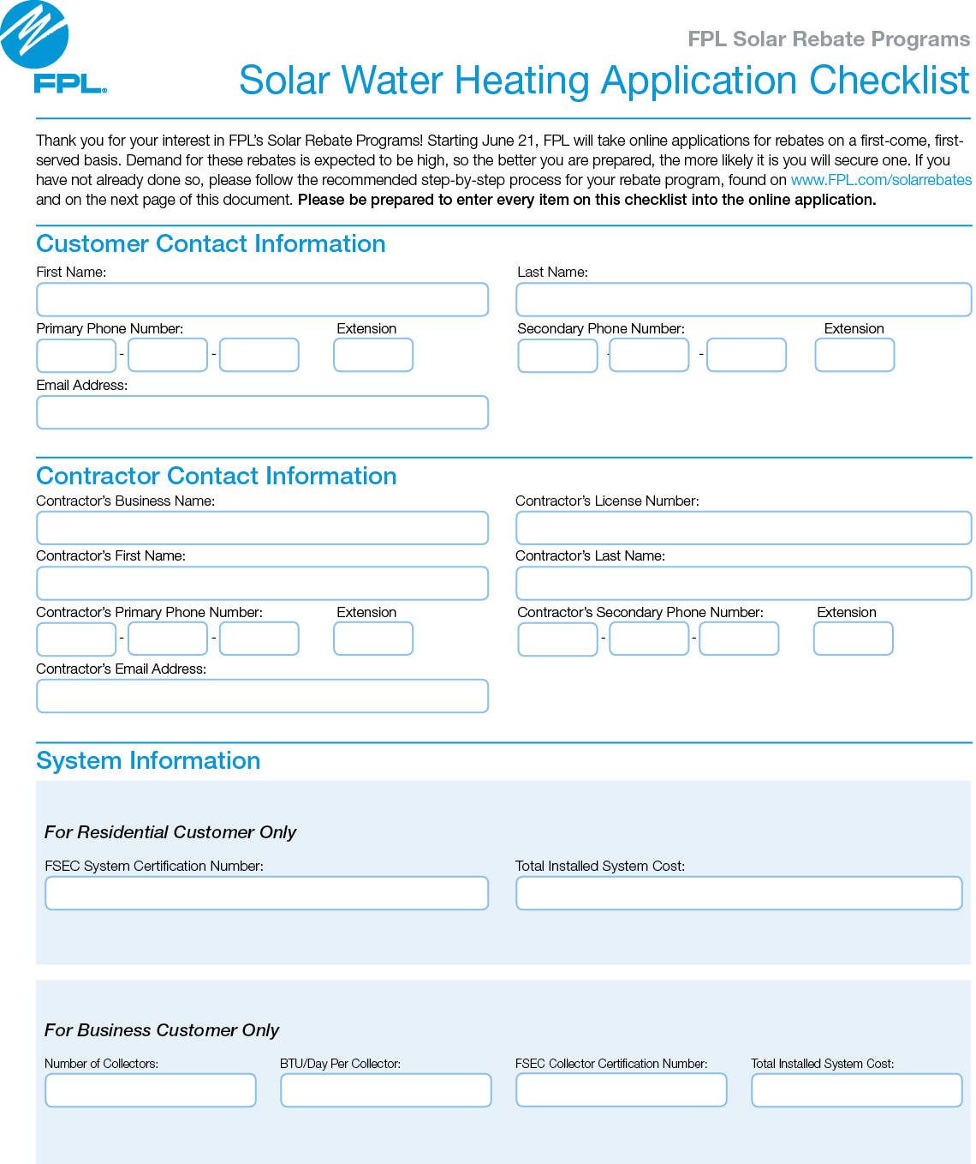
Solar Water Heating Checklist

Slide 23
Summary
All information, including Program Standards, are available on www.FPL.com/solarrebates
Reservations must be reserved through your online account at www.FPL.com
If you do not have online access to your account, register for it before the scheduled solar launch in October, date TBD
Obtain a building permit and have the contractor you choose and hire build a system that meets all program standards and requirements
When construction is complete, fill out the rebate certificate and provide all required documentation to FPL
You will receive the rebate six to eight weeks after your documentation is approved

Slide 24
Know Your Solar Rights
George Cavros
Energy and Environmental Law Attorney
Southern Alliance for Clean Energy

Slide 25
Solar Installations and
Insurance Coverage
Robert Foote &
Susie Krix
Furman Insurance

Slide 26
Insurance Coverage Essentials for Commercial Building Owners with PV Systems
Presenter: Rob Foote, Insurance Advisor/Partner
Susie Krix, Insurance Advisor
Frank H. Furman Inc., Pompano Beach, Florida
January 25 - 26, 2013

Slide 27

Who are We?
50 years of insurance and risk management advise to corporations and property owners in Florida
The Furman Agency, is a “Top 20” Agency as reported by SFBJ.

Slide 28
Insurance Coverage Essentials for Commercial Owners – Solar Systems
Replacement Cost insurance coverage provision reduces negative financial impact to building Owner, in the event of a Wind or a severe Fire Loss, that may cause severe damage to PV System
Replaces Building/PV Equipment “New for Old”
PV= Photovoltaic (PV)

Slide 29
Co-Insurance Impact – The insured value of the Building must include the replacement cost of the (PV) system
If insurance policy requires 90% co-insurance, then insured value of building and PV system must equal 90% today’s of replacement value
  i.e. Building value including PV investment is
  $1 Million:
    A major wind event occurs causing a roof blow claim
    The property Owner carries $500,000 of insurance coverage then at settlement time = $0.50 on the Dollar

Slide 30
Stored Materials?
Partially installed PV System
Who is responsible?
Contractual Risk Transfer – Building Owner must either protect the PV on the first party policy insurance policy or contractually transfer risk to PV installer.
Potential Exposure – Who replaces partially completed (PV) System in the event of an electrical fire during the course of installation?
  Must address contractually
  i.e. building Owner may insist on the PV installer to accept Risk until the system is put to intended use

Slide 31
Installation Floater
Protects the PV System while on site
Who is responsible pays to protect PV equipment?
  Mounting System
  Panels
  Inverters
Does PV Contractor have a Blanket or site specific Installation Floater?

Slide 32
Solar System Performance Guarantees
Who guarantees the Output?
Panel manufacturers warranty – How proven and financially stable is the panel manufacturer?
PV Contractor/Installer – Can a family owned PV contracting firm absorb the efficiency guarantee risk on their balance sheet?

Slide 33
Key Components of efficiency guarantees
Identify Percentage of output anticipated/guaranteed to building Owner i.e. 80%, 90% etc.
What is financial remedy/consequence to the PV installer/Design firm if output does not reach contractually guaranteed levels?

Slide 34
Energy efficiency Guarantees - An emerging exposure for insurance industry,
Installer must qualify
Balance sheet strength of PV installer
Completion track record/experience
Time tested PV Components i.e. inverters, panels, auxiliary equipment etc.
Expertise of Design/Engineering firm
The number of years of the Guarantee
Maintenance and Monitoring of System

Slide 35
General Risk Management Recommendations for Building Owners that are contemplating a PV Project
Building owner must have a formal written contract with PV installer, transferring risk (away from Owner) to the Installer
  Invest in Legal Council to draft your contract and do not sign Installers Contract
  Indemnification Provisions
  Hold Harmless Provisions
Sample Insurance requirements for the PV Contractor:
  $1 Million General Liability – including completed operations/products
  $1 Million Workers’ Compensation – protection for falls, etc.
  $1 Million Automobile – Protect Tenants/General Public from Auto Exposure
  Installation Floater for value of PV system

Slide 36
Protect your Home and Control Personal
Insurance Cost
Solar Energy Systems and Homeowners Insurance
Susie Krix
Manager Personal Lines
Frank H. Furman, Inc.

Slide 37
Insurance
Most Homeowners Policies already have Solar System coverage included in their Homeowners Policy
You should contact your agent if a Solar System is installed and discuss:
    Value
    Coverage Increase

Slide 38
Insurance
Homeowners have the duty…..
In case of damage to the solar system, due to wind or other hazards, to protect property from further penetration damage
For coverage to apply Solar System must be attached to the home

Slide 39

Controlling the cost of insurance
What is the most critical item?
Mitigation Inspection
  Roof
    Florida Building Code
    Windstorm Protection
      Impact vs. non-Impact
  Make sure Inspector sees enhancements
    Homeowner should receive copies of inspection and photos

Slide 40

Rob Foote, Commercial Insurance Advisor
Susie Krix – Personal Insurance Advisor
Frank H. Furman Inc.
1314 E. Atlantic Blvd.
Pompano Beach, FL 33060
800-344-4833
          Corporate Insurance
          Homeowner’s Insurance
          Bonds
          Risk Management
          OSHA Compliance
          Employee Benefits Programs

Slide 41
Finance Solutions for Your
Solar Project
Wolfgang Beaugrand
MAGE Solar Inc. & Florida Alliance for Renewable Energy Board member

Slide 42
Finance Solutions for Your Solar Project
Wolfgang Beaugrand, MAGE SOLAR USA (Southeast Regional Sales Manager) & Florida Allicance for Renewable Energy (Board Member)

Slide 43
I want Solar today!
How do I pay for it?

Slide 44
Financing Your Solar PV System
Residential
When considering purchasing a Solar PV System, there are several financial considerations.
What is your budget? System size will be affected your energy consumption but also buy only what you are comfortable paying.
You have the option of cash, loan or lease (only available in some states).
  Loan examples include: 10-Year or 20-Year FHA Home Improvement Loans, 30-Year Refinance Options, and always check with your local bank for finance solutions.
  Florida Only - Smart Investment in Solar (SIS): 20-year loan for pre-designed residential MAGE SOLAR Solar Systems
  Leases vary depending on state and installer, but always read the details for the end of the lease – do you own, owe FMV (fair market value), or will the array be removed (at your expense or installers)?
When you purchase your own Solar PV System, whether by cash or loan, you are eligible for a 30% Income Tax Credit (form 5695).
Some states also offer a State Tax Credit.
Some utilities offer a rebate or net metering program.

Slide 45
SIS Kit Options
All Kits are designed using the MAGE 240 / 6 PL US AC Module powered by a SolarBridge microinverter and utilizing MAGE SYSTEMTEC racking for wind loads of 120 mph* (160 mph wind load available at additional cost).
2.88kW (SIS 3-120 or SIS 3-160)
  Two rows of six are standard design
4.8kW (SIS 5-120 or SIS 5-160)
  Two rows of ten are standard design
7.2kW (SIS 7-120 or SIS 7-160)
  Three rows of ten are standard design
10.08kW (SIS 10-120 or SIS 10-160)
  Three rows of fourteen are standard design
Transition cables, cable clips, Power Manager (AC Module) and other BOS are included in each of the standard designed kits for a shingled pitched roof. Other roof structures are available at additional fees.

Slide 46
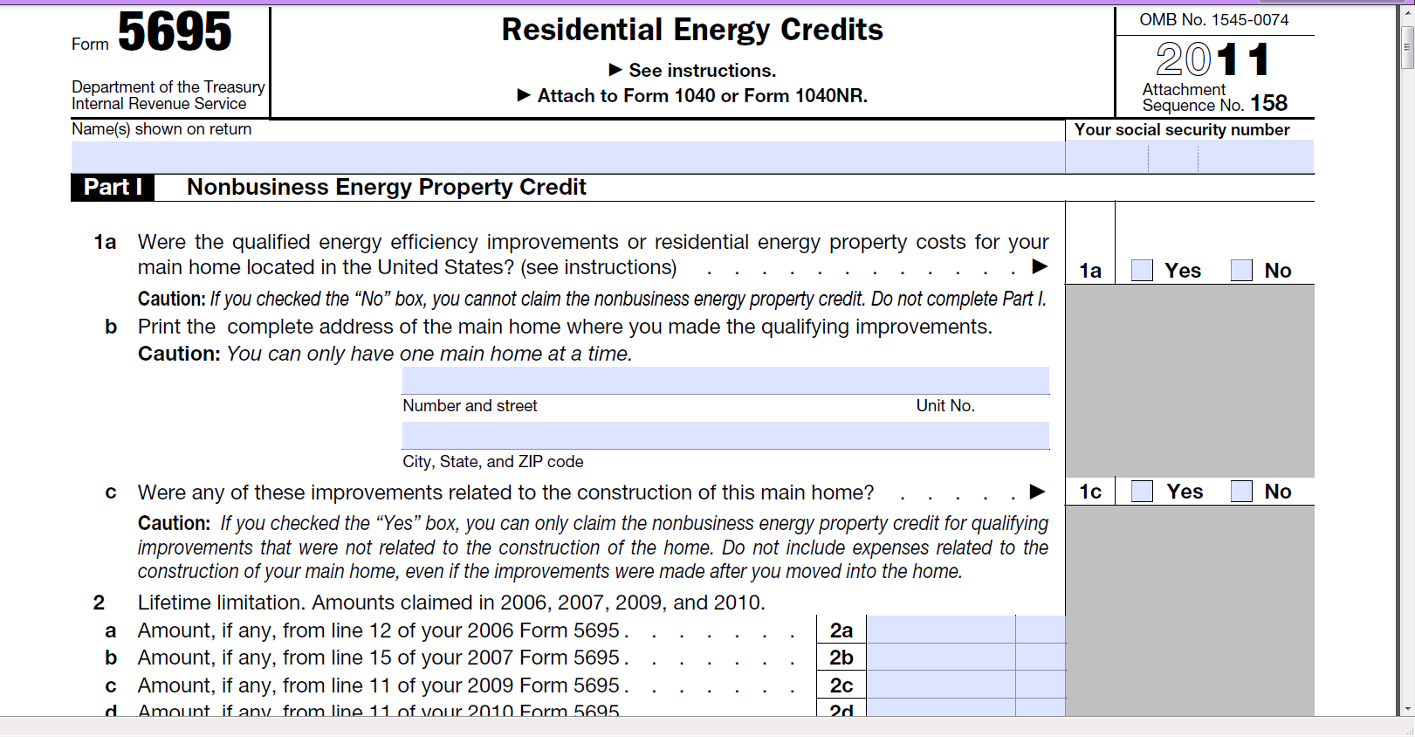
30% Federal Income Tax Credit Available

Slide 47
Compare Financial Options - Residential
Example: Residential System Value $36,000 gross Current bill $200/mo FICO 650 own, 700+ rent/lease 20 Year Term | A Purchase from savings and cash or home equity | B 20+ FHA Title 1 Home Improvement Loan ~6.95% | C Rent/Lease Equipment
Monthly | $0 | $195 | $170 (~3% increase annually)
Total Paid | $36,000 | $46,800 | $52,924
Total Interest pd | $0 | $21,600 | $0
Incentive | $0 | $0 | $0
Fed ITC Tax credit | - $10,800 | - $10,800 | $0
Interest tax deduction | $0 | $21,600 (dependant on tax rate) | $0
Total spent | $25,200 | $46,800 (minus interest tax deduction) | $52,924
Total Owed after payments | $0 | $0 | *$0 to $52,924 (or FMV or removal)
Asset Value gain/ loss | Home value + System value gain | Home value + System value gain | Lien will be placed on home until end of lease
Ownership | Yes | Yes | No

Slide 48




Finance Options For Commercial End Users*
Commercial
Financing*
► Basic Qualifications Business existing Business existing Business existing
> 5 years > 5 years > 3 years
► Terms** 5-12 years 2-7 years 3 - 7 years
10 (special credit models)
► Tax Lease Options Yes No PPA Equity Options available
► Loan Amount
minimum $0 $50,000 $10,000
maximum $10,000,000 $5,000,000 No upper limit
► Lease Amount Flexible
minimum $500,000 $50,000 $20,000
maximum $10,000,000 $5,000,000 No upper limit
► Funding Amount 100% 100% 100%
► Processing Fee N/A N/A $500
Credited back
upon funding
*Financing available for MAGE SOLAR PV-Systems only. Specific details should be discussed with REEL.
**Dollar amount financed determines terms available.

Slide 49
Finance Options for Municipalities and Schools
Credit Ratings | AA or AAA rated
Lease Terms | 3 to 30+ Years**
Lease Amount
Minimum | $500,000
Maximum | $400,000,000
Buy-Out Option | Yes
Funding Amount | 100%
Availability | All 50 States
Tax-Exempt Lease | Yes
Tax-Exempt Bonds | Yes
Taxable Bonds | Yes
*Financing available for MAGE SOLAR PV-Systems only
**Dollar amount financed determines terms available

Slide 50
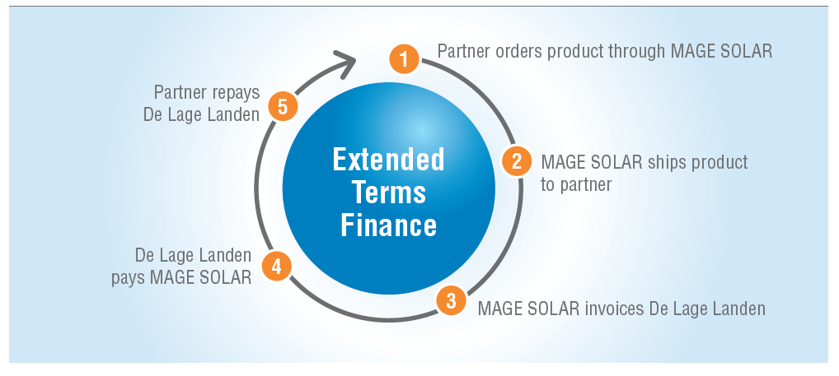
Finance Options for Installers
Program Details
Dealer Repayment Terms:
  30 or 60 day terms available to qualified installers
  Payment due in full on day 30 or 60

Slide 51


MAGE SOLAR Finance Solutions Partners*
MAGE SOLAR Complete Solar PV-Solutions
Residential Financing
Commercial Financing
Municipal Financing
Installer Financing
* Financing available for MAGE SOLAR PV-Systems only

Slide 52
MAGE SOLAR – Are you ready?
Let's go!

Slide 53




Contact us:
MAGE SOLAR Customer Service
    (877) 311-6243 Toll-free 720 Industrial Boulevard
    (478) 609-6640 Main Office Dublin, Georgia 31021
    (478) 275-7685 Fax U.S.A.
    info@magesolar.com
    www.magesolar.com

Slide 54
Overview of Tax Equity Financing
Structures for Solar Projects
Kamran Idrees
Chad Bourne & Parke, LLP

Slide 55
Project Financing: the Big Picture
Kamran Idrees
kidrees@chadbourne.com

Slide 56


Slide 57
More than one source of capital may be needed to finance a project.
Five main capital tiers from least to most expensive:
  Free money
  Government-guaranteed debt
  Straight debt
  Tax Equity
  True Equity

Slide 58
Tax Equity
The federal government currently pays a significant portion of a renewables project’s cost, in the form of tax subsidies.
  The main subsidies are:
    production or investment tax credits; and
    Depreciation/bonus depreciation.
  Few developers can use the subsidies efficiently.

Slide 59
There are at least 20 active tax equity investors with a number of additional smaller players doing one-off deals.
  Yields are all over the map from 7% to 22.5%, with a significant premium still in leveraged deals.
  Depreciation only?

Slide 60
Partnerships
Partnership Structures are flexible vehicles designed to achieve multi-investor business goals.
Earn a return on their investment from a combination of three sources:
  Project cash flow
  Tax credits
  Tax losses (i.e., depreciation) early in the deal
These three revenue streams can be allocated (or distributed) to the partners in different ratios throughout the life of the project.

Slide 61
First Period:
  Investor is allocated 99% of income (loss) and credits
  Developer receives all of the cash until it recovers its investment, or a cutoff date
Second Period:
  Investor is allocated 99% of income (loss) and credits
  Investor receives 99% of the cash
  Until a pre-negotiated ATIRR is achieved by Investor
Third Period:
  Once the ATIRR is achieved, Developer receives 95% of project cash flows and profits and Investor receives balance of project cash flows and profits
Partnership Structure
Investors
Developer
Class A
Class B
Project
Company
LLC
Energy
Offtaker

Slide 62
Sale-Leaseback
An alternative to the partnership structure is to sell and lease back the project.
  The tax equity investor claims the tax benefits and passes through part of the value in the rent it charges the developer for use of the project.
  Leases only make sense if one pushes out the lease term to 80% of the expected life and value of the project. The developer must pay full value at the end of the lease if it wants to keep the project.
  A sale-leaseback may make more sense in cases where the project is expected to be worth significantly more at the end of construction than it cost to build.

Slide 63
Basic Lease Structure
Lender
Investor
(Owner Participant)
Equity
Equity
Return
Loan
Repayment
of Loan $
Owner/
Lessor
Purchase Price
Developer
Rents $
Assets

Slide 64
Lease Pass-through
Think of a yo-yo.
  First, the developer leases the project to a taxable investor for a term of years (e.g., 5 years).
  Then, the parties elect to pass any tax benefits to or grants the investor.
  Lastly, when the lease terminates, the developer pulls control of the project back at zero cost.
Note: at no time does the developer lose ownership.

Slide 65
Lease Pass-through
Developer
Investor
Lease
Rent $$
Claims depreciation
and retains ownership
Claims
Tax Credits/Grants

Slide 66
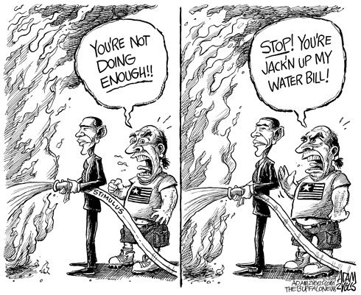
Market Update

Slide 67
Sequestration
Cash Grant Payouts
  Developer fees
Tax reform
ITC extension

Slide 68
Project Financing: the Big Picture
Kamran Idrees
kidrees@chadbourne.com

