Slide 1

A Blueprint for Successful Renewable Energy Applications

Slide 2
Siemens’ Public-Private Partnerships in Sustainability
Daniel Wishnick
Business Development for Cities
Siemens Industry, Inc.

Slide 3
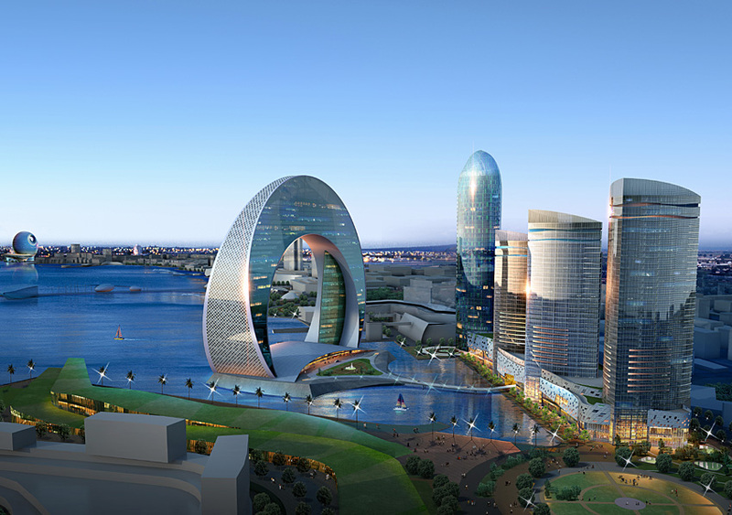
…A Vibrant, Growing and Green Community
Public-Private Partnerships in Sustainability
Dan Wishnick
SIEMENS

Slide 4
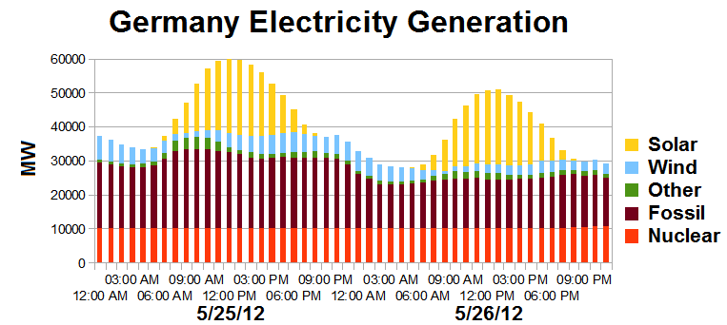
Solar – The German Experience
In 1999, 32MW; in 2012, 30,000MW = to 13 nuclear plants
Renewables of all kinds = 25% of power into grid compared to 6% in US

Slide 5
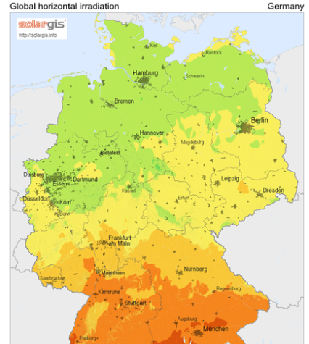
Solar – The German Experience
How?
Decentralization of the power system - Renewable Energy Act of 2000, known in Germany as the EEG
Replace coal and nuclear with goal of 80% by 2050
Funded by FiT program – not government funded

Slide 6
…A Vibrant, Growing and Green Community
…it’s dynamic and moving rapidly with vigor and energy.
…it’s thriving and developing to reach maturity.
…it’s sustaining itself .
LP

Slide 7
What is Sustainability?
…the capacity to endure (longevity)
…the capacity to support (maintain)
…the stewardship of environment
…the management of resources
… it is resourceful
CH

Slide 8
…A Vibrant, Growing and Green Community
Challenges
LP

Slide 9
Municipal Infrastructure Study…
…The most serious infrastructure challenges facing cities.
…How infrastructure budgets are being affected by the
global economic crisis.
…Stimulus infrastructure priorities.
…Promising technologies for reducing the impact of
infrastructure on climate change.
…Measures to help adapt to the impacts of climate change.
…Improving sustainable infrastructure investments through
metropolitan planning and decision making.
CH

Slide 10

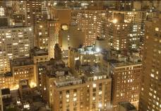
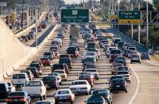
Challenges of a vibrant, growing and green community
Key Issues
Key Challenges
Economics
The state of local government finances… Community impact of economic downturn… Current economic crisis… How long? How deep?
Population migration – rural to urban, etc… Rapid growth of major metro areas… Strains on infrastructure… Aging population; demands for services…
Scarcity of natural resources… Cities responsible for 80% of GHG… Ability to attract business, maintain vitality… Changing attitudes towards environment… Local government taking leadership role…
The ability to provide and fund necessary services and community infrastructure
Demographics
The impact of broad demographic shifts on cities and counties
Sustainability
Sustainability
The ability to remain a viable, sustainable community for years to come
LP

Slide 11
Findings of local governments…
Opportunities
…Infrastructure budgets for 2009 adversely affected by economic crisis.
Approximately 22% of respondents expect a reduction of 15% or more this year.
…City leaders identify lack of funding to meet infrastructure needs as most serious challenge.
…Climate friendly technologies represent significant economic opportunity for cities.
…Broad recognition that infrastructure plays critical role in addressing climate issues.
CH

Slide 12
Give me your email address…
and this report will be sent to you.
LP

Slide 13
…A Vibrant, Growing and Green Community
Solutions
LP

Slide 14

What is LEED?
LEED is… Leadership in Energy and Environmental Design.
…it is a rating system in seven major categories for the design, construction and operation of high performance buildings.
CH

Slide 15

LEED Major Categories
…Sustainable Sites
…Water Efficiency
…Energy and Atmosphere
…Materials and Resources
…Indoor Environmental Quality
…Innovation in Design
…Regional Priority
CH

Slide 16
A Vibrant, Growing and Green Community is…
…is smart, livable and sustainable manner by means of its leadership and policies.
Smart… it maximizes resources and efficiencies by human and artificial operation.
Livable… it makes sense for the population according to the needs of the locality.
Sustainable… it has as long of life as the maximizing of “resources and efficiencies” allows.
Leadership… acting with common sense.
Policies… based on individual and greater good.
LP

Slide 17
What does it look like?
…A sustainable city is a city operated with consideration of cultural and environmental impact.
…It is inhabited by people dedicated to the minimization of required inputs (energy, water and food) and outputs (waste, heat and pollution).
…It operates in a smart, livable and sustainable manner by means of its leadership and policies.
…It embraces the pillars of competitiveness, environment, quality of life and good governance.
CH

Slide 18
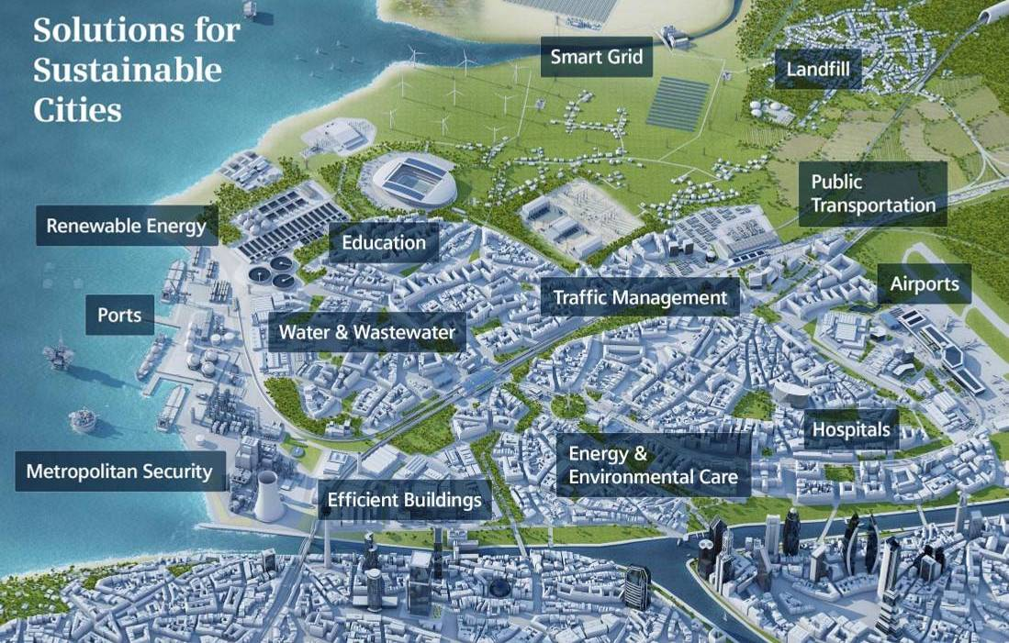

Slide 19
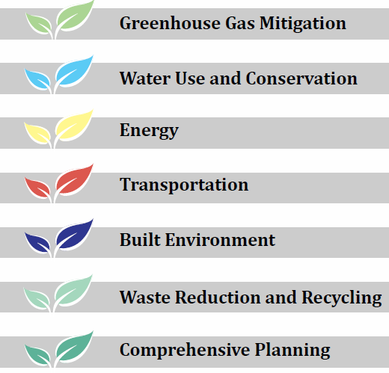
Just Like Broward County…

Slide 20
…A Vibrant, Growing and Green Community
Financials
LP

Slide 21
Challenges of a vibrant, growing and green community…..
If energy conservation both saves money and is good for the planet, why don't people do more of it?

Slide 22


Show me…
The Money!
CH

Slide 23
The Money!
Financial Resources…
-Capital Dollars… Taxes or Bonds.
-Capital Contributions…
Federal (CDBG), State (CDBG) and Foundation Grants
-Operating Dollars… Redirecting.

Slide 24
…A Vibrant, Growing and Green Community
Instrument
LP

Slide 25
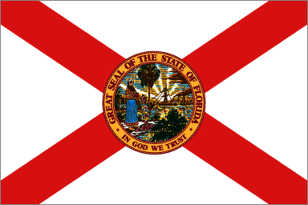
Florida Legislation
LP

Slide 26
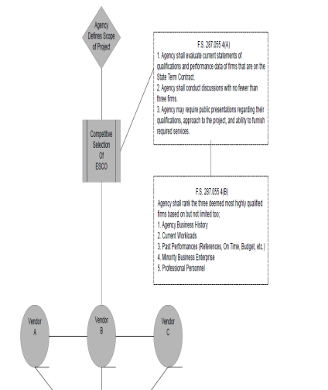
Florida Process
To provide a concise, easy to understand process, that labels each parties basic responsibilities for an Energy Performance Contract. All process steps must adhere to Florida Statues 489.145, 287.055, 255.05 and 287.057

Slide 27
How Do We Pay for the Improvements?
Operating Costs
Immediate savings
Savings
Excess savings
Operating Costs with PC
Program payments
Costs
Time
Current
During Construction
During Guarantee Period
After Guarantee / Finance Period
Page 27
Notes:
27

Slide 28

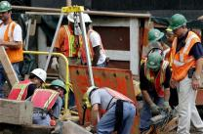

Potential for Florida
National Association of Energy Service Companies
…State and local government facilities are wasting $250,000,000 per year in energy.
…Savings from redirecting wasted energy dollars could fund $1,400,000,000 in projects.
…The $1,400,000,000 would create 17,000 direct jobs in engineering, construction, and manufacturing. Plus 20,000 indirect jobs.
LP

Slide 29
Potential for Florida
Year 2010 Experience
National Association of Energy Service Companies
…In 2010, $121M in project investment
…1400 job years created
…Over 1M MMBTU of energy saved and 18,000 tons of carbon avoided
LP

Slide 30
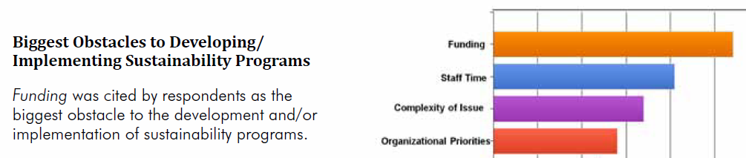
Broward County Experience….

Slide 31
…A Vibrant, Growing and Green Community
SUMMARY
LP

Slide 32
…A Vibrant, Growing and Green Community
…it’s dynamic and moving rapidly with vigor and energy.
…it’s thriving and developing to reach maturity.
…it’s sustaining itself .
CH

Slide 33

Questions
LP

Slide 34
Waste Management’s Investment in Renewable Energy
John Albert
Government Affairs Manager
Waste Management, Inc.

Slide 35
More Efficiently Managing Public Space Waste & Recycling Collection through Information and the Software-Enabled BigBelly System
November 2011
The Smart Grid for
Waste and Recycling TM

Slide 36
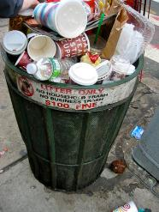
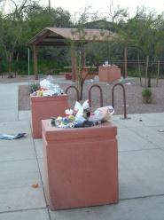
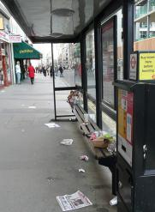
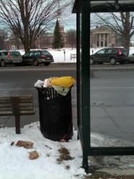
The full “system costs” of trash collection can be surprisingly high
Average annual collection costs ($ per trash bin per year)
City Streets
$2,005
Parks
$1,785
Transit Stops
$1,850
Colleges
$1,630
Route length/density - Vehicle costs - Fuel - Collection frequency - Staff costs
Note: Based on BigBelly Solar collection cost analyses

Slide 37
Without information, overflow & litter risks are (mostly) buffered by over-resourcing …
Excessive
collections, and
Still get “dinged”
despite over-
resourcing
Still have
unpredictable
overflows
Route collection
frequency
Wasted
Resources (red)
Required
collections
(black)
Enormous resource buffer of trucks, bins and staffs is (mis)applied based on peak loads, given the lack of actionable information – tremendous opportunity for more focused and efficient resource utilization

Slide 38
Leveraging the power of the BigBelly Solar
Smart Grid for Waste & Recycling TM to dramatically improve operations performance
Route collection
frequency
70 - 80+ %
Route collection
frequency
Reduced overall collection levels - AND - shaved off peaks (overflows)
Nimble adjustments, leveraging the power of visibility and control, as patterns change

Slide 39






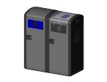
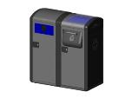
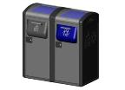
The System: Management Console, Command Center and family of Stations
Command
Center
Analysis
Reports
Insights
Transparency
Auditing
Support
Management
Console
Commands
Data
Remote
Settings
Inventory
Mgmt
Software Service permeates the entire System, including:
The Management Console, driven by data stored and analyzed in the Command Center
The functions of the Stations, based on data analyzed and commands given by the Command Center
Software helpdesk support
Stations
Components

Slide 40
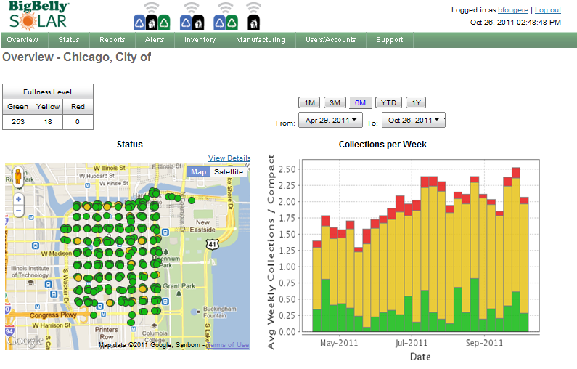
Information is the Answer – delivering visibility, transparency and control

Slide 41
The BigBelly System: slashing collections using information tools and software-enabled stations
Case Study: Densely Populated Urban Environment, Winter 2010-11
Power of Information:
Wasted Trips for
Empty Baskets
89% Total Reduction
w/ BigBelly Solar
(70-80%+ are typical)
Eliminated Trips
Due to Compaction
… while Improving service levels (reduced overflows and litter)

Slide 42
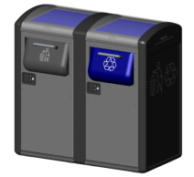
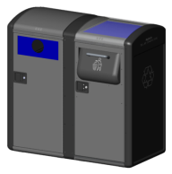
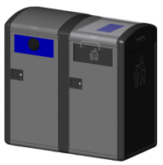
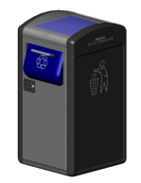
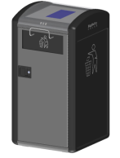
“A Solution for Every Corner”
A mix and match family of stations and components to match your specific needs – volumes, stream mix, etc.
BigBelly SOLAR COMPACTOR
BigBelly COMPACTING RECYCLER
SmartBelly FOR WASTE
SmartBelly FOR RECYCLING
With active software service contracts required to enable information management and core station functionality (e.g., compaction, sensing and communications)

Slide 43
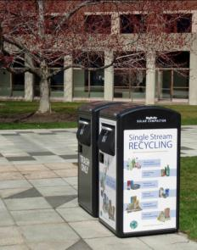
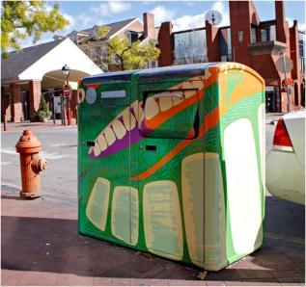
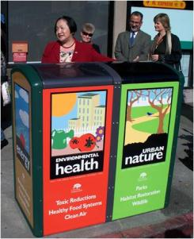
Capture your company’s imagination by customizing Imagery and Messaging
A highly visible street-level user Engagement Platform, with sponsorship and advertising options for communities who have that interest (or financial need)

Slide 44
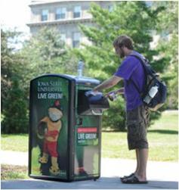
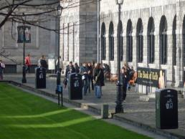
The BigBelly System will be a highly-visible “early win” in your sustainability program
Eye-level solar panels are attention magnets
  Visible demonstration of your sustainability commitment
  Visible in ways that your rooftop solar, HVAC efficiency and LED lighting changeouts aren’t
  Messaging panels can cross-promote your other green initiatives
  Receive credit for your sustainability actions!
Provide operational and financial “quick wins” that can generate momentum for other programs
Cleaner streets, parks, waterways, etc.

Slide 45
Key System & System Pricing Principles
System pricing is structured to provide the following benefits:
  Volume price breaks are also offered, based on cumulative End Customer footprint.
    This change – vs. the prior order-volume based approach – will provide accelerated savings to customers as they grow their footprint
  There is a minimum effective scale for the system to function optimally, which is an initial minimum of 5 stations per End Customer
  5 stations also represents a threshold order size for the standard pricing matrix.
    Once an End Customer achieves minimum scale, they can purchase subsequent stations at quantities lower than 5 stations, but a 20% upcharge (relative to the End Customer’s position on the pricing matrix of term length and cumulative volume) will apply for orders of fewer than 5 stations due to higher BigBelly processing costs

Slide 46
JM Family Enterprises:
Local Business Leader in Sustainability
Erik Jacobsen
JM Family Enterprises

Slide 47

JM Family Enterprises
Solar Projects
January 25, 2013

Slide 48

Driving the Vision
JM Family’s commitment to Environmental Sustainability has called for an increased use of renewable energy sources for electricity.
Solar Power continues to be an attractive means for meeting our goals.

Slide 49
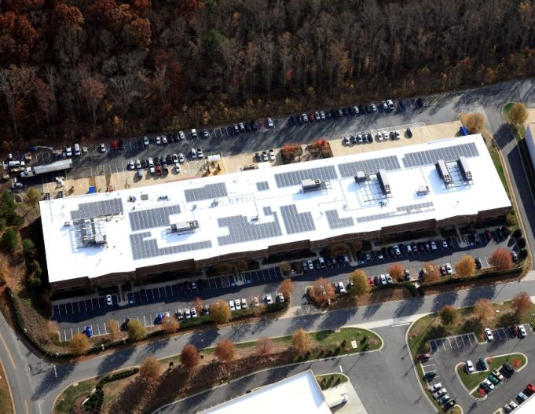
Alpharetta, GA

Slide 50
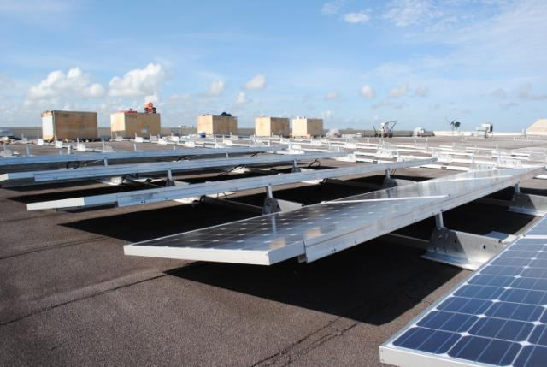
JM Lexus Service Center, Margate, FL

Slide 51
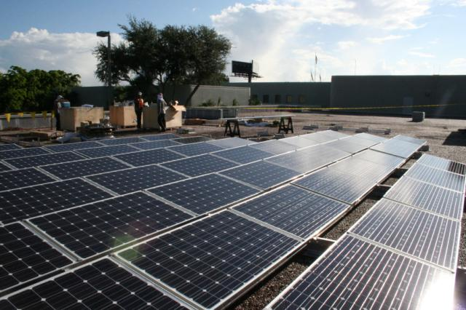
Deerfield Beach, FL

Slide 52
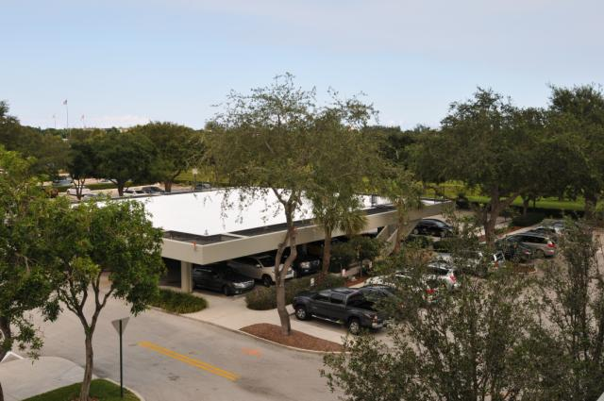
Parking Garage, Deerfield Beach, FL

Slide 53
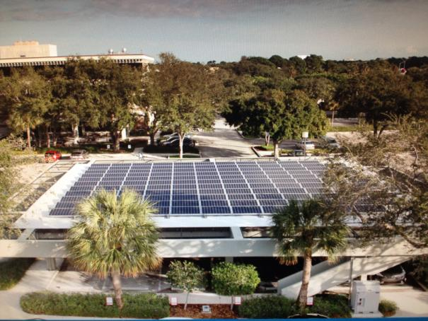

Slide 54
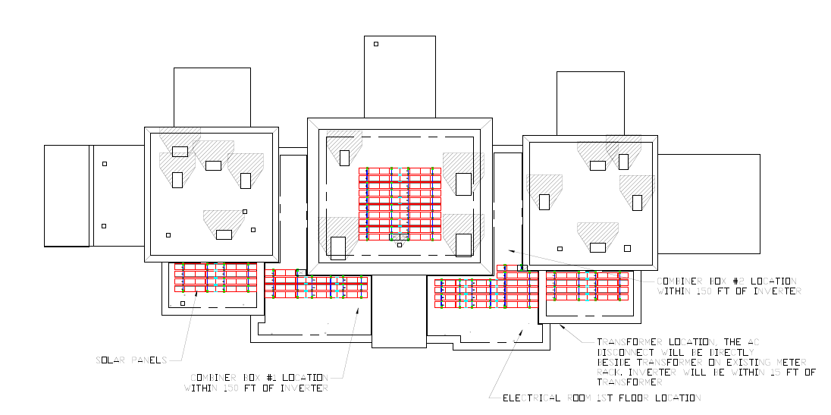
JM Lexus New Car Showroom

Slide 55


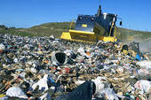
Environmental Offsets
A 56.35kW array has the capability to reduce the carbon footprint by 46.7 metric tons of carbon dioxide equivalents which is equal to emissions from:
Burning 5,231 gallons of gasoline
Consuming 109 barrels of oil
Sending 16.3 tons of waste to the landfill

Slide 56
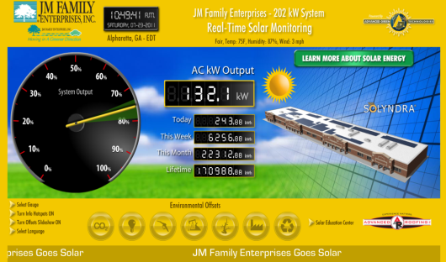
Solar Production Monitoring
Real-time output monitoring
JMFEsolar.com

Slide 57
Welcome to the Greater Fort Lauderdale – Broward County
Convention Center
LEED Gold Facility
Julia Johnson
Sustainability Programs Manager

Slide 58

 | JULIA JOHNSON, LEED AP+ O&M Sustainable Programs Manager Greater Fort Lauderdale t Broward County Convention Center 1950 Eisenhower Blvd, Ft. Lauderdale, FL 33316 Phone: (954)765-5906 Fax: (954)763-9551 E-mail: jjohnson@ftlauderdalecc.com Website: www.ftlauderdalecc.com

Slide 59


Slide 60
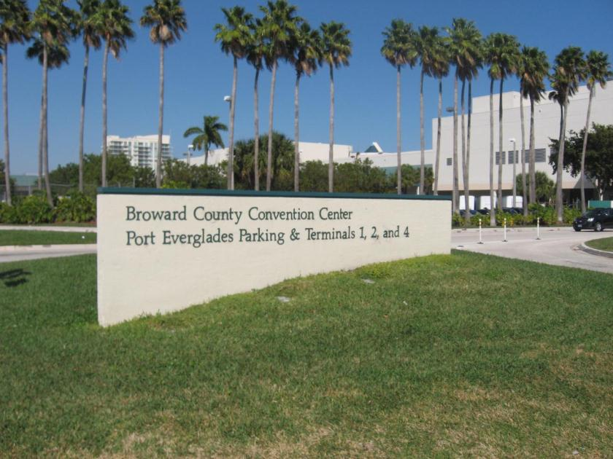
BEFORE
After 20 years it was
time for some upgrades…not
only for water efficiency but
to make arrival more appealing

Slide 61
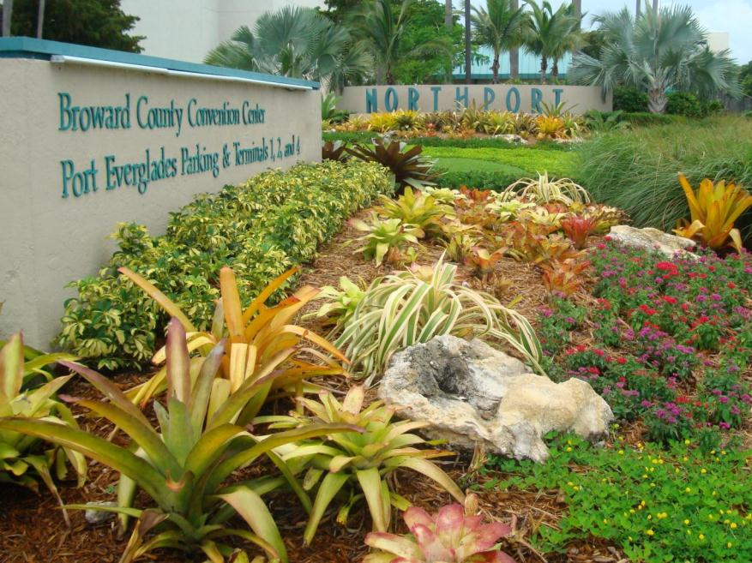

Slide 62
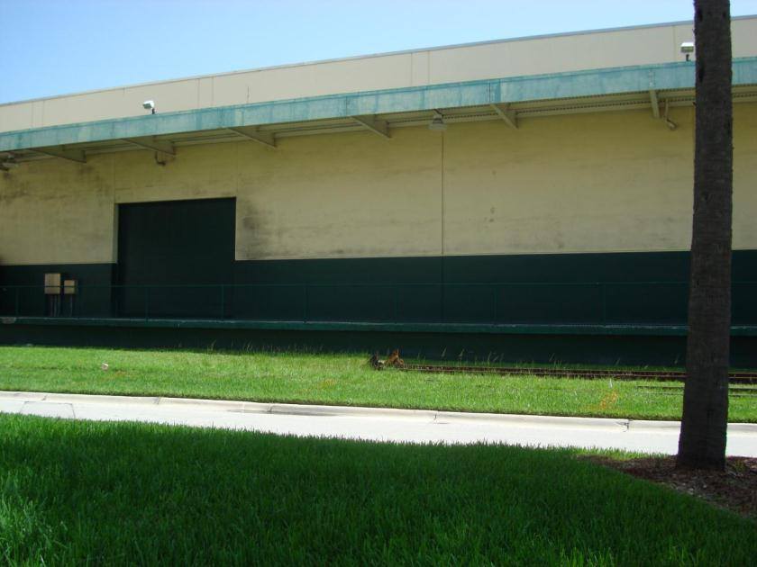
BEFORE
Terminal 4 Building was an
unattractive distraction

Slide 63
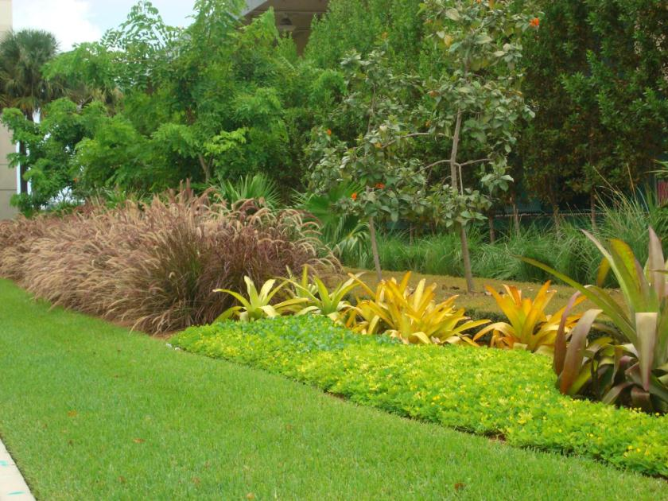
AFTER
New landscape material and micro-drip irrigation uses 65% less water than before. A savings of more than 6 million gallons of water per year.

Slide 64
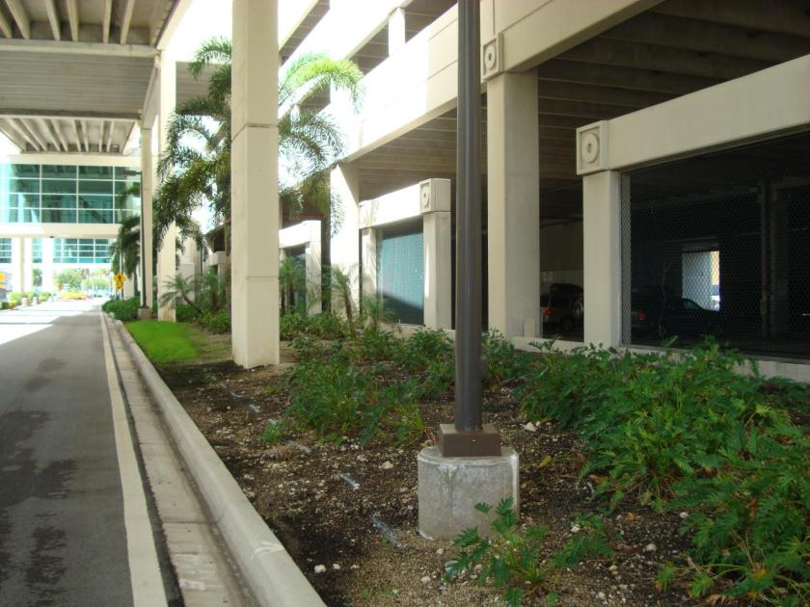
BEFORE

Slide 65
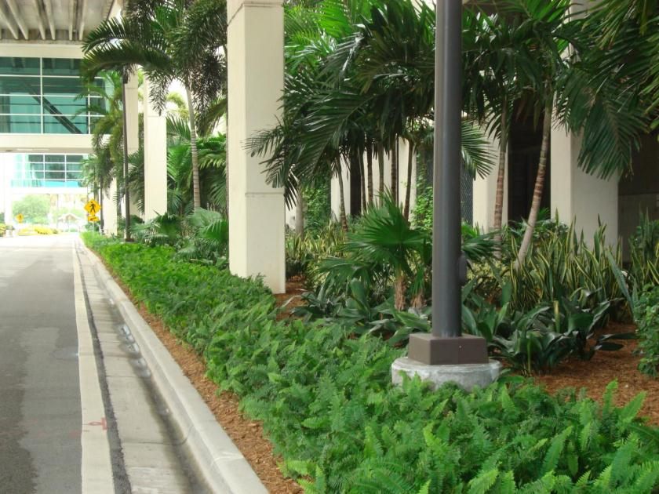
AFTER
Use of native and adaptive plants and trees indigenous to South Florida reduces the need for watering.

Slide 66
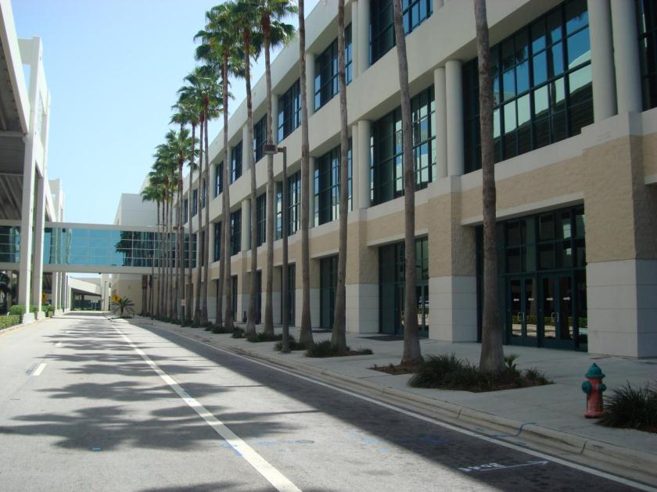
BEFORE

Slide 67
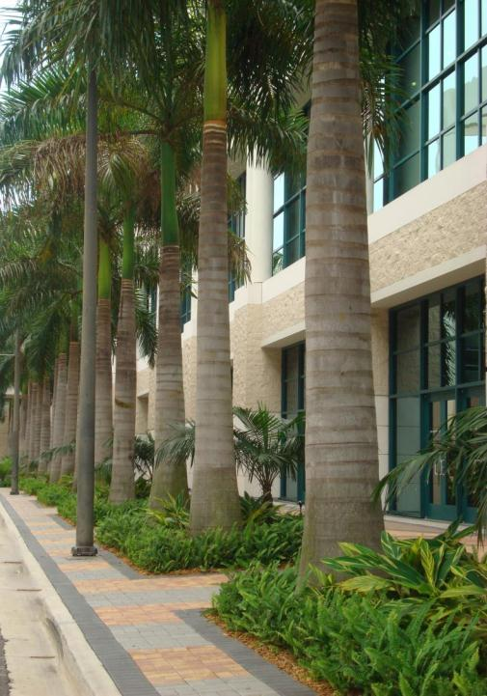
AFTER

Slide 68
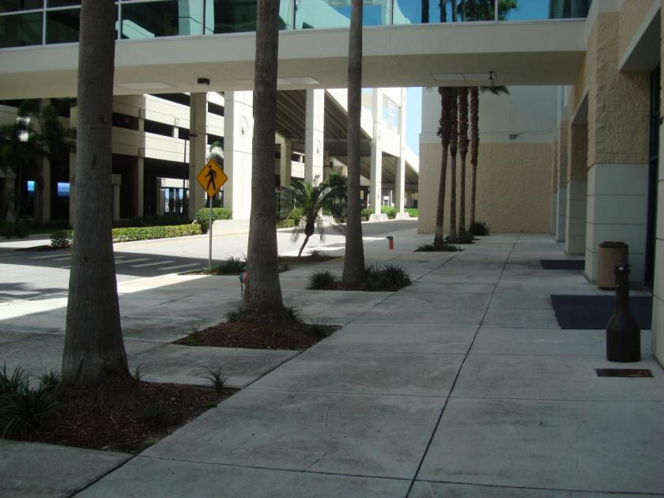
BEFORE

Slide 69
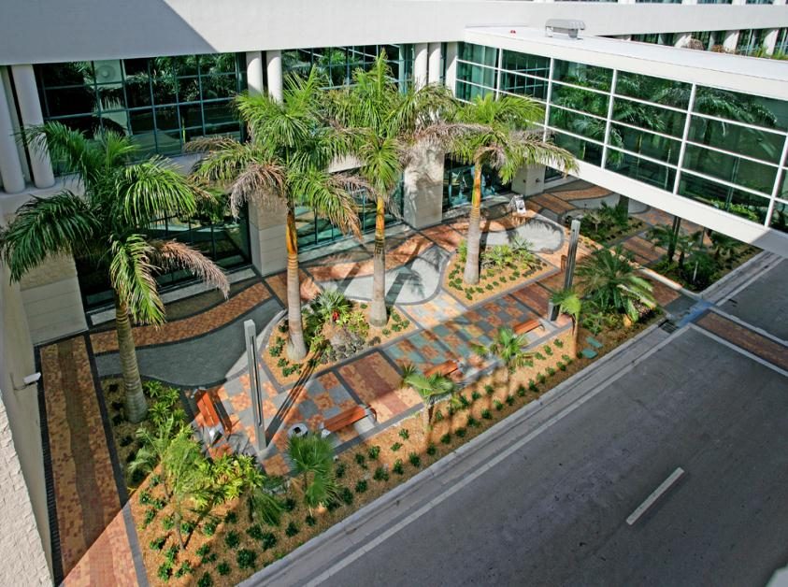
AFTER

Slide 70
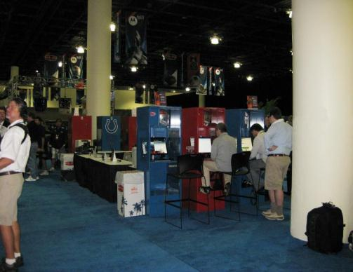
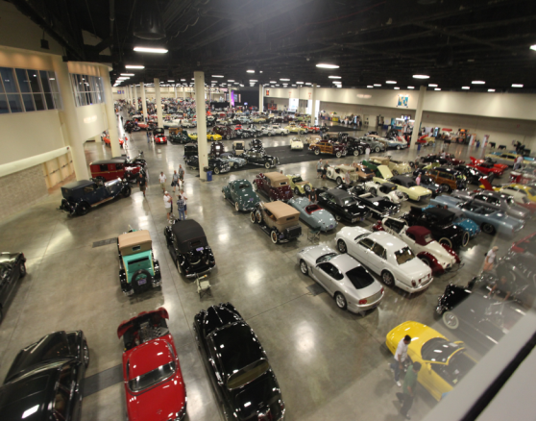
Replacement of older, less energy-efficient lighting…
with a combination of new more energy-efficient fluorescents, LEDs, CFLs and induction lighting to reduce both heat and energy, resulting in a savings of 18 percent off the electric bill.

Slide 71
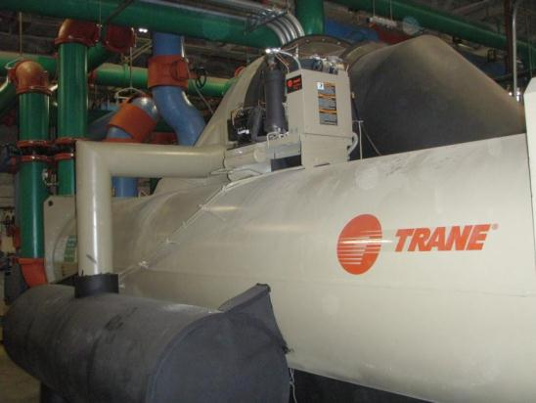

The replacement of two 19-year-old water-cooled chillers with new, more energy-efficient Trane Earthwise® water-cooled chillers
along with upgrades to the air-handling and ventilation system, including CO2 sensors for enhanced indoor air quality

Slide 72

October 2010
We were recycling
8% of total waste
December 2012 -
We are recycling
63%!!!

Slide 73

SAVOR has risen to the challenge of becoming a LEED certified facility trailblazing zero-waste programs that range from biodegradable eating utensils to composting kitchen scraps.

Slide 74

“Diane the Digester” converts all of our organic food waste into water that can be turned back into drinking water.
I can digest 100 pounds of organic waste in 1 hour!

Slide 75

White roof reflects the sun’s heat and saves the building on cooling energy.

Slide 76

SUSTAINABLE FURNITURE
GreenGuard Certified
Made from >20% recycled materials
Will be able to recycle >80% at end of life

Slide 77

All pre-function and meeting room lighting was upgraded to more energy-efficient lamps. We also upgraded our plumbing fixtures to save 45% on water use.

Slide 78


Slide 79


