Slide 1

Solar 101 for Residents, Small Businesses and
Interested Stakeholders

Slide 2
U.S. Department of Energy’s
Vision to Advance Solar Nationally
Minh Le
Director, Solar Energy Technologies Office
U.S. Department of Energy

Slide 3






So what is the SunShot Initiative?
Price
SunShot Initiative
SunShot Initiative
5 - 6¢/kwh without subsidy
A 75% cost reduction by the end of the decade
Notes:
The SunShot Initiative is a collaborative national effort to reduce the total cost of solar by 75% so it can be cost-competitive with other energy sources by 2020. DOE supports several programs that work toward this aggressive goal along the entire cost spectrum. Among these, the Incubator program is unique because it addresses all of the targeted reduction areas needed to achieve cost parity.

Slide 4
PV Systems would need to sell for $1/W
(Modules $0.50/W)

Slide 5
Where was the industry in 2010?

Slide 6
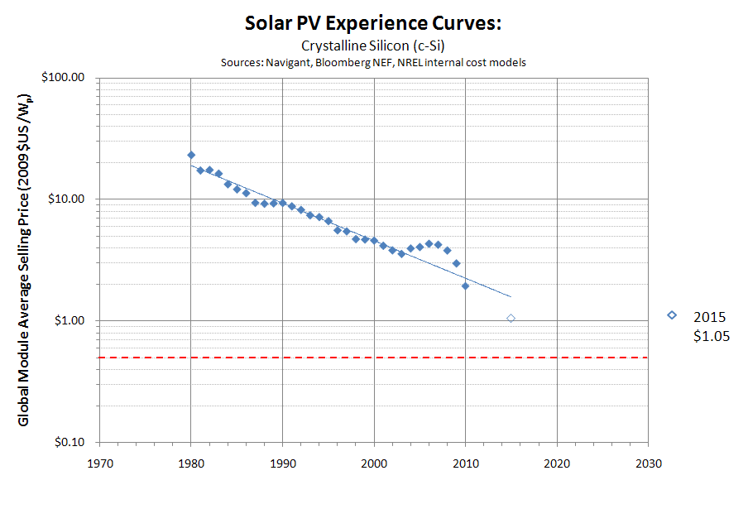
PV Module Prices
2012 prices
$0.50/W
Reaching $.50/W could take until 2030 for Si modules*
Notes:
In 2010, PV modules were selling between $1.70/W to $1.90/W. The industry was more interested in making money in the near term, profits were strong. Subsidies were strong around the world. Secretary Chu challenged the DOE to look beyond subsidies, and envision a world where renewable energy can compete against conventional forms of energy generation without subsidies. For solar, PV modules would need to sell at around $0.50/W.
If you look at a straight trendline on the experience curve, it would take until 2030 to reach $0.50/W modules. Our challenge was to help the industry achieve that in half the time that was expected. Our goals were twice as aggressive as industry was.
In the past couple of years, excess manufacturing supply was built up. PV modules are now selling below $0.80/W, less than half the prices just 2 years ago. A decades worth of cost reduction happened overnight. Without the vision of SunShot to enable our industry to develop technological solutions that are more aggressive than their roadmaps, our industry would be even more unprepared for these challenging times.

Slide 7
SunShot for Utility Solar PV
Largest potential for further
cost reduction
Module
$1.29/W
drop in 2 years
Module Price
2012
SunShot
Target
System Price
2010
Notes:
When SunShot was planned at the DOE in 2010, the average price of a Utility scale power plant was about $3.80/W. The goal of SunShot was to drive innovations that enabled solar the be competitive with conventional forms of energy generation, without subsidies, broadly across the US by 2020. This aggressive target would require solar at the utility scale to be sold at about $1/W. In just 1-2 years, tremendous advances have already occurred. By the end of 2011, utility scale solar was selling for about $2.79/W. Most recently, in Q3 2012, according to GTM and SEIA, the costs have come down to about $2.40/W, 50% of the way towards our cost reduction goals in just 2 years. Much of this price decline can be attributed to gross oversupply in the PV module industry, but the DOE’s investments in technology innovation has had a clear impact. Over the 30+ years, the DOE has funded technology development that led to more than 50% of the world’s records for solar cell efficiencies. Energy Department support of early solar PV research led to foundational knowledge that drives today’s private sector innovation, including an estimated 274 patent families that are cited by about 30% of the patents in solar energy.
But technology innovation is not in itself sufficient to achieve our objectives. We need a healthy manufacturing sector that can compete in a competitive and fair global marketplace. While hardware prices have fallen rapidly, the non-hardware prices have not come down nearly as rapidly. In the residential sector, this is even more pronounced where non-hardware costs can account for more than 50% of the system cost. To overcome these barriers, the DOE has made investments in new programs such as the Rooftop Solar Challenge and the SunShot Prize to achieve $1/W non-hardware costs for residential solar.
Solar is a sector that is growing in the US. The latest U.S. figures from The Solar Foundation, show a 13 percent growth in high-skilled solar jobs spanning installations, sales, marketing, manufacturing and software development -- bringing total direct jobs to 119,000 in the sector. That is a job growth rate about 6 times the broader economy. This has been fueled by strong growth in deployment of solar. By the end of his first term, there will be 6 times more solar in the US than when President Obama took office 4 years ago, supporting the President’s goal of doubling energy from renewables.

Slide 8
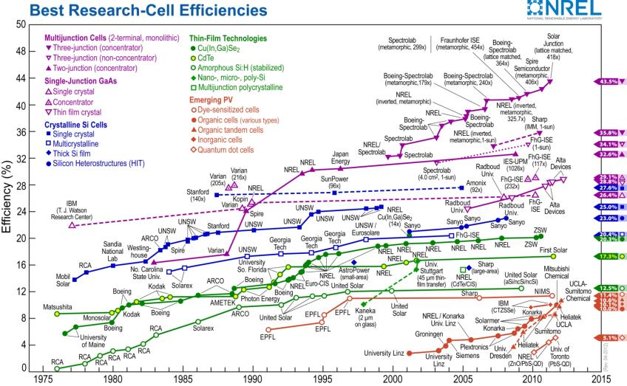
World Record Cell Efficiencies
~50% of the world record cell efficiencies from 1975-2011 were made by researchers supported by the DOE

Slide 9
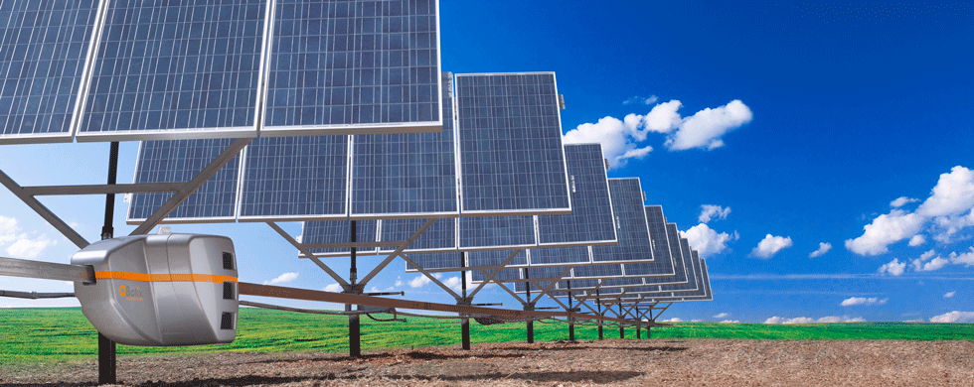
Cheaper Solar Trackers
Solar powered by Robotics
One robot replaces 400 tracking motors
50% reduction in tracker cost
Robot manufactured exclusively in the USA
$1M in DOE funding
Notes:
“In utility scale solar tracking, normally each tracker contains its own motors for following the sun.”
“QBotix took all the motors out of the system, and replaced them with an autonomous robot that moves from tracker to tracker and adjusts each one to face the sun throughout the day.”
“This significantly lowers the system cost and the cost of energy.”

Slide 10
The Issue:
“Even if you paid nothing for the hardware, you'd still pay thousands of dollars to install a residential solar power system” - Secretary Chu
Non Hardware costs:
Customer Acquisition
Financing and Contracting
Permitting, Inspection, and Interconnection
Installation and Performance
10

Slide 11


More Paperwork = Higher Cost

Slide 12
One Hypothetical City’s Process…

Slide 13
Pre-Application
Install Complies with Zoning Rules
Special Building Type?
Yes
Apply to Commission A
Receive Commission A Approval

Slide 14
Utility Track

Slide 15
Utility - Application
Solar to be utility connected?
Apply Electronically for Interconnection
Yes
Yes
Apply via mail for Interconnection
Utility Report Auto-Generated
Person Creates Utility Report
Report Sent to Appropriate Area
> 30 kW?
No
Authorization Letter
Equipment Spec Sheets
3-Line Diagram
Contract Type 1
Yes
Yes
Application Type 3
Application Fee
Application Type 2

Slide 16
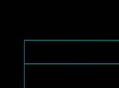
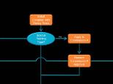
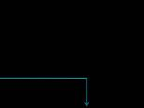

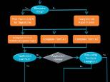
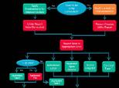
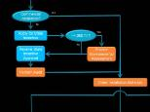
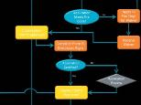
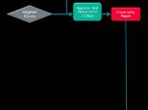
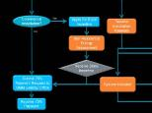
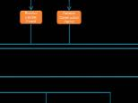
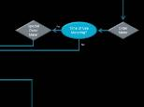

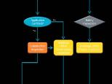
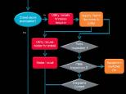
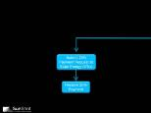
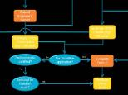
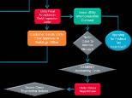

Slide 17
More than a Year Later,
You’re Finally Ready for Solar

Slide 18
And Permitting is
Different Everywhere

Slide 19
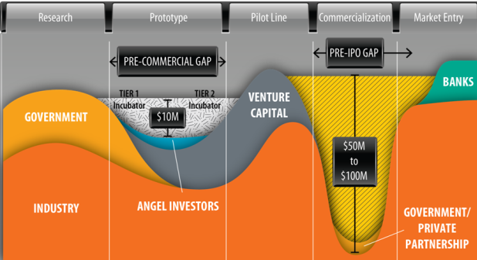
SunShot Incubator
Program focused on accelerating the commercialization of proven PV, CSP, and BOS solutions to meet aggressive installed cost goals.
Novel program structure
  Broad Scope – Open to all ideas which could aid our mission
  Cooperative agreement with milestone based reimbursement
  Rapid metric based negotiation around milestones table
  Non performing awardees can be, and are, rapidly terminated

Slide 20
Incubator Economic Growth Factor

Slide 21

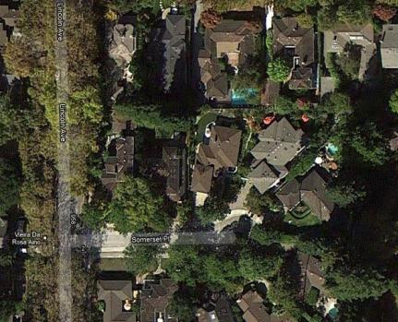
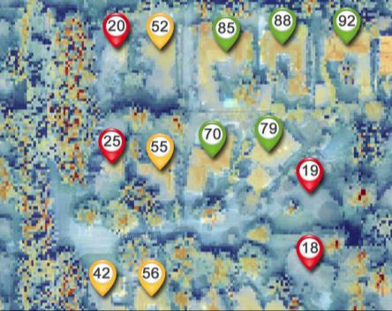
A Sun Number for Everyone
Sun Number = Solar Suitability
Score for every building, starting in 10 U.S. cities
Big data meets solar
Notes:
Like a “walk score” for solar
Urban Glue is creating an automated solar assessment tool that can give a score to every building in a city. Homeowners and businesses will be able to quickly and easily determine if their rooftop is suitable for solar energy based on their custom score, which is determined by a complex algorithm that utilizes remotely sensed data and other inputs.
Helping to reduce the cost of PV and increase solar awareness, the Sun Number provides consumers a baseline solar assessment of their building to use in evaluating PV solutions.
Big data meets solar, Sun Numbers are created using time based simulations that process billions of data points resulting in highly accurate solar assessments.
A national repository of Sun Numbers for every building in the United States available to anyone and everyone.

Slide 22
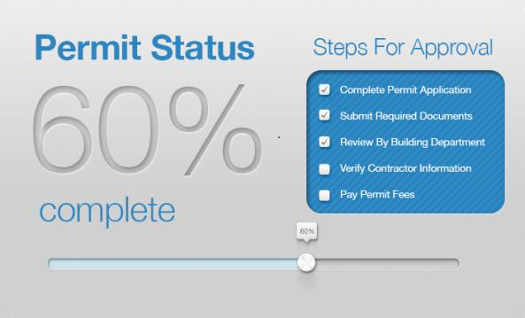
Streamlined Permitting, Inspection
Web-Based permitting
Track you permits in real time
Eliminate trips to permitting office
Notes:
By combining a simple, efficient way to submit application requests with the ability for Authority having jurisdictions (AHJ’s) and installers to view and share information seamlessly, Simply Civic is removing many of the barriers that have traditionally prevented permit, inspection, or interconnection requests from being processed as efficiently as possible.

Slide 23

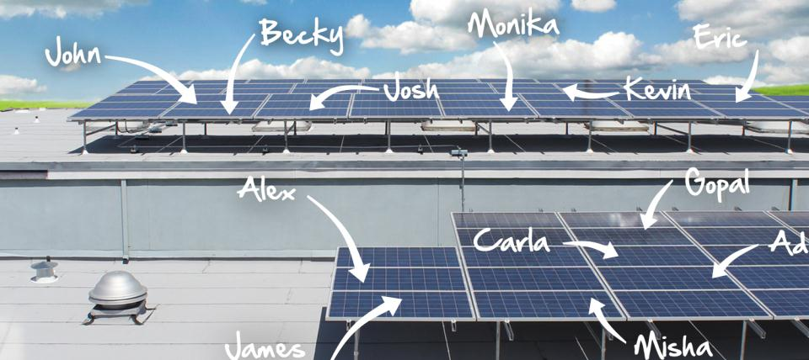
Crowd-Funded Solar
Non-homeowners can go solar for $25
Crowdfunding lowers the cost of capital
Notes:
Solar Mosaic will bring much-needed capital to the solar industry by building a web platform for everyday Americans to create and fund solar projects. Mosaic's unique online crowdfunding platform will help reduce the soft costs of solar financing and customer acquisition while enabling thousands of Americans to own a piece of the growing clean energy economy.
A recent NREL study concluded that only 22-27% of US residential rooftop area is suitable for solar photovoltaic installations. This model makes it possible for many more Americans to participate in going solar. (1)
Crowd-funded capital lowers the cost of financing for borrowers. For example, crowd-funding platforms providing consumer loans at 30% lower than consumer bank loans. (2)
With help from the DOE, Mosaic will enable millions of Americans to finance solar projects in communities around the country, creating new jobs and stimulating local economies.
Picture: Solar Mosaic Project, Asian Resource Center, Oakland, CA
Sources:
(1) NREL. “Supply Curves for Rooftop Solar PV-Generated Electricity for the United States.” Accessed: 06/06/2012 <http://www.nrel.gov/docs/fy09osti/44073.pdf>
(2) Lending Club, “Compare Rates.” Accessed: 06/06/2012 <http://www.lendingclub.com/public/compare-borrower-rates.action>

Slide 24
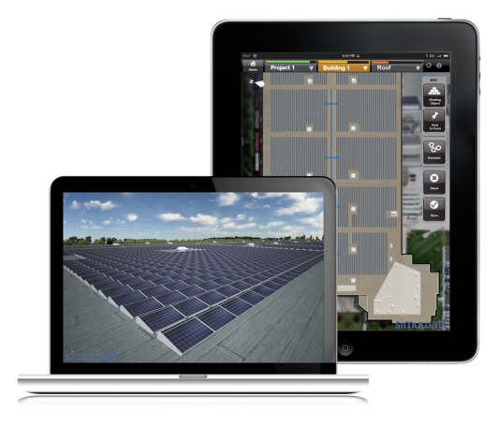
Instant System Design
Mobile platform
3D system renderings
Instant design documentation for permits
Notes:
concept3D is building simuwatt, a virtual, visual, data-rich mobile application to rapidly determine solar energy output for commercial buildings and instantly provide design documentation for permits. simuwatt will also enable 3D visualization of solar projects for utilities, installers, and manufacturers, creating a new pathway to reduce customer acquisition costs.

Slide 25
Comparison Shopping for Solar
Your home profile viewable by many installers
Installers compete for your business
Save 10% or more on your PV system
Notes:
EnergySage™ is building a solar quote comparison shopping platform that simplifies the solar purchase process for property owners
The platform helps consumers to get the best price by automating the collection and comparison of multiple quotes.
In just a few minutes a consumer can solicit multiple quotes from a long list of pre-screened, high-quality installers.
The quotes are displayed in a standardized format that allows consumers to easily evaluate and compare them to select the best option
The tool is integrated into EnergySage’s purchase platform that includes a comprehensive suite of educational, analytical, and comparison-shopping tools, providing consumers with confidence in their purchase decision.
EnergySage.com streamlines the cumbersome solar photovoltaic purchase process and lowers the cost of installed systems. fostering price transparency and competition.
EnergySage™ helps installers grow their business and bottom-line by reducing their sales costs by up to 60% and providing access to a large pool of educated, ready-to-buy consumers.
Everyone saves time, money and hassle.

Slide 26

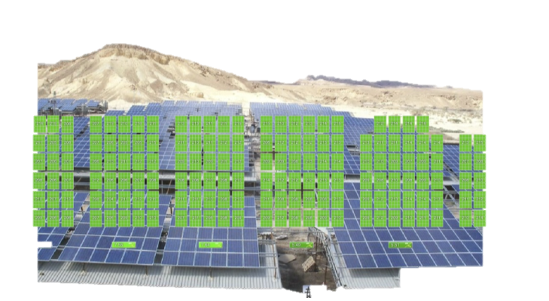
Faster, Lower Cost O&M
Real-time panel-by-panel performance monitoring
Automated commissioning
Automated notification when service is cost effective
World’s largest PV performance database opened to universities
Notes:
Tigo Energy is developing innovative software for solar PV systems that will use module-level monitoring data to automate key steps in the commissioning process, analyze system performance characteristics, and optimize the scheduling of ongoing O&M activities. This will benefit installers, system owners, and operations personnel by enabling them to target service and maintenance precisely where and when it is needed, reducing up-front labor costs and helping provide the lowest levelized cost of energy.
You can only improve what you measure. Tigo Energy is developing innovative new software which will improve the commissioning and operations of solar PV systems by analyzing module-level performance measurements.
Targeted, proactive commissioning and O&M enabled by Tigo Energy's advanced software ensures the highest safety and lowest cost of clean, renewable energy from PV systems.
The Tigo Energy Academic Data Portal will provide access to over 163,416 years of module-level monitoring data.

Slide 27
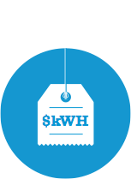


“
What’s my utility bill with solar?”
Answer took hours.
Enter Zip
GO
Now it’s one click.
Notes:
“Whats my bill with Solar?" With over 3,000 utilities and 10,000 rate plans the answer is unique for each customer. It took hours to work out. Now Genability determines costs and saving for a specific project. With one click you can find out or Developers will give you a better answer and reduce their sales soft costs 30%.

Slide 28
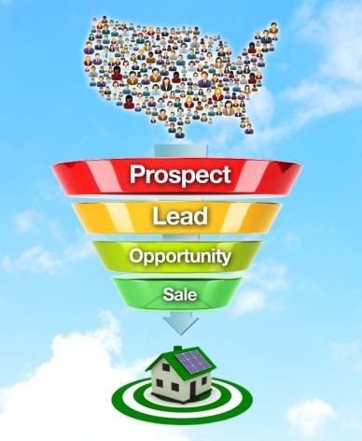

Cloud-based Customer Acquisition Toolkit
Efficiently convert solar curiosity to solar systems
Save $1000 per avg residential install
Impacts 10,000+ leads/mo, 300+ installers, 50%+ of the residential market*
*(by install volume, at software launch)
Notes:
Every American home and business is a potential candidate for a solar system and many would experience significant financial and environmental benefits. So why doesn’t everyone have solar right now? The challenge is to create awareness and increase adoption rates.
Clean Energy Experts, a company that already supports hundreds of installers by generating thousands of leads each month across America, is developing a software platform that will drastically improve the ability to convert solar curiosity into solar systems!
The online software platform will be available to all installers across the country and is expected to save approximately $1,000 per average residential installation.

Slide 29
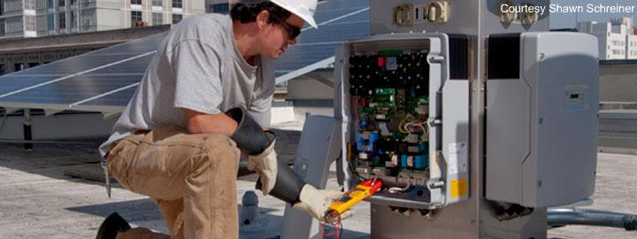

ONLINE O&M MARKETPLACE FOR SOLAR INSTALLATIONS
Access lifetime system O&M, for less
50%+ reduction in financing costs
Prerequisite for securitization of solar
Notes:
O&M marketplace project addresses a major impediment to widespread consumer adoption of and investor interest in solar. Consumers and investors want assurance that their system/asset will be cared for during the length of the contract (20-25 years). At the moment, consumers are locked into a relationship with their system installer, and investors have no recourse to bidding out system O&M to make sure they’re getting competitive services. The O&M marketplace provides a market-based mechanism to supply homeowners and investors with cost-competitive O&M services and creates opportunities for servicing companies to grow their businesses. Removing concerns such as ongoing O&M is key to bringing more investors into the solar market and to securitization, which would flood the market with capital and make solar a true mass-market consumer good.
“Clean Power Finance is working on a project, supported by SolarCity, Google and Morgan Stanley, to create an online marketplace for operations and maintenance (O&M) services on installed solar systems. Using this marketplace, companies that provide residential solar financing will competitively bid out servicing jobs or work orders to a pool of O&M vendors (like the gentleman in the picture). How to obtain quality, cost-competitive O&M services is a concern for some homeowners and investors. This marketplace will address that concern, paving the way for increased solar adoption and investment, and eventually securitization.”

Slide 30
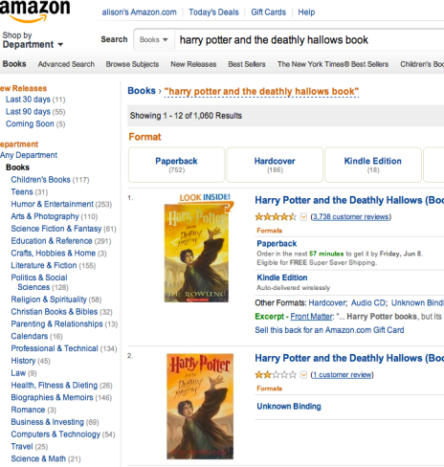
ONLINE BROKERAGE FOR CUSTOMER ACQUISITION FOR SOLAR INSTALLERS
10% $/W reduction
15% more labor efficiency
Average installation times cut by 20 days
Notes:
Clean Power Finance is building an online brokerage for customer acquisition for solar installers. The brokerage will enable installers to use the services of independent companies to lower their acquisition cost as well as their operations cost through steadier project flows. You can draw a simple comparison to Amazon or eBay, where you can buy different items from different vendors so you can mix and match what works best for you. The image on this slide, for instance, is a book available on eBay: let’s say you were buying books for your child’s school library, and you wanted a complete set of Harry Potter books. But one seller only has this book; another has two, and a third has the rest. You can buy from multiple providers to complete your task. With the brokerage, installers can better mix and match where they install, when they install, what equipment they use and for how much. The brokerage provides a more efficient way for solar installers to acquire new customers and install more solar and allows solar companies to grow faster by focusing on core competencies. Specialization leads to economies of scale which ultimately drives down the installed cost of solar.
“Clean Power Finance is building an online brokerage for customer acquisition for solar installers. That’s a mouthful. A comparable situation would be Amazon or eBay, where people can buy different items from different vendors to mix and match to suit individual needs. In this case, the brokerage would allow installers to us the services of independent companies to better mix and match where they install, when they install, what equipment they use and for how much. This outsourcing of services will allow solar companies to focus on their core competencies. This specialization will lead to economies of scale in the “soft cost” area of the solar industry—a key component to driving down the overall installed cost of solar.”

Slide 31
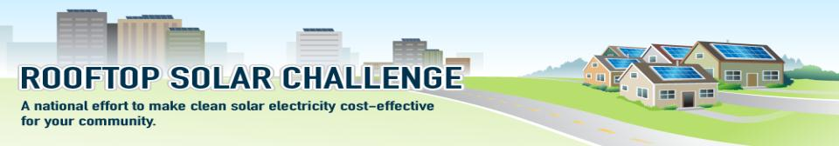
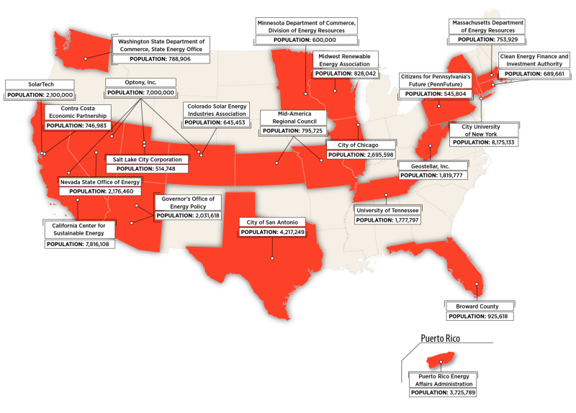
31

Slide 32

Early Successes and Program Targets
Broward County, FL
Permitting: online
Standard design templates for systems
Standard, flat fee across 15 jurisdictions

Slide 33


Early Successes and Program Targets
Group Purchasing
Group purchasing and education programs
Lowering costs, boosting local manufacturing

Slide 34

Early Successes and Program Targets
Optony – Southwest Solar Transformation Initiative
Customized online roadmaps for 60 SW jurisdictions
Planning and zoning revisions adopted

Slide 35
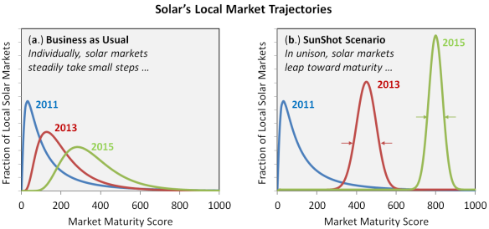
RSC II: Objectives
The Rooftop Solar Challenge II (RSC II) has three goals, which are:
To build strong regional solar markets by rapidly deploying innovative, transformative, locally-generated solutions on a broad scale;
To enable solar companies to more efficiently manage their labor, material and cash flows, and customer interactions by introducing process predictability and standardization at the local government level; and
To increase affordability of residential and small-scale solar PV.
Notes:
In setting out this Funding Opportunity, DOE intends to fund projects which develop a strong national solar marketplace.
We’ve identified that a mature national marketplace is characterized by two parameters: 1) a large portion of highly mature local markets and 2) a narrow distribution of these maturity levels. A narrow distribution signifies uniformity in processes, and a wide distribution signifies market fragmentation. A “business as usual” approach, where each local solar market matures on its own terms, leads to a stratified national marketplace. The Rooftop Solar Challenge II spurs communities to rapidly scale practices and policies, such as streamlined permitting and interconnection processes, in order to eliminate stratification and to bring about solar market growth and cost reduction. Figure 2 conceptually compares national solar marketplace trajectories in a “business as usual” versus a SunShot-inspired approach.

Slide 36
RSC II Action Areas
Applicants should propose compelling and innovative means of achieving improvements and standardization in the following action areas:
Permitting and Interconnection Processes
Financing Options
Planning and Zoning Rules
Net Metering and Interconnection Standards
Notes:
These action areas were designed so that awardees that succeed in all action areas will have the necessary policy and process framework in place to support a robust solar market in their region. While success in one action area would represent important progress, it is only with results in all four action areas that awardees will truly reap the economic and environmental benefits associated with a healthy solar energy market. Applicants will need to engage the necessary stakeholders so that all four action areas can be addressed.

Slide 37


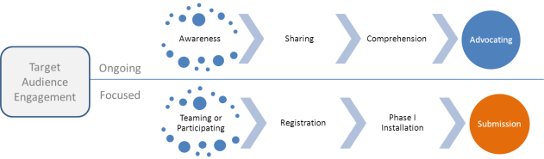
SunShot Prize:
Race to the Rooftops
Phase I + Phase II
5,000 + 1,000
Installations
2015
$10m
Total Prize Awards
$1/W
Average Pre-subsidy
Soft Cost
*
2kW – 15kW
Online Ads
Blog Post
Webinars
Events
* Winner of SunShot Prize: America Most Affordable Rooftop Solar

Slide 38
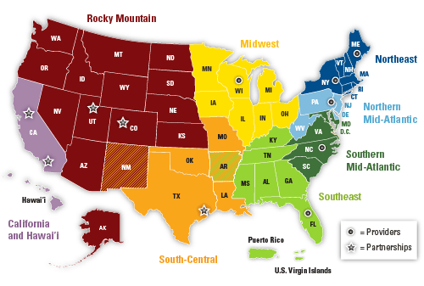
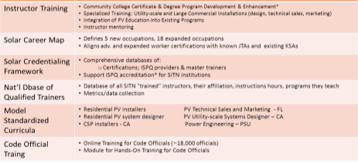
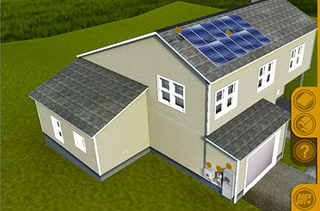
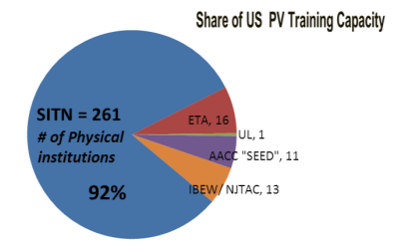
The Solution
Impact
www.NTERlearning.org → “Photovoltaic”
Future: Solar Training and Development – Integration Across Occupations and Sectors

Slide 39

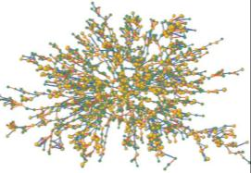
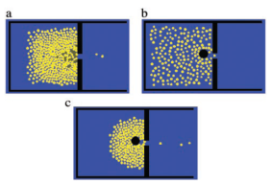
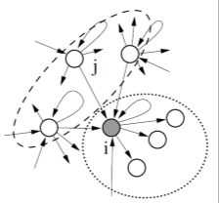
Solar Energy Evolution and Diffusion Studies
Network Science
Overview
Innovation diffusion R&D incorporating the human aspects of our energy challenges can spur policy and business innovation Big data and computer modeling are used to probe such issues in new ways Pilot tests ensure that results are applied in real-time
Agent-based Modeling
Goals
Advance the cutting-edge in innovation diffusion R&D Form partnerships between researchers and market players Develop real-world strategies for solar market transformation
Econophysics

Slide 40
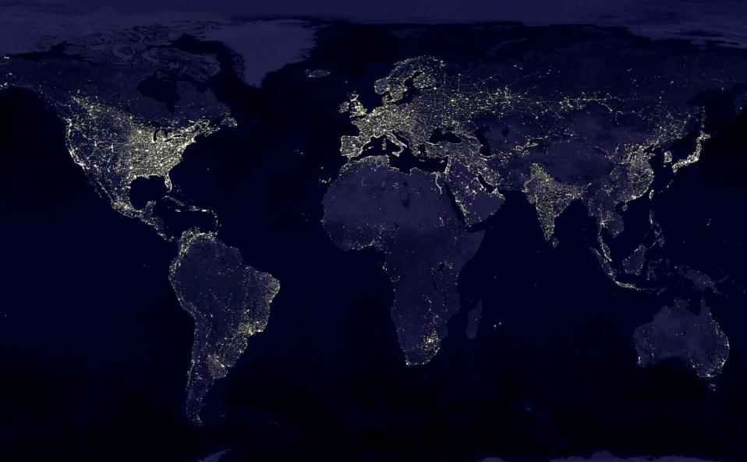

Thank You
Minh Le
Director
SunShot Initiative
Notes:
40

Slide 41
Benefits of Solar and How Solar Works
Clinton A. Sockman
Vice President of Renewable Energy
Advanced Green Technologies

Slide 42
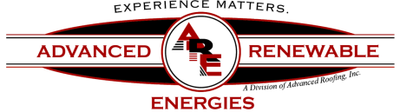
BENEFITS OF SOLAR AND HOW SOLAR WORKS
PRESENTED BY
CLINTON A. SOCKMAN
VICE PRESIDENT
ADVANCED RENEWABLE ENERGIES

Slide 43
WHAT ARE PHOTOVOLTAICS?
Photovoltaics (PV) is a method of generating electrical power by converting solar radiation into direct current electricity using semiconductors that exhibit the photovoltaic effect
Photovoltaic effect is the creation of voltage or electric current in a material upon exposure to light

Slide 44
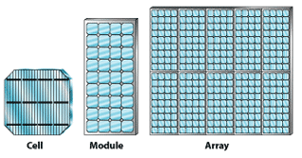
Components of a Photovoltaic Array
Modules

Slide 45
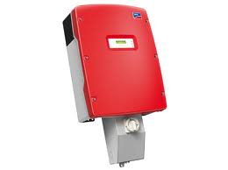
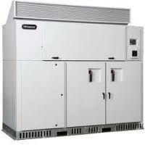
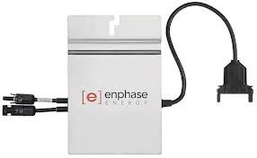
Components of a Photovoltaic Array
Inverters
A power inverter, or inverter, is an electrical power converter that changes direct current (DC) to alternating current (AC);[1] the converted AC can be at any required voltage and frequency with the use of appropriate transformers, switching, and control circuits

Slide 46
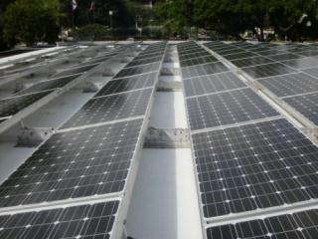
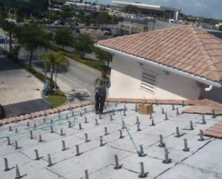
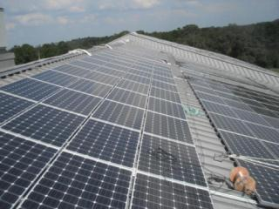
Components of a Photovoltaic Array
Racking Systems
Flat Roofs
Tile Roofs
Shingle Roofs
Metal Panel Roofs

Slide 47




Components of a Photovoltaic Array
Racking Systems Con’t
Carports
Walkways
Awnings
Ground Mounted
Solar Trees

Slide 48




BALANCE OF SYSTEMS
BALANCE OF SYSTEMS
  Data Monitoring
  Weather Stations
  AC and DC Disconnects
  Utility Meters
  Wiring
  Combiner Boxes
Notes:
48

Slide 49



BASIC ILLUSTRATION OF A SOLAR RADIATION AND PV MODULE INTERACTION
Notes:
49

Slide 50

ILLUSTRATION OF A SMALL SCALE RESIDENTIAL
SOLAR ARRAY
Notes:
50

Slide 51

GRID TIED SOLAR PV SYSTEMS AND NET METERING
Net Metering allows Utility customers to earn a payback from connecting approved renewable generation systems - such as solar panels - to the electric grid. On any given day, you generate electricity from free, renewable sources like the sun and wind, providing energy for your home or business and reducing the amount you purchase from your utility and your monthly bills. If your system ever produces more energy than you need, the excess is supplied to the grid and that amount is subtracted from your current monthly bill or banked for use on a future bill in the same calendar year.

Slide 52
BENEFITS OF SOLAR ENERGY
FINANCIAL BENEFITS
  Reduction of your monthly energy bill
  Attractive Tax Credits from the Federal Government
  Utility Rebates and Incentives
  Attractive Return on Investments
  Long Term Hedge against Increasing Energy Costs
  Possible Increase of Home Resale Value
ENVIROMENTAL BENEFITS
  Reduction of your Carbon Footprint by utilizing a virtually endless supply of free clean energy
  Bring awareness to your entire family/organization about energy conservation and consumption

Slide 53
Financing Options for Solar Projects
Wolfgang Beaugrand
MAGE Solar Inc. & Florida Alliance for Renewable Energy Board member

Slide 54
Finance Solutions for Your Solar Project
Wolfgang Beaugrand, MAGE SOLAR USA (Southeast Regional Sales Manager) & Florida Allicance for Renewable Energy (Board Member)

Slide 55
I want Solar today!
How do I pay for it?

Slide 56
Financing Your Solar PV System
Residential
When considering purchasing a Solar PV System, there are several financial considerations.
What is your budget? System size will be affected your energy consumption but also buy only what you are comfortable paying.
You have the option of cash, loan or lease (only available in some states).
  Loan examples include: 10-Year or 20-Year FHA Home Improvement Loans, 30-Year Refinance Options, and always check with your local bank for finance solutions.
  Florida Only - Smart Investment in Solar (SIS): 20-year loan for pre-designed residential MAGE SOLAR Solar Systems
  Leases vary depending on state and installer, but always read the details for the end of the lease – do you own, owe FMV (fair market value), or will the array be removed (at your expense or installers)?
When you purchase your own Solar PV System, whether by cash or loan, you are eligible for a 30% Income Tax Credit (form 5695).
Some states also offer a State Tax Credit.
Some utilities offer a rebate or net metering program.

Slide 57
SIS Kit Options
All Kits are designed using the MAGE 240 / 6 PL US AC Module powered by a SolarBridge microinverter and utilizing MAGE SYSTEMTEC racking for wind loads of 120 mph* (160 mph wind load available at additional cost).
2.88kW (SIS 3-120 or SIS 3-160)
  Two rows of six are standard design
4.8kW (SIS 5-120 or SIS 5-160)
  Two rows of ten are standard design
7.2kW (SIS 7-120 or SIS 7-160)
  Three rows of ten are standard design
10.08kW (SIS 10-120 or SIS 10-160)
  Three rows of fourteen are standard design
Transition cables, cable clips, Power Manager (AC Module) and other BOS are included in each of the standard designed kits for a shingled pitched roof. Other roof structures are available at additional fees.

Slide 58

30% Federal Income Tax Credit Available

Slide 59
Compare Financial Options - Residential
Example: Residential System Value $36,000 gross Current bill $200/mo FICO 650 own, 700+ rent/lease 20 Year Term | A Purchase from savings and cash or home equity | B 20+ FHA Title 1 Home Improvement Loan ~6.95% | C Rent/Lease Equipment
Monthly | $0 | $195 | $170 (~3% increase annually)
Total Paid | $36,000 | $46,800 | $52,924
Total Interest pd | $0 | $21,600 | $0
Incentive | $0 | $0 | $0
Fed ITC Tax credit | - $10,800 | - $10,800 | $0
Interest tax deduction | $0 | $21,600 (dependant on tax rate) | $0
Total spent | $25,200 | $46,800 (minus interest tax deduction) | $52,924
Total Owed after payments | $0 | $0 | *$0 to $52,924 (or FMV or removal)
Asset Value gain/ loss | Home value + System value gain | Home value + System value gain | Lien will be placed on home until end of lease
Ownership | Yes | Yes | No

Slide 60




Finance Options For Commercial End Users*
Commercial
Financing*
► Basic Qualifications Business existing Business existing Business existing
> 5 years > 5 years > 3 years
► Terms** 5-12 years 2-7 years 3 - 7 years
10 (special credit models)
► Tax Lease Options Yes No PPA Equity Options available
► Loan Amount
minimum $0 $50,000 $10,000
maximum $10,000,000 $5,000,000 No upper limit
► Lease Amount Flexible
minimum $500,000 $50,000 $20,000
maximum $10,000,000 $5,000,000 No upper limit
► Funding Amount 100% 100% 100%
► Processing Fee N/A N/A $500
Credited back
upon funding
*Financing available for MAGE SOLAR PV-Systems only. Specific details should be discussed with REEL.
**Dollar amount financed determines terms available.

Slide 61
Finance Options for Municipalities and Schools
Credit Ratings | AA or AAA rated
Lease Terms | 3 to 30+ Years**
Lease Amount
Minimum | $500,000
Maximum | $400,000,000
Buy-Out Option | Yes
Funding Amount | 100%
Availability | All 50 States
Tax-Exempt Lease | Yes
Tax-Exempt Bonds | Yes
Taxable Bonds | Yes
*Financing available for MAGE SOLAR PV-Systems only
**Dollar amount financed determines terms available

Slide 62

Finance Options for Installers
Program Details
Dealer Repayment Terms:
  30 or 60 day terms available to qualified installers
  Payment due in full on day 30 or 60

Slide 63




MAGE SOLAR Finance Solutions Partners*
MAGE SOLAR Complete Solar PV-Solutions
Residential Financing
Commercial Financing
Municipal Financing
Installer Financing
* Financing available for MAGE SOLAR PV-Systems only

Slide 64
MAGE SOLAR – Are you ready?
Let's go!

Slide 65




Contact us:
MAGE SOLAR Customer Service
    (877) 311-6243 Toll-free 720 Industrial Boulevard
    (478) 609-6640 Main Office Dublin, Georgia 31021
    (478) 275-7685 Fax U.S.A.
    info@magesolar.com
    www.magesolar.com

Slide 66
Insurance Coverage for
Your Solar Project
Robert Foote & Susie Krix
Furman Insurance

Slide 67
Insurance Coverage Essentials for Commercial Building Owners with PV Systems
Presenter: Rob Foote, Insurance Advisor/Partner
Susie Krix, Insurance Advisor
Frank H. Furman Inc., Pompano Beach, Florida
January 25 - 26, 2013

Slide 68

Who are We?
50 years of insurance and risk management advise to corporations and property owners in Florida
The Furman Agency, is a “Top 20” Agency as reported by SFBJ.

Slide 69
Insurance Coverage Essentials for Commercial Owners – Solar Systems
Replacement Cost insurance coverage provision reduces negative financial impact to building Owner, in the event of a Wind or a severe Fire Loss, that may cause severe damage to PV System
Replaces Building/PV Equipment “New for Old”
PV= Photovoltaic (PV)

Slide 70
Co-Insurance Impact – The insured value of the Building must include the replacement cost of the (PV) system
If insurance policy requires 90% co-insurance, then insured value of building and PV system must equal 90% today’s of replacement value
  i.e. Building value including PV investment is
  $1 Million:
    A major wind event occurs causing a roof blow claim
    The property Owner carries $500,000 of insurance coverage then at settlement time = $0.50 on the Dollar

Slide 71
Stored Materials?
Partially installed PV System
Who is responsible?
Contractual Risk Transfer – Building Owner must either protect the PV on the first party policy insurance policy or contractually transfer risk to PV installer.
Potential Exposure – Who replaces partially completed (PV) System in the event of an electrical fire during the course of installation?
  Must address contractually
  i.e. building Owner may insist on the PV installer to accept Risk until the system is put to intended use

Slide 72
Installation Floater
Protects the PV System while on site
Who is responsible pays to protect PV equipment?
  Mounting System
  Panels
  Inverters
Does PV Contractor have a Blanket or site specific Installation Floater?

Slide 73
Solar System Performance Guarantees
Who guarantees the Output?
Panel manufacturers warranty – How proven and financially stable is the panel manufacturer?
PV Contractor/Installer – Can a family owned PV contracting firm absorb the efficiency guarantee risk on their balance sheet?

Slide 74
Key Components of efficiency guarantees
Identify Percentage of output anticipated/guaranteed to building Owner i.e. 80%, 90% etc.
What is financial remedy/consequence to the PV installer/Design firm if output does not reach contractually guaranteed levels?

Slide 75
Energy efficiency Guarantees - An emerging exposure for insurance industry,
Installer must qualify
Balance sheet strength of PV installer
Completion track record/experience
Time tested PV Components i.e. inverters, panels, auxiliary equipment etc.
Expertise of Design/Engineering firm
The number of years of the Guarantee
Maintenance and Monitoring of System

Slide 76
General Risk Management Recommendations for Building Owners that are contemplating a PV Project
Building owner must have a formal written contract with PV installer, transferring risk (away from Owner) to the Installer
  Invest in Legal Council to draft your contract and do not sign Installers Contract
  Indemnification Provisions
  Hold Harmless Provisions
Sample Insurance requirements for the PV Contractor:
  $1 Million General Liability – including completed operations/products
  $1 Million Workers’ Compensation – protection for falls, etc.
  $1 Million Automobile – Protect Tenants/General Public from Auto Exposure
  Installation Floater for value of PV system

Slide 77
Protect your Home and Control Personal
Insurance Cost
Solar Energy Systems and Homeowners Insurance
Susie Krix
Manager Personal Lines
Frank H. Furman, Inc.

Slide 78
Insurance
Most Homeowners Policies already have Solar System coverage included in their Homeowners Policy
You should contact your agent if a Solar System is installed and discuss:
    Value
    Coverage Increase

Slide 79
Insurance
Homeowners have the duty…..
In case of damage to the solar system, due to wind or other hazards, to protect property from further penetration damage
For coverage to apply Solar System must be attached to the home

Slide 80

Controlling the cost of insurance
What is the most critical item?
Mitigation Inspection
  Roof
    Florida Building Code
    Windstorm Protection
      Impact vs. non-Impact
  Make sure Inspector sees enhancements
    Homeowner should receive copies of inspection and photos

Slide 81

Rob Foote, Commercial Insurance Advisor
Susie Krix – Personal Insurance Advisor
Frank H. Furman Inc.
1314 E. Atlantic Blvd.
Pompano Beach, FL 33060
800-344-4833
          Corporate Insurance
          Homeowner’s Insurance
          Bonds
          Risk Management
          OSHA Compliance
          Employee Benefits Programs

