Slide 1
Solar 201 for Residents, Small Businesses and Interested Stakeholders

Slide 2
Know Your Solar Rights
Jason M. Rodgers-da Cruz, Esq.
Siegfried, Rivera, Lerner, De La Torre & Sobel, P.A.

Slide 3
Know Your Solar Rights
Presented by: Jason Rodgers-da Cruz

Slide 4
Section 163.04, Florida Statutes, entitled “Energy devices based on renewable resources.”
(1) Notwithstanding any provision of this chapter or other provision of general or special law, the adoption of an ordinance by a governing body, as those terms are defined in this chapter, which prohibits or has the effect of prohibiting the installation of solar collectors, clotheslines, or other energy devices based on renewable resources is expressly prohibited.
(2) A deed restriction, covenant, declaration, or similar binding agreement may not prohibit or have the effect of prohibiting solar collectors, clotheslines, or other energy devices based on renewable resources from being installed on buildings erected on the lots or parcels covered by the deed restriction, covenant, declaration, or binding agreement. A property owner may not be denied permission to install solar collectors or other energy devices by any entity granted the power or right in any deed restriction, covenant, declaration, or similar binding agreement to approve, forbid, control, or direct alteration of property with respect to residential dwellings and within the boundaries of a condominium unit. Such entity may determine the specific location where solar collectors may be installed on the roof within an orientation to the south or within 45° east or west of due south if such determination does not impair the effective operation of the solar collectors.

Slide 5
Section 163.04, Florida Statutes, entitled “Energy devices based on renewable resources.”
(3) In any litigation arising under the provisions of this section, the prevailing party shall be entitled to costs and reasonable attorney’s fees.
(4) The legislative intent in enacting these provisions is to protect the public health, safety, and welfare by encouraging the development and use of renewable resources in order to conserve and protect the value of land, buildings, and resources by preventing the adoption of measures which will have the ultimate effect, however unintended, of driving the costs of owning and operating commercial or residential property beyond the capacity of private owners to maintain. This section shall not apply to patio railings in condominiums, cooperatives, or apartments.

Slide 6
Condominium Unit Owner Considerations
Governing Documents
Common Elements
Potential damage to Common Elements

Slide 7
Net Metering, Interconnection and Solar Rebates
John McComb
Florida Power & Light

Slide 8
GO SOLAR Fest
FPL Customer Service
Customer Technology Support
John McComb, P.E., E.C.
Jan. 26,2013

Slide 9
Agenda
The FPSC Net Metering rule
Net Metering Example
Net Metering Interconnection Requirements
Net Metering Customers
FPL Contact Information

Slide 10
FPSC Rule 25-6.065: Interconnection and Net Metering of Customer-Owned Renewable Generation
The Public Service Commission of Florida sets forth the requirements for interconnecting a renewable energy source
The rule:
Sets forth the conditions required for a renewable energy source to be interconnected with the local utility safely through the customer’s internal wiring
Requires an interconnection agreement between the customer and the utility
Defines Net Metering as a metering and billing methodology whereby customer-owned renewable generation is allowed to offset the customer’s electricity on-site
All retail rate customers are eligible it interconnect once they satisfy the program requirements found at www.FPL.com/netmetering

Slide 11
Net metering measures both energy used from the grid and excess energy produced that is sent to the grid
FPL’s meter only measures the “excess energy” sent to the grid, not the total energy produced by the PV system

Slide 12
Net Metering Interconnection Agreement
All renewable energy systems connected to the grid require an interconnection agreement
An agreement between FPL and a customer, allowing the customer to safely interconnect a renewable energy system to the grid through internal wiring
The Interconnection Agreement has different requirements dependent upon the system (tier) size
Tier 1 – 0 kW to 10 kW AC
Tier 2 – Larger than 10 kW to 100 kW AC
Tier 3 – Larger than 100 kW to 2,000 kW AC
All retail rate customers are eligible it interconnect once they satisfy the program requirements found at www.FPL.com/netmetering

Slide 13
Interconnection Agreement – Tier 1 Requirements
The majority of renewable energy systems meet the Tier 1 requirements
To approve the system to be energized, FPL must have copies of:
Application
This document includes customer and system information necessary to approve the interconnection agreement
Completed Interconnection Agreement
An agreement between FPL and a customer, allowing the customer to safely interconnect a renewable energy source to the grid through internal wiring
Building Permit approving the installation of the renewable energy system. This permit must be signed by the local Authority Having Jurisdiction (AHJ)
Tier 2 and Tier 3 have additional requirements for insurance and a safety disconnect switch

Slide 14
FPL has renewable energy customers throughout its service area
Interconnected Customers as of Jan. 15, 2013
Broward FPL
Residential
Customers 146 1,710
kW 870 9,666
Commercial
Customers 65 456
kW 1,555 9,795

Slide 15
You can contact FPL by email, phone or fax if you have questions on net metering or solar rebates
Contact Information
www.FPL.com/netmetering
Agreements, application and instructions
www.FPL.com/solarrebates
Solar rebate reservation information
E-mail: netmetering@fpl.com
SolarPVSupport@fpl.com
Phone: (305) 387-6614 - Net Metering
(800) Dial FPL - Solar Rebates
(305) 552-2275 - Net Metering FAX

Slide 16
FPL’s Solar Rebate Program

Slide 17
FPL offers solar rebate programs for customers who install solar photovoltaic (PV) and solar water heating systems in their homes and businesses
FPL’s Solar Rebate Programs
FPL’s solar rebates are part of a five-year pilot program authorized by the Florida Public Service Commission to promote clean solar power and reduce energy consumption
Rebates are limited and will be available on a first-come-first-served basis
Any system components installed prior to FPL’s issuance of a rebate reservation will not qualify for the rebate
Notes:
Welcome and short description of each topic
17

Slide 18
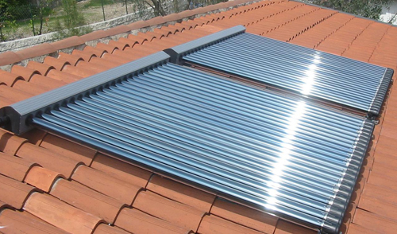
There are four rebate programs that are available to customers
Solar Pilot Portfolio Overview
Solar Water Heating
RESIDENTIAL REBATES | BUSINESS REBATES
Solar Photovoltaics
RESIDENTIAL REBATES | BUSINESS REBATES
Notes:
Portfolio has 7 programs,
6 resulting in customer owned installations of solar water heating and PV
1 that allows FPL to demonstrate, educate and evaluate emerging renewable technologies
The incentive programs are focused on the 2 technologies identified by the FPSC : Solar Water Heating and Solar PV
The Renewable Research and Demonstration project
Allows FPL educate and create awareness around the applicability of these technologies.
Makes sure that FPL is ahead of technology curve and has reliable performance data on new technologies.
Total budget cap of approximately $2.5 MM over 5 years
FPL led a collaboration with TECO, Gulf and Progress that led to consistency across the solar portfolios
Most incentive programs offered are the same, the only exception is that FPL is only utility with business solar water heating
Florida rebate information showed FPL business customers installing SWH
Incentive structures are similar
Differences in budget allocations stem primarily from differences in the limitations on overall pilot funds. Gulf and Teco very small budgets.
FPSC staff trying to investigate and achieve more consistency of allocations across utilities without a formal workshop.
18

Slide 19
FPL is offering new rebate programs for customers who install solar photovoltaic and solar water heating systems in their homes and businesses
Residential Solar Water Heating $1000 per installed solar water heater. One rebate per premise* for the life of the program | Business Solar Water Heating $30 per 1,000 BTUh/day of the maximum rated output of the installed system; $50,000 maximum rebate amount per premise* for the life of the program (Customers with multiple premises* can receive a maximum combined rebate for their premises* of up to $150,000 per funding year)
Residential PV $2 per watt of the direct current (DC) rating of the solar panels of a PV system , with maximum rebate of $20,000 per premise.* One rebate per premise* for the life of the program | Business PV Variable rebate depending on the direct current (DC) rating of the solar panels: $2 per watt for the first 10 kilowatts, $1.50 per DC watt 10 kW up to 25 kW, and $1 per DC watt greater than 25 kW. Up to $50,000 per premise* for the life of the program (Customers with multiple premises* can receive a maximum combined rebate for their premises* of up to $150,000 per funding year)
*A premise is defined as a dwelling or business under the control of a single customer where electric utility service terminates. Separate buildings and adjoining buildings in a group of buildings, which have separate FPL electric service, and contain separate dwellings or businesses, are separate premises.

Slide 20
Get ready
You will need to log-in to your account on www.FPL.com in order to apply for this program,
If you are not registered with FPL you will need to register for online access
Mark your calendar to go to www.FPL.com/solarrebates
You will be prompted to log-in using the username and password that you created for online access to your account
2014 funds will be available in October, 2013, date and time is TBD

Slide 21
PV Checklist
The FPL Rebate Certificate with the FPL customer’s signature.(can be downloaded at www.FPL.com/solarrebates )
A signed purchase agreement contract for the purpose of the photovoltaic system
A document showing the anticipated annual electric production of the proposed system using the PVWatts-1 calculation
Digital photos of the installation
Digital photos panel nameplate(s) (sticker located behind the panel that specifies the wattage of the panel)
A copy of the contractor’s invoice
Net-metering application
A signed Net Metering Interconnection agreement
A copy of the final passed permit, indicating the date the permit was applied for and the date it passed inspection. Permit issued date must be after reservation approval date
If your PV system is Tier 2 or 3, proof of insurance

Slide 22
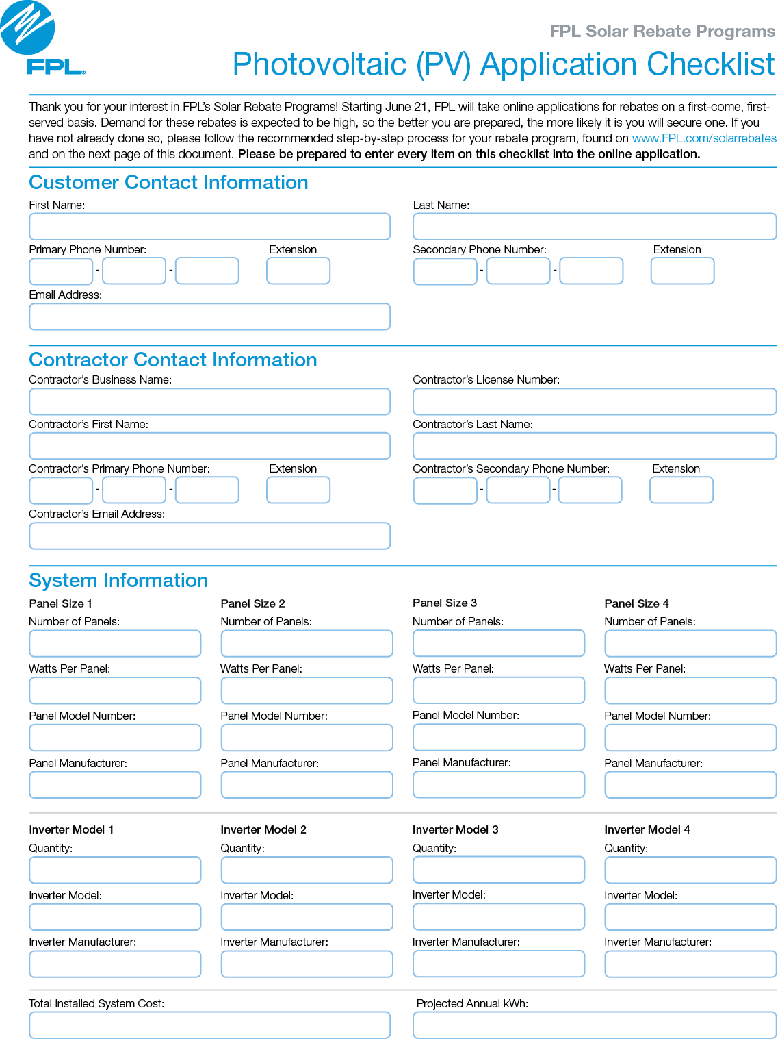
PV Checklist

Slide 23
Go Solar Online Permitting System Designs
Gino A. Valderrama, PE
Vice President/CLA Operations Manager
TY Lin International

Slide 25
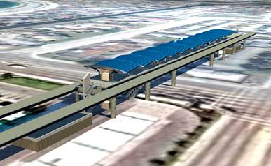
Challenges
Develop a prototype roof mounting system for residential and small commercial Photovoltaic Panels using available industry systems
Comply with Florida Building Code 2010 for Overturn, Uplift, Exposure, etc.
Make the system web based and user friendly
Incorporate industry construction practices

Slide 26
Roof Layout

Slide 27
Up-lift Calculations

Slide 28
Mounting Details – Various Roof Types

Slide 29
Flat Roofs

Slide 30
Flat Roof Details

Slide 31
Thank You!

