Slide 1
Photovoltaic Innovation Landscape: A Global and Local Perspective
Fatima Toor, Ph.D.
Research Analyst
Lux Research Inc.
June 6th, 2014

Slide 2
About Lux Research
Technology coverage
Helps clients find new business opportunities from emerging technologies in physical and life sciences
Offers ongoing technology and market intelligence, as well as market data and consulting services
Over 250 clients on six continents – multinational corporations, investors, governments, and SMEs
Global reach, with over 90 employees in Boston, New York, Amsterdam, Singapore, Shanghai, and Tokyo
Combines deep technical expertise with business analysis to support strategic decisions
Solar
Agricultural Innovation
Energy Storage
Autonomous Systems
Alternative Fuels
Bio-based Materials & Chemicals
Food and Nutrition
Exploration and Production
Water
Advanced Materials
Bioelectronics
Energy Electronics
Sustainable Building Materials
Efficient Building Systems
Printed, Flexible, and Organic Electronics
China Innovation

Slide 3
Agenda
Photovoltaic (PV) Market Trends
Global PV Innovation Trends
Near Term : Silevo & Solar Frontier
Long Term: Solexel & Heliatek
Florida PV Industry Landscape
Research Institute: Florida Solar Energy Center
Solar Initiatives by Florida Light & Power
PV Industry Outlook
Notes:
http://www.seia.org/state-solar-policy/texas

Slide 4
100% Overcapacity in 2012…..however 2015 will Bring Supply Constraint
Source: Lux Research
Q4 2013 Supply Tracker

Slide 5
Global Trade Wars on the Rise
U.S. Tariffs on Chinese Solar Cells
EU Tariffs on Chinese Solar “Panels”
Chinese Tariffs on U.S. and South Korean Polysilicon Dumping

Slide 6
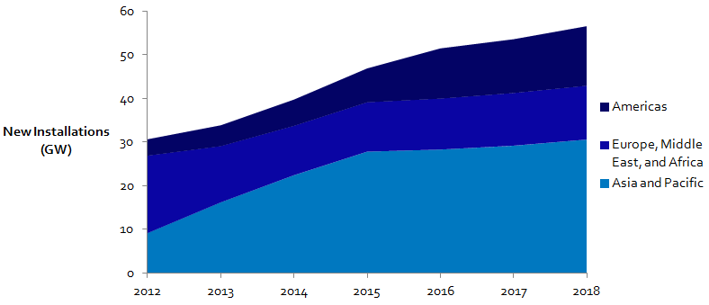
Total Global PV Module Demand will be Dominated by Asia and Pacific
Source: Lux Research

Slide 7
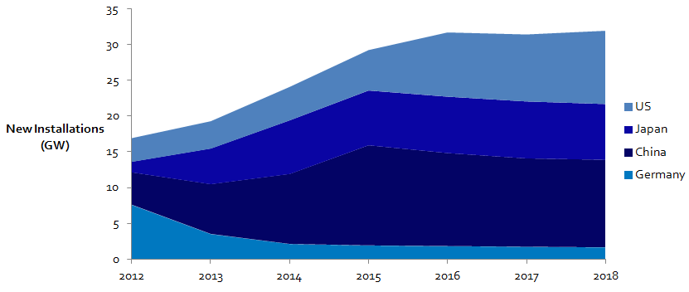
China, Japan, and U.S. Drive New Installations Today as Germany Dials Down
Source: Lux Research

Slide 8
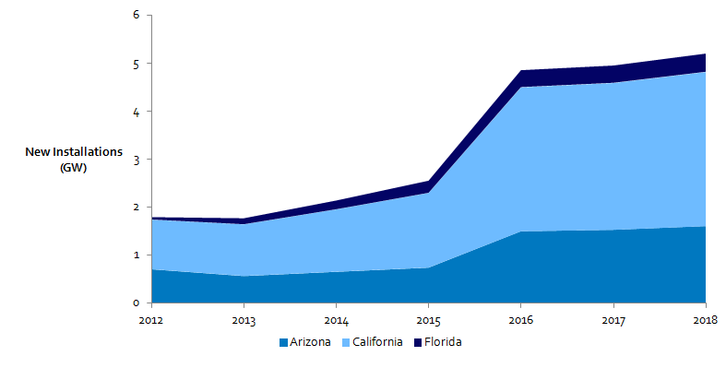
Within U.S., California will be the Largest Demand Market while Florida will Reach 400 MW/year of New Installations by 2018
Source: Lux Research

Slide 9
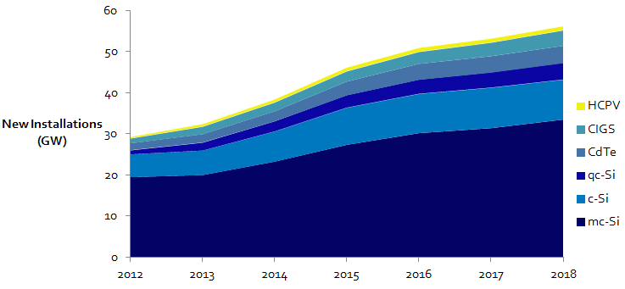
Crystalline Silicon Will Dominate the PV Module Demand
Source: Lux Research

Slide 10
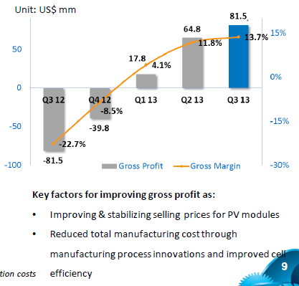
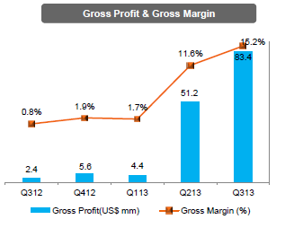
2013 Investor Presentations Indicate Return of Double Digit Margins for Tier 1 Module Manufacturers

Slide 11
Agenda
Photovoltaic (PV) Market Trends
Global PV Innovation Trends
Near Term : Silevo & Solar Frontier
Long Term: Solexel & Heliatek
Florida PV Industry Landscape
Research Institute: Florida Solar Energy Center
Solar Initiatives by Florida Light & Power
PV Industry Outlook
Notes:
http://www.seia.org/state-solar-policy/texas

Slide 12
Cost, Efficiency, and Price are the Fundamental Drivers of the Photovoltaic Industry
Price & Profit
Margin
Incentives &
Demand
Cost & Module
Efficiency
Source: Lux Research

Slide 13
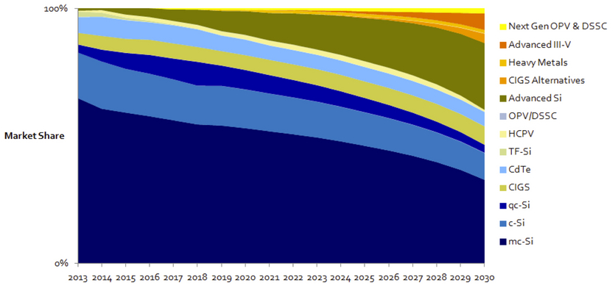
PV Modules in 2030 Will be More Technologically Diverse Than Today
“Energy revolution by accelerated [technology] evolution is needed because given the high storage costs, PV needs to be at least two to three times cheaper than where it is today, for solar electricity generation and storage to become cost competitive to traditional sources of energy” – J. Poortmans, IMEC
Source: Lux Research

Slide 14
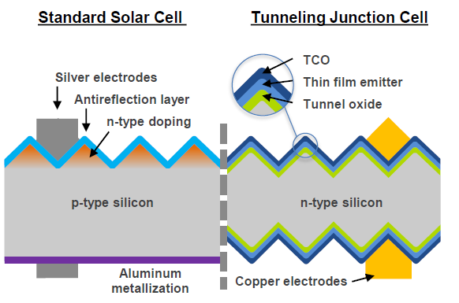
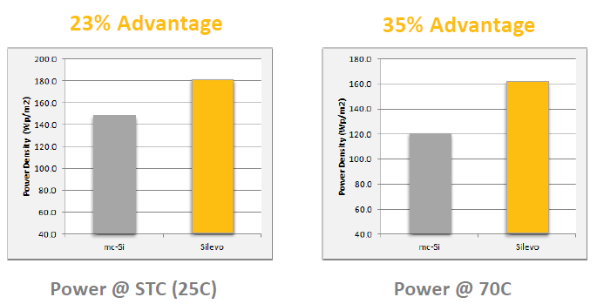
Silevo
Technology
Small scale c-Si cell and module manufacturer
156 mm x 156 mm n-type c-Si high-efficiency solar cells named Triex with electroplated Cu metallization and tunnel junction oxide
Industry’s first 72 cell module with 355 W output enables BOS and labor cost reductions of $0.37/W
Module efficiency is 18% to 18.5%; production costs of $0.95/W at 32 MW capacity in Hangzhou, China
Strategy and Markets
Claims 100% capacity utilization in China
Currently building a 200 MW cell and module facility in upstate New York, U.S.
Lux Take: Positive
Silevo is a strong competitor to SunPower and Panasonic in terms of technology and production costs
Triex Cells have Lower Temperature Coefficient than Conventional mc-Si Cells

Slide 15
Solar Frontier
Technology
Develops sputtered copper indium gallium selenide (CIGS) modules with an efficiency of 13.8% for commercial modules and 14.6% champion efficiency; module manufacturing costs of $0.67/W
Ultra-thin module with 2 mm thick glass, named Solacis neo, with a special mounting system, Cross One, for the residential market
Research partnership with IBM for copper zinc tin sulfide (CZTS) solar cells
Strategy and Markets
Module capacity of 980 MW with expansions plans to go beyond 1 GW
Solar Frontier/SUNY CNSE conducting feasibility study to build a CIGS module manufacturing facility in Buffalo, NY
Lux Take: Positive
Solar Frontier is the only company that has been able to successfully scale CIGS modules and will benefit from the booming Japanese as well as growing global demand
Innovation Partners

Slide 16
Solexel
Technology
Develops thin-film superstrate (TFSS) epitaxial silicon (epi-Si) solar cells with 21.2% efficient 156 mm X 156 mm champion solar cell
Expects module costs to reach $0.62/W at 100 MW of production and $0.42/W long term at scale
Strategy and Markets
Targeting lightweight and flexible modules for initial penetration to maintain high margins
Raised a total of $164 million; plans to ramp a pilot cell line in 2014, followed by a 100 MW cell facility in Malaysia while contracting out module assembly
SunPower is a recent investor
Lux Take: Wait and See
Promising epitaxial silicon kerfless wafer technology with reasonable capex and low materials costs; will need to prove scalability
Solexel’s Epi-Si Module Manufacturing Process
Flexible Epi-Si Cell

Slide 17
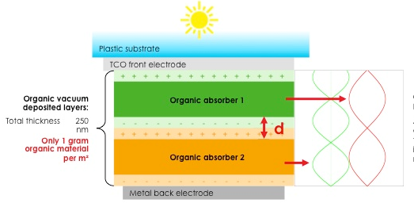
Heliatek
Technology
Develops vacuum-deposited small molecule bulk heterojunciton organic photovoltaic cells
Verified 12% efficient cell at AM1.5 conditions with 1.1 cm² area on glass substrate; claims 10.5% small cell efficiency on PET
Claims manufacturing costs of $10/W to $20/W
Strategy and Markets
Targeting building integrated photovoltaics (BIPV), automobiles, and consumer electronics applications
Company plans to sell semi-finished products to undisclosed partners who are glass, concrete, steel, polycarbonate, membrane, and car roof manufacturers
Lux Take: Caution
Costs are too high while efficiencies are non-competitive to other thin-film PV technologies for BIPV applications
Heliatek’s p-i-n tandem cell
Innovation Partners

Slide 18
Agenda
Photovoltaic (PV) Market Trends
Global PV Innovation Trends
Near Term : Silevo & Solar Frontier
Long Term: Solexel & Heliatek
Florida PV Industry Landscape
Research Institute: Florida Solar Energy Center
Solar Initiatives by Florida Light & Power
PV Industry Outlook
Notes:
http://www.seia.org/state-solar-policy/texas

Slide 19
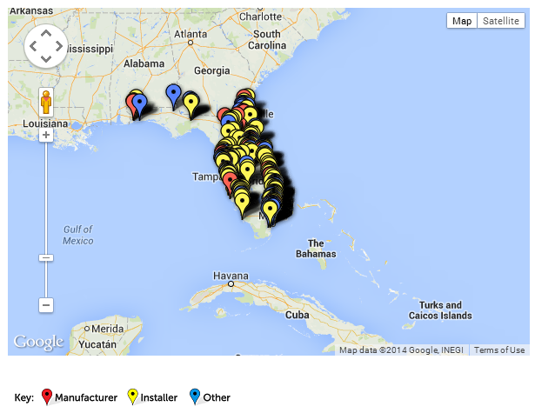
306 Solar Companies at Work Across the Value Chain in Florida
169 contractors/installers
46 manufacturers
29 distributors
21 project developers
41 engaged in other solar activities including financing, engineering and legal support
Source: SEIA

Slide 20
Florida Solar Energy Center
Florida Solar Energy Center is a research institute of the University of Central Florida, located on a 20 acre research complex
PV Materials Research
FSEC faculty involved in research of low cost and high throughput production of CIGS modules on glass and stainless steel substrates for terrestrial and space applications
PV and Concentrating Solar Power (CSP) Systems Testing
FSEC /UCF remains the only test facility in the U.S. capable of testing certain types of CSP system equipment
FSEC/UCF partnered with Sandia National Laboratories (SNL), the Southwest Technical Development Institute (SWTDI), and the California Energy Commissions Public Interest Energy Research (CEC PIER) to characterize the performance of PV modules and inverters operating over extended periods of time

Slide 21
2012-2017 Cost Trends Indicate that CIGS and mc-Si Manufacturing Costs will Converge
Source: Lux Research

Slide 22
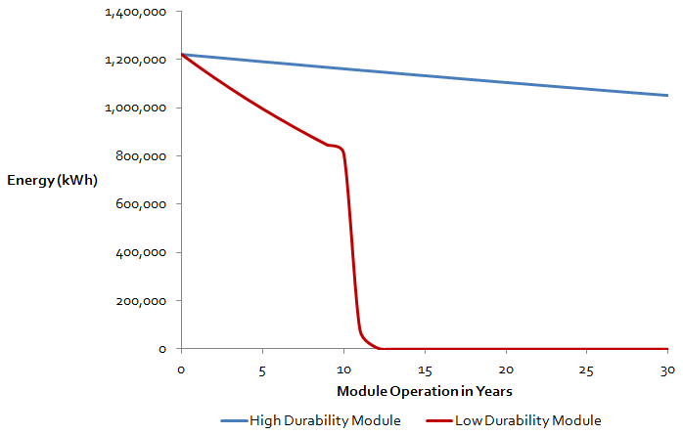
Net Present Value (NPV) Energy of PV Power Plants over 30 Years can Vary Significantly due to Module Quality
Financial Metrics | High Durability Module | Low Durability Module
LCOE ($/kWh) | $0.115/kWh | $0.323/kWh
NPV energy over 30 years ($) | $17.57 million | $8.o4 million
Loss ($) |  | $9.53 million
Source: NREL

Slide 23
Agenda
Photovoltaic (PV) Market Trends
Global PV Innovation Trends
Near Term : Silevo & Solar Frontier
Long Term: Solexel & Heliatek
Florida PV Industry Landscape
Research Institute: Florida Solar Energy Center
Solar Initiatives by Florida Light & Power
PV Industry Outlook
Notes:
http://www.seia.org/state-solar-policy/texas

Slide 24
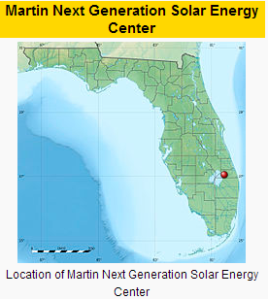
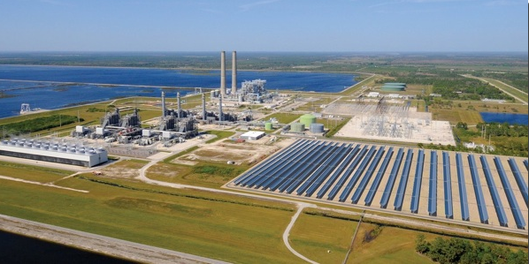
Solar Initiatives by Florida Light and Power Martin Next Generation Clean Energy Center
Martin Next Generation Solar Energy Center was completed in 2010 by Florida Power and Light
First hybrid combined cycle natural gas + concentrating solar power (CSP) plant to be developed in the U.S.
Hybrid CSP plant includes a field of 190,000 parabolic mirrors that heat a synthetic oil thermal fluid to temperatures of 398 ºC
Superheated thermal fluid is run through a heat exchange system and used to generate steam to supplement the existing natural gas/ oil plant’s (4) combined-cycle steam turbine units
Capacity of 75 MW of parabolic trough CSP is enough to power over 11,000 Florida homes

Slide 25
LCOE for Parabolic Trough based CSP Plants with 14 hours of Thermal Energy Storage (TES) will be Competitive to mc-Si with single-axis PV Plants by 2020
Source: Lux Research Report, Dec 2013,
“Turning up the heat on advanced concentrating solar power components”
Notes:
high temperature receivers and isulation, Low-cost energy storage, AR and AS coatings, material reducing frames and trackers

Slide 26
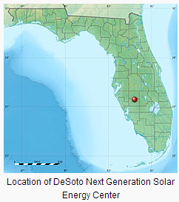
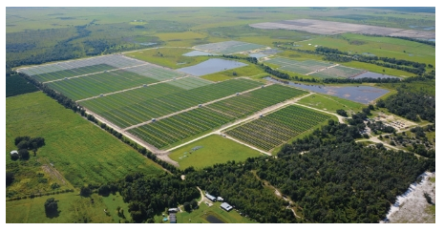
Solar Initiatives by Florida Light and Power DeSoto Next Generation Solar Energy Center
DeSoto Next Generation Solar Energy Center is among the largest PV solar installations in Florida and was completed in 2009 by SunPower
Power plant consists of 90,000 SunPower PV modules with SunPower’s single-axis T-zero (T0) trackers
To trackers enable minimized shading while grouping the trackers closer together resulting in 20% less land than conventional crystalline silicon fixed tilt systems and 60% less than thin-film modules
At 25 MW capacity, this PV project has enough electric capacity to power more than 2,500 Florida homes

Slide 27
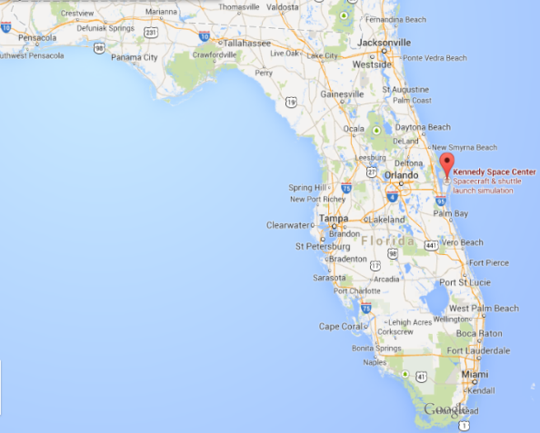
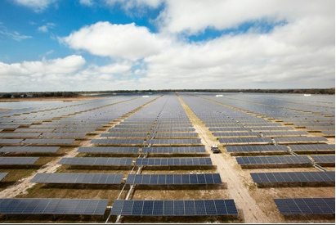
Solar Initiatives by Florida Light and Power Space Coast Next Generation Solar Energy Center
Space Coast Next Generation Solar Energy Center is located at NASA’s Kennedy Space Center which was completed in 2010 as a partnership between NASA and Florida Power & Light.
Power plant consists of over 35,000 SunPower PV modules with SunPower’s single-axis T0 trackers
The plant provides slightly less than 1% of the Kennedy Space Center’s electricity needs
At 10 MW capacity, this PV project has enough electric capacity to power more than 1,1 00 Florida homes
Location of Space Coast Next Generation Solar Energy Center

Slide 28
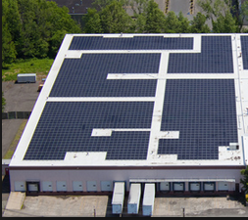
Solar Initiatives by Florida Light and Power Rebate Programs
Residential Customer Rebates
Residential customers may receive a rebate of up to $20,000 for installing a photovoltaic (PV) system and interconnecting to FPL's grid
Business Customer Rebates
Business customers may receive rebates up to $50,000 per site for installing a PV system and interconnecting to FPL's grid
PV for Schools
FPL will install the systems in at least one school in each of the 28 districts, up to 81 schools over 5 years; FPL will own and maintain the PV systems for the first 5 years and then transfer ownership and maintenance to the school districts; FPL also will provide teacher training and classroom materials.

Slide 29
2.2% of Florida’s total net electricity generation in 2013 was from renewable energy and the state ranked 7th in the nation in net generation from utility-scale solar energy
Source: U.S. EIA

Slide 30
Agenda
Photovoltaic (PV) Market Trends
Global PV Innovation Trends
Near Term : Silevo & Solar Frontier
Long Term: Solexel & Heliatek
Florida PV Industry Landscape
Research Institute: Florida Solar Energy Center
Solar Initiatives by Florida Light & Power
PV Industry Outlook
Notes:
http://www.seia.org/state-solar-policy/texas

Slide 31
Outlook
Solar PV demand will continue to grow with U.S., Japan, and China as the leading demand markets
PV innovation across the value chain is necessary for
module manufacturers to differentiate products and maintain sustainable profit margins
solar electricity to become cost competitive to coal and natural gas
Florida research institutes will play an important role in the PV innovation landscape by developing low cost and/or high efficiency solar technologies
Florida utilities will also play an important role to grow the local solar energy economy through solar rebates, leasing, and investment partnerships

Slide 32
Thank you
Fatima Toor, Ph.D.
Research Analyst
Lux Research Inc.
+1 (617) 502-5318
fatima.toor@luxresearchinc.com

