Slide 1
Solar Microgrids for Local Resilience
Achieving community goals with solar energy, microgrid technologies, and strategic planning and development.
Michael Burr, Director

Slide 2
What is Microgrid Institute?
Microgrid Institute is a collaborative organization that focuses on key factors affecting microgrids and distributed energy.
Our efforts address markets, regulation, financing, and project feasibility and development.
Multidisciplinary collaboration with industry leaders
Independent, objective thought leadership
Studies, events, project management
Charting pathways for resilience and sustainability.

Slide 3
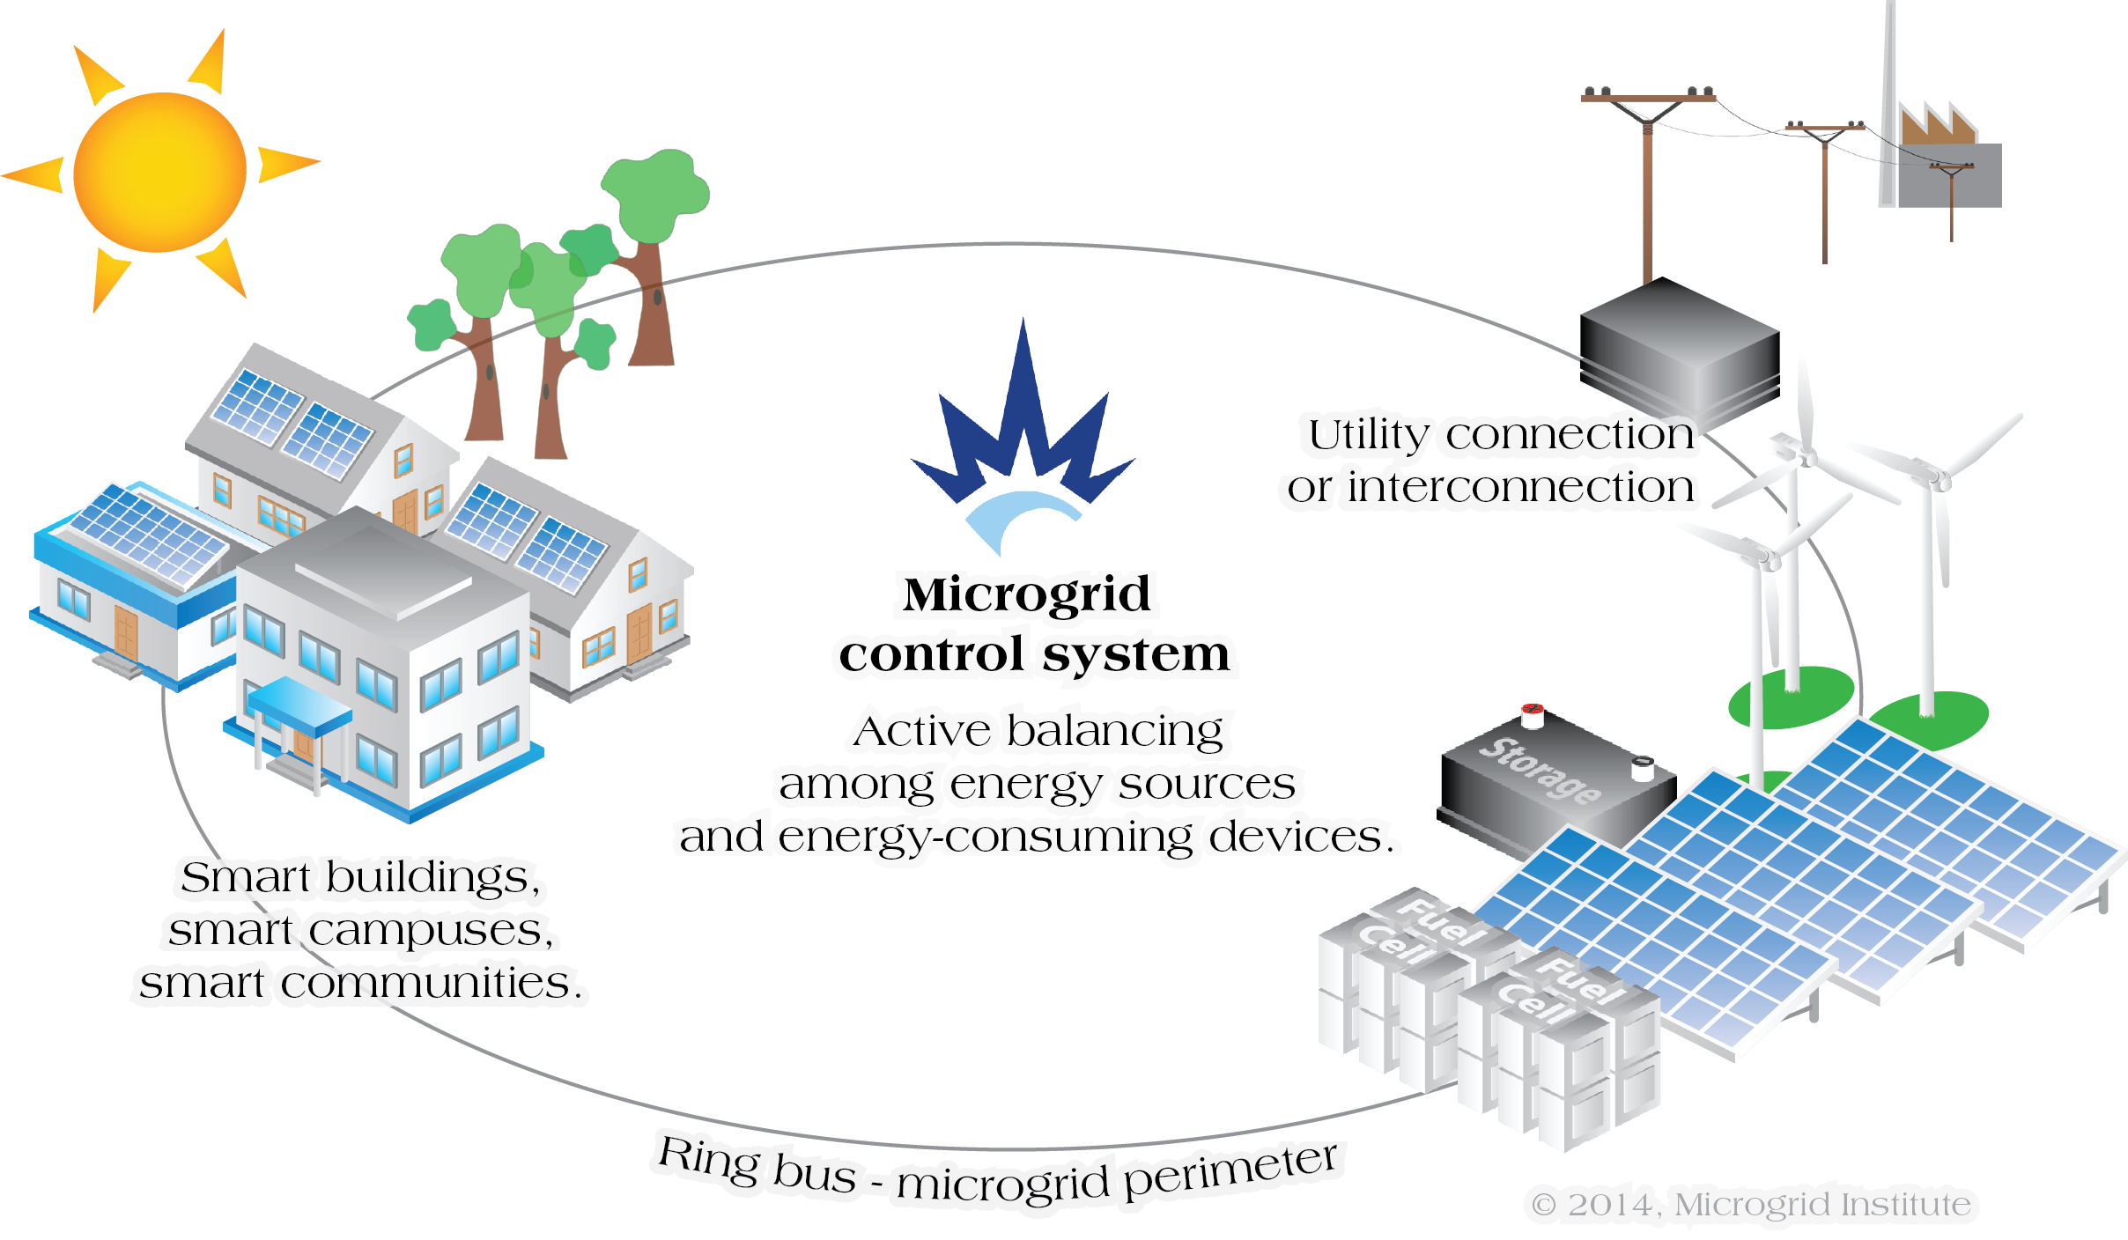
What is a microgrid?
A microgrid is a small energy system capable of balancing captive supply and demand resources to maintain stable service within a defined boundary.
A community microgrid provides resilient and stable energy supplies for vital community facilities and assets.

Slide 4
Microgrids Empower Resilient Communities
Microgrid systems help communities to achieve local resilience for vital services and interdependent community assets:
Lighting, street lights, traffic lights
Pumping, refrigeration, HVAC
City water and wastewater
Cell towers, telecom, Internet
Gas stations, grocery stores, pharmacies

Slide 5
Local Energy = Local Benefits
Microgrid energy management systems help local communities to capture local energy resources – such as solar, wind, and biomass – at higher levels. This yields many community benefits:
Keeping energy dollars local
Reducing dependence on energy that must be transported over long distances
Shrinking total environmental footprint
Conserving energy and reducing costs
integrating renewables
community resilience
microgrid energy management
peak shaving
conservation
asset optimization

Slide 6
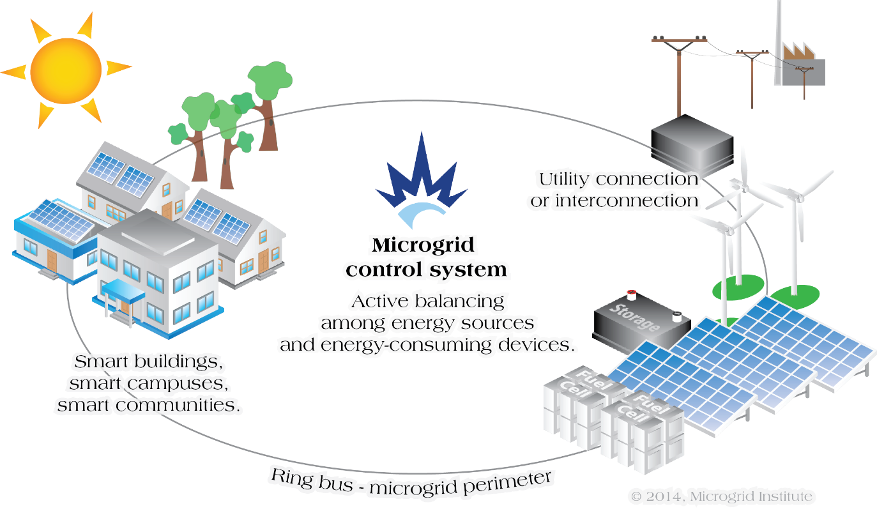
Solar Energy + Microgrids
Community microgrids solve many challenges of integrating solar energy.
Solar Energy Challenges
Sun doesn’t always shine
Grid-actuated PV panels shut down during utility outages
PV panels are expensive!
Variable energy creates instability

Slide 7
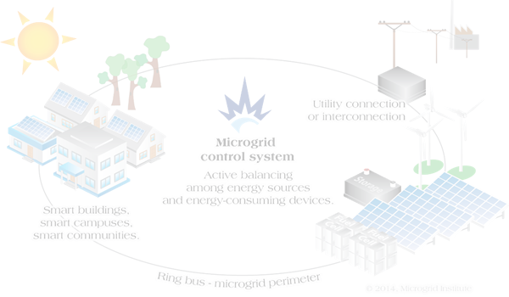
Solar Energy + Microgrids
Community microgrids solve many challenges of integrating solar energy.
Solar Energy Challenges
Sun doesn’t always shine
Grid-actuated PV panels shut down during utility outages
PV panels are expensive!
Variable energy creates instability
Load-shifting, efficiency, and conservation technologies to optimize use of solar generation

Slide 8
Solar Energy + Microgrids
Community microgrids solve many challenges of integrating solar energy.
Solar Energy Challenges
Sun doesn’t always shine
Grid-actuated PV panels shut down during utility outages
PV panels are expensive!
Variable energy creates instability
Microgrid control systems manage supply and demand in real time to maintain balanced and stable operation

Slide 9
Solar Energy + Microgrids
Community microgrids solve many challenges of integrating solar energy.
Solar Energy Challenges
Sun doesn’t always shine
Grid-actuated PV panels shut down during utility outages
PV panels are expensive!
Variable energy creates instabilities
Safe islanding; industry-standard (IEEE 1547) interconnection to
keep PV operating during outages

Slide 10
Solar Energy + Microgrids
Community microgrids solve many challenges of integrating solar energy.
Solar Energy Challenges
Sun doesn’t always shine
Grid-actuated PV panels shut down during utility outages
PV panels are expensive!
Variable energy creates instabilities
Resilient community microgrids represent a creditworthy customer for accessing low-cost financing

Slide 11
Solar Energy + Microgrids
Community microgrids solve many challenges of integrating solar energy.
Solar Energy Challenges
Sun doesn’t always shine
Grid-actuated PV panels shut down during utility outages
PV panels are expensive!
Variable energy creates instabilities
Resilient community microgrids represent a creditworthy customer for accessing low-cost financing
-AND-

Slide 12
Solar Energy + Microgrids
Community microgrids solve many challenges of integrating solar energy.
Solar Energy Challenges
Sun doesn’t always shine
Grid-actuated PV panels shut down during utility outages
PV panels are expensive!
Variable energy creates instabilities
Resilient community microgrids represent a creditworthy customer for accessing low-cost financing
-AND-
Phased deployment strategies allow taking advantage of falling PV system prices

Slide 13
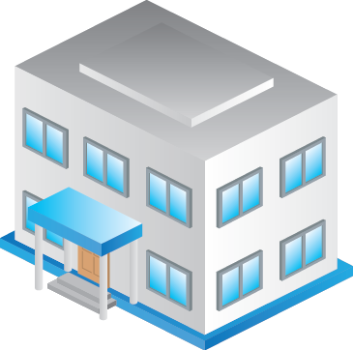
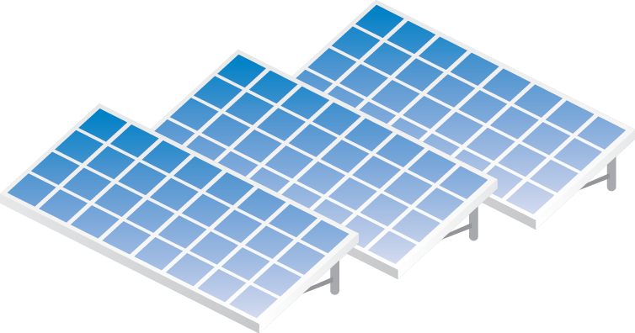
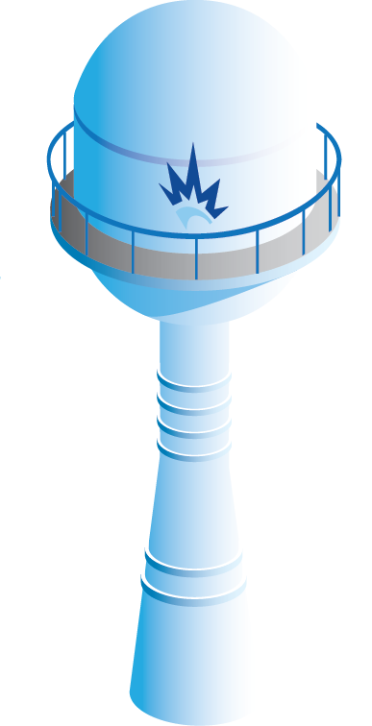
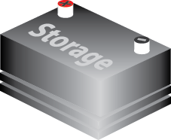
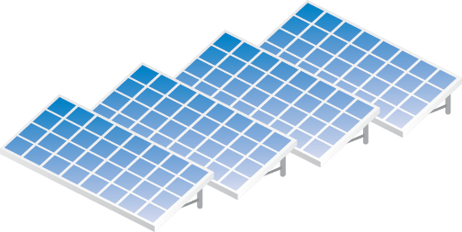
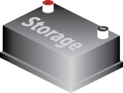
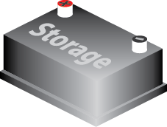
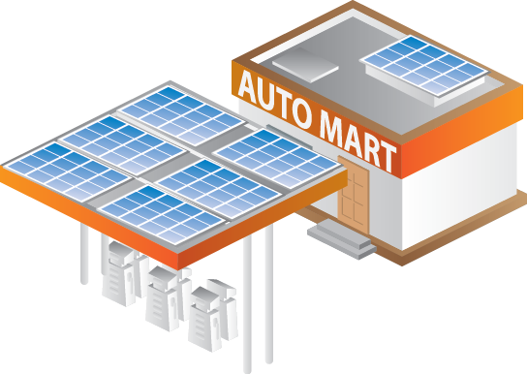
A note on nanogrids and solar storage systems
A nanogrid is the smallest type of microgrid, typically designed for a single building or asset.
A solar storage system is a PV array with connected batteries. If it can operate in isolation, it’s a type of nanogrid.
Such systems allow individual customers (businesses, institutions, homeowners, etc.) to capture the benefits of microgrid control technologies and achieve sustainable hyper-local resilience.

Slide 14
What is the Resilient Communities Initiative?
Mission Statement: Microgrid Institute formed the Resilient Communities Initiative to help communities plan, develop, and implement their resilience strategies.
We assist communities as they strive to improve resilience for vital services, optimize local energy resources, increase energy efficiency, and reduce their environmental footprint.
workshops services
insight tools
data

Slide 15
Programs and services
Resilient Communities Workshop Series | Information Resource Center | Advisory Services and Support
Learn how to plan and implement comprehensive community resilience strategies | Access data and objective analysis about community resilience strategies, programs, projects, technical options, and financing | Obtain help evaluating options, developing strategies, financing projects, and deploying solutions
Local workshops and online webinars | Online reports, data, and tools | Strategic consulting and project management services
Benefits for community leaders
Resources

Slide 16
from Resilient Communities Workshop
Questions and Action Steps
Resilience Strategies | Microgrid Solutions | Development Approaches | Feasibility Factors | Pitfalls and Lessons Learned
What do resilient communities do differently? What strategic approaches are most successful? | How do microgrids work? What are their limitations? What roles do they play in resilience strategies? | How do resilience projects get built? Who leads the effort and how? Who provides financing? | Which options are best for our community? What factors will determine success? | What mistakes can we avoid? What approaches have succeeded? What examples are most instructive?
Establishing a strategic vision to achieve multiple community goals | Setting project scope, priorities, and benchmarks | Project initiation, planning, and execution | Research, planning, and feasibility analysis | Integrating lessons and examples into strategic plans
Questions
Actions

Slide 17
Can we help your community? Yes!
Contact Us
www.microgridinstitute.org
Michael Burr, Director +1.320.632.5342 mtburr@microgridinstitute.org

