Slide 1
Mobility Advancement Program (MAP)
Municipal Finance Workshop
October 27, 2021
10:00 am

Slide 2
Agenda
Introduction
Mobility Advancement Program (MAP) Administration
Surtax Grant Award Process
Funding
Reporting Requirements
Payment Application and Expense Summary
Quarterly Financial Reporting
Reconciliation Final Invoice

Slide 3
Workshop Structure
This Workshop is being recorded and will be available for future reference.
Questions are encouraged, however please hold all questions until the end.
You may also place questions in the Chat area, and they will be read and answered at the conclusion of the Workshop.

Slide 4
Purpose
This is the first finance workshop being presented by MAP Administration.
The main purpose of this workshop:
Clarify the financial management aspects of surtax funds
Facilitate municipalities’ familiarity with the financial-related terms of the Project Funding Agreement (PFA)*
Relationship building with MAP Administration-Finance

Slide 5
MAP Administration
The Oversight Board was established to oversee the surtax program and provide independence, transparency and accountability.
MAP Administration was created to operationalize the Oversight Board’s responsibilities.
The MAP team also works with each municipality to:
Ensure timely monitoring of surtax funds expenditures
Provide assistance with general questions/issues related to the PFA

Slide 6
Municipal Projects Status Update
97 Municipal Capital Projects (MCPs) were originally approved for Cycle 1 funding, of which 89 remain active
40 Rehabilitation & Maintenance Projects (R&M) were approved for Cycle 1 funding
26 Fully Executed Project Funding Agreements (PFA)

Slide 7
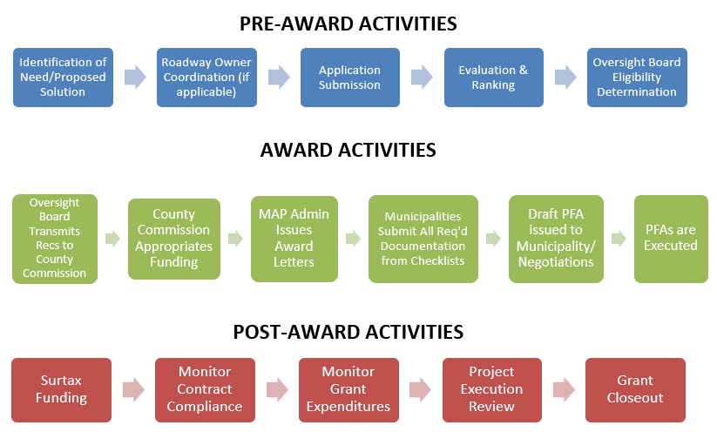
Surtax Award Process

Slide 8
Surtax Post-Award
Financial oversight focuses on Post-Award Activities

Slide 9
Surtax Funding (Sections 5.1 - 5.4)
After the PFA is fully executed and all the required documentation completed, surtax funds are advanced to the municipality consistent with the terms of the PFA Funding Schedule (Exhibit B of the Agreement).
The Funding Schedule includes:
Requirements to complete the Payment Application
The maximum amounts payable for each project phase
A list of ineligible expenses under the Agreement
Note: All surtax grants are funded through advance payments

Slide 10
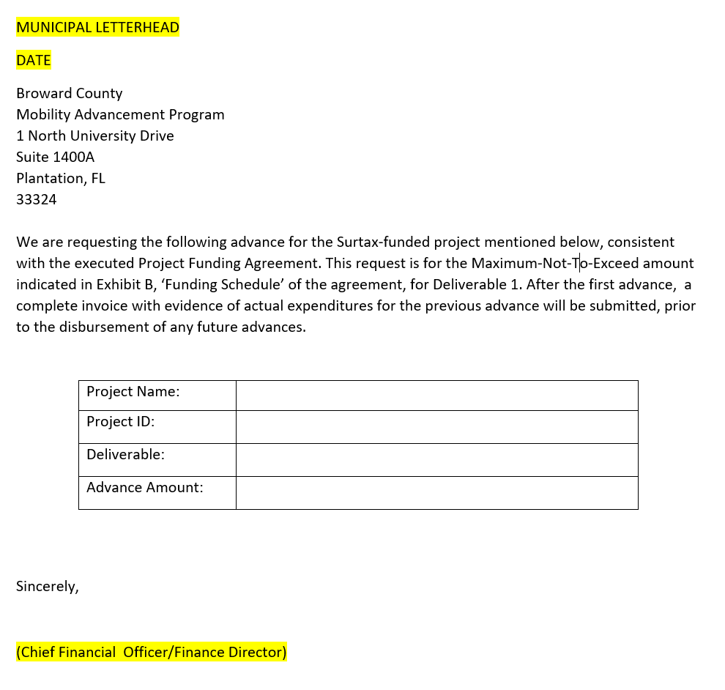
Getting Your Surtax Funding
Payment Application
The first payment application must be submitted on the municipality’s letterhead and signed by the Finance Director (or designee) with the amount consistent with the funding schedule
Subsequent payment requests will be processed through an Expense Summary
SAMPLE

Slide 11
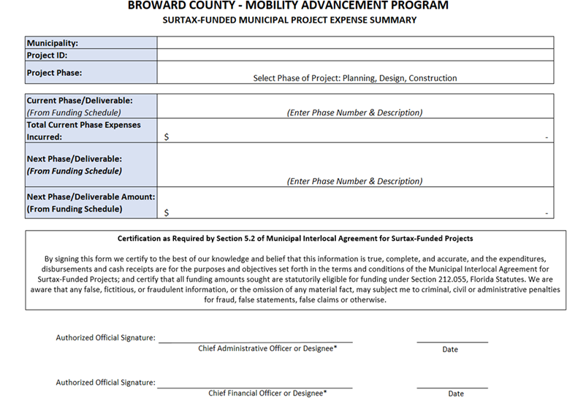
Expense Summary
Complete when requesting second Phase/Deliverable funding.
Must be accompanied by a supporting detail of all expenses incurred and all amounts paid
Includes certification, signed by the Chief Administrative Officer and the Chief Financial Officer, or designee(s)
MAP Admin will reconcile expenses reported with the previous advance to determine the amount of the next advance

Slide 12
Funding Schedule and Deliverables
Funding is associated with deliverables
Funding occurs in sequential phases consistent with the Funding Schedule (Exhibit B)
Deliverables and expense summary must be submitted when applying for funding after the first advance
Municipalities may request funding for phases that occur simultaneously with adequate justification, which must be reviewed and approved by the Contract Administrator

Slide 13
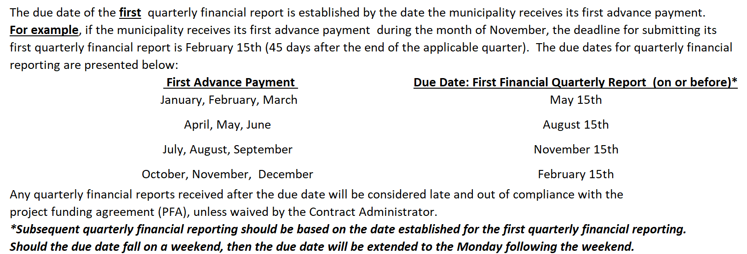
Reporting Requirements (Article 6.1)

Slide 14
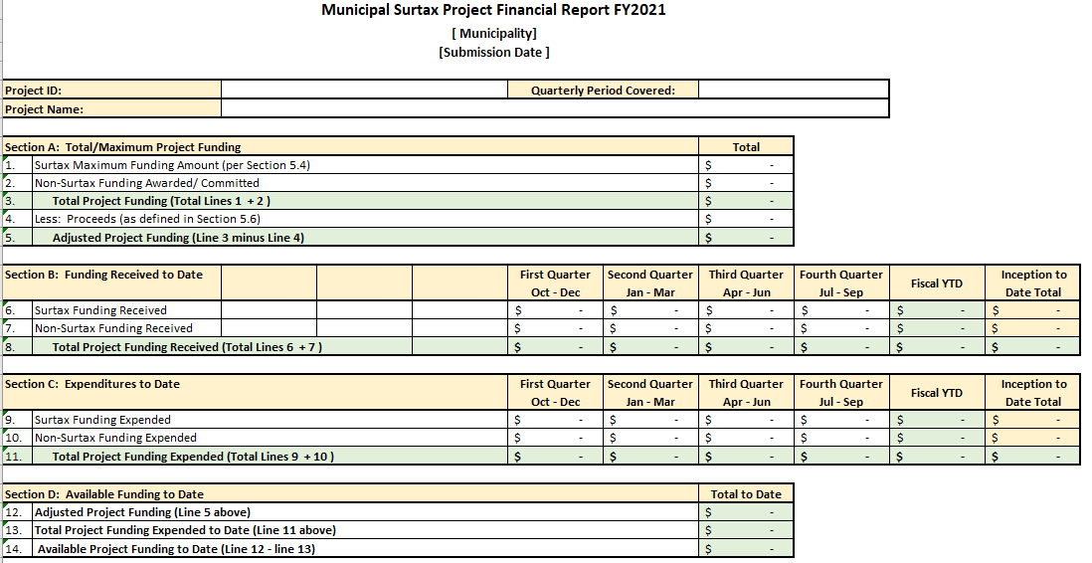
Project Financial Report

Slide 15
Project Financial Report – Contractor Financials

Slide 16
Project Financial Report-Detailed Invoice Expenditure

Slide 17
Final Invoice and Reconciliation (Section 5.9)
Must be submitted to MAP no later that 120 days after the completion of the project.
Should include summary of all expenses incurred and all amounts paid for Project.

Slide 18
Reporting Requirements (Article 6.1)
Reporting deadlines
Quarterly Reports: 45 days after the reporting period ends
Annual Reports: 180 days after the end of the fiscal year
Final Invoice and Reconciliation: 120 days after project completion
Note: Some reporting requirements can be waived by the Contract Administrator

Slide 19
Reporting Areas to Note
A separate general ledger fund or account created must be maintained to account for all surtax related financial transactions
Expenditures must have appropriate supporting documentation consistent with the ‘Funding Schedule’- Invoicing/Application for Funding Documentation (Exhibit B of the PFA)
The municipality should be able to generate a Financial Report on a quarterly basis, consistent with ‘Reporting Requirements’ (Exhibit C of the PFA)

Slide 20
Document Submission
Surtax Project Portal for document submission is being expanded, currently under development
Currently there is an interim solution in place
Allows multiple municipal users
Each municipality can only see its own projects
Allows for categorization of files uploaded

Slide 21
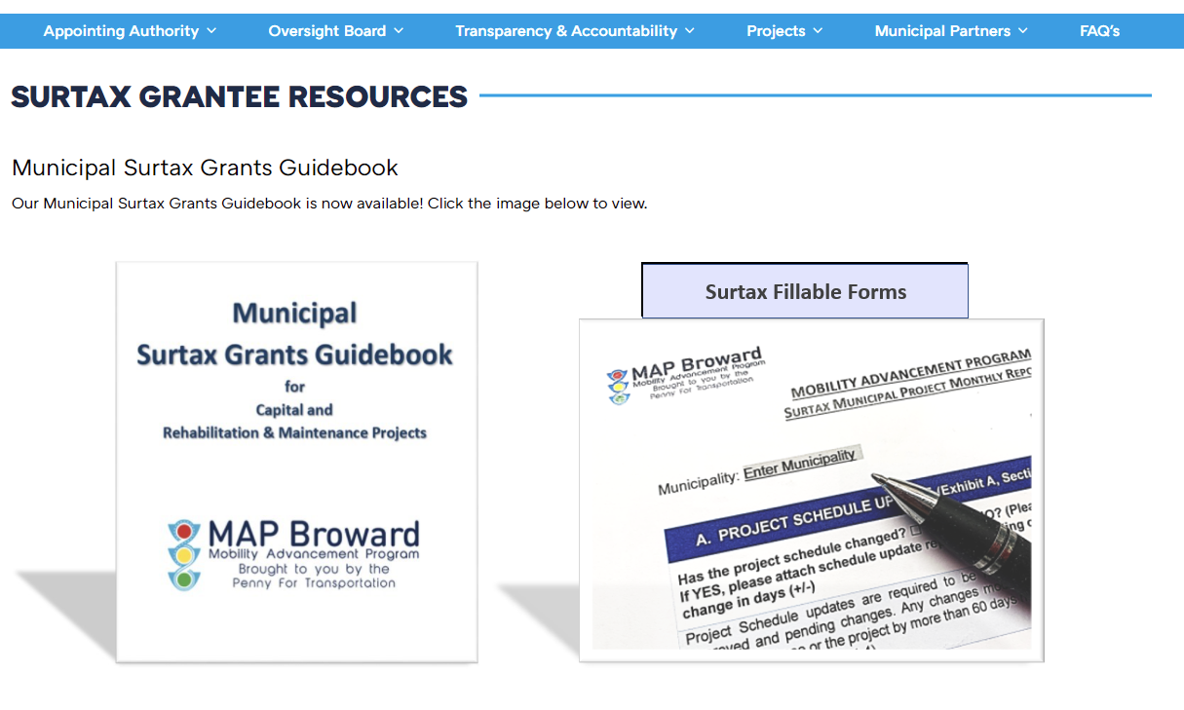
Municipal Surtax Grants Guidebook
https://www.broward.org/PennyForTransportation/Transparency/Documents/MunicipalSurtaxGrantsGuidebook-8.10.21.pdf
Guidebook Resources
PFA Process Descriptions
Updated surtax project guidance and instructions
Forms, templates and samples
Reports
Deliverables
Expense Summary
Designation
Etc.
Other resources for grantees

Slide 22
Contact Information
Margaret Dalley-Johns
Finance Manager
mdalleyjohns@broward.org
Alexander Mayorga
Program Performance Coordinator
amayorga@broward.org
Lina Silva
Program Project Coordinator
lsilva@broward.org

Slide 23
Thank you for your time!

Slide 24
Questions

