Slide 1


Slide 2

What is Go SOLAR
Broward Rooftop Solar Challenge?
U.S. Department of Energy Grant
Broward County and 14 partner cities collaborating to make solar rooftop systems easier, faster and cheaper for residents and businesses
Notes:
What is Go SOLAR?:
It’s a US Department of Energy grant awarded to Broward County to find ways to make it easier, faster and cheaper to install rooftop solar systems.
Broward County is one of the 22 awardees nationwide and the only one in the Southeastern United States.
The County is working collaboratively with 14 partner cities to Streamline Rooftop Solar Permitting

Slide 3
Why is Broward taking this Challenge?
According to the Department of Energy, “customer acquisition, permitting, inspection, installation, and interconnection currently make up approximately 30-40% of the total installed cost of a rooftop solar system”
Permitting can be as much as 20% of the cost to install a solar system
Notes:
According to DOE
“Non-hardware costs associated with processes such as customer acquisition, permitting, inspection, installation, and interconnection currently make up approximately 30-40% of the total installed cost of a rooftop PV system” U.S. DOE
Permitting can be as much as 20% of the installation cost. We are doing our part to reduce some of these costs by implementing an online solar permitting system for Broward unincorporated areas and the 14 partner cities.
DOE wants to streamline permitting to reduce costs of installation and improve market conditions for solar regionally and nationwide. Solar systems are costly but this is our first step to help reduce the cost of solar installations for residents and businesses.
Bottom line – Broward County is doing Go SOLAR because it reduces customer costs in solar permitting, and is an opportunity to pilot an innovation in permitting that is the vanguard for other county epermiting programs

Slide 4
Why Go SOLAR?
Utility company rebates for up to $20,000 per system
Federal tax credit for up to 30% of the residential system cost
With tax incentives , rebates, and energy savings
  Nationally, recover up to 76% of initial cost
  Broward County example, recovered 56% of initial cost, with an estimated payback of 15 years
Cleaner source of energy
Results in greenhouse gas reductions
Notes:
What are some of the benefits of going solar?
Our local utility company, FPL, provides rebates annually of up to $20,000 per installation.
FPL offers a rebate of $2 per direct current (DC) Watt nameplate rating of the solar panels up to a maximum rebate per premise of $20,000.
http://www.fpl.com/landing/solar_rebate/index.shtml
Federal tax credit for up to 30% of the cost of the qualified property.
Residential Energy Efficient Property Credit on qualified solar electricity equipment. The credit, which runs through 2016, is 30% of the cost of qualified property with no cap on the amount of credit available.
http://www.irs.gov/newsroom/article/0,,id=255304,00.html
According to a technical report of the National Renewable Energy Laboratory , residential PV solar systems can recover up to 76% of their initial cost with utility rebates, tax credits and energy savings over the expected life of the system (analysis for 20 years). If State rebates are available the return could be up to 109% of the initial cost.
Broward County Example: One resident paid $26,000 – after rebates, costs was $11,400 (not including battery backup). Estimated payback is 15 years.
This clean source of energy results in greenhouse gas(GHG) reductions in support of the Board’s climate protection policies.

Slide 5
Local Example: Residential PV System
System’s Output Power: 3.15 KW Estimated Annual Solar Energy Use: 4,570 kWh
Powers 60% of the Home
Up Front Cost $26,002
Rebates/Tax Credits $14,600
DOE’s Expected Cost Savings (30% permitting , installation, etc.) $ 7,801
Net Cost $ 3,601
Estimated Annual Savings on FPL Bill $ 640
100% payback realized in 6 years from annual savings on FPL bill
Total Estimated Cost Savings Over Life of System (25 years) $ 12,395
Greenhouse Gas Reductions for the Life of the System 80 Metric Tons
Notes:
Example of a Broward County residential solar PV installation.
System’s Output Power: 3.15 KW Estimated Annual Solar Energy Use: 4570 kWh
Powers 60% of the Home
Up Front Cost $26,002
Rebates/Tax Credits $14,600
DOE’s Expected Cost Savings (30% Non-hardware costs: customer acquisition, permitting, inspection, installation, and interconnection ) $ 7,801
Net Cost $ 3,601
Estimated Annual Savings on FPL Bill $ 640
100% payback realized in 6 years from annual savings on FPL bill
Total Estimated Cost Savings Over Life of System (25 years) $ 12,395
Greenhouse Gas Reductions for the Life of the System 80 Metric Tons

Slide 6
Streamlining
Solar Permitting!
Solar Contractor
Engineer Designs System
Apply in Person at City for Permit
Building Department
Review
Review Comments/
Responses Process
Zoning Department
Review
Go to City to Pay Fee and Obtain Permit
Solar Contractor
Apply & Obtain Permit Online
Current process
several weeks
Proposed Process
A Few Minutes
Notes:
The current manual permitting process is cumbersome and costly, taking several weeks.
Once an owner has contracted with a Solar Contractor, an Engineer must be retained to design the system.
Next the contractor must apply in person at the City’s Building Department.
Now the Building and Zoning Departments review the documents and provide comments
Next the Contractor and Engineer re-submit revised documents to the City for further review. Normally this takes two to three iterations before approval can be obtained.
The contractor returns to the City to pay the permit fee and obtain a printed copy of the approval package.
Processing time can be several weeks (TRANSITION IN RED LOGO)
In the Streamlined Permitting Process the Solar Contractor can obtain the permit on-line in minutes. This online system will be able to process approximately 80% of the residential and small commercial installations in Broward.
How will this be accomplished?

Slide 7
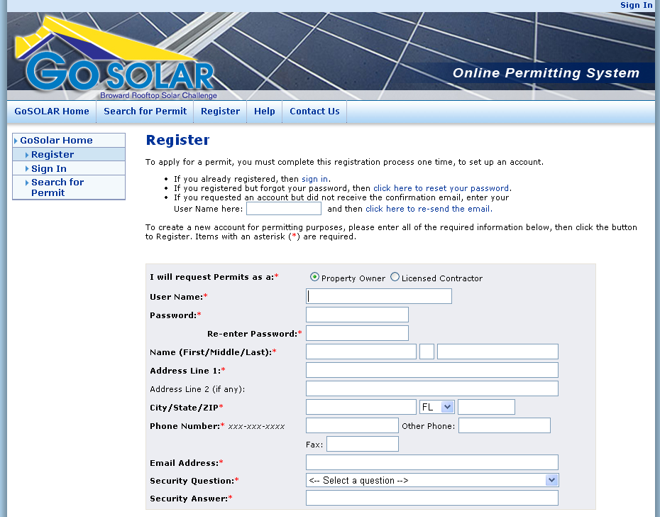
NEW Online Permit System
Save Time: Apply online 24/7
Save Money: Select pre-approved engineered designs – eliminate complicated plan review process
One Fee: Pay standard permit fee online
Notes:
First of all, a contractor can apply on-line 24/7.
The online permitting system will contained a library of pre-engineer designs that have been pre-approved by County and participating Cities Building Officials’.
This eliminates the need to hire and pay for an Engineer to design the solar system. A substantial cost savings.
It also eliminates the current complicated, time consuming and costly plan review process
One standard permit fee has been agreed upon which can paid online. This allows the Contractor to provide an accurate cost estimate to the owner for the installation
The permit can be issued in minutes!

Slide 8

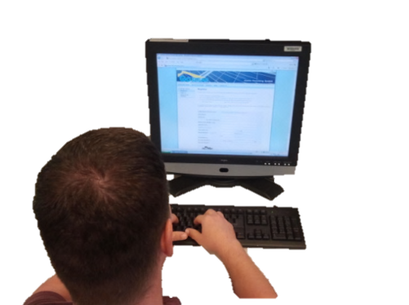

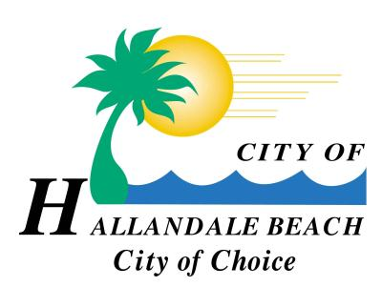













Permitting Collaboration
Broward County will Provide Electronic Permitting for 14 Cities and Unincorporated Areas
Notes:
What’s also unique about this streamlined permitting system is that Solar Contractors will only need to access Broward County’s website to obtain electronic permits for the 14 partner cities and the unincorporated area.
Through Interlocal agreements with the 14 cities, Broward County will issue and collect permit fees for rooftop solar permits on behalf of the participating cities.
The 14 partner cities are; Coconut Creek, Dania Beach, Davie, Deerfield Beach, Fort Lauderdale, Hallandale Beach, Hillsboro Beach, Lauderdale-by-the-Sea, Miramar, North Lauderdale, Oakland Park, Pompano Beach, Sunrise and Tamarac.

Slide 9
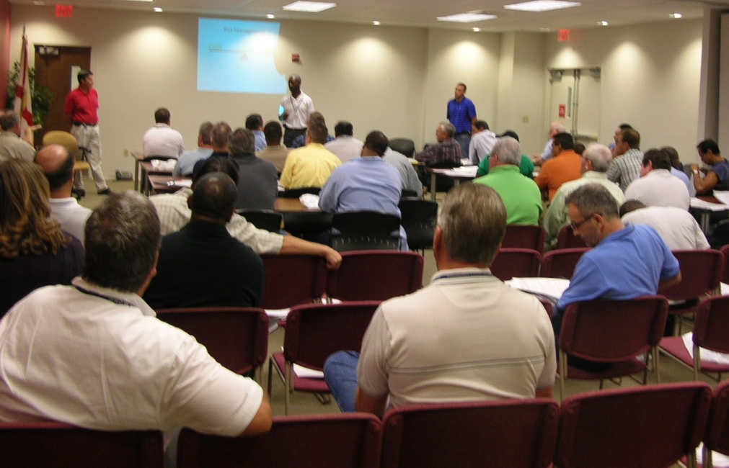
Training
Broward County will provide training on the new online permitting system to:
Building Officials
Inspectors
Plan Reviewers
Zoning Officials
Solar Contractors
Residents
Businesses
Notes:
Broward County will also provide education and training for the new online permitting system
Target audiences include:
Building Officials
Inspectors
Plan Reviewers
Zoning Officials
Solar Contractors
Homeowners
Business owners
Already feedback from industry on need for improved training

Slide 10
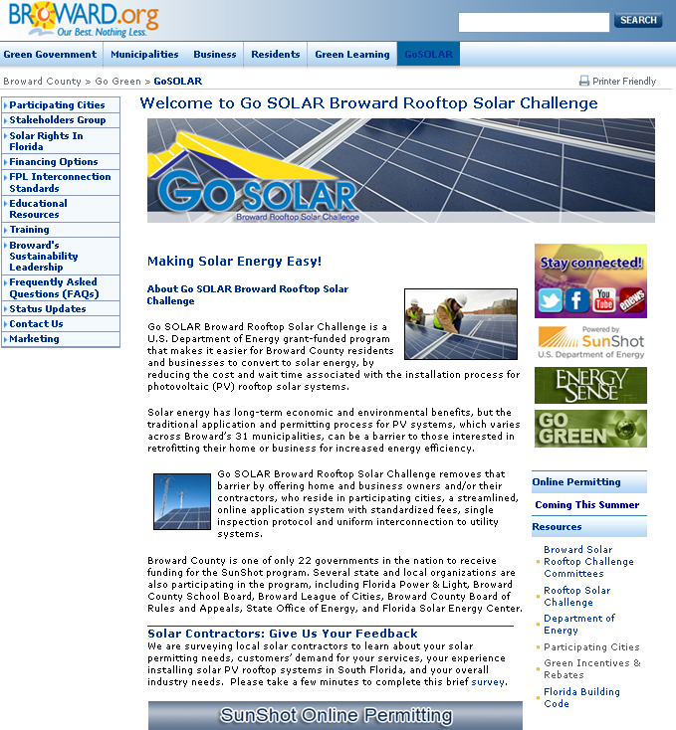
Outreach
Go SOLAR brochure
Website
Staff available for presentations
broward.org/gogreen/gosolar
Notes:
The Go Solar Outreach team and our Public Communications Office has developed a Go Solar website (broward.org/gogreen/gosolar)
The website provides educational and informational materials
There is also Go Solar brochure that can be downloaded on the site a copy of which has been provided to you
Staff is very excited about the program an is available to make presentations.

Slide 11
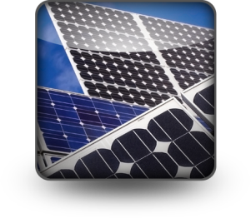
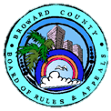

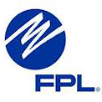




Partnerships…
Key to Success
Solar
Industry
Notes:
Broward County is also working with key stakeholders to ensure that the new streamline solar permitting is in conformance with their requirements and regulations.
Key stakeholders include:
Partner cities through the League of Cities
Florida Solar Energy Center
Building Officials Association of Florida
FPL
School Board
Broward County Board of Rules and Appeals
Department of Energy
Solar industry
Contributions and participation by Solar manufacturers and Contractors is being obtained through the County’s Advantage Marketing Program.
Pristine and Healthy Environment. Goal 1: Promote, protect and enhance the environment with collaborative partners.

Slide 12

Leveraging Resources
Use of In-kind Exchange Agreement to obtain
  Structural design plans
  Solar powered permitting kiosks for Government Center and Government Center West
Notes:
Broward County is using the Advantage Marketing In-kind Exchange agreement to obtain structural design plans from PV mounting manufacturers and for two solar powered permitting kiosks for Government Center and Government Center West. The kiosks will also provide general information about the benefits of solar energy.

Slide 13
Timeline
System Development
4th Quarter FY2012
User Testing & Training
1st Quarter FY2013
Go Live!
2nd Quarter FY2013
Notes:
Currently staff is working with partner cities, key stakeholders, solar industry and design professionals to develop the permitting system.
During the first quarter of 2013 the county will perform testing and provide training workshops
We expect to Go live in the second quarter of 2013 meeting DOE’s grant timeline.

Slide 14
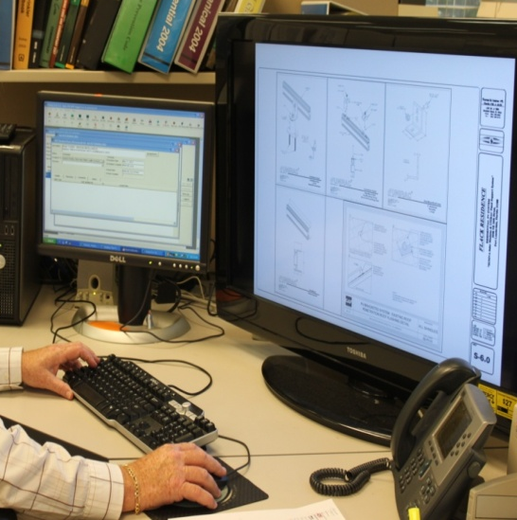
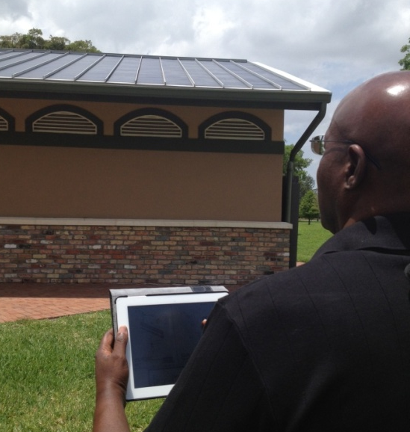
What’s Next?
E-Permits
Several County agencies working collaboratively to convert County manual permitting processes to electronic.
    Environmental Review
    Building Permits
    Air Quality Permits
    Waste Regulation Permits
    Surface Water Management Permits
    Tree Removal Permits
    Aquatic and Wetlands Resource Permits
    Storage Tank Modification Permits
    Highway Engineering Permits
    Water & Wastewater Permits
Notes:
What’s Next? ………. E-permits
In parallel to the Go Solar initiative, there is another team currently working collaboratively to convert current manual permitting processes to electronic.
Types of permits that will be provided electronically include:
Environmental Review
Building Permits
Air Quality Permits
Waste Regulation Permits
Surface Water Management Permits
Tree Removal Permits
Aquatic and Wetlands Resource Permits
Storage Tank Modification Permits
Highway Engineering Permits
Water & Wastewater Permits

Slide 15

For more information: broward.org/gogreen/gosolar
Notes:
In summary: Broward County and the Partner Cities’ are committed to making solar energy easy!
For more information visit our website at broward.org/gogreen/gosolar

