Slide 2
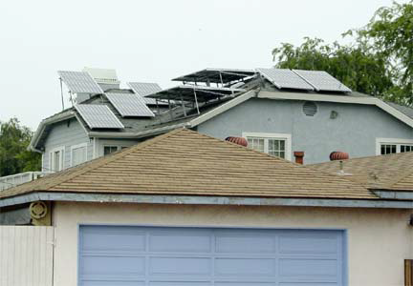
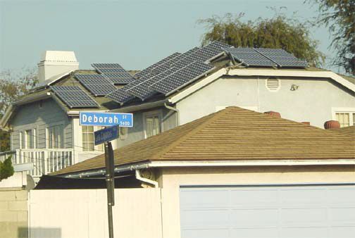
What we don’t want
#2

Slide 3
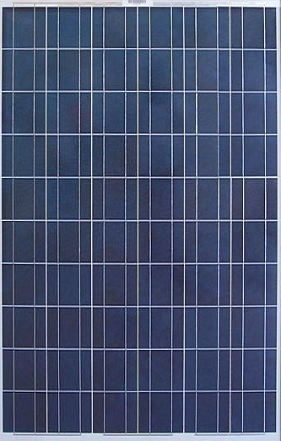
PV modules in the online system will be roughly 65”X 39” each
#4

Slide 4
Residential
1.25 kW system consisting of 5 modules
2 kW system consisting of 8 modules
3 kW system consisting of 12 modules
4 kW system consisting of 16 modules
5 kW system consisting of 20 modules
6 kW system consisting of 24 modules
7 kW system consisting of 28 modules
#5

Slide 5
Commercial
10 kW system consisting of 40 modules
15 kW system consisting of 60 modules
20 kW system consisting of 80 modules
#6

Slide 6
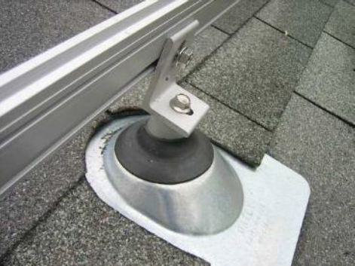
Mounts attach to roof structure
#7

Slide 7
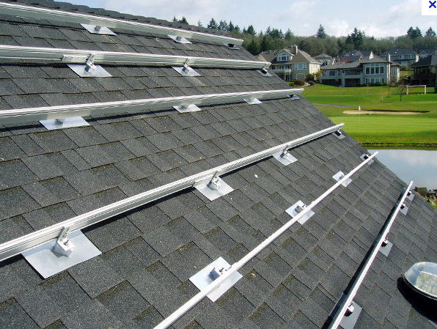
Rails attach to mounts
#8

Slide 8
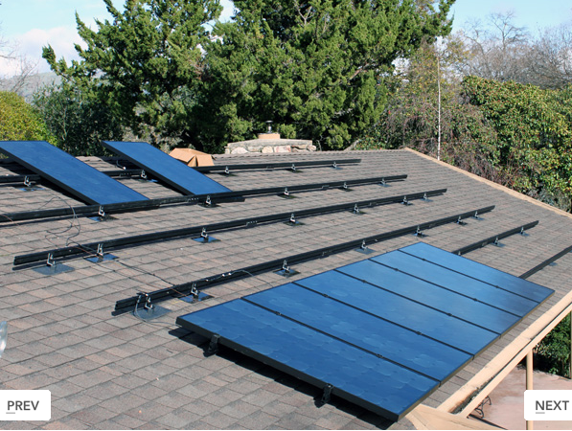
PV modules attach to rails
#9

Slide 9
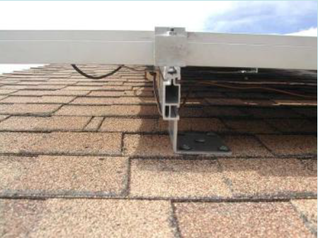
3” to 12” typical between the PV module and the roof.
#10

Slide 10
Positioning on Roof
Installations likely to be within the area required for effective operation
facing south, or east or west of due south
Sloped roof installations typically match the roof slope
#11

Slide 11
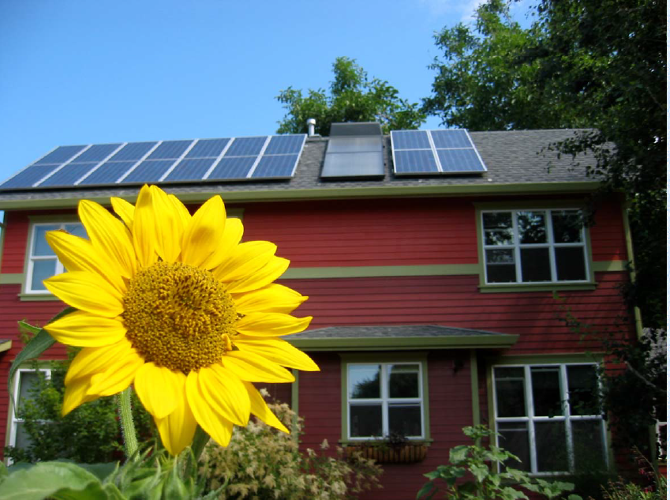
#12

Slide 12
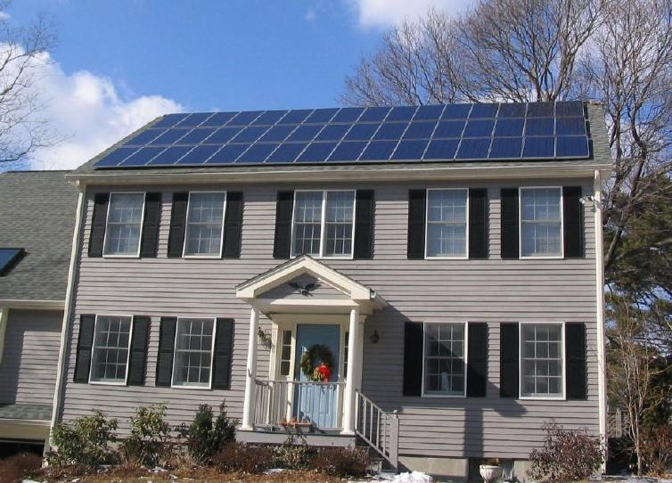
#13

Slide 13
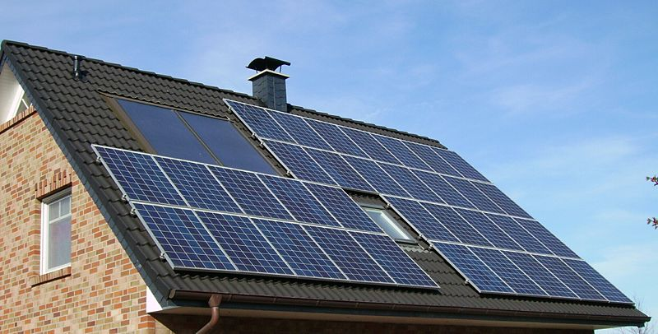
#14

Slide 14
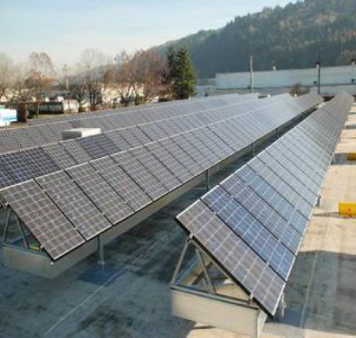
Flat Roof installations may require tilting
#15

Slide 15
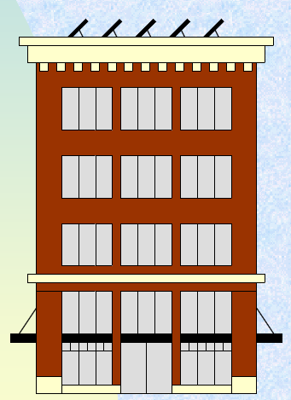
Flat Roof
#16

