Slide 1


Slide 2

What is Go SOLAR
Broward Rooftop Solar Challenge?
U.S. Department of Energy Grant
Broward County and 14 partner cities collaborating to make solar rooftop systems easier, faster and cheaper for residents and businesses
Notes:
What is Go SOLAR?:
It’s a US Department of Energy grant awarded to Broward County to find ways to make it easier, faster and cheaper to install rooftop solar systems.
Broward County is one of the 22 awardees nationwide and the only one in the Southeastern United States.
The County is working collaboratively with 14 partner cities to Streamline Rooftop Solar Permitting

Slide 3

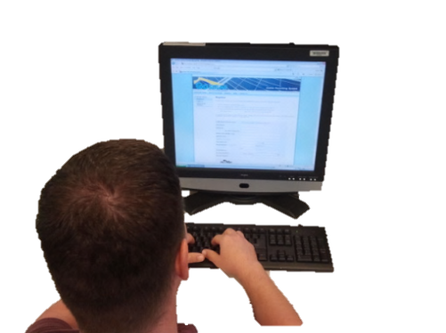















Permitting Collaboration
Broward County will Provide Electronic Permitting for 14 Cities and Unincorporated Areas
Notes:
What’s also unique about this streamlined permitting system is that Solar Contractors will only need to access Broward County’s website to obtain electronic permits for the 14 partner cities and the unincorporated area.
Through Interlocal agreements with the 14 cities, Broward County will issue and collect permit fees for rooftop solar permits on behalf of the participating cities.
The 14 partner cities are; Coconut Creek, Dania Beach, Davie, Deerfield Beach, Fort Lauderdale, Hallandale Beach, Hillsboro Beach, Lauderdale-by-the-Sea, Miramar, North Lauderdale, Oakland Park, Pompano Beach, Sunrise and Tamarac.

Slide 4
Grant Objectives
Objective 1: Develop and make available best practices for streamlining and standardizing permitting and interconnection processes.
Objective 2: Conduct outreach to municipal utilities and co-ops regarding net metering standards and conduct research into restrictive interconnection requirements across the State of Florida.

Slide 5
Tasks To Be Performed
Task 1.0: Streamline and standardize the permitting process for rooftop PV installations.
Broward SOLAR will develop and implement a common, expedited solar permitting process for residential and small commercial properties, with a flat fee and single application form, with the goal of issuing permits within 24 hours of application.
• Sub-Task 1.1: Research successful permitting models
During the first quarter of the grant period, successful strategies from other parts of the country will be evaluated for their applicability to local and regional needs, both through literature review and by contacting national experts.

Slide 6
Tasks To Be Performed
Sub-Task 1.2: Create a streamlined solar permitting process for all participating
permitting departments throughout Broward County.
Sub-Task 1.3: Implement and Test
Implementation and testing of the new permitting database within participating jurisdictions is expected to take approximately one month, and will be finalized by the end of the third quarter.
Sub-Task 1.4: Educate
By the end of the third quarter, a series of workshops will be conducted to familiarize permitting inspectors in each municipality with the simplified procedure, and teach solar installers and customers how to navigate the new system.

Slide 7
Tasks To Be Performed
Task 3.0: Develop and make available best practices regarding the following:
• Sub-Task 3.1: Net Metering and Interconnection Standards
Develop and make available best practices regarding net metering and interconnection standards.

Slide 8
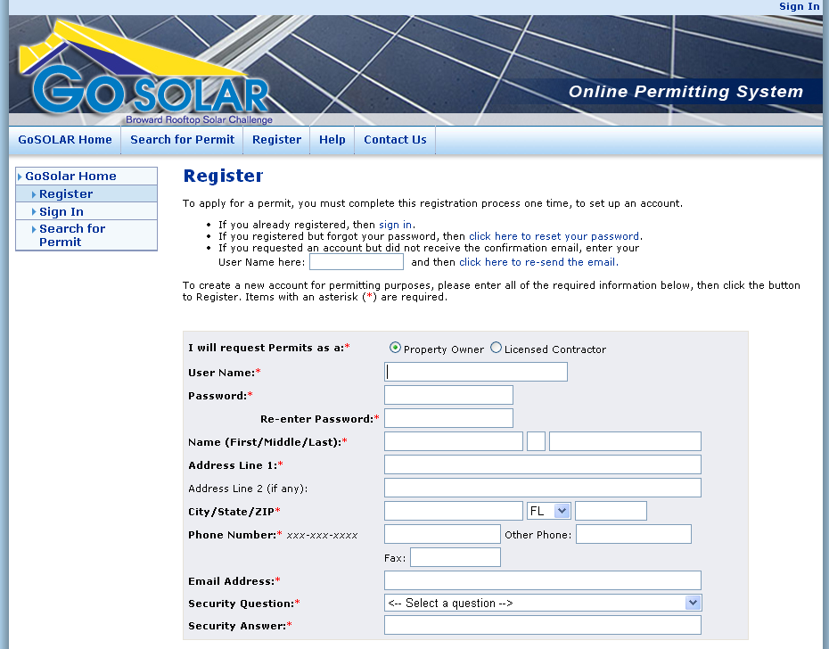
NEW Online Permit System
Save Time: Apply online 24/7
Save Money: Select pre-approved engineered designs
Pay standard permit fee online
Obtain permit electronically in minutes without complicated plan review process
Notes:
First of all, a contractor can apply on-line 24/7.
The online permitting system will contained a library of pre-engineer designs that have been pre-approved by County and participating Cities Building Officials’.
This eliminates the need to hire and pay for an Engineer to design the solar system. A substantial cost savings.
It also eliminates the current complicated, time consuming and costly plan review process
One standard permit fee has been agreed upon which can paid online. This allows the Contractor to provide an accurate cost estimate to the owner for the installation
The permit can be issued in minutes!

Slide 9
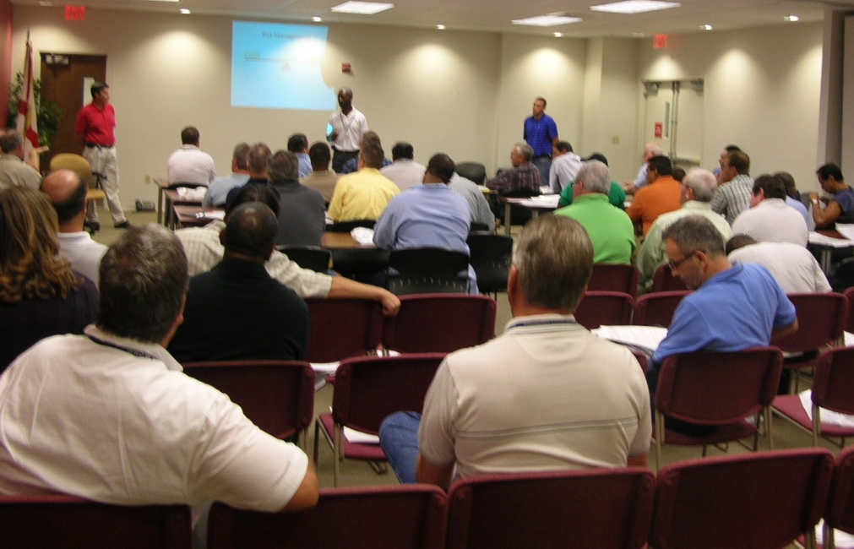
Training
Broward County will provide training on the new online permitting system to:
Building Officials
Inspectors
Plan Reviewers
Zoning Officials
Solar Contractors
Residents
Businesses
Notes:
Broward County will also provide education and training for the new online permitting system
Target audiences include:
Building Officials
Inspectors
Plan Reviewers
Zoning Officials
Solar Contractors
Homeowners
Business owners

Slide 10

For more information: www.broward.org/gogreen/gosolar
Notes:
In summary: Broward County and the Partner Cities’ are committed to making solar energy easy!
For more information visit our website at broward.org/gogreen/gosolar

