Slide 1
Independent Transportation Surtax Oversight Board
Regular Meeting
November 19, 2021
9:30 AM

Slide 2
Regular agenda
REGULAR AGENDA
Motion to Approve the Minutes of the August 20th Regular Meeting
Motion to Approve surtax funding in the not-to-exceed amount of $2.75M per year for up to five years ($13.75M total) for a Broward County Transit (BCT) Community Micro-transit Pilot Program
Motion to Approve surtax funding in the not-to-exceed amount of $2M per year for up to five years ($10M total) for a BCT Late Shift Connect Pilot Program
Motion to Approve surtax funding in the not-to-exceed amount of $500,000 to Broward County Public Works to begin a Broadview Park (Unincorporated Broward County) Drainage Study (preparing for Grant-Funded Project)
Motion to Approve surtax funding in the not-to-exceed amount of $29M for the design, construction, right of way acquisition, drainage, land acquisition, and environmental mitigation required for the Pat Salerno Interchange project partnership with FDOT
Motion to Approve surtax funding in the not-to-exceed amount of $2.35M to support County’s role in Memorandum of Understanding with FDOT regarding the PD&E Study (Broward Commuter Rail)

Slide 3
Action Item 1
Discussion of, or corrections to, Workshop Verbatim Minutes from August 19, 2021
Approval of Minutes from Regular Meeting August 20, 2021 (FY 2022 Budget Requests and Approvals; Five-Year Plan Review and Approval (FY2022-2026))

Slide 4
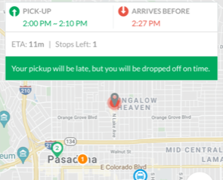
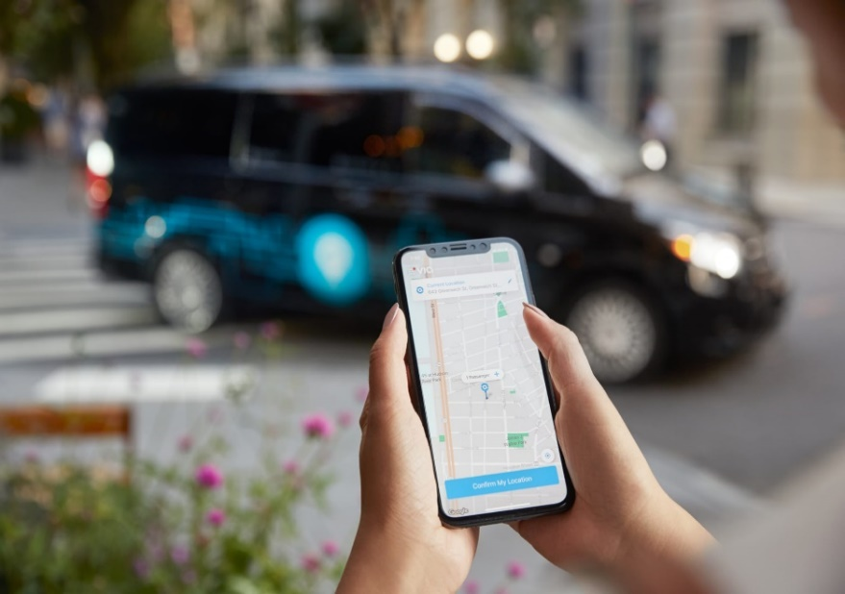
Action Item 2: Community Microtransit Pilot Program
Goal: To provide a convenient and flexible on-demand transit option to compliment the BCT Community Shuttle Program in areas that cannot substantiate fixed route bus service.
Total Surtax Request: $13.75M ($2.75M/year for up to five years)
Vendor will provide Microtransit as a “turn-key” solution, including:
  Vehicles (ADA accessible)
  Operators
  Mobile Application
  Dedicated Call Center
  Marketing
  Five (5) initial microtransit service zones, plus future expansion
Service Characteristics:
  Free Fare – complimentary to community shuttle
  Micro-transit provides trips up to 3 miles within the pick-up zone
  Vendor ensures 15-minute maximum wait time as a service standard
  Initial Service Span is 7am to 7pm, 5 days per week
  Preference for Low and No Emission Vehicles
  Vendor to provide fleet that meets all State/Federal Requirements for operation on all roadways
  MAP Broward Branding of Micro-transit Vehicles
BCT Service & Strategic Planning will actively monitor the service throughout the pilot program. Flexibility is built into solicitation to permit adjustments based on customer feedback.
4
Updated Content on 11.17.21

Slide 5
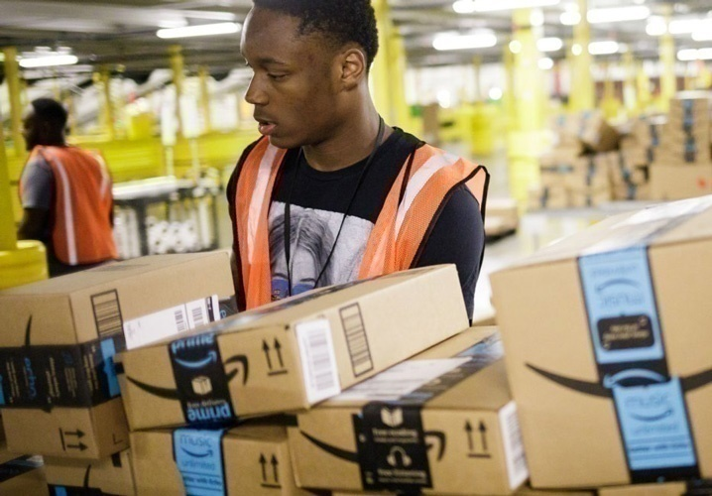
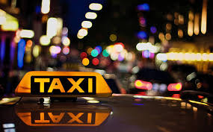
Action Item 3: Late Shift Connect Pilot Program
Goal: To provide a flexible mobility option for late shift workers to commute to work.
Total Surtax Request: $10M ($2M/year for up to five years)
Negotiate with existing vendor (Cab Connect) to configure program for late shift connect, including:
  System Configuration
  Purchase of Fare Cards/Physical Media
  Maintenance of System
  Data Sharing for BCT to Monitor Service
Service Characteristics:
  Program is for exclusive use of late shift commuters
  Eligible late shift workers complete registration to receive a program fare card
  Fare card provides $15 dollar taxi/TNC subsidy on eligible trips to or from work locations during late night hours (11PM – 6AM)
  Passenger responsible for $2 per trip fee, portion of fare in excess of $15, and gratuity to driver
  Maximum of five (5) trips per week. Up to $300 in savings per month
  Trip origin and destination must be within Broward County
BCT Service & Strategic Planning will actively monitor the service throughout the pilot program. Adjustments to be made based on customer feedback.
5
Updated Content on 11.17.21

Slide 6
Discussion? Q&A?

Slide 7
Eligible Uses-- Sec. 212.055(1)(d)(1)(4), Florida Statutes
Project eligibility recommendations by Surtax General Counsel
“(d) Proceeds from the surtax shall be applied to as many or as few of the uses enumerated below in whatever combination the county commission deems appropriate:
1. Deposited by the county in the trust fund and shall be used for the purposes of development, construction, equipment, maintenance, operation, supportive services, including a countywide bus system, on-demand transportation services, and related costs of a fixed guideway rapid transit system; . . .
4. Used by the county for the planning, development, construction, operation, and maintenance of roads and bridges in the county; for the planning, development, expansion, operation, and maintenance of bus and fixed guideway systems; for the planning, development, construction, operation, and maintenance of on-demand transportation services . . . Pursuant to an interlocal agreement entered into pursuant to chapter 163, the governing body of the county may distribute proceeds from the tax to a municipality. . .”

Slide 8
Action Items 2 and 3
Motion to Approve surtax funding in the not-to-exceed amount of $2.75M per year for up to five years ($13.75M total) for a Broward County Transit (BCT) Community Micro-transit Pilot Program
Motion to Approve surtax funding in the not-to-exceed amount of $2M per year for up to five years ($10M total) for a BCT Late Shift Connect Pilot Program
Updated Content on 11.17.21

Slide 9
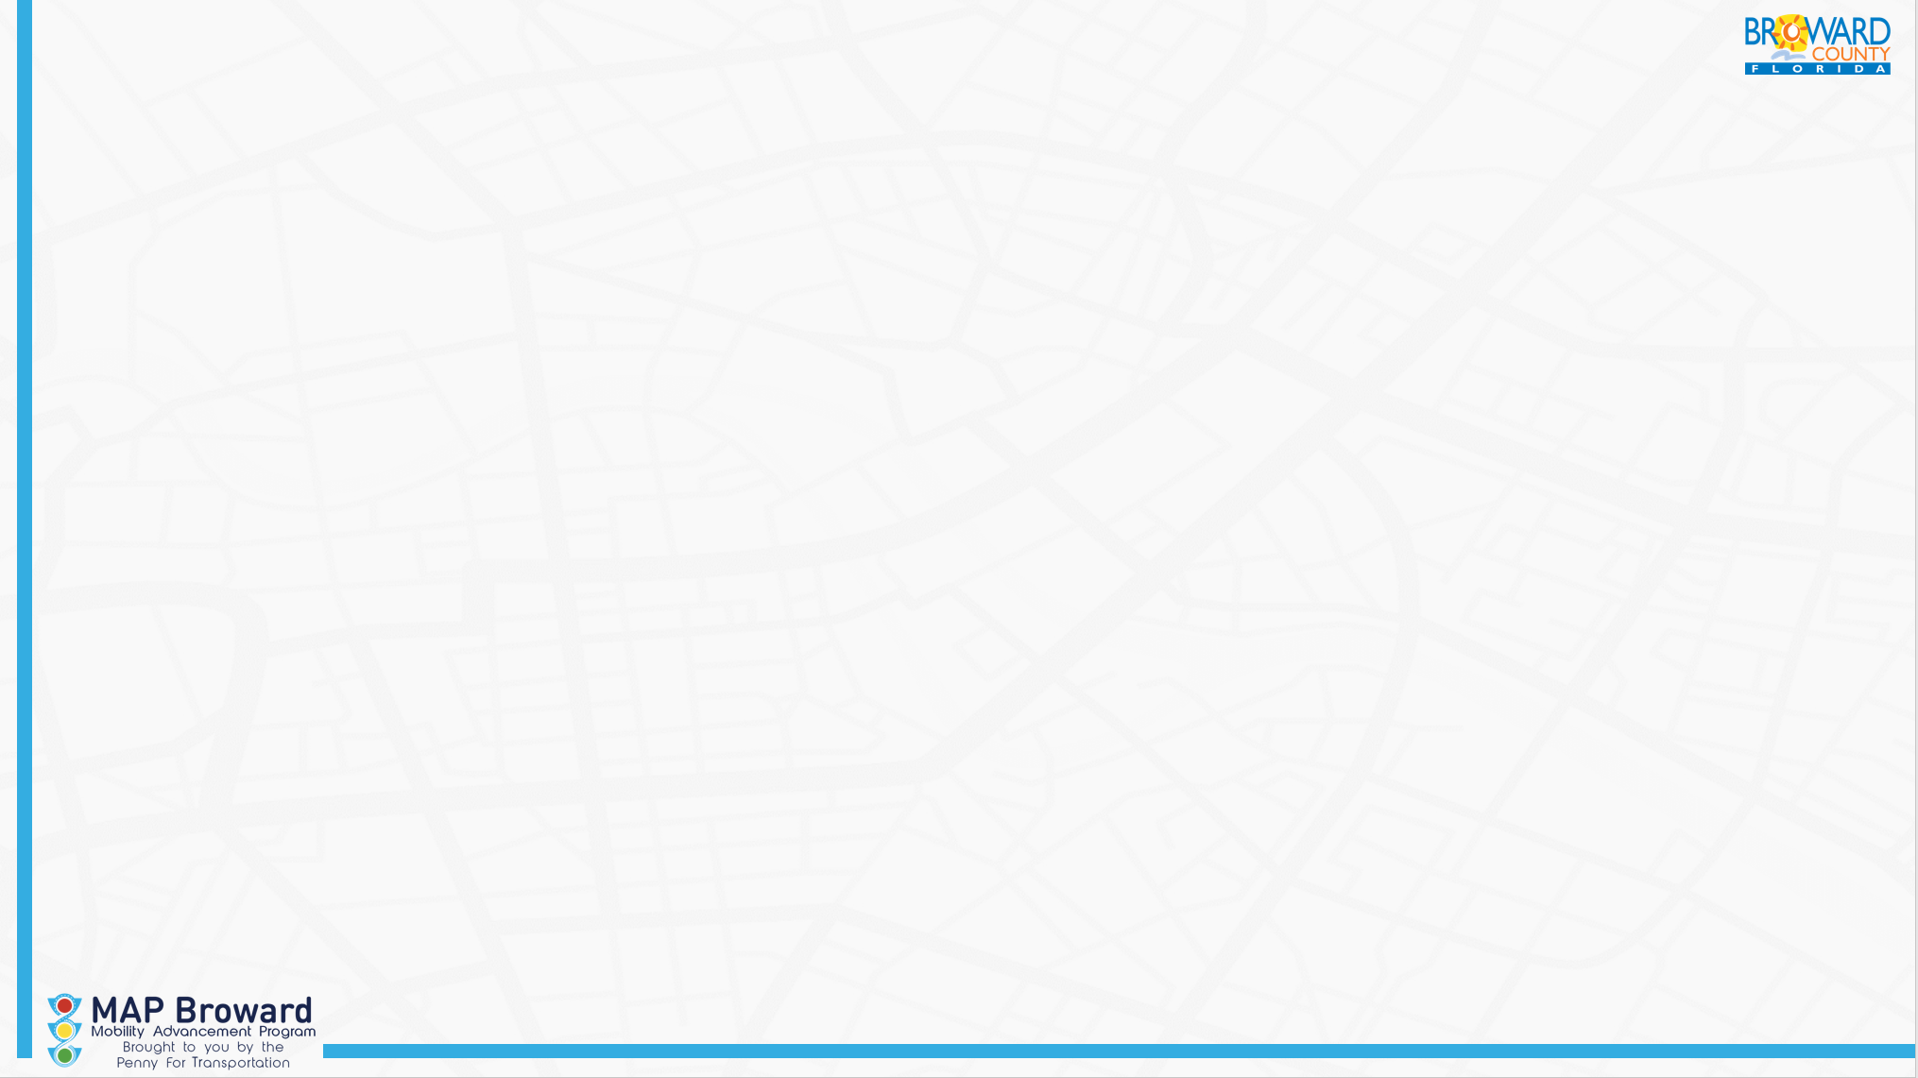
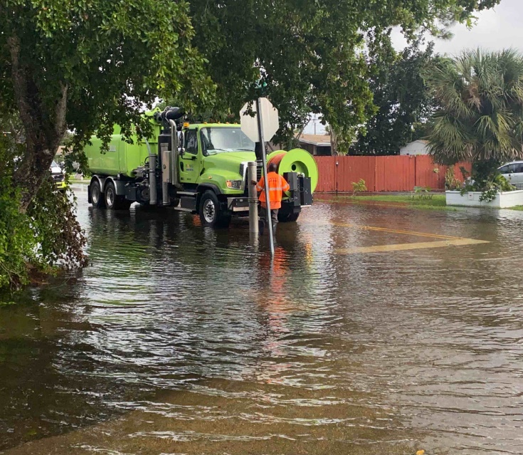
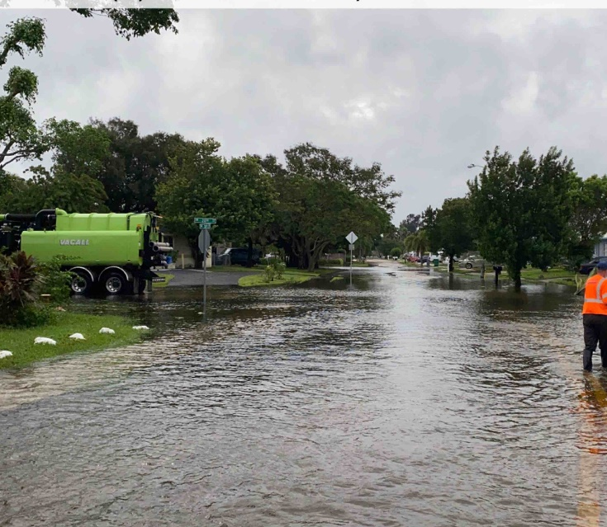
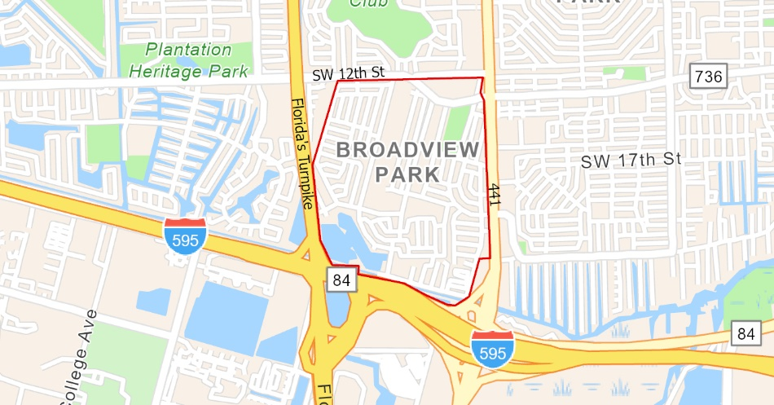
Action item 4
Action Item 4:
D104 Broadview Park Neighborhood Drainage Improvement Project
*NEW PROJECT*
Broward Municipal Services District
Replace aged drainage piping and install green stormwater management infrastructure to reduce roadway flooding in Broadview Park. FL Dept. of Economic Opportunity (DEO) is currently reviewing a grant application for this project (total cost-$21.7M, DEO grant for $16.7M and County match of $5M). DEO requires a planning study to fully define scope and schedule before final grant approval, which is expected in 1st Quarter of 2022. If grant is approved, a future request for remaining $4.5M County match will be submitted for MAP funding approval.
Broward County Public Works
November 2021
Capital Cost Estimate:
Current Capital Cost - $5M (County match)
FY21-25 Cap. Plan Cost – N/A
Reasons for Change – New Project
FY2022 Budget Request:
$500,000 for Planning Study
Schedule:
Current Study Start – 2022
FT21-25 Cap. Plan Start –N/A
Reasons for Change – New Project

Slide 10
Discussion? Q&A?

Slide 11
Eligible Uses- Sec. 212.055(1)(d)(1)(4), Florida Statutes
Project eligibility recommendations by Surtax General Counsel
“(d) Proceeds from the surtax shall be applied to as many or as few of the uses enumerated below in whatever combination the county commission deems appropriate:
1. Deposited by the county in the trust fund and shall be used for the purposes of development, construction, equipment, maintenance, operation, supportive services, including a countywide bus system, on-demand transportation services, and related costs of a fixed guideway rapid transit system; . . .
4. Used by the county for the planning, development, construction, operation, and maintenance of roads and bridges in the county; for the planning, development, expansion, operation, and maintenance of bus and fixed guideway systems; for the planning, development, construction, operation, and maintenance of on-demand transportation services . . . Pursuant to an interlocal agreement entered into pursuant to chapter 163, the governing body of the county may distribute proceeds from the tax to a municipality. . .”
11

Slide 12
Action Item #4
4. Motion to Approve surtax funding in the not-to-exceed amount of $500,000 to Broward County Public Works to begin a Broadview Park (Unincorporated Broward County) Drainage Study (preparing for Grant-Funded Project)

Slide 13
Action Item 5: Pat Salerno Interchange
During the Oversight Board Budget Workshop in August 2020, funding for Pat Salerno Interchange was included in the Five-Year Plan and it was noted that future funding needs were unknown (subject to negotiations)
At the Oversight Board’s January 29, 2021 Meeting, Item 1, staff noted for the record that the County Commission approved an agreement to work with the City of Sunrise and the Florida Turnpike Enterprise/FDOT to continue to work reach an agreement for the full funding of a full north/south interchange at the Pat Salerno Drive and the Sawgrass Expressway (SR 869) by using $3,000,000 of FY 2021 surtax funds to continue the interchange’s design for the calendar year 2021.
An Agreement as to how the Local Funding will be shared between the City of Sunrise and Broward County has been agreed to and is expected to be finalized before December 31, 2021, and the Florida Turnpike Enterprise/FDOT and Broward County are expected in late December or early January 2022 to finalize a Local Funding Agreement.
Updated Content on 11.16.21

Slide 14
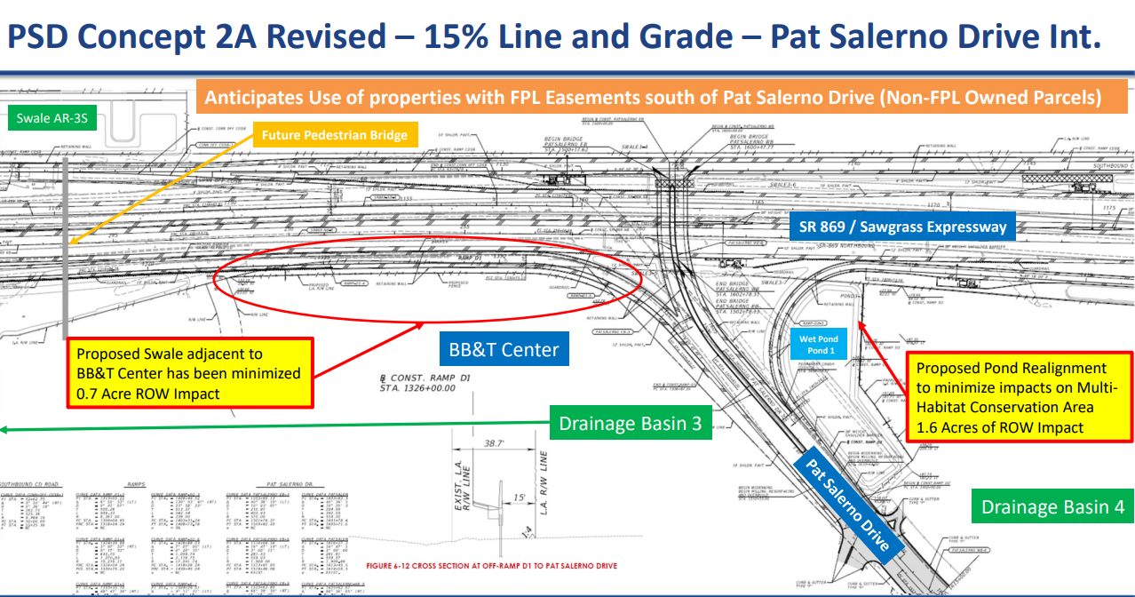
Pat Salerno interface

Slide 15
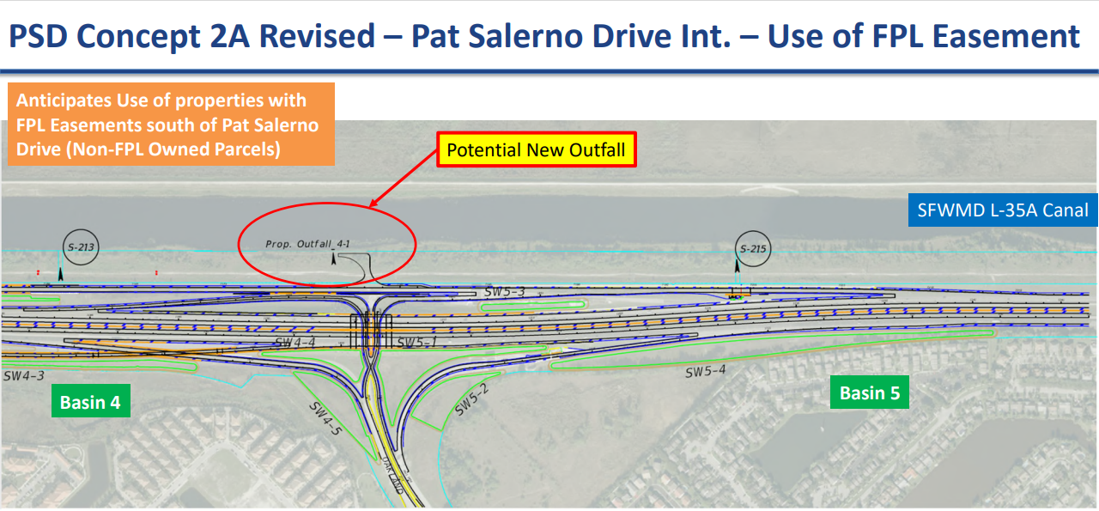
Pat Salerno Drive (PSD) Interchange (cont.)

Slide 16
Action Item 5: Pat Salerno Interchange cont…
Surtax funding is being requested in a not-to-exceed amount of $29M (including the $3 million already approved) to complete the scope of work described as follows.
Full Bi-directional Interchange: New Northbound (NB) braided on-ramp from Pat Salerno Dr and New Southbound (SB) collector-distributor (CD) system
One (1) Removal and three (3) New / Modified Structures: Removal of existing Pat Salerno Dr Bridge over Sawgrass Expressway, New Pat Salerno Dr Bridge over Sawgrass Expressway, New NB access braided ramp bridge over off-ramp to Oakland Park Blvd, Additional widening of the NB mainline bridge over Oakland Park Blvd
Three (3) Tolling Points: Two (2) reconstructed tolling points (Pat Salerno Dr and Oakland Park Blvd), One (1) new ramp tolling point (New NB on-ramp from Pat Salerno Dr)
Updated Content on 11.16.21

Slide 17
Discussion? Q&A

Slide 18
Action Item 5
This project has already been reviewed for eligibility by the Oversight Board and received surtax funding in the amount of $3M
5. Motion to Approve surtax funding in the not-to-exceed amount of $29M for the design, construction, right of way acquisition, drainage, land acquisition, and environmental mitigation required for the Pat Salerno Interchange project partnership with FDOT, Turnpike Authority

Slide 19
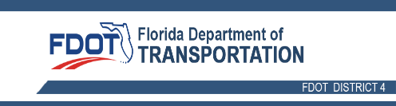
Action Item 6: Broward Commuter Rail Briefing and Request for Surtax Funding

Slide 20
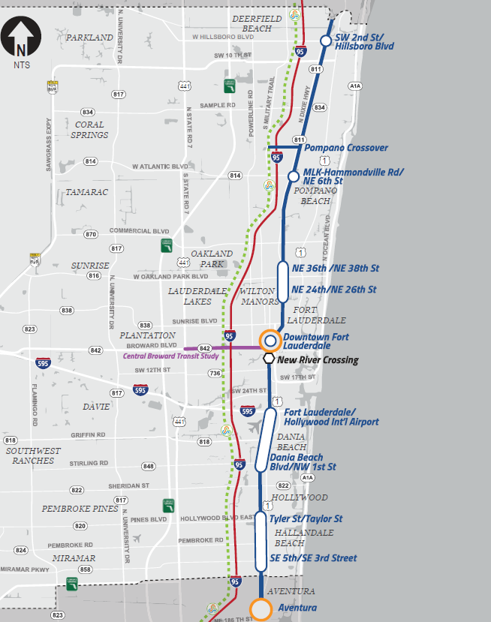
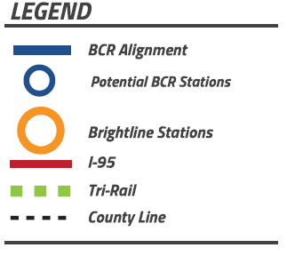
BPartnership Approach between FDOT and Broward County
CR PD&E Study
As described during January 29, 2021, Oversight Board Meeting, Item #2, Broward County and FDOT entered into a Memorandum of Understanding (MOU)
FDOT conducting PD&E Study
  Environmental Analysis of Commuter Rail on FEC railroad
  Aventura to Deerfield Beach including Pompano Crossover
  Includes continued evaluation of the crossing at the New River (Workshop held November 18, 2021 re NRC)
  Evaluations will include east/west traffic analysis for crossings and stations
  Maintain eligibility for federal funding – CIG and other grants
Broward County responsibilities per MOU
  Stakeholder outreach and station locations
  Track access, design/construction and O&M agreements
  Identify local share of capital costs and annual O&M funds
  Draft financial plan
BROWARD COUNTY
MIAMI-DADE COUNTY

Slide 21



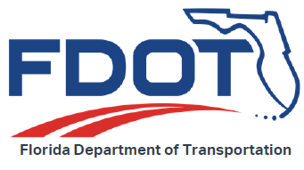

Project Development & Environment (PD&E)
Lead Federal Agency
Cooperating Agency
PD&E Responsibility
Funding and Stakeholder Support Responsibilities
Purpose and Need
Develop Alternatives to Meet Needs
Evaluate Environmental Impacts
Evaluate Cost
Public Involvement
Identify Locally Preferred Alternative (LPA)
Federal/ State Agencies/ Municipalities/ MPO/ Stakeholder Communications
Notes:
Can elaborate some on the FTA and ultimate decision on class of action and will need to approve the project limits and how they view with the NE Corridor project that has been underway since 2018….

Slide 22

Project Funding & Financing
Sources:
Federal
State of Florida
County Government
Municipal Governments
  Special Assessments
  Tax Increment Financing
  Joint Development
  Developer/Impact Fee
Private Sector
  Developers (Commercial, Residential)
  Operators (rail service, parking, others directly interested in business opportunities)
Approaches:
Financial Plan depends on other inputs, including:
  Track access and other agreements
  Very different scenarios/funding needs depending on technical solution chosen for New River crossing, other elements
Local/private funding key to Federal funding
  Enhance components of Project to maximize competitiveness
  Need to I.D & firm-up commitments from private parties & other local governments ASAP

Slide 23
Project Funding & Financing (cont’d.)
Surtax (local dedicated source of revenue to support operations and maintenance) improves prospects for this and other projects
However, certain limits make fiscal discipline important:
  Surtax budget based on 26.1 miles of LRT, along with 7 BRT corridors
  Commuter rail not included in original financial plan
  Cannot sacrifice East-West connectivity for North-South
Availability of counterpart funds from other sources, critical to project being viable
Notes:
Commissioner Furr: De-emphasize E-W connectivity, LRT/BRT; Highlight more the links to surtax projects
Priorities:
Alleviating congestion
Improving mobility
Too much text on this slide, put bullets, follow 5X5 rule

Slide 24

Context
Transit Rail Modes:
Light Rail (e.g., TECO Street Car in Tampa, Dart in Dallas) :
  Routes typically 5-15 miles,
  Avg. speeds 10-30 mph
  ¼ - 1 mile typical station spacing
  Frequency 10-20 minutes (5 @ peak)
Heavy Rail (e.g., MetroRail Miami, Wash. DC Metro, MARTA, NYC Metro):
  Routes from 5-15 miles
  Avg. speeds 25-40 mph
  Frequency: 10-20 minutes (5-10 @ peak)
  ½ to 2-mile typical station spacing
  Dedicated rail lines, grade separated, elevated or subway tracks
Commuter Rail (e.g., Tri-Rail, SunRail, WA Sounder, Caltrain, Metro North NY):
  Routes from 20-50 miles,
  Avg. speeds 30-50 mph
  2 ½ - 5 mile typical station spacing
  Approx. 30 minute frequency @ peak
High Speed Rail (Brightline, Acela Express, Bullet train Japan):
  Much longer routes (NY-Wash = 250 miles)
  Avg. speeds: 80-250 mph
  Inter-City station spacing (25+ miles)
  Frequency: 1 hour +
Commuter Rail is not what people often think.
Typically shares tracks on freight rail lines.
Historically has served white collar workers commuting to work in large cities from outlying suburban residential areas.
Requires wider spacing of stations to allow relatively heavier locomotives to reach higher average speeds.
Leverages existing infrastructure, but provides less options for locomotive types (third rail not feasible).
Safety and traffic considerations for at-grade crossings.
May or may not compare favorably to other modes, including BRT

Slide 25
A Look at Commuter Rail in the U.S. (2019)
Top 5 according to Operating Cost/Trip:
  Caltrain CA ($7.71)
  Denver RTD CO ($8.26)
  Frontrunner UT ($8.53)
  Sprinter CA ($8.95)
  SEPTA PA ($8.98)
Florida systems are among bottom 3rd
  Tri-Rail FL ($21.77)
  SunRail FL ($30.33)

Slide 26
BCR’s Future/Feasibility Challenges
FDOT and Broward County signed MOU to collaborate on PD&E study (Jan. 2021)
Corridor closer to urban cores, ridership expected to be greater than Tri-Rail
Most municipalities on-board to share costs for stations; business community supportive
Dade County apparently moving forward with their portion (FTA approved Project Development phase for N.E. Corridor)
Potential synergies/economies of scale with Tri-Rail if SFRTA operates
Federal funding possible, if project compares favorably with competing grant proposals at national level (Infrastructure Bill’s passage could assist with challenging aspects of financing)
Not included in original Surtax finance plan
Separate from “System-Wide Transit Study, Planning & Preliminary Design” (BCT)
  26.1 miles of Light Rail Transit
  7 Bus Rapid Transit Corridors
Governance structure: to be defined
Higher operating costs due to track access fees to be negotiated with Brightline
New River Crossing
  Price tag of some options raise questions about cost effectiveness, FTA rating
  Importance of confirming a viable “Locally Preferred Alternative” prior to grant application submittal
Further analysis required before feasibility is confirmed
Proposing limited use of Surtax funding (up to $2.35 million) to cover initial study & planning costs

Slide 27
Request for surtax funds for initial study & planning
Total of $2.35M:
Financial Advisor | $100,500
Strategy & Procurement Support | $45,334
Legal Counsel | $100,000
General Engineering Consulting Services | $2,100,000

Slide 28
Discussion? Q&A

Slide 29
Eligible Uses-- Sec. 212.055(1)(d)(1)(4),Florida Statutes
Project eligibility recommendations by Surtax General Counsel
“(d) Proceeds from the surtax shall be applied to as many or as few of the uses enumerated below in whatever combination the county commission deems appropriate:
1. Deposited by the county in the trust fund and shall be used for the purposes of development, construction, equipment, maintenance, operation, supportive services, including a countywide bus system, on-demand transportation services, and related costs of a fixed guideway rapid transit system; . . .
4. Used by the county for the planning, development, construction, operation, and maintenance of roads and bridges in the county; for the planning, development, expansion, operation, and maintenance of bus and fixed guideway systems; for the planning, development, construction, operation, and maintenance of on-demand transportation services . . . Pursuant to an interlocal agreement entered into pursuant to chapter 163, the governing body of the county may distribute proceeds from the tax to a municipality. . .”

Slide 30
Action Item 6
6. Motion to Approve surtax funding in the not-to-exceed amount of $2.35M to support County’s role in Memorandum of Understanding with FDOT regarding the PD&E Study (Broward Commuter Rail)

Slide 31
Presentations

Slide 32
Broward Commuter Rail (BCR) PD&E Update
(FDOT District 4, Mr. Steve Braun and Consultant Team leading PD&E Study)

Slide 33
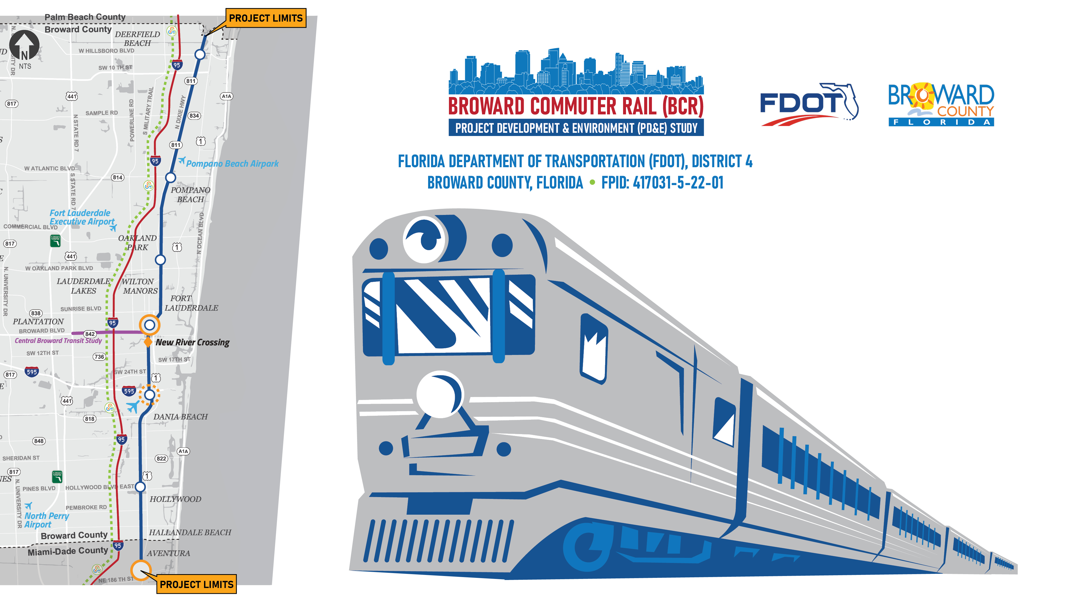
FDOT commuter rail presentation
Transportation Surtax
Oversight Board
Presentation
November 19, 2021

Slide 34





Importance and Benefits of Commuter Rail
  ECONOMIC & RESIDENTIAL GROWTH
  Transit Oriented Development (TOD)
    Increased business investment
    Affordable housing incentives
  Mixed land uses to support the increase in residential and business development
  ENHANCE QUALITY OF LIFE
  Increased mobility and transportation choices
  Greater access to employment, education, and essential services
  TRANSIT INCENTIVES TO THE PUBLIC
Reduce travel times and automobile dependence
Save money on gas, parking, and car maintenance/repairs
  ENVIRONMENTAL
Cleaner air by reducing traffic congestion (reduced vehicle emissions)
  COMMUTER RAIL BENEFITS EMPLOYERS
Access to a wider pool of talent
Dependable and reliable transit service may boost and enhance productivity
Notes:
Commuter rail has many important benefits. Economic and residential growth will include Transit Oriented Development and mixed land uses to support the increase in residential and business development. Commuter rail helps to enhance quality of life by increasing mobility and transportation choices and providing greater access to employment, education, and essential services.
Transit benefits to the public include reduced travel times and automobile dependence and avoiding the stress of road traffic. Environmental benefits include cleaner air by reducing traffic congestion and less wear and tear on our highways. Commuter rail benefits employers with potential cost savings on subsidized parking and access to a wider pool of talent.

Slide 35
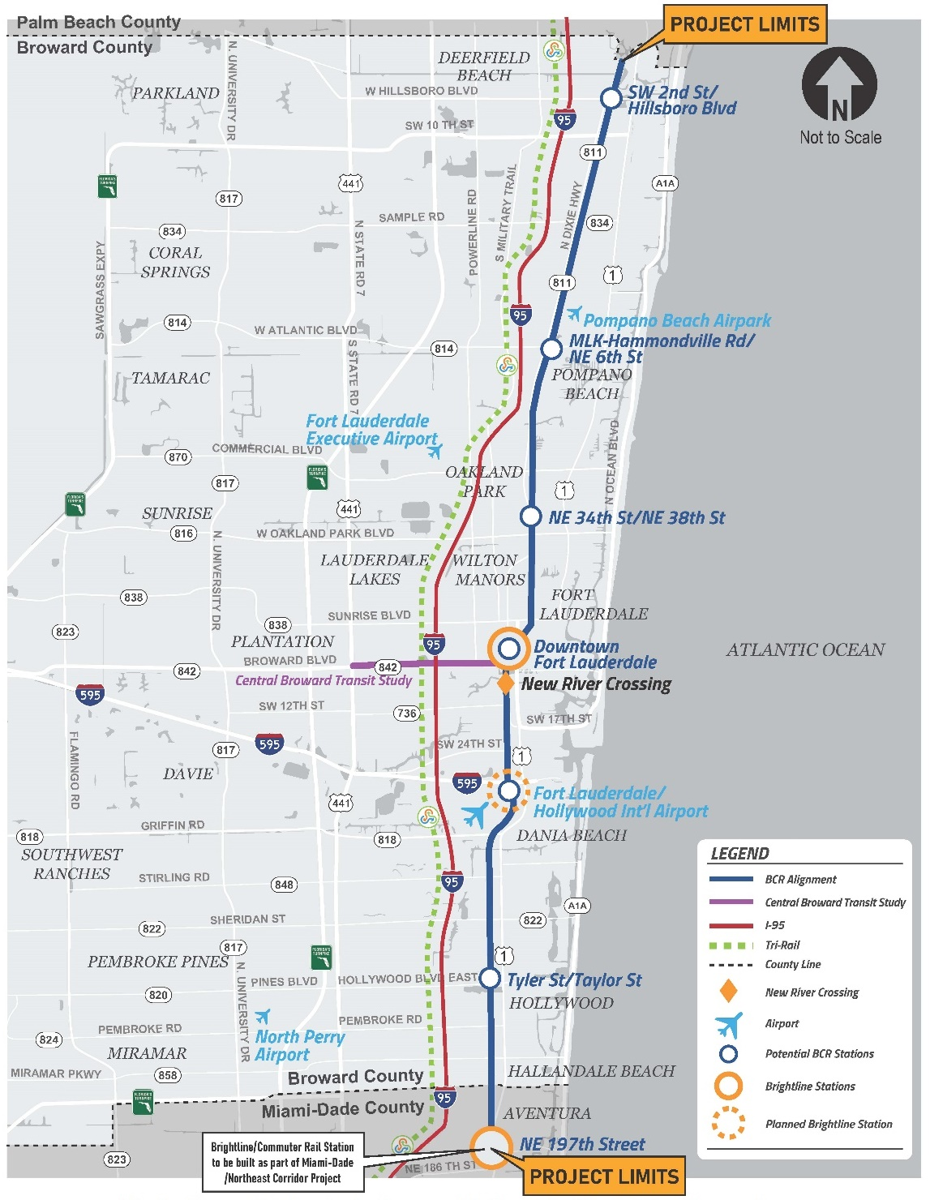
Study Overview
  From Aventura in Miami-Dade County to Deerfield Beach in Broward County
  27 Miles along the FEC Railroad
  Miami-Dade is moving forward with commuter rail as part of their Northeast Corridor Project which is part of their county wide Smart Plan
  There is potential for Palm Beach county to extend the commuter rail up to Jupiter based on the original Coastal Link Study
  BCR is being developed taking into consideration potential future extension into Palm Beach County
  Technical recommendations have been made for 6 station locations
  Extensive coordination needed with Brightline, FECR, FTA, local municipalities as well as Miami-Dade County
Notes:
Throughout many years of station planning, nearly 100 potential station areas were originally identified in the corridor. This list was refined to 26 potential station areas in the tri-county area. Through coordination with municipalities and stakeholders in Broward County, the 9 station areas originally identified in Broward have been further screened to 6 Broward Commuter Rail station areas to advance through the PD&E process.

Slide 36
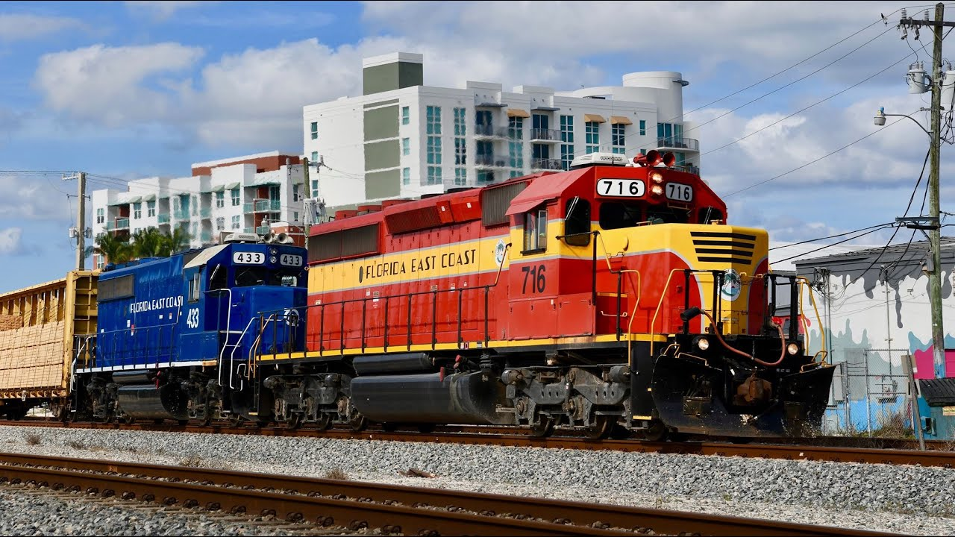
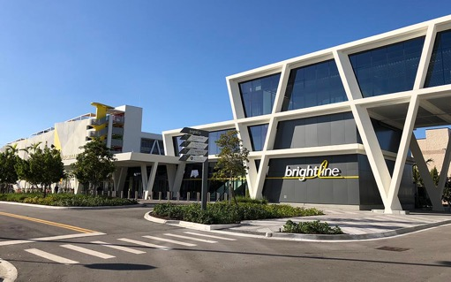
Rail Services in the FEC Corridor
  Shared-use corridor with FEC freight trains and intercity passenger trains
  Florida East Coast Railway, L.L.C. owns the FECR right of way and operates freight service
  Brightline operates inter-city passenger rail trains via a passenger easement in the corridor
Notes:
The FEC corridor is a shared-use corridor with FEC freight trains and intercity passenger trains. Florida East Coast Railway, L.L.C. owns the FECR right of way and operates freight service. Brightline operates inter-city passenger rail trains via a passenger easement in the corridor. The commuter rail will share tracks with freight and Brightline. The study is being conducted in coordination with many parties that have an interest in the FEC railroad corridor.

Slide 37
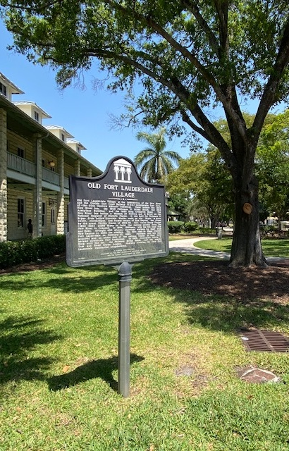
Environmental Considerations
  Social Environment
  Social Resources
  Economic
  Land Use Changes
  Mobility
  Aesthetic Effects
  Relocation
  Recreational Section 4(f) (Parks and Preserves)
  Cultural Environment
  Historic Resources
  Archaeological Resources
  Involves Coordination with the State Historic Preservation Officer
  Natural Environment
  Wetlands
  Protected Species
  Essential Fish Habitat
  Water Resources
  Floodplains
  Special Designations
  Physical Environment
  Farmlands
  Noise
  Air Quality
  Contamination
Pedestrian Crossing North of the New River Bridge
Looking South at New River Bridge
Old Fort Lauderdale Village Historic District
Notes:
The PD&E Study will take into account numerous environmental considerations including:
Social Resources
Economic
Land Use Changes
Mobility
Aesthetic Effects
Relocation potential
Recreational Section 4(f)(Parks and Preserves)
Cultural Environment considerations include:
Historic Resources
Archaeological Resources
As well as Coordination and consultation with the State Historic Preservation Officer
The Federal Transit Administration will lead the cultural resources effort.
Natural Environment considerations include:
Wetlands
Protected Species
Essential Fish Habitat
Water Resources
Floodplains
Special Designations
Physical Environment considerations include:
Farmlands
Noise
Air Quality
Contamination

Slide 38
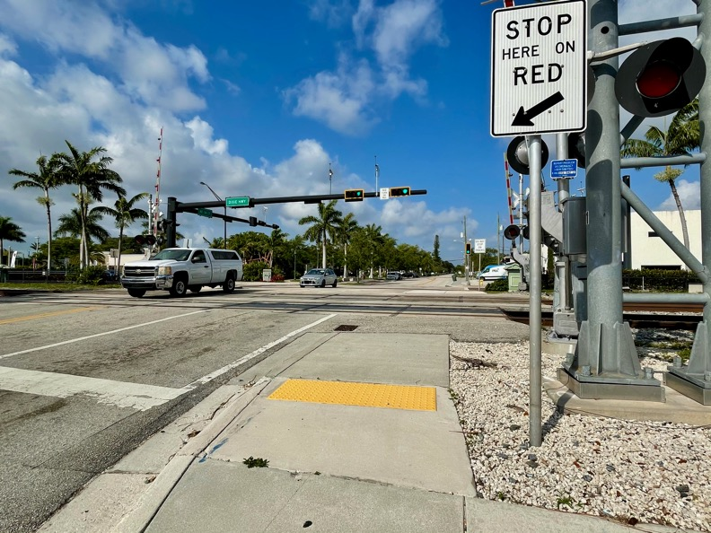
Traffic Analysis Approach
  Roadway Traffic Analysis at:
  Representative worst case railroad crossings on east-west roads
  Proposed station locations
  Evaluation of Existing, No-Build, and Build Alternatives
  Step-By-Step Process
  Identify traffic analysis locations and collect data
  Estimate future traffic demand
  Perform traffic operational analysis
  Intersection's level of service
  Queuing length analyses
Notes:
Two types of traffic analyses will be performed as part of the PD&E Study. The first one involves the railroad crossings on the east-west roadways and the second location is at the proposed station locations.
The PD&E Study will evaluate three scenarios: Existing Conditions, a future No-Build No-Construction condition, and a future Build condition.
The traffic evaluation follows a step by step process that consists of the following key efforts:
The study area has 66 east-west railroad crossings. Not all the crossings will be evaluated. Therefore, the study will select crossings representing 2-Lane, 4-Lane, and 6-Lane roadways.
Traffic data will be collected within the identified traffic analysis areas.
Future Traffic Demand will be estimated to forecast the number of vehicles traveling along the railroad crossing areas and proposed station areas.
A Traffic Operational Analysis will be performed to evaluate the intersection operations within the railroad crossings and proposed station areas. The analysis will include intersection’s level of service and queue lengths.

Slide 39
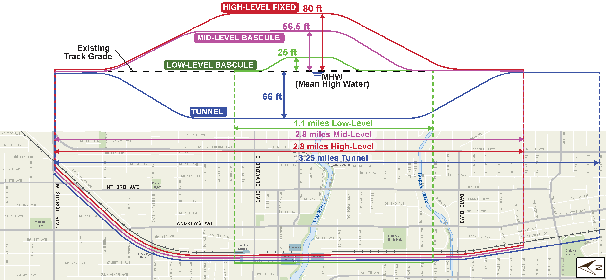
New River Crossing Alternatives Overview

Slide 40
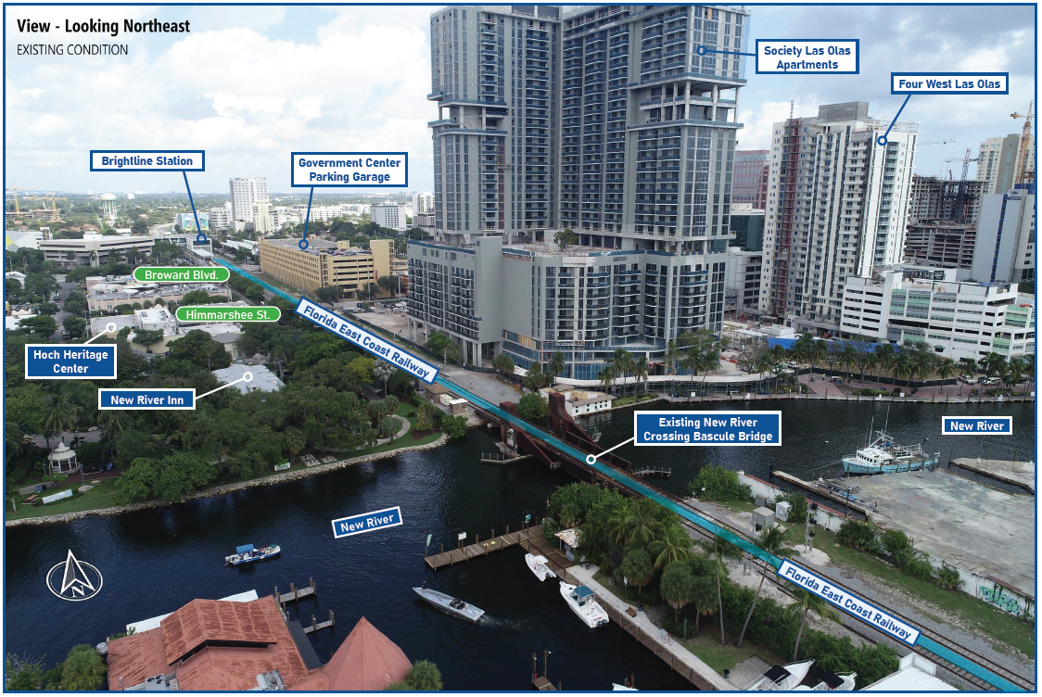
New River Crossing Analysis
  Feasibility Study Completed in 2020
  Extensive Stakeholder and Agency Coordination
  Considerations
  Maintain maritime, freight and passenger operations
  Existing freight bascule bridge to remain
  Accommodate planned Premium Transit on Broward Boulevard
  Connect to Brightline station downtown
  Improve connectivity downtown
  Avoid, minimize, or mitigate impacts to historical resources, neighborhoods and right of way
  Four Crossing Alternatives Under Evaluation from Feasibility Study*
  Low-Level Bascule Bridge: $216 – $324 Million
  Mid-Level Bascule Bridge: $400 – $600 Million
  High-Level Fixed Bridge: $407 – $611 Million
  Tunnel: $1.64 – $2.46 Billion
  *Note: Preliminary cost estimates are reasonable high-level ranges at the current stage of this PD&E Study. Refined cost estimates will be continually updated throughout the life of the project.
Notes:
The New River Crossing Feasibility Study was completed in 2020 with extensive Stakeholder and Agency Coordination and in response to the state legislative action.
The main considerations for the river crossing are to:
Maintain maritime, freight and passenger operations
Keep the freight bascule bridge in service
Accommodate planned Premium Transit on Broward Boulevard
Connect to the Brightline station downtown
Improve connectivity in the downtown area
Mitigate, minimize, or avoid impacts to historical resources, neighborhoods and right of way
There are four Crossing Alternatives Under Evaluation:
A Low Level Bascule Bridge, which is a drawbridge that would remain open and closes when a train passes
A Mid Level Bascule Bridge
A High Level Fixed Bridge
And a Tunnel
Preliminary cost estimates are reasonable high-level ranges at the current stage of this PD&E Study. Refined cost estimates will be continually updated throughout the life of the project.

Slide 41
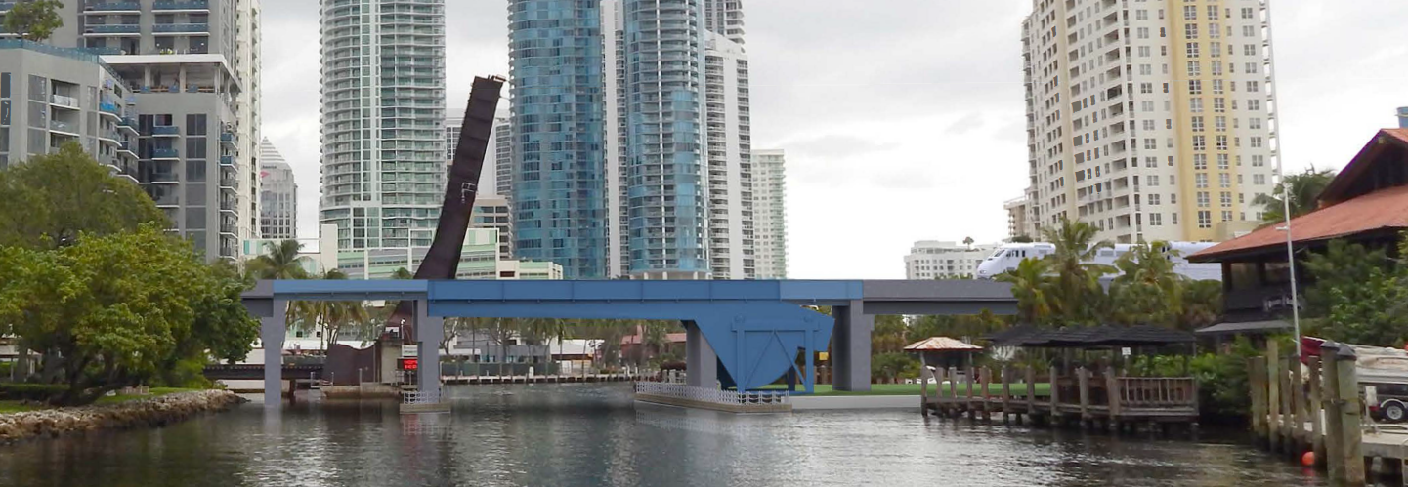
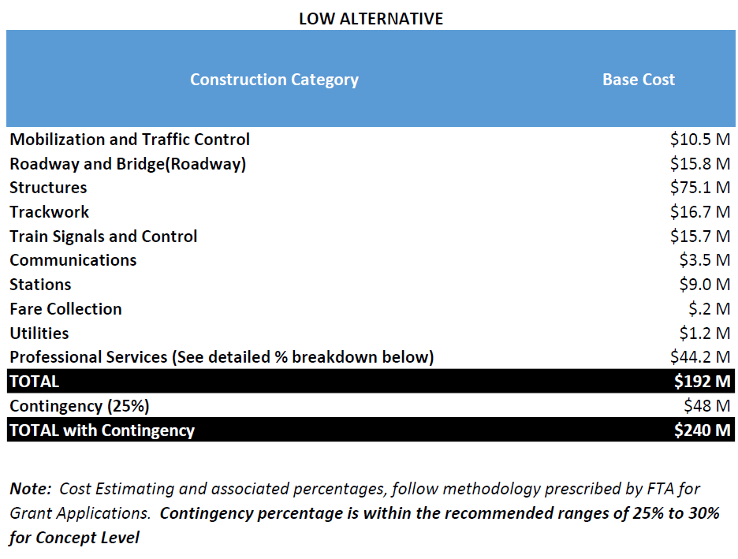
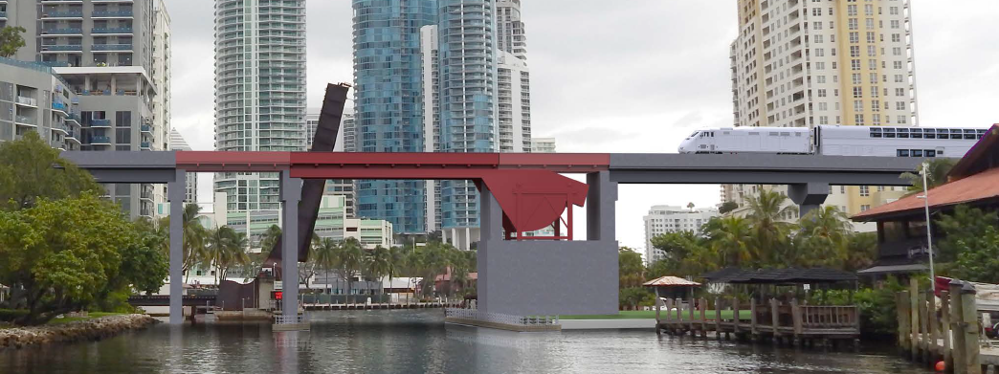
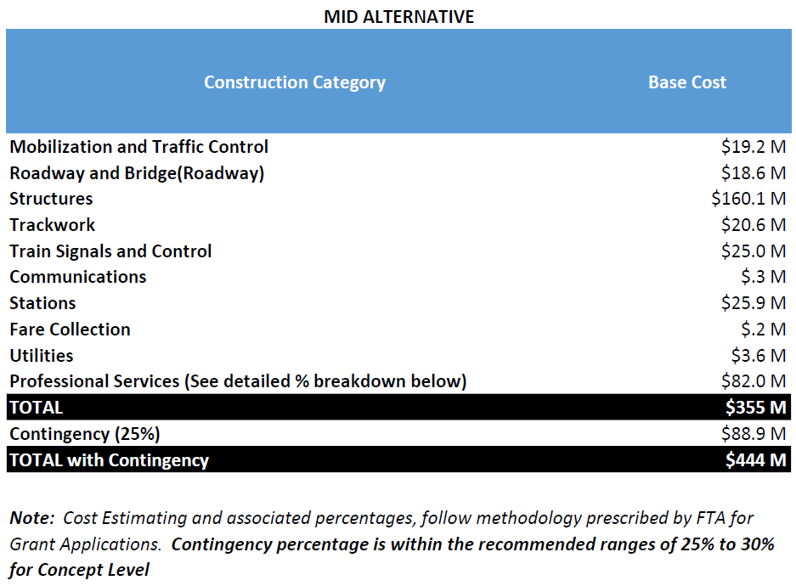
Alternatives Overview
Low Level Bascule Bridge (25 Feet Clearance)
Low Level Alternative
Mid Level Bascule Bridge (56 Feet Clearance)
Mid Level Alternative

Slide 42
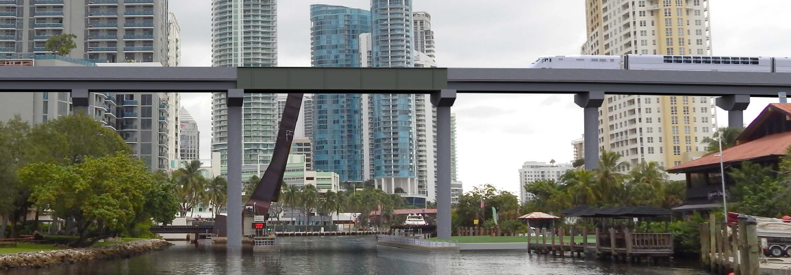

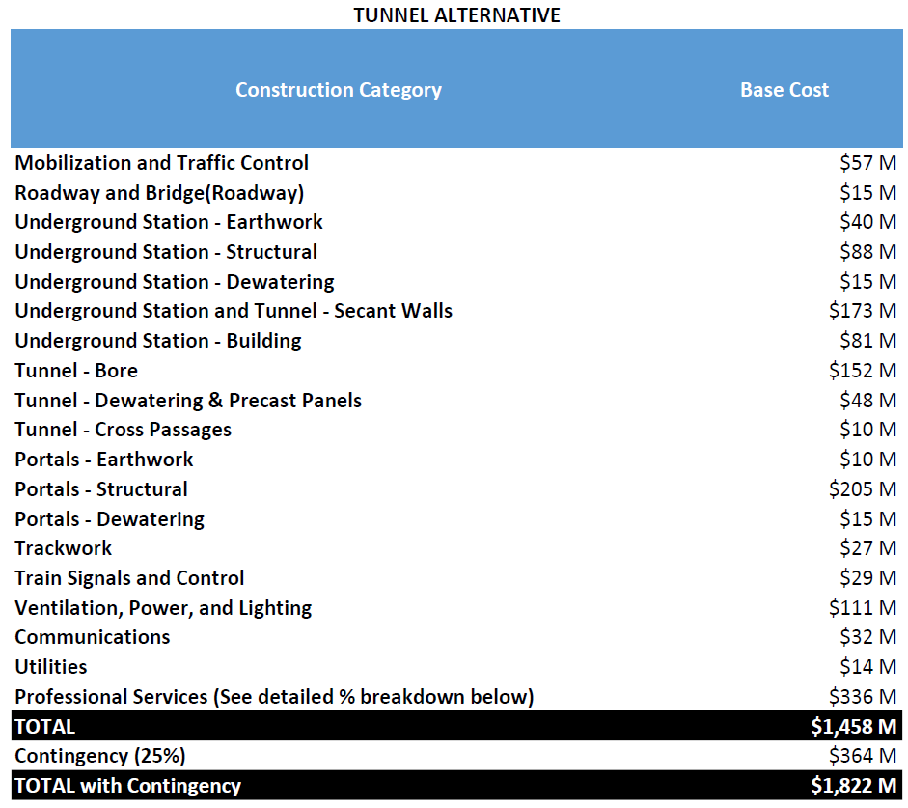
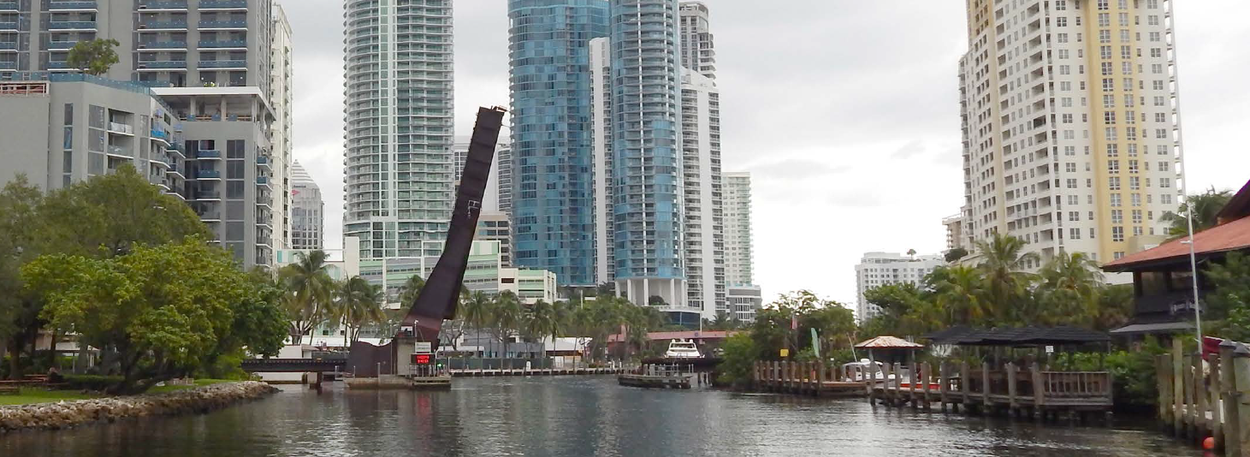
Alternatives Overview
High Level Fixed Span Bridge (80 Feet Clearance)
High Level Alternative
Tunnel / Existing Condition
Tunnel Alternative

Slide 43
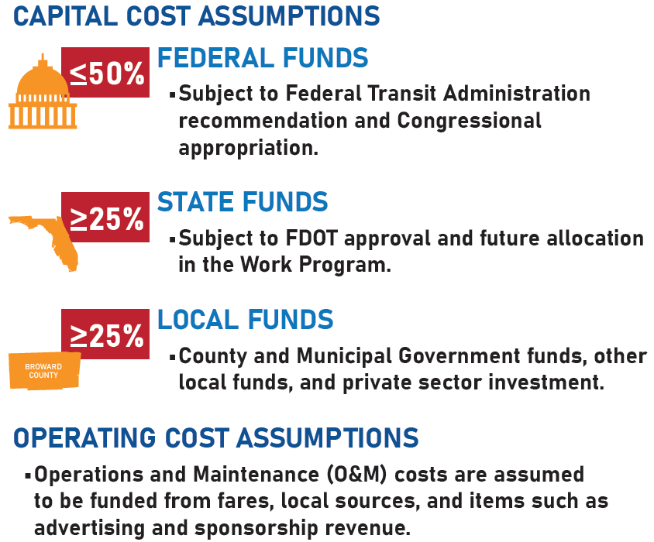

Cost Effectiveness / Funding Assumptions
  In order to qualify for federal funds, the project must meet the FTA’s cost effectiveness evaluation criteria.
  To meet cost effectiveness criteria the NRC may need to be removed from the cost effectiveness calculation and may require separate funding.
  Infrastructure Investment and Jobs Act (IIJA) – New act may provide the opportunity for additional funds.
Notes:
The project funding assumes federal, state and local participation in the capital or construction costs. During the course of the PD&E study, the project’s capital cost and the operations and maintenance costs will be estimated to determine the most appropriate funding mix to maximize the chances of qualifying for FTA’s competitive transit capital project funding programs.

Slide 44
Next Steps
What to expect over the next 6-9 months

Slide 45
Questions?

Slide 46
Federal Legislative Update/Infrastructure Package
Thorn-Run Partners (Mr. Greg Burns)

Slide 47
Infrastructure Investment and Jobs Act (IIJA)
Law as of November 15, 2021
$1.2 trillion bill that includes two main components:
  A five-year surface transportation authorization to replace the FAST Act; and
  Roughly $550 billion in additional investment in infrastructure, generally intended to be spent over five years – or ~$110 billion per year.

Slide 48
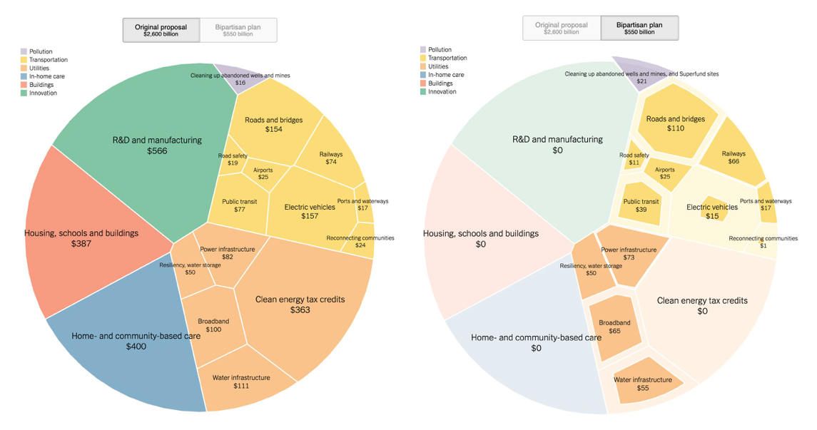
Biden Initial Infrastructure Proposal vs. IIJA

Slide 49
IIJA Key Takeaways
Of $550 billion in new spending above baseline, more than half is for transportation
  Of that, more than 1/3 will be granted by DOT via competitive applications
  The remainder will be provided to states, etc. via formula programs
  IIJA not as transformational as originally envisioned
  Rail the biggest winner – mostly to Amtrak
  This is not the ARRA Obama-era stimulus bill
    Focus not on immediate job creation, but investment in transformative infrastructure

Slide 50
Surface Transportation Programs
More than a dozen new programs to be created
  Will take time for DOT to set up
  Focused on major transformational projects, safety, smart city, resiliency, carbon reductions, etc.
  More information forthcoming
Existing programs often provided with more funding
  RAISE/BUILD/TIGER
  INFRA, etc.

Slide 51
Transit Funding
Increase of 63 percent from current levels
Increases for each of the formula and competitive grant programs by 35-37 percent compared to current levels
  For example, Miami UZA receives $173 million in 5307 funding in FY 2021
  Increases to $241 million by FY 2026
Provides $23 billion over 5 years for the Capital Investment Grants (CIG) program
  Important for Broward Commuter Rail, etc.

Slide 52
What to Expect: Timing, Next Steps, Etc.
Federal agency hiring spree
  Department of Energy reportedly considering hiring 1,000 new employees
  Department of Transportation may need to do something similar
Existing grant opportunities with new funding should have applications open within 90 days or so.
New grant opportunities will need to be developed; may require public participation.
5-year bill, so funding will trickle out over time
  Will allow for good planning to prepare for opportunities.

Slide 53
Questions?

Slide 54
Surtax Services Update
Broward MPO and Whitehouse Group (Mr. Bryan Caletka and Mr. Todd Brauer)

Slide 55

MUNICIPAL CAPITAL PROJECTS (MCPs) UPDATE
NEW TOOLS AND ASSISTANCE
Independent Transportation Surtax Oversight Board
November 19, 2021

Slide 56
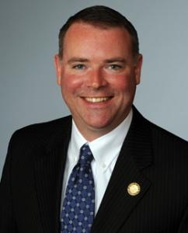
BRYAN CALETKA
Director of Transportation
Broward MPO contact supporting Broward County with the Surtax Program (per the Second Amendment)
Leads efforts to assist municipalities in preparing Municipal Capital Projects (MCPs) for County recommendation
Available to work with all elected officials and present to municipal commissions about MCPs and the role of the MPO as needed.

Slide 57



ROLE OF THE MPO
TEACH
TRAIN
SUPPORT

Slide 58


ROLE OF THE MPO
RANK
RECOMMEND
NEW MUNICIPAL CAPITAL PROJECTS (MCPs)
MCPs WITHIN THE MINIMUM ANNUAL GUARANTEE (MAG)
Cycle 1 MCPs are priority, then New MCPs. Funding allocations are within the annual MAG as provided by Broward County.
MCPs EXCEEDING THE MAG
Upon request from the County Administrator

Slide 59



What’s The Difference Between Cycle 1 And New MCPs?
Cycle 1 MCPs
The original 110 (of the total 510) MCPs already approved by the County. Readiness required before an Interlocal Agreement executed for funding.
New MCPs consist of:
Previously submitted MCPs, ranked 111-510. Eligibility required to be ranked.
Newly submitted MCPs in current and future cycles. Eligibility required to be ranked.

Slide 60
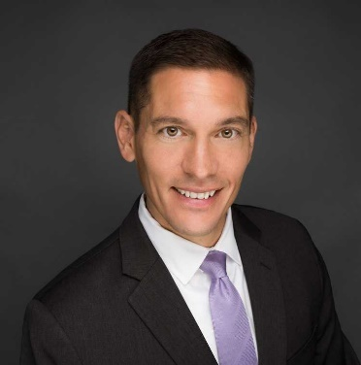
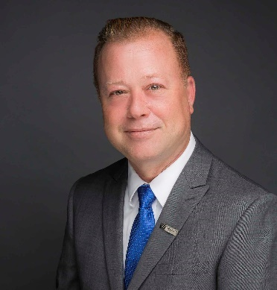
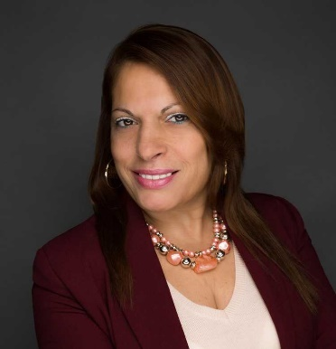
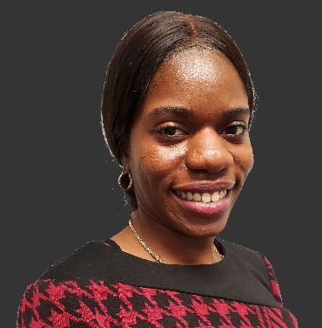
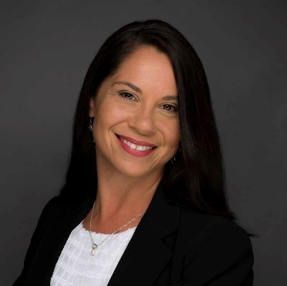
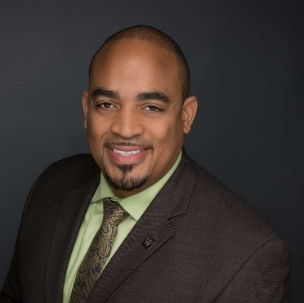
MCP LIAISON TEAM
Todd Brauer, AICP, PTP
RECOMMENDATIONS
(754) 701-1611
Wade White, AICP
RANKING
(717) 980-5417
Maria Rigal, Notary
SCHEDULING
(754) 701-1610
Kathrina Regnier
APPLICATION REVIEWS
(754) 701-1612
Amy Vargas
READINESS REVIEWS
(954) 533-9702
Dale Largie, CPA
READINESS REVIEWS
(754) 701-1614

Slide 61
OBJECTIVES FOR 2022 APPLICATION PERIOD
Robust Communication Infrastructure
Cycle 1 MCPs Support
Clean New MCPs Database

Slide 62
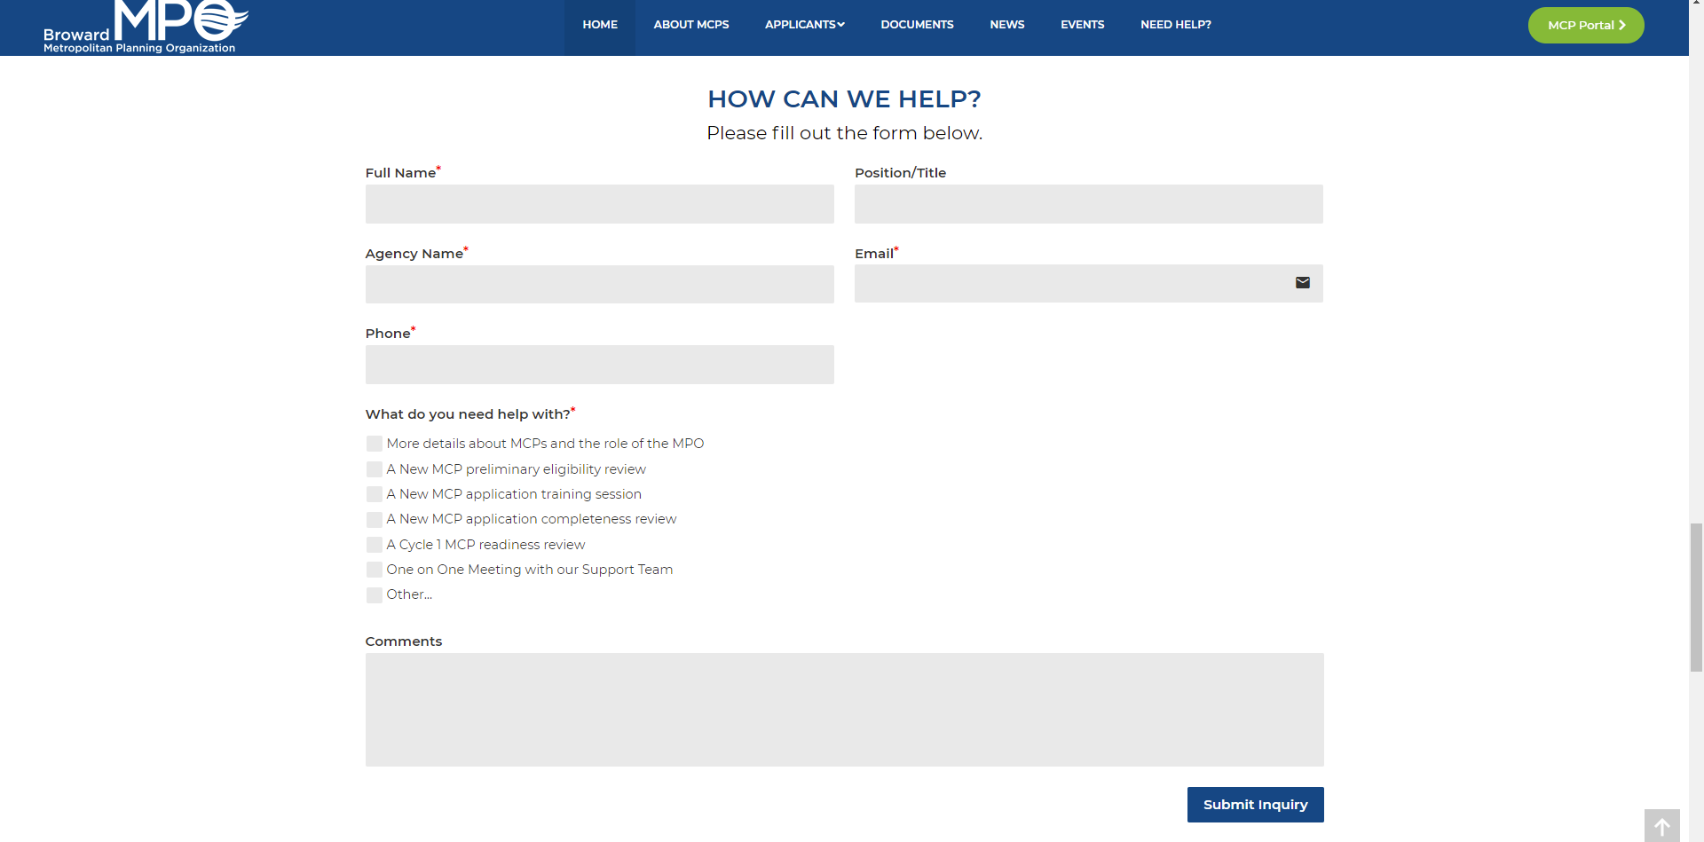
WEBSITE
One-stop shop for everything:
  Access Portal to New MCPs
  Latest News
  Upcoming Events
  Templates
  Educational Resources
  Contact Form to Connect with MCP Liaisons

Slide 63




WHAT’S NEXT / ACTION ITEMS
Visit the Website
Contact us with questions or ideas for improvement:
Review New MCPs
BRYAN CALETKA
Director of Transportation
caletkab@browardmpo.org
(954) 876-0070
TODD BRAUER, AICP, PTP
President / COO
tbrauer@whitehousegroup.com
(754) 701-1611
Register for Upcoming Workshops
Looking forward to an even better MCP cycle in 2022!

Slide 64
Penny for transportation – where the change happens
Introduction of Regional Location-Based Services (LBS) Data
Min-Tang Li, Ph.D., Licensed Engineer/Mobility Modeler

Slide 65
Agenda
Background
RITIX Trip Analytics
Replica
  Trends
  Places
Demo
-- Please hold questions until the end of the demonstration--

Slide 66
Background
Regional Data Acquisition Memorandum of Understanding (MOU)
  Regional Partnership also delineated cost-sharing among the partners
  Surtax contributed $25,000 to the contract
Data Acquisition Contract managed by Broward MPO
  Two vendors jointly submitted and were selected based on a competitive solicitation process (RLI) to mainly focus on improving data sources for the regional planning model

Slide 67
Regional Data Acquisition MOU
September 18, 2020, MOU was jointly signed into effect by 3 regional MPOs, FDOT D4&6, and Broward County to acquire probed GPS/mobile spatial and temporal data mainly for southeast regional planning model (SERPM) development

Slide 68
Data Acquisition Contract
June 10, 2021, INRIX/Replica Team were selected as the vendors to provide data for regional partners to use
INRIX 8-month data, accessed via Regional Integrated Transportation Information System (RITIX), cover the following temporal spans:
  2019: March – May, July, September-November
  2020: Mid December – Mid January

Slide 69
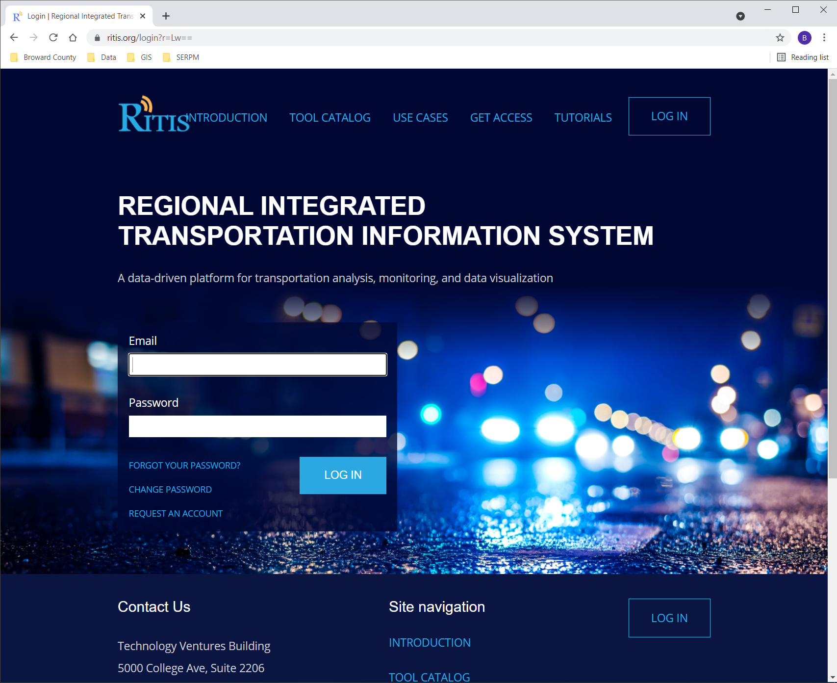
RITIX
ITS (Intelligent Transportation system) data warehouse and analytics platform for FDOT and others

Slide 70
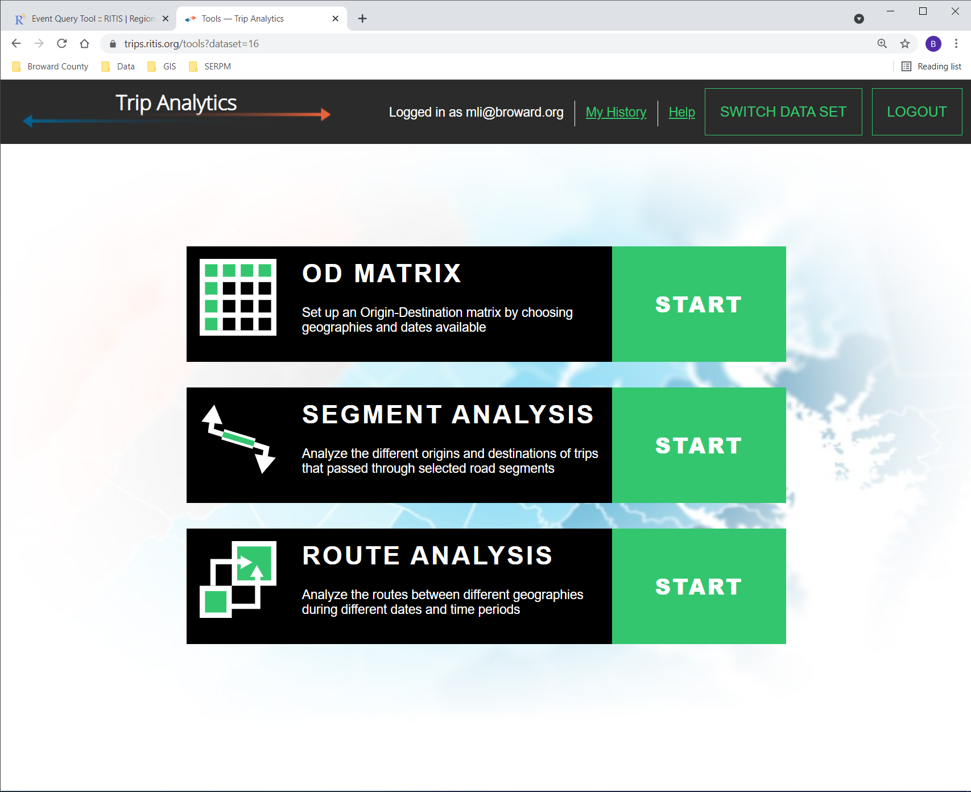
RITIX Trip Analytics –
INRIX Data
Origin-Destination (OD) Matrix
Segment Analysis
Route Analysis

Slide 71
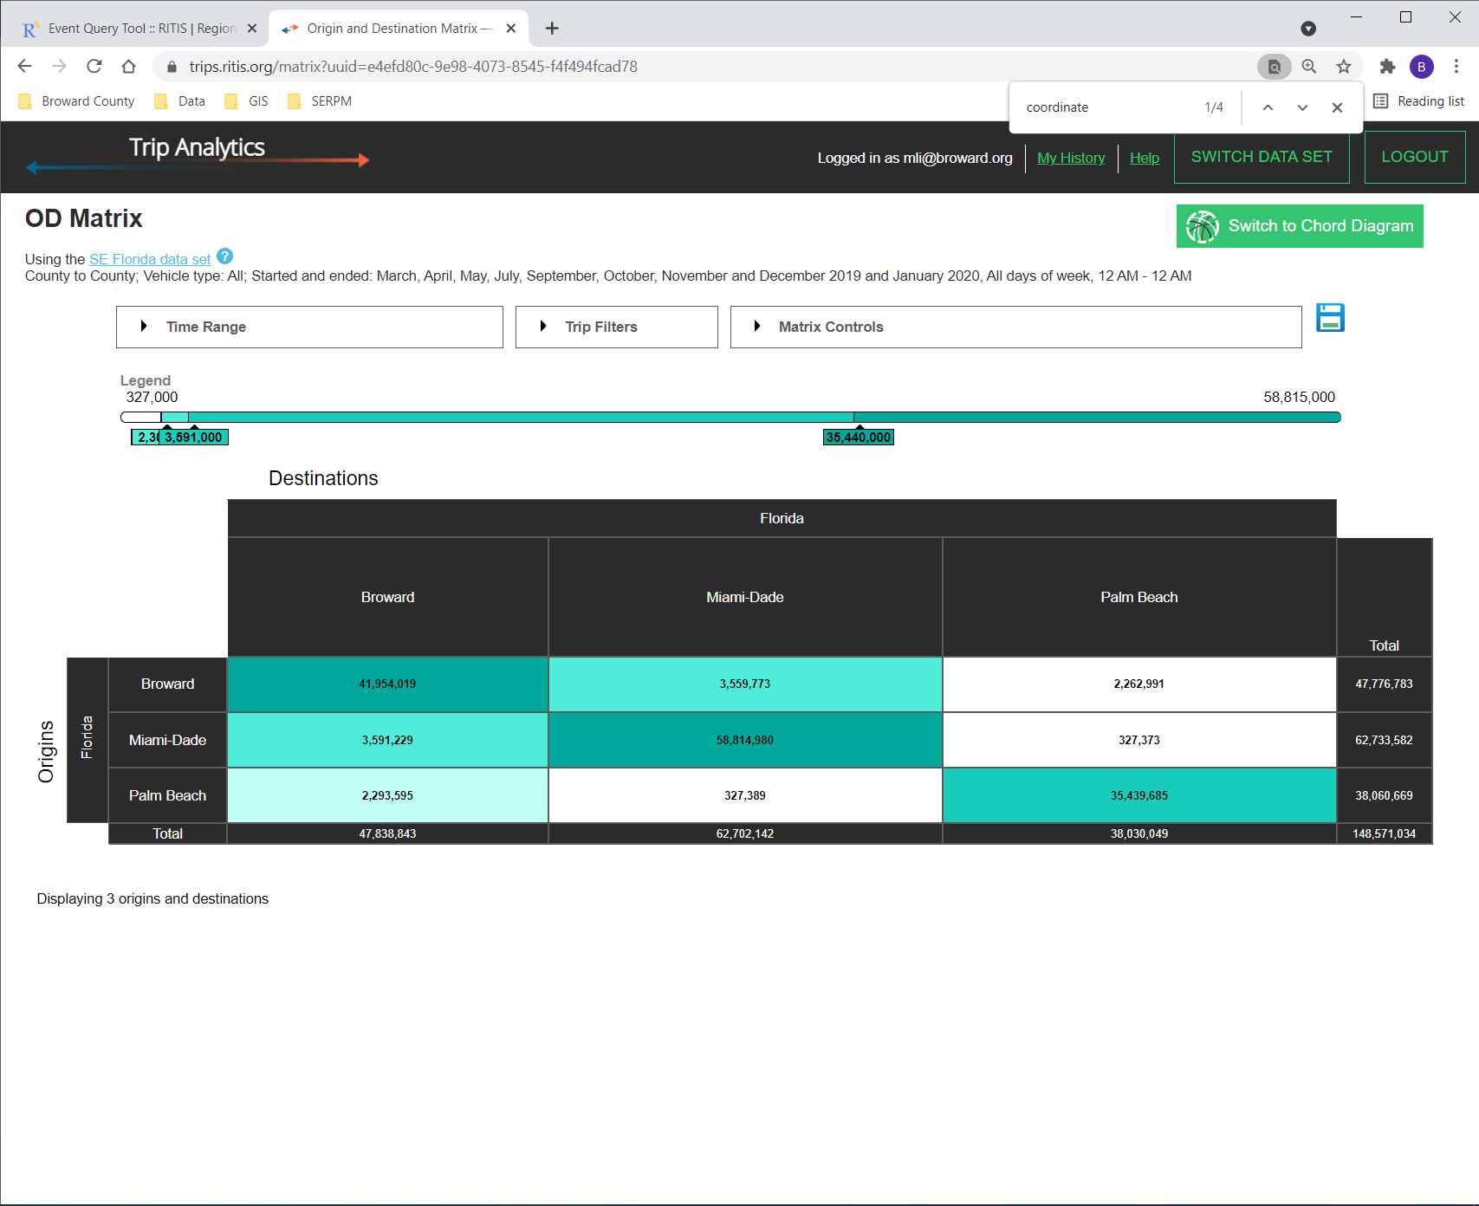
Trip Analytics – OD Matrix
The Origin-Destination (OD) Matrix tool generates geography-to-geography trip tables based on trip start and endpoints. Zones can be a county, sub-county, or TAZ. Users can filter by date range, time-of-day, day-of-week, and by vehicle class.
Matrix Layout
  Matching Axes – same number of OD axes
  Custom Axes – customized OD axes

Slide 72
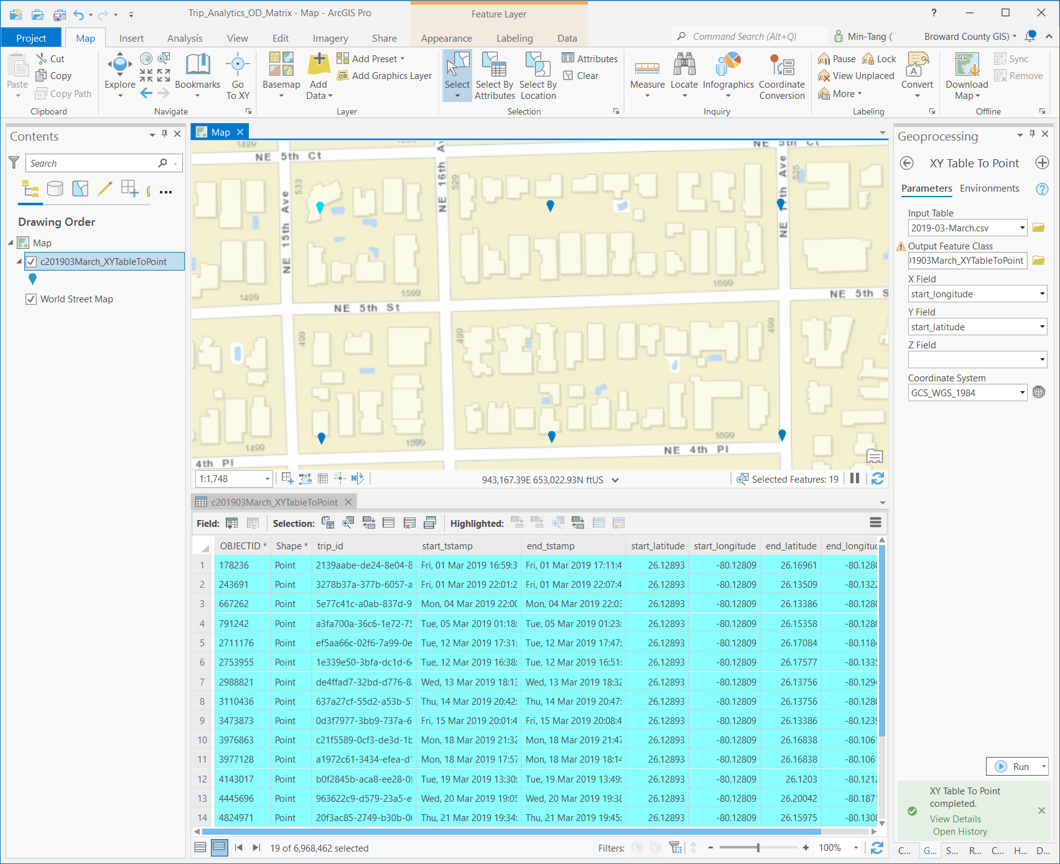
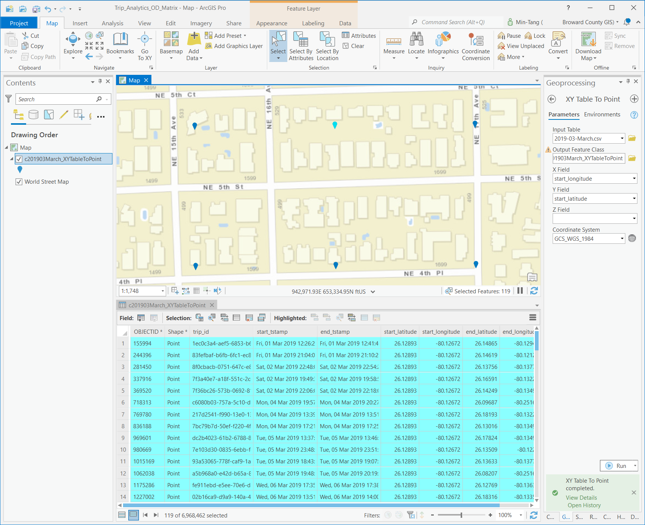
Aggregated & Anonymous Raw Data:
Predefined OD Locations

Slide 73
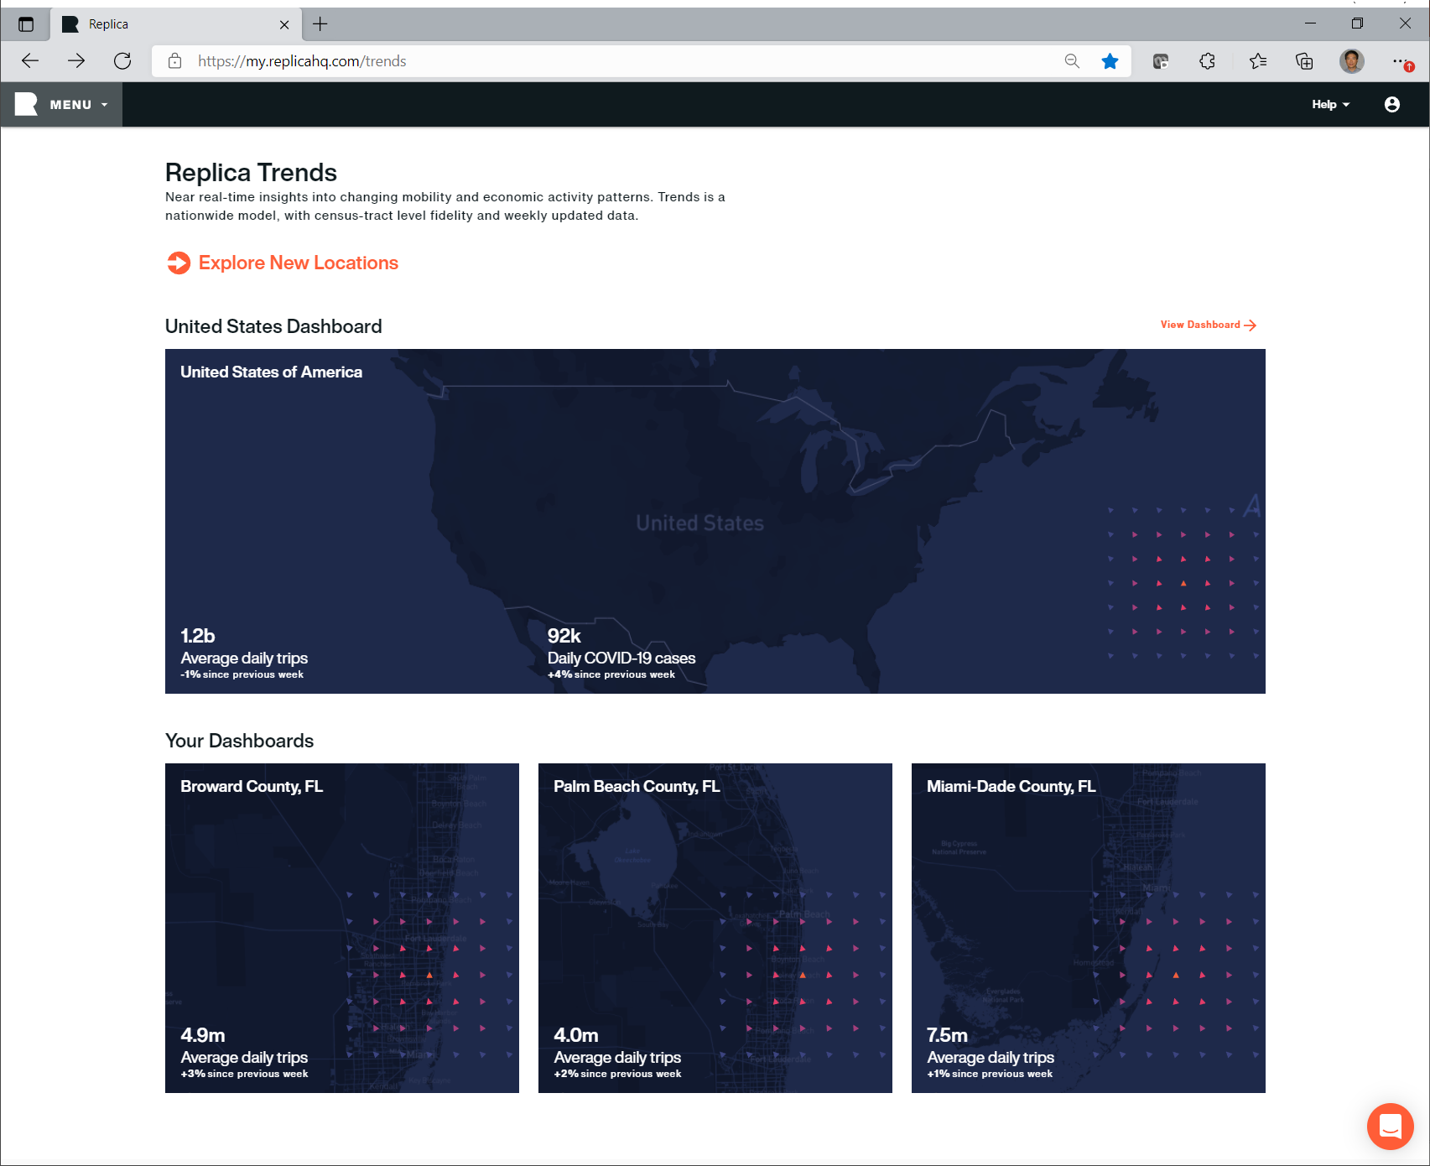
Replica Trends
Nationwide census-tract level fidelity and weekly updated data

Slide 74
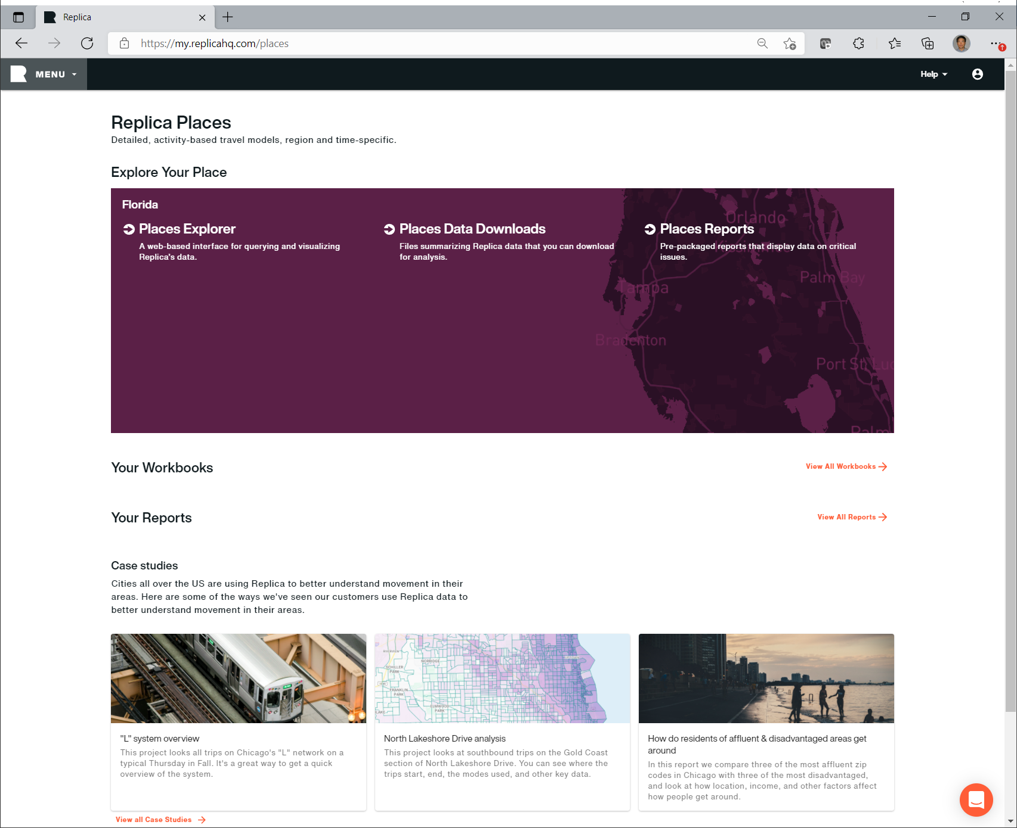
Replica Places
Modeled trip table for an average weekday and weekend day for each season, and a quality report that measures the model’s outputs against observed data.

Slide 75
Demo
https://ritis.org/
https://replicahq.com/
Discussion? Questions?

Slide 76
NON-AGENDA & ADJOURN
Regular Meeting of Oversight Board November 19, 2021

Slide 77
LUNCH BREAK
Oversight Board Members should report to Workshop Room, 430

